Slide 1
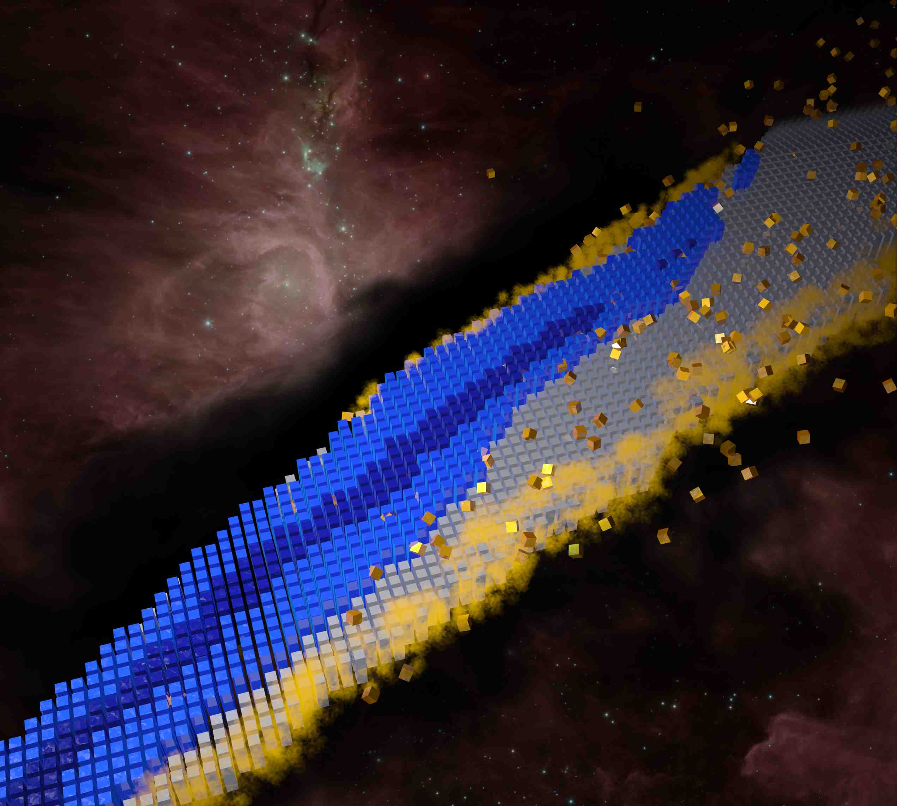
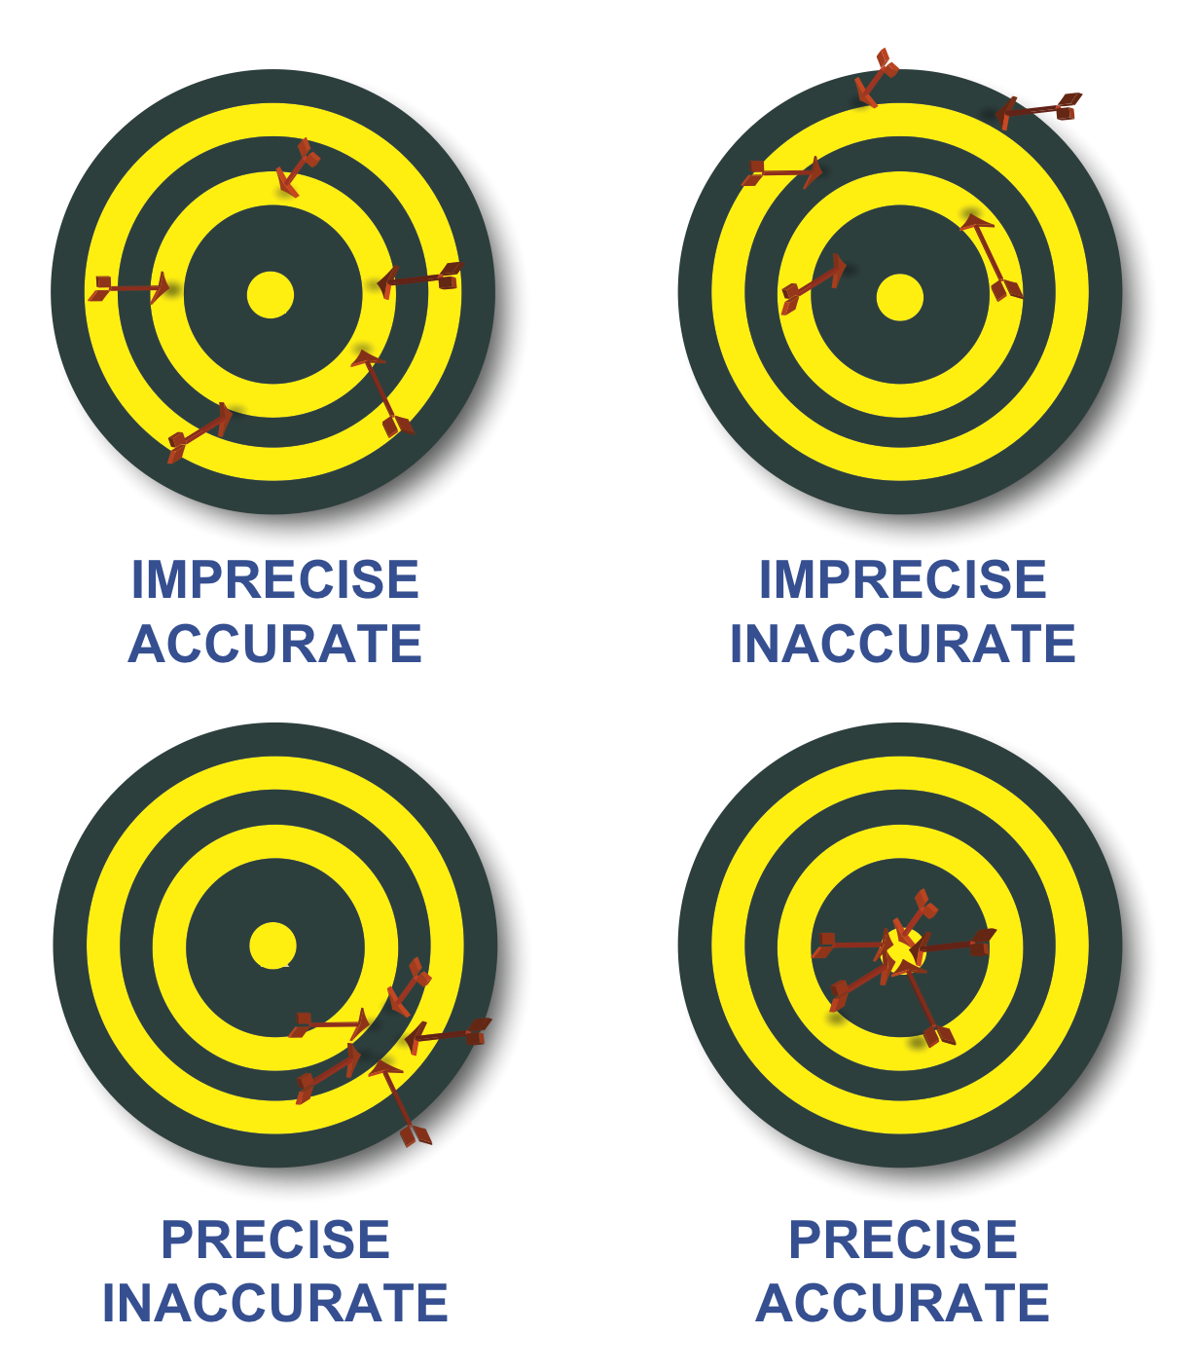
Uncertainty Quantification and Bayesian Model Averaging
Witold Nazarewicz (FRIB/MSU)
DOE topical collaboration “Nuclear Theory for Double-Beta Decay and Fundamental Symmetries”, February 3-4, 2017, ACFI, UMass Amherst
Perspective
UQ: statistical aspects
UQ: systematic aspects
Bayesian Model Selection and Averaging
Conclusions and Homework

Slide 2
Current 0νββ predictions
“There is generally significant variation among different calculations of the nuclear matrix elements for a given isotope. For consideration of future experiments and their projected sensitivity it would be very desirable to reduce the uncertainty in these nuclear matrix elements.” (Neutrinoless Double Beta Decay NSAC Report 2014)
Low-resolution and high-resolution models
Global and local models
Based on very different assumptions
Fitted to vastly different observables
No uncertainties are provided!

Slide 3
The promise... (in our proposal)
The tools that support much of this work have been or are being developed through the SciDAC NUCLEI collaboration. Our collaboration contains all the expertise needed to fully apply those tools, which include innovative methods for estimating uncertainty,
to double-beta decay matrix elements.
Accurate nuclear matrix elements with quantified uncertainty are perhaps the most urgent project for our collaboration.
Our collaboration intends to reduce the uncertainty considerably.
Benchmarking and Uncertainty Quantification
To have confidence in our predictions, we need to to quantify both systematic and statistical error. At present, systematic errors on nuclear matrix elements dominate statistical errors, and assigning uncertainty is difficult
How will the procedure work in detail? First, with each method we will calculate observables that can be compared with experiment: spectra and transitions...
All this benchmarking concerns difficult systematic error. We will also address statistical error, which reflects the degree of variation in the predictions of a single model with parameters that are fit to large amounts of experimental data, and which, fortunately, is easier to assess. Nuclear physicists typically apply linear regression and/or Bayesian inference to quantify statistical error. If one knows the covariance matrix or posterior distribution of model parameters, it is straightforward to estimate an associated error for any observable...

Slide 4
Consider a model described by coupling constants θ ={θ₁, θ_{2…}θ_{κ} ).
Any predicted expectation value of an observable Y_{i} is a function of these parameters. Since the model space has been optimized to a limited set of observables, there may also exist correlations between model parameters. Note that a model is defined through:
mathematical framework (equations, approximations...)
parameters/coupling constants and active space
fit-observables
Objective
function
Model predictions
fit-observables
(may include pseudo-data)
Expected uncertainties

Slide 5
Parameter estimation. The set of fit-observables
M₁
M₁₂₇₁
M₂
Y
M₃
M_{α}
Y ⊂Y_{α} ⊂Y_{tot}
Y_{α}
set of observables Y_{tot}
Notes:
MLE=maximum likelihood estimate

Slide 6
θ₁(SM)
θ₈₂₀₇₆₅(SM)
θ₃(SM)
θ₂(SM)
Notes:
maximum likelihood estimate

Slide 7
Minimal nuclear theorist’s approach to a statistical model error estimate
Statistical uncertainty in variable A:
covariance matrix
Correlation between variables A and B:
Product-moment correlation coefficient between
two observables/variables A and B:
=1: full alignment/correlation
=0: not aligned/statistically
independent

Slide 8
Nuclear charge and neutron radii and nuclear matter:
trend analysis in Skyrme-DFT approach
P.-G. Reinhard and WN, PRC 93, 051303 (R) (2016)
14-parameter model, optimized to 2 different sets of fit-observables
(Y=E, R)
(Y=E)
stiff
stiff
sloppy
sloppy
sloppy

Slide 9
P.-G. Reinhard and WN, PRC 93, 051303 (R) (2016)
SV-E
SV-min
Notes:
Their lengths represent the magnitude of corresponding variations.

Slide 10
Uncertainty Quantification for Nuclear Density Functional Theory and Information
Content of New Measurements, J. McDonnell et al., Phys. Rev. Lett. 114, 122501 (2015).
Pilot Study Applied to UNEDF1
Massively parallel approach
Uniform priors with bounds
130 data points (including deformed nuclei)
Gaussian process response surface
200 test parameter sets
Latin hyper-rectangle
UNEDF1
No improvement on model’s predictibility except for postdictions on additional data
UNEDF1_{CPT}
See also: Higdon et al., A Bayesian Approach for Parameter Estimation and Prediction Using a Computationally Intensive Model, J. Phys. G 42, 034009 (2015)

Slide 11
Naïve nuclear theorist’s approach to a systematic (model) error estimate:
Take a set of reasonable models M_{i}
Make a prediction E(y;M_{i})=y_{i}
Compute average and variation within this set
Compute rms deviation from existing experimental data. If the number of fit-observables is large, statistical error is small and the error is predominantly systematic.
^
Can we do better? Yes!

Slide 12
Bayesian Model Averaging (BMA)
models considered
posterior distribution given data
Posterior distribution of y under each model
quantity of interest
fit-observables
(data)
posterior probability of a model
The posterior probability for model M_{k}
prior probability that the model M_{k} is true (!!!)
marginal density of the data; integrated likelihood of model M_{k}
likelihood
prior distribution of parameters

Slide 13
Model selection and Bayes Factor (BF)
BF an be used to decide which of two models is more likely given a result y.
The outcome
The posterior mean and variance of y are:

Slide 14
What is required?
Common dataset Y (as large as possible) needs to be defined
Statistical analysis for individual models needs to be carried out. Priors, posteriors, likelihoods determined
Individual model predictions carried out, including statistical uncertainties
Decision should be made on the prior model probability p(M_{k})
ISNET website: http://iopscience.iop.org/journal/0954-3899/page/ISNET
INT Program INT-16-2a: http://www.int.washington.edu/PROGRAMS/16-2a/
  References: http://bayesint.github.io/references.html
Bayesian Model Averaging refs: http://www.stat.washington.edu/raftery/Research/bma.html
  Hoeting BMA review: http://www.stat.washington.edu/www/research/online/hoeting1999.pdf
  Wasserman BMA review: https://pdfs.semanticscholar.org/207c/cd4e6514824bf489362799bc138e1ec8ac44.pdf

Slide 15
From Hoeting and Wasserman:
When faced with several candidate models, the analyst can either choose one model or average over the models. Bayesian methods provide a set of tools for these problems. Bayesian methods also give us a numerical measure of the relative evidence in favor of competing theories.
Model selection refers to the problem of using the data to select one model from the list of candidate models. Model averaging refers to the process of estimating some quantity under each model and then averaging the estimates according to how likely each model is.
Bayesian model selection and model averaging is a conceptually simple, unified approach. An intrinsic Bayes factor might also be a useful approach.
There is no need to choose one model. It is possible to average the predictions from several models.
Simulation methods make it feasible to compute posterior probabilities in many problems.
It should be emphasized that BMA should not be used as an excuse for poor science... BMA is useful after careful scientific analysis of the problem at hand. Indeed, BMA offers one more tool in the toolbox of applied statisticians for improved data analysis and interpretation.

