Slide 1
Kaon and nucleon matrix elements probing CP violation
Craig Roberts, Physics Division

Slide 2
Collaborators: 2012-Present
Students, Postdocs, Asst. Profs.
Rocio BERMUDEZ (U Michoácan);
Shi CHAO (Nanjing U) ;
Ming-hui DING (PKU);
Fei GAO (PKU) ;
S. HERNÁNDEZ (U Michoácan);
Cédric MEZRAG (CEA, Saclay) ;
Trang NGUYEN (KSU);
Khépani RAYA (U Michoácan);
Hannes ROBERTS (ANL, FZJ, UBerkeley);
Chien-Yeah SENG (UM-Amherst) ;
Kun-lun WANG (PKU);
Shu-sheng XU (Nanjing U) ;
Chen CHEN (USTC);
J. Javier COBOS-MARTINEZ (U.Sonora);
Mario PITSCHMANN (Vienna);
Si-xue QIN (ANL, U. Frankfurt am Main, PKU);
Jorge SEGOVIA (ANL);
David WILSON (ODU);
Lei Chang (U. Adelaide) ;
Ian Cloet (ANL) ;
Bruno El-Bennich (São Paulo);
Adnan BASHIR (U Michoácan);
Daniele Binosi (ECT*)
Stan BRODSKY (SLAC);
Gastão KREIN (São Paulo) ;
Roy HOLT (ANL);
Yu-xin LIU (PKU);
Hervé Moutarde (CEA, Saclay) ;
Joannis Papavassiliou (U.Valencia)
Michael RAMSEY-MUSOLF (UM-Amherst) ;
Alfredo RAYA (U Michoácan);
Jose Rodriguez Qintero (U. Huelva) ;
Sebastian SCHMIDT (IAS-FZJ & JARA);
Robert SHROCK (Stony Brook);
Peter TANDY (KSU);
Tony THOMAS (U.Adelaide) ;
Shaolong WAN (USTC) ;
Hong-Shi ZONG (Nanjing U)

Slide 3
Key Questions for the Future
What is confinement?
Where is the mass of the nucleon?
Where is the nucleon's magnetic moment?
What is the nucleon?
What is a hadron?
…
Examples of
Emergent Phenomena in QCD,
the strong-interaction sector of the Standard Model

Slide 4
What is QCD?

Slide 5
QCD is a Theory
(not an effective theory)
Very likely a self-contained, nonperturbatively renormalisable and hence well defined Quantum Field Theory
This is not true of QED – cannot be defined nonperturbatively
No confirmed breakdown over an enormous energy domain: 0 GeV < E < 8 TeV
Increasingly probable that any extension of the Standard Model will be based on the paradigm established by QCD
Extended Technicolour: electroweak symmetry breaks via a fermion bilinear operator in a strongly-interacting non-Abelian theory. (Andersen et al. “Discovering Technicolor” Eur.Phys.J.Plus 126 (2011) 81)
Higgs sector of the SM becomes an effective description of a more fundamental fermionic theory, similar to the Ginzburg-Landau theory of superconductivity
wikipedia.org/wiki/Technicolor_(physics)

Slide 6
What is Confinement?

Slide 7
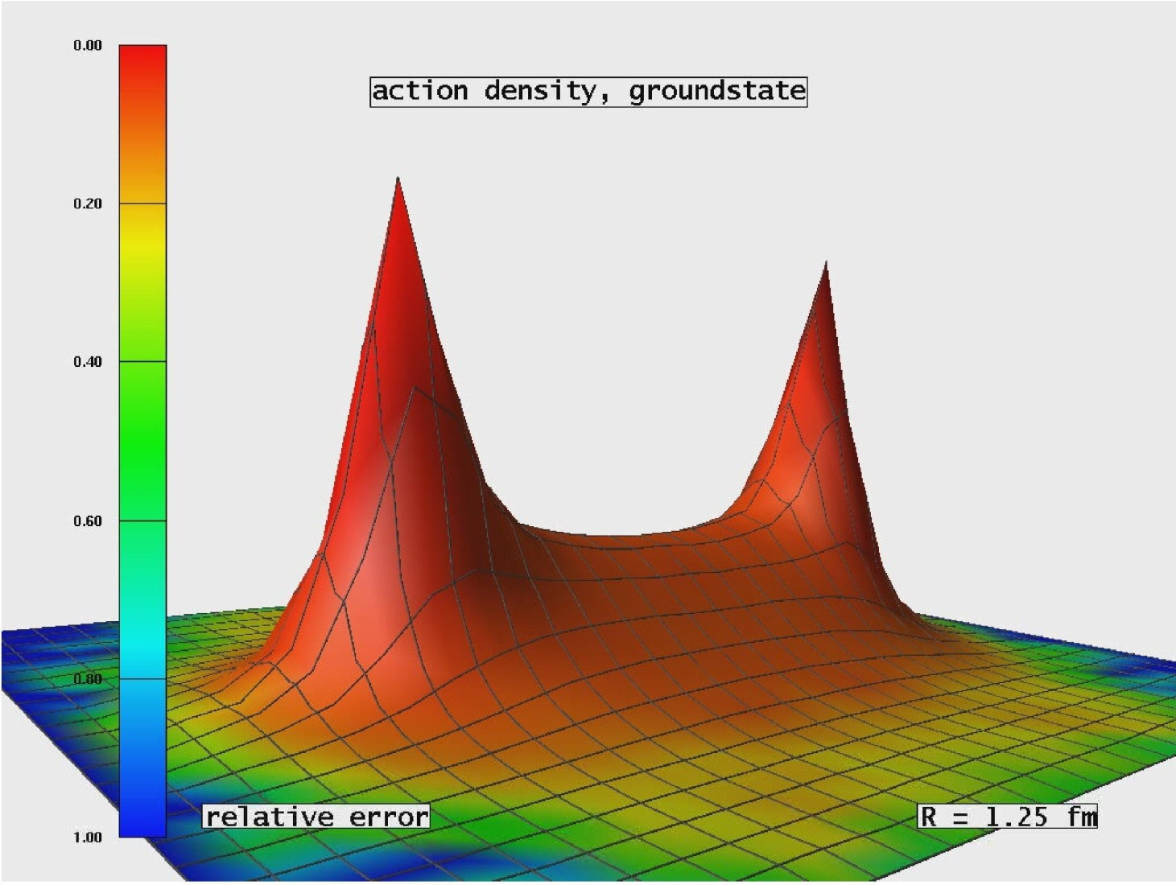
Light quarks & Confinement
Folklore … JLab Hall-D Conceptual Design Report(5)
“The color field lines between a quark and an anti-quark form flux tubes.
A unit area placed midway between the quarks and perpendicular to the line connecting them intercepts a constant number of field lines, independent of the distance between the quarks.
This leads to a constant force between the quarks – and a large force at that, equal to about 16 metric tons.”

Slide 8
Light quarks & Confinement
Problem:
Pions …
They’re unnaturally light
so 16 tonnes of force
makes a lot of them.

Slide 9
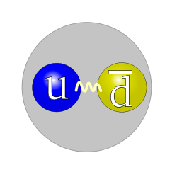
Light quarks & Confinement
Problem:
16 tonnes of force
makes a lot of pions.

Slide 10
Light quarks & Confinement
G. Bali et al., PoS LAT2005 (2006) 308
In the presence of light quarks, pair creation seems to occur non-localized and instantaneously

Slide 11
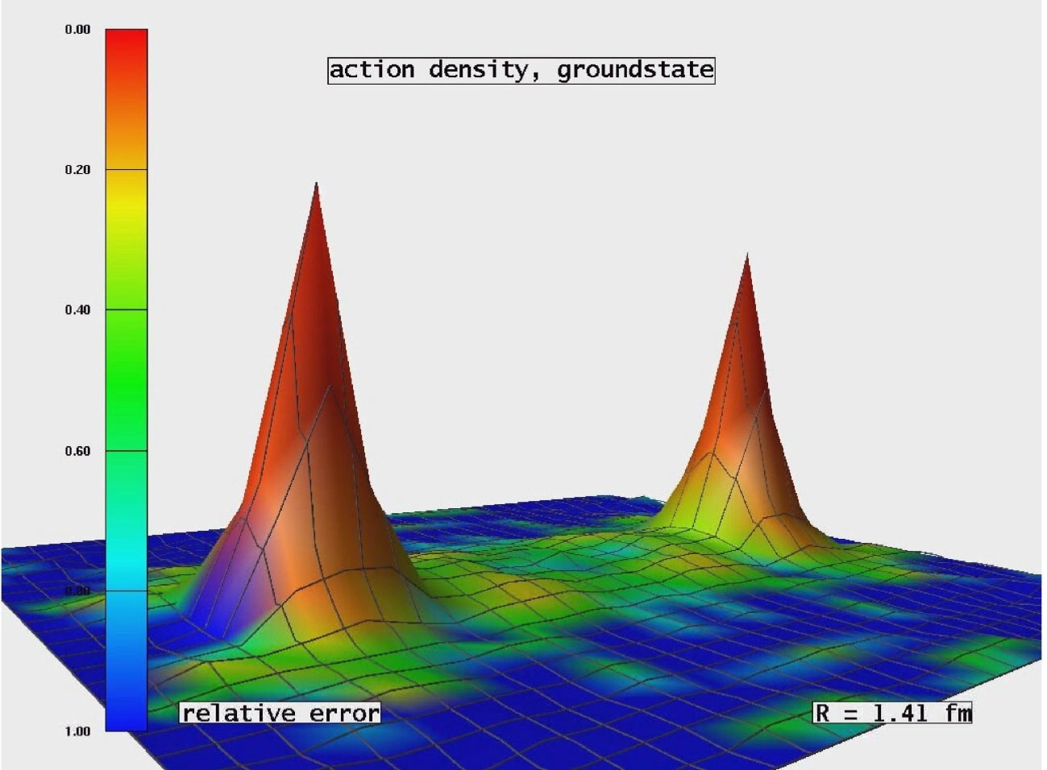
Light quarks & Confinement
G. Bali et al., PoS LAT2005 (2006) 308
In the presence of light quarks, pair creation seems to occur non-localized and instantaneously
No flux tube in a theory with light-quarks.
Flux-tube is not the correct paradigm for confinement in hadron physics

Slide 12
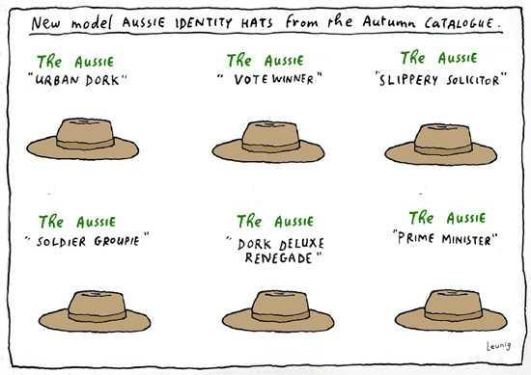
What is Dressing?

Slide 13
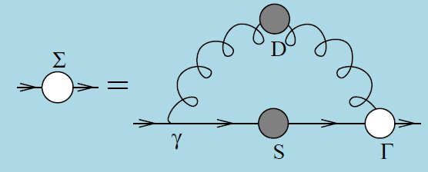
Quark Gap Equation

Slide 14
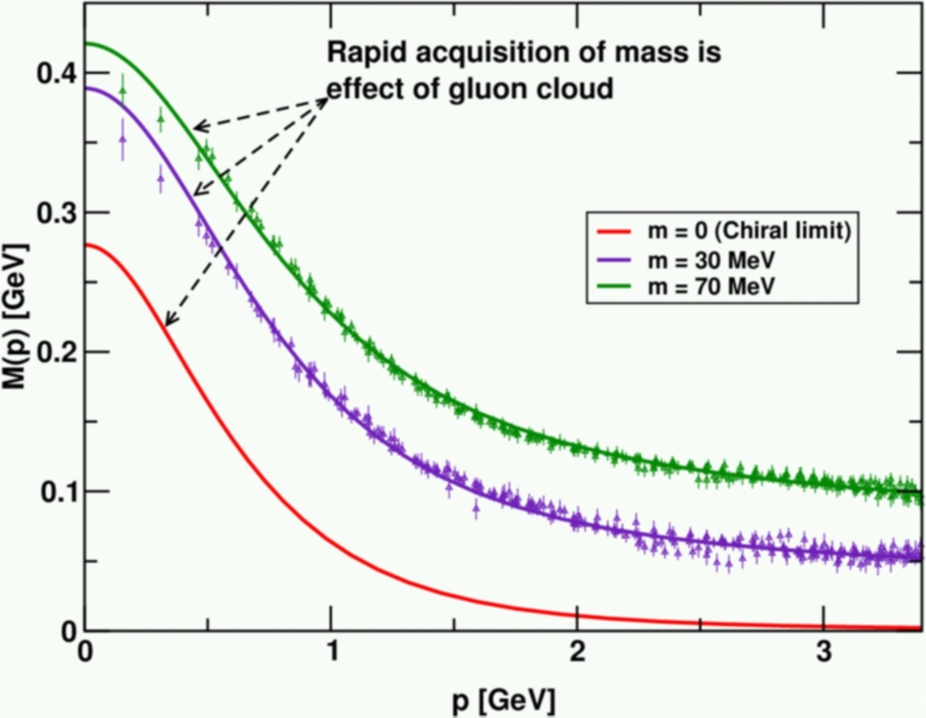
Dynamical Chiral Symmetry Breaking
DCSB is a fact in QCD
Dynamical, not spontaneous
Add nothing to QCD ,
No Higgs field, nothing!
Effect achieved purely through
quark+gluon dynamics.
It’s the most important
mass generating mechanism
for visible matter in the Universe.
Responsible for ≈98% of the proton’s mass.
Higgs mechanism is (almost) irrelevant to light-quarks.

Slide 15
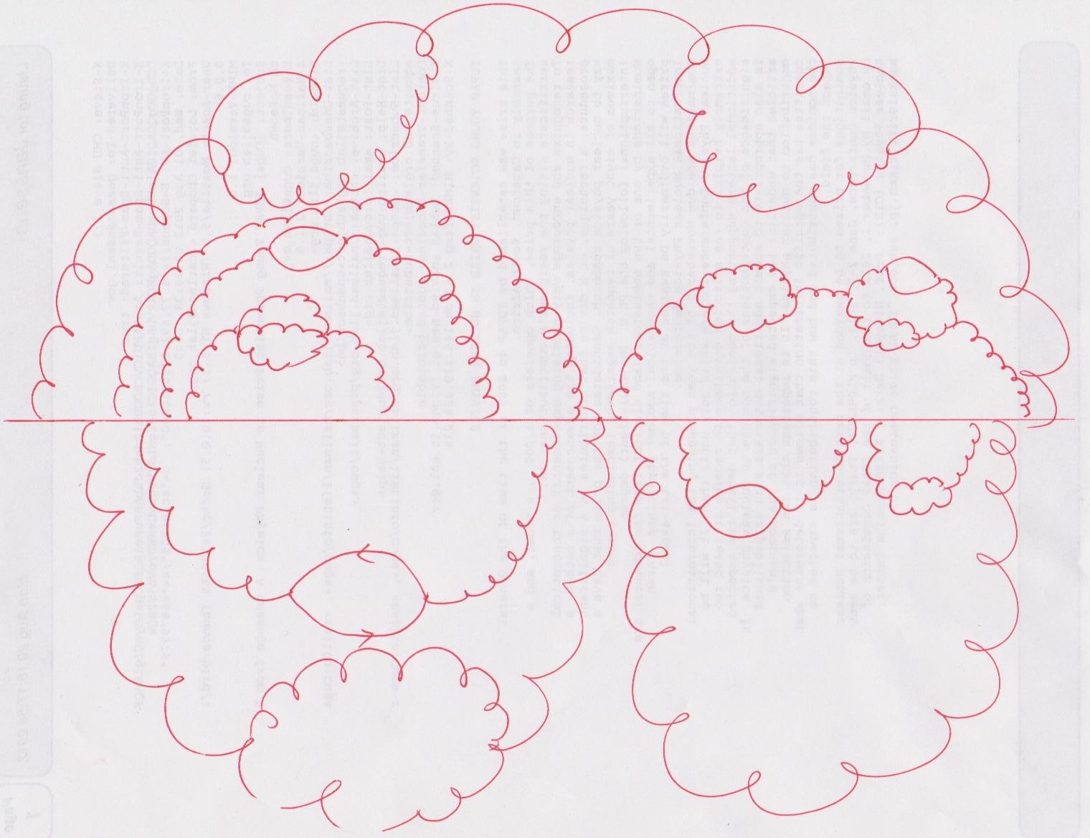
Where does the mass come from?
Deceptively simply picture
Corresponds to the sum of a countable infinity of diagrams.
NB. QED has 12,672 α⁵ diagrams
Impossible to compute this in perturbation theory.
The standard algebraic manipulation
tools are just inadequate
α_{S}²³
Just one of the terms that are summed in a solution of the simplest, sensible
gap equation
Notes:
QED 12,672 alpha^5 diagrams

Slide 16
Gluons, too, have a gap equation
Non-perturbative comparison of QCD effective charges, A.C. Aguilar, D. Binosi, J. Papavassiliou and J. Rodriguez-Quintero, Phys. Rev. D80 (2009) 085018
Pinch-technique + background field method … reordering of diagrammatic summations in the self-energy – Π_{μν} – ensures that subclusters are individually transverse and gluon-loop and ghost-loop contributions are separately transverse
STIs → WGTIs
Enables systematic analysis and evaluation of truncations and straightforward comparison of results with those of lQCD

Slide 17
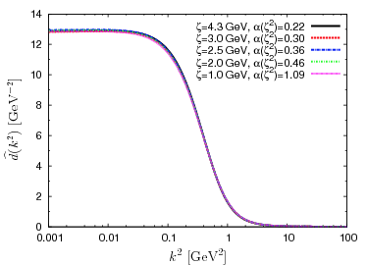
RGI running interaction
Bridging a gap between continuum-QCD and ab initio predictions of hadron observables, D. Binosi, L. Chang, J.Papavassiliou, C.D. Roberts, arXiv:1412.4782 [nucl-th], Phys. Lett. B in press.
Input to the DSE analysis
= lQCD result for the ghost dressing function at a given renormalisation scale, ζ
Solve ghost gap equation self-consistently such that α_{S}(ζ) reproduces lQCD result
Gluon-ghost vertex in ghost gap equation is computed from its own DSE in the one-loop dressed approximation.
Continuum- and lattice-QCD solutions agree on solution for the gluon self energy
d̂(k²)= α(ζ) Δ̂(k²; ζ)

Slide 18
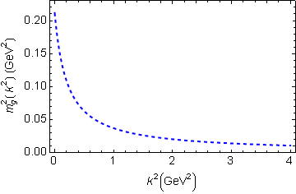
In QCD: Gluons also become massive!
Bridging a gap between continuum-QCD and ab initio predictions of hadron observables, D. Binosi, L. Chang, J.Papavassiliou, C.D. Roberts, arXiv:1412.4782 [nucl-th], Phys. Lett. B in press.
Running gluon mass
Gluons are cannibals – a particle species whose members become massive by eating each other!
Gluon mass-squared function
Power-law suppressed in ultraviolet, so invisible in perturbation theory
Interaction model for the gap equation, S.-x.Qin, L.Chang, Y-x.Liu, C.D.Roberts and D. J. Wilson, arXiv:1108.0603 [nucl-th], Phys. Rev. C 84 (2011) 042202(R) [5 pages]

Slide 19
Massive Gauge Bosons!
Gauge boson cannibalism
… a new physics frontier … within the Standard Model
Asymptotic freedom means
… ultraviolet behaviour of QCD is controllable
Dynamically generated masses for gluons and quarks means that QCD dynamically generates its own infrared cutoffs
Gluons and quarks with
wavelength λ > 2/mass ≈ 1 fm
decouple from the dynamics … Confinement?!
How does that affect observables?
It will have an impact in
any continuum study
Must play a role in gluon saturation ...
In fact, perhaps it’s a harbinger of gluon saturation?

Slide 20
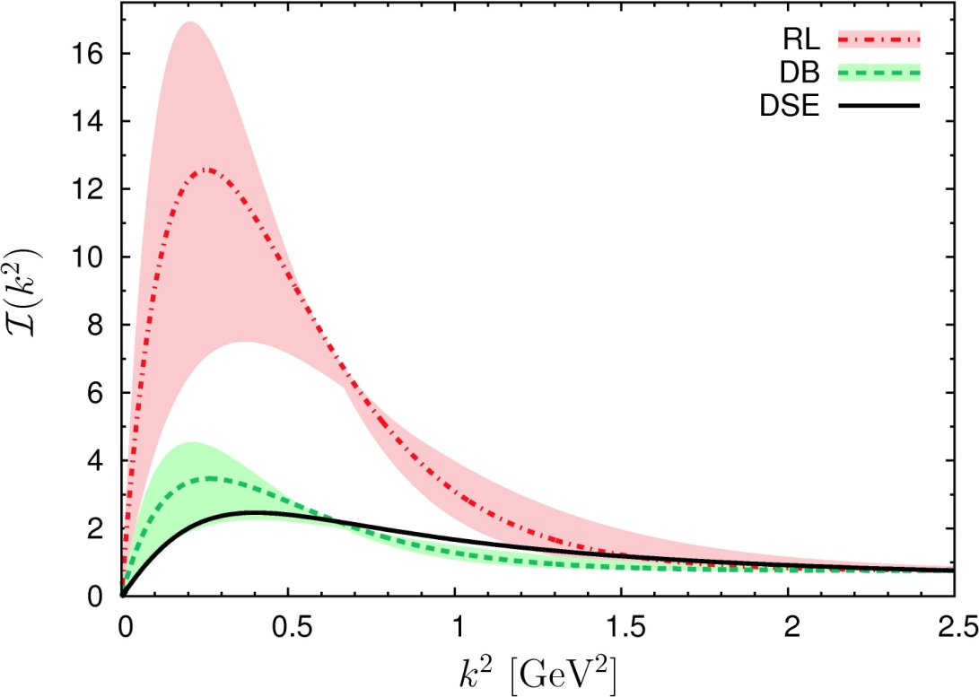
Top down & Bottom up
Bridging a gap between continuum-QCD
& ab initio predictions of hadron observables
D. Binosi (Italy), L. Chang (Australia), J. Papavassiliou (Spain),
C. D. Roberts (US), arXiv:1412.4782 [nucl-th] , Phys. Lett. B in press
“Maris-Tandy” interaction. Developed at ANL & KSU in 1997-1998. More-than 600 citations – but quantitative disagreement with gauge-sector solution.
Top-down approach – ab initio computation of the interaction via direct analysis of the gauge-sector gap equations
Bottom-up scheme – infer interaction by fitting data within a well-defined truncation of the matter sector DSEs that are relevant to bound-state properties.
Serendipitous collaboration, conceived at one-week ECT* Workshop on DSEs in Mathematics and Physics, has united these two approaches
Modern kernels and interaction, developed at ANL and Peking U.
One parameter, fitted to ground-state properties without reference to gauge-sector studies.
Modern top-down and bottom-up results agree within 3% !
Top-down result = gauge-sector prediction
– Interaction predicted by modern analyses of QCD's gauge sector coincides with that required to describe ground-state observables using the sophisticated matter-sector ANL-PKU DSE truncation

Slide 21
Top down & Bottom up
Bridging a gap between continuum-QCD
& ab initio predictions of hadron observables
D. Binosi (Italy), L. Chang (Australia), J. Papavassiliou (Spain),
C. D. Roberts (US), arXiv:1412.4782 [nucl-th] , Phys. Lett. B in press
“Maris-Tandy” interaction. Developed at ANL & KSU in 1997-1998. More-than 600 citations – but quantitative disagreement with gauge-sector solution.
Top-down approach – ab initio computation of the interaction via direct analysis of the gauge-sector gap equations
Bottom-up scheme – infer interaction by fitting data within a well-defined truncation of the matter sector DSEs that are relevant to bound-state properties.
Serendipitous collaboration, conceived at one-week ECT* Workshop on DSEs in Mathematics and Physics, has united these two approaches
Modern kernels and interaction, developed at ANL and Peking U.
One parameter, fitted to ground-state properties without reference to gauge-sector studies.
Modern top-down and bottom-up results agree within 3% !
Significant steps toward
parameter-free prediction of hadron properties
Top-down result = gauge-sector prediction
– Interaction predicted by modern analyses of QCD's gauge sector coincides with that required to describe ground-state observables using the sophisticated matter-sector ANL-PKU DSE truncation

Slide 22
Confinement is dynamical!

Slide 23
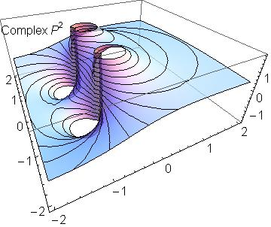
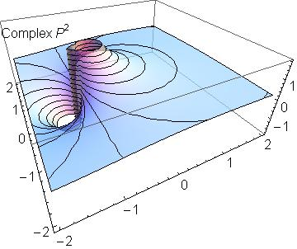
Confinement
QFT Paradigm:
Confinement is expressed through a dramatic change in the analytic structure of propagators for coloured states
It can be read from a plot of the dressed-propagator for a coloured state
Confined particle
Normal particle
Propagation described by rapidly damped wave & hence state cannot exist in observable spectrum
σ ≈ 1/Im(m)
≈ 1/2Λ_{QCD} ≈ ½fm
Real-axis mass-pole splits,
moving into pair(s) of complex conjugate singularities, (or qualitatively analogous structures chracterised by a dynamically generated mass-scale)

Slide 24
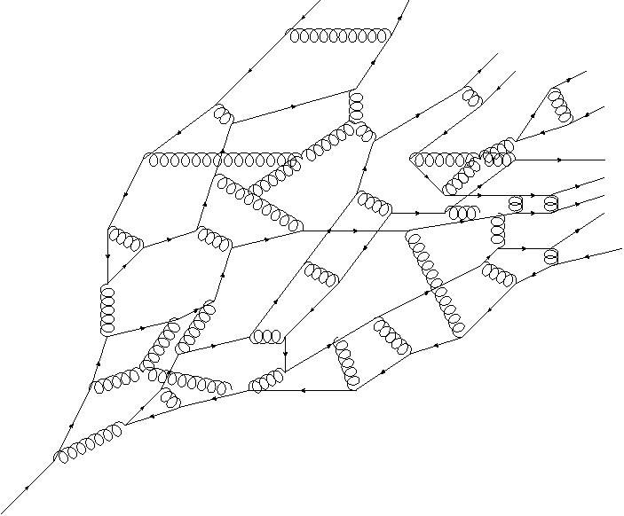
Quark Fragmentation
A quark begins to propagate in spacetime
But after each “step” of length σ, on average, an interaction occurs, so that the quark loses its identity, sharing it with other partons
Finally, a cloud of partons is produced, which coalesces into colour-singlet final states
An EIC will enable “3D” measurements relating to fragmentation and insight into real-world confinement
meson
meson
meson
Baryon
meson
Real-world confinement is a dynamical phenomenon, surrounded by mystery!
σ

Slide 25
Symmetry preserving analyses in continuum QCD

Slide 26
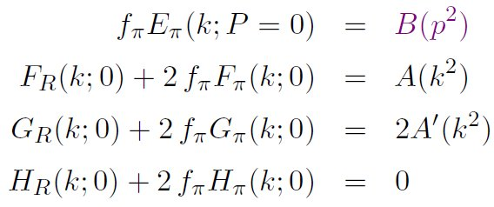
Pion’s Goldberger -Treiman relation
Maris, Roberts and Tandy
nucl-th/9707003, Phys.Lett. B420 (1998) 267-273
Pion’s Bethe-Salpeter amplitude
Solution of the Bethe-Salpeter equation
Dressed-quark propagator
Axial-vector Ward-Takahashi identity entails
B(k²)
Owing to DCSB
& Exact in
Chiral QCD
Miracle: two body problem solved, almost completely, once solution of one body problem is known

Slide 27
The most fundamental expression of Goldstone’s Theorem and DCSB
f_{π} E_{π}(p²) = B(p²)

Slide 28
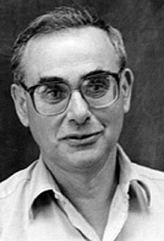
Enigma of mass
f_{π} E_{π}(p²) = B(p²)
The quark level Goldberger-Treiman relation shows that DCSB has a very deep and far reaching impact on physics within the strong interaction sector of the Standard Model; viz.,
Goldstone's theorem is fundamentally an expression of equivalence between the one-body problem and the two-body problem in the pseudoscalar channel.
This emphasises that Goldstone's theorem has a pointwise expression in QCD
Hence, pion properties are an almost direct measure of
the dressed-quark mass function.
Thus, enigmatically, the properties of the massless pion
are the cleanest expression of the mechanism that is
responsible for almost all the visible mass in the universe.

Slide 29
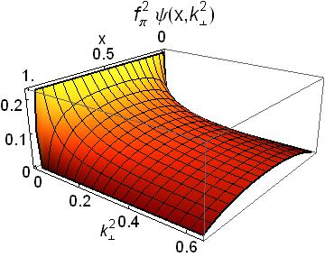
Pion’s Wave Function

Slide 30
Meson PDAs – φ(u)
Frameworks with a direct connection to QCD are typically formulated in Euclidean space
… Consequently they do not provide the u-dependence directly but moments instead:
〈u^{n}〉 = ∫₀¹ du u^{n} φ (u)
Owing to the loss of rotational invariance in lQCD, only the first two nontrivial PDA moments can be computed
Working with DSE solutions, so long as one does not rely on brute numerical techniques, one can obtain arbitrarily many moments
… explained in
Imaging dynamical chiral symmetry breaking: pion wave function on the light front, Lei Chang, et al., arXiv:1301.0324 [nucl-th], Phys. Rev. Lett. 110 (2013) 132001 (2013) [5 pages].

Slide 31
How best can one use PDA moments?
Conformal QCD:
Meson PDA is actually a function of two variables
φ_{P}(u,τ), τ=1/ζ, where ζ is the energy-scale relevant to the process
In the neighbourhood τΛ_{QCD} ≃ 0, QCD is invariant under the collinear conformal group SL(2,R)
Hence,
where a_{j}^{3/2} → 0 as τΛ_{QCD} → 0
Gegenbauer- α= 3/2 polynomials are the irreducible representations of SL(2,R). (A correspondence with the spherical harmonics expansion of the wave functions for O(3)-invariant systems in quantum mechanics is plain.)
However, the conformal expansion is invalid at any energy scale that is foreseeable.
Expansion in Gegenbauer polynomials

Slide 32
How best can one use PDA moments
Accept that at all accessible scales, the pointwise profile of PDAs is determined by nonperturbative dynamics
Hence PDAs should be reconstructed from moments by using Gegenbauer polynomials of order α, with this order − the value of α − determined by the moments themselves, not fixed beforehand.
Generalisation to case of mesons constituted from light-quarks with unequal masses: expansion in Jacobi polynomials (u^{bar} = 1-u)
In actual calculations, this procedure is refined but the idea is unchanged
Flavour symmetry breaking in the kaon parton distribution amplitude, Chao Shi et al., arXiv:1406:3353 [nucl-th], Phys. Lett. B 738 (2014) pp. 512–518

Slide 33
Pion’s valence-quark Distribution Amplitude
Imaging dynamical chiral symmetry breaking: pion wave function on the light front, Lei Chang, et al., arXiv:1301.0324 [nucl-th], Phys. Rev. Lett. 110 (2013) 132001 (2013) [5 pages].
Last two years, methods have been developed that enable direct computation of meson light-front wave functions
φ_{π}(x) = twist-two parton distribution amplitude = projection of the pion’s Poincaré-covariant wave-function onto the light-front
Results have been obtained with rainbow-ladder DSE kernel, simplest symmetry preserving form; and the best DCSB-improved kernel that is currently available, which precisely matches gauge sector prediction
x^{α} (1-x)^{α}, with α≈0.5

Slide 34
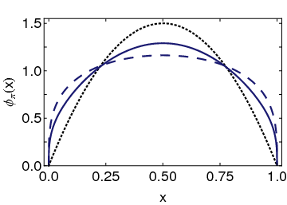
Pion’s valence-quark Distribution Amplitude
Imaging dynamical chiral symmetry breaking: pion wave function on the light front, Lei Chang, et al., arXiv:1301.0324 [nucl-th], Phys. Rev. Lett. 110 (2013) 132001 (2013) [5 pages].
Continuum-QCD prediction:
marked broadening of φ_{π}(x), which owes to DCSB
DB
Asymptotic
RL
Real-world PDAs are squat and fat

Slide 35
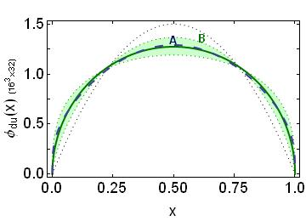
Lattice-QCD & Pion’s valence-quark Distribution Amplitude
Distribution amplitudes of light-quark mesons from lattice QCD,
J. Segovia, et al., arXiv:1311.1390 [nucl-th] , Phys. Lett. B 731 (2014) pp. 13-18
Isolated dotted curve = conformal QCD
Green curve & band = result inferred from the single pion moment computed in lattice-QCD
Blue dashed curve = DSE prediction obtained with DB kernel
Precise agreement between DSE & lQCD predictions

Slide 36
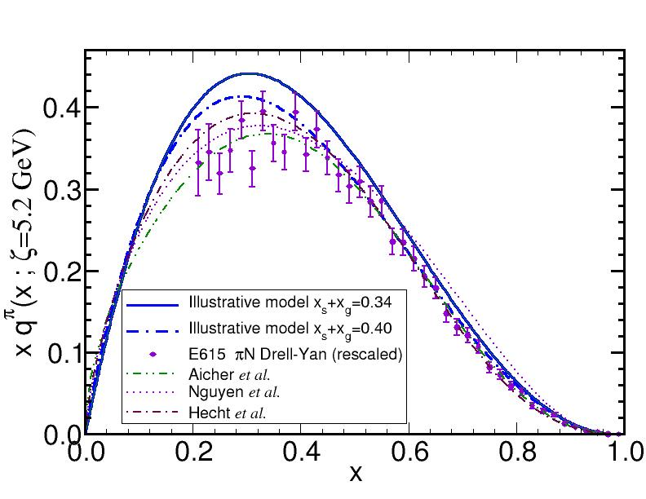
When is asymptotic PDA valid?
Explanation and Prediction of Observables using Continuum Strong QCD, Ian C. Cloët and Craig D. Roberts, arXiv:1310.2651 [nucl-th], Prog. Part. Nucl. Phys. 77 (2014) pp. 1–69 [on-line]
PDA is a wave function
∴ not directly observable
but PDF is.
φ_{π}^{asy}(x) can only be a good approximation to the pion's PDA when it is accurate to write
u_{v}^{π} (x) ≈ δ(x)
for the pion's valence-quark distribution function.
This is far from valid at currently accessible scales
Basic features of the pion valence-quark distribution function, L. Chang et al., Phys. Lett. B 737 (2014) pp. 23–29
Q²=27 GeV²
This is not δ(x)!

Slide 37
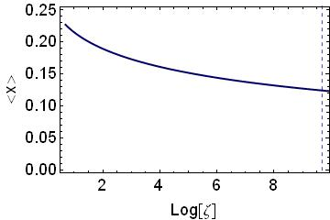
When is asymptotic PDA valid?
Explanation and Prediction of Observables using Continuum Strong QCD, Ian C. Cloët and Craig D. Roberts, arXiv:1310.2651 [nucl-th], Prog. Part. Nucl. Phys. 77 (2014) pp. 1–69 [on-line]
When is asymptopia reached?
If u_{v}^{π}(x) ≈ δ(x), then
<x> = ∫₀¹ dx x u_{v}^{π}(x) = 0;
i.e., the light-front momentum fraction carried by valence-quarks is ZERO
∴ Asymptopia is reached when <x> is “small”
As usual, the computed valence-quark distribution produces (π = u+d_{bar})
2<x>_{2GeV} = 44%
When is <x> small?
JLab 2GeV
LHC: 16TeV
Evolution in QCD is LOGARITHMIC
NLO evolution of PDF, computation of <x>.
Even at LHC energies, light-front fraction of the π momentum:
<x>_{dressed valence-quarks} = 21%
<x>_{glue} = 54%, <x>_{sea-quarks} = 25%

Slide 38
Hard Exclusive Processes & PDAs
In the theory of strong interactions, the cross-sections for many hard exclusive hadronic reactions can be expressed in terms of the PDAs of the hadrons involved
Example: pseudoscalar-meson elastic electromagnetic form factor
α_{S}(Q²) is the strong running coupling,
φ_{π}(u) is the meson’s twist-two valence-quark PDA
f_{P} is the meson's leptonic decay constant
It was promised that JLab would verify this fundamental prediction

Slide 39
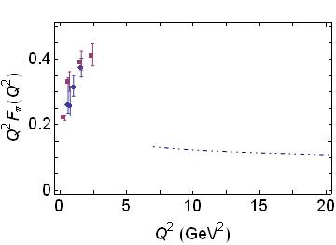
Pion electromagnetic form factor
In 2001 – seven years after beginning operations, Jefferson Lab provided the first high precision pion electroproduction data for F_{π} between Q² values of 0.6 and 1.6 (GeV/c)².
JLab Data
Result imagined by many to be QCD prediction
Evaluated with φ_{π} = 6x(1-x)
2006 & 2007 – new result, at Q²=2.45 (GeV/c)²
Authors of the publications stated: “still far from the transition to the Q² region where the pion looks like a simple quark-antiquark pair”
disappointment and surprise

Slide 40
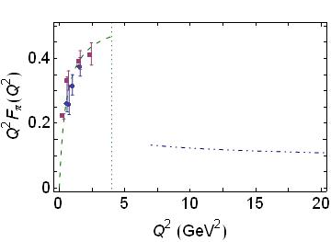
Pion electromagnetic form factor
Factor of three discrepancy
Year 2000 prediction for F_{π}(Q²)
P.Maris & P.C. Tandy, Phys.Rev. C62 (2000) 055204
Problem … used brute-force computational method … unable to compute for Q²>4GeV²
JLab Data
Result imagined by many to be QCD prediction
Evaluated with φ_{π} = 6x(1-x)
Shape of prediction suggested to many that one might never see parton model scaling and QCD scaling violations

Slide 41
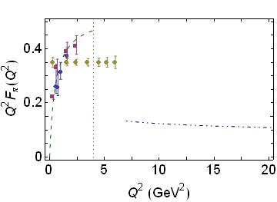
Pion electromagnetic form factor
Plans were made and an experiment approved that use the higher-energy electron beam at the 12 GeV Upgrade at Jefferson Lab.
The Upgrade will allow an extension of the F_{π} measurement up to a value of Q² of about 6 (GeV/c)², which will probe the pion at double the resolution.
Projected JLab reach
Result imagined by many to be QCD prediction
Evaluated with φ_{π} = 6x(1-x)
Will there be any hint of a trend toward the asymptotic pQCD prediction?

Slide 42
New Algorithm New Insights

Slide 43
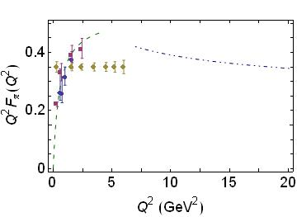
Pion electromagnetic form factor
Solution – Part 1
Compare data with the real QCD prediction; i.e. the result calculated using the broad pion PDA predicted by modern analyses of continuum QCD
Real QCD prediction – obtained with realistic, computed PDA
Result imagined by many to be QCD prediction
Evaluated with φ_{π} = 6x(1-x)

Slide 44
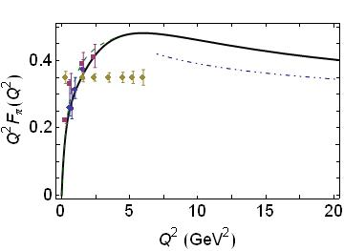
Pion electromagnetic form factor
Agreement within 15%
Solution – Part 1
Compare data with the real QCD prediction; i.e. the result calculated using the broad pion PDA predicted by modern analyses of continuum QCD
Solution – Part 2
Algorithm used to compute the PDA can also be employed to compute F_{π}(Q²) directly, to arbitrarily large Q²
maximum
Real QCD prediction – obtained with realistic, computed PDA
Predictions:
JLab will see maximum
Experiments to 8GeV² will see parton model scaling and QCD scaling violations for the first time in a hadron form factor
Pion electromagnetic form factor at spacelike momenta L. Chang, I. C. Cloët, C. D. Roberts, S. M. Schmidt and P. C. Tandy, arXiv:1307.0026 [nucl-th], Phys. Rev. Lett. 111, 141802 (2013)

Slide 45
Implications
Verify the theory of factorisation in hard exclusive processes, with dominance of hard contributions to the pion form factor for Q²>8GeV².
Notwithstanding that, normalisation of F_{π}(Q²) is fixed by a pion wave-function whose dilation with respect to φ_{π}^{asy}(x)=6x(1-x) is a definitive signature of DCSB
Empirical measurement of the strength of DCSB in the Standard Model – the origin of visible mass
Close the book on a story that began thirty-five years ago
Paves the way for a dramatic reassessment of pictures of proton & neutron structure, which is already well underway

Slide 46
Flavour symmetry breaking in the kaon parton distribution amplitude
Flavour symmetry breaking in the kaon parton distribution amplitude, Chao Shi et al., arXiv:1406:3353 [nucl-th], Phys. Lett. B 738 (2014) pp. 512–518
Following quark model, it became common to assume, in the absence of reliable dynamical information to the contrary, that hadron wave functions and currents exhibit SU(2) ⊗ SU(3) spin-flavour symmetry.
That assumption has implications for numerous observables, including the hadron spectrum and a host of other static and dynamical properties.
Moreover, in an asymptotically free gauge field theory with N_{c} colours, this symmetry is exact on 1/N_{c} ≃ 0
Kaons therefore provide the simplest system in which the accuracy of these assumptions and predictions can be tested.

Slide 47
Flavour symmetry breaking in the kaon parton distribution amplitude
Flavour symmetry breaking in the kaon parton distribution amplitude, Chao Shi et al., arXiv:1406:3353 [nucl-th], Phys. Lett. B 738 (2014) pp. 512–518
Kaons = strong interaction bound states, decay mediated only by the weak interaction ⇒ they have a relatively long lifetime
Kaons have therefore been instrumental in establishing the foundation and properties of the Standard Model; notably, the physics of CP violation.
In this connection the nonleptonic decays of B mesons are crucial because, e.g. the transitions
B± → (πK)± and B± → π±π⁰
provide access to the imaginary part of the CKM matrix element V_{ub}: γ = Arg(V∗_{ub}).

Slide 48
Flavour symmetry breaking in the kaon parton distribution amplitude
Flavour symmetry breaking in the kaon parton distribution amplitude, Chao Shi et al., arXiv:1406:3353 [nucl-th], Phys. Lett. B 738 (2014) pp. 512–518
Factorisation theorems are applicable to such decays.
However, formulae involve a certain class of so-called “non-factorisable” corrections because the PDAs of strange mesons are not symmetric with respect to quark and antiquark momenta.
Therefore, any derived estimate of γ is only as accurate as the evaluation of both
the difference between K and π PDAs and
their respective differences from the asymptotic distribution,
φ^{asy}(u) = 6u(1 − u).
Amplitudes of twist-two and –three are involved.

Slide 49
Computing the kaon’s twist-two PDA
Flavour symmetry breaking in the kaon parton distribution amplitude, Chao Shi et al., arXiv:1406:3353 [nucl-th], Phys. Lett. B 738 (2014) pp. 512–518
Formula is analogous to that of pion
Solve for gap equation for u- and s-quark propagators, and Bethe-Salpeter equation for kaon bound-state amplitude
Flavour-symmetry breaking is evident in
differences between u- and s-quark propagators and
in the fact that the kaon’s Bethe-Salpeter amplitude is asymmetric under (q⋅ P) → (– q⋅ P)

Slide 50
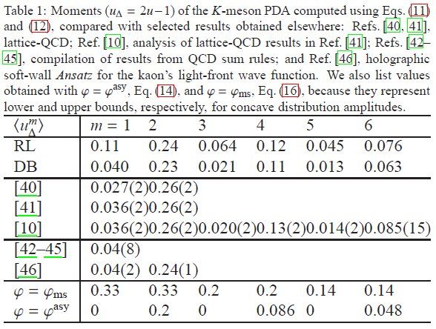
Comparison of moments
〈u_{Δ}^{n}〉 = ∫₀¹ du (2u-1)^{n} φ (u).
lQCD (2006 & 2010)
G-α analysis of 2010 lQCD
QCD SR

Slide 51
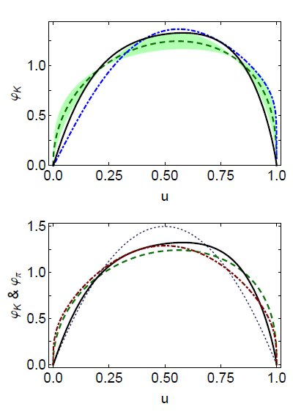
Pointwise behaviour of Kaon and pion PDAs
Green curve & band = result inferred from the two nontrivial kaon moments computed in lQCD
Solid black curve = DSE prediction obtained with DB kernels
DSE-DB and lQCD agree within errors
Comparison of pion and kaon PDAs
pion
kaon: DB
kaon: lQCD

Slide 52
Observations & Messages
Background … in a meson constituted from valence-quarks with equal current-mass, the distribution amplitude is symmetric and peaks at u = 1/2
kaon distribution is skewed, peak at
RL … u = 0.56
DB … u = 0.58
result inferred from lQCD moments … u = 0.56+0.02−0.01.
Unambiguous conclusion is that, on the light-front,
s-quark carries more of kaon’s momentum than the u̅ quark.

Slide 53
Observations & Messages
The 12-16% shift in peak location is a quantitative measure of SU(3)-flavour-symmetry breaking in hadrons.
Comparable with
15% shift in peak of the kaon’s valence s-quark parton distribution function, s_{K}^{v}(x), relative to u_{K}^{v}(x)
and ratio of neutral- and charged-kaon electromagnetic form factors measured in e⁺e⁻ annihilation at s_{U} = 17.4GeV²
|F_{KS} _{KL}(s_{U})|/|F_{K−K+} (s_{U})| ≈ 0.12.
Notable that ratio of s-to-u current-quark masses is
m_{s}/m_{u} ≈ 27,
whereas ratio of nonperturbatively generated constituent-quark masses is typically M_{S}/M_{U} ≈ 1.5 & f_{K}/ f_{π} ≈ 1.2
Both latter quantities are equivalent order parameters for DCSB.

Slide 54
Observations & Messages
Flavour-dependence of DCSB rather than explicit chiral symmetry breaking is measured by skewness of φ_{K}(u)
SU(3)-flavour-symmetry breaking is far smaller than might naively have expected because DCSB impacts heavily on u, d and s-quarks.
Near precise match between the DSE-DB result and that inferred from lQCD
⇒ theory has now arrived at a reliable form of the kaon’s PDA and an understanding of flavour symmetry breaking therein
kaon and pion PDAs described here should serve as the basis for future attempts to access CP violation in the Standard Model

Slide 55
Baryon Bound-States

Slide 56
Baryon Structure
Poincaré covariant Faddeev equation sums all possible exchanges and interactions that can take place between three dressed-quarks
Confinement and DCSB are readily expressed
Prediction: strong diquark correlations exist within baryons as a dynamical consequence of DCSB in QCD
The same mechanism that produces an almost massless pion from two dynamically-massive quarks forces a strong correlation between two quarks in colour-antitriplet channels within a baryon
Diquark correlations are not pointlike
Typically, r₀₊ ~ r_{π} & r₁₊ ~ r_{ρ} (actually 10% larger)
They have soft form factors

Slide 57
Baryon Structure
Poincaré covariant Faddeev equation sums all possible exchanges and interactions that can take place between three dressed-quarks
Confinement and DCSB are readily expressed
Prediction: strong diquark correlations exist within baryons as a dynamical consequence of DCSB in QCD
The same mechanism that produces an almost massless pion from two dynamically-massive quarks forces a strong correlation between two quarks in colour-antitriplet channels within a baryon
Diquark correlations are not pointlike
Typically, r₀₊ ~ r_{π} & r₁₊ ~ r_{ρ} (actually 10% larger)
They have soft form factors
Nucleon wave function can be calculated … prediction of nucleon properties is possible

Slide 58
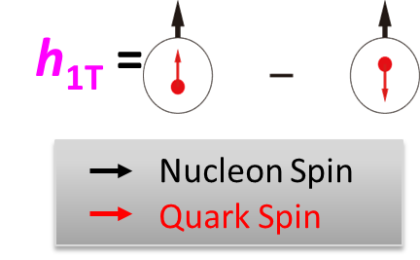
TMDs … Transversity … Tensor Charge
Direction of motion
Intrinsic, defining property of the nucleon
… just as significant as axial-charge
No gluon transversity distribution
Value of tensor charge places constraints on some extensions of the Standard Model <PRD85 (2012) 054512>
Current knowledge of transversity:
SIDIS @HERMES, COMPASS, JLab
Future SIDIS at JLab (SoLId), EIC, …

Slide 59
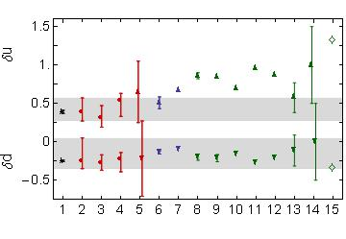
TMDs … Transversity … Tensor Charge
Direction of motion
Pitschmann et al., arXiv:1411. 2052 – Nucleon tensor charges and electric dipole moments
Presence of diquark correlations in the proton wave function suppresses δu by 50% cf. SU(6) quark model prediction
Axial-vector correlation is crucial, e.g.: δd is only nonzero because the proton wave function contains axial-vector correlations; and axial-vector suppresses δu
models
Data fits
DSE
lattice

Slide 60
Summary
Conformal anomaly ... gluons and quarks acquire mass dynamically
Top-down and bottom-up DSE analyses agree on RGI interaction in QCD
⇒ parameter-free prediction of meson properties
DCSB ⇒ reliable predictions of pion and kaon properties
Prediction = PDAs are squat and fat
Prediction = factorisation in hard scattering formalism will be verified in pion form factor at JLab
Prediction = SU(3) flavour symmetry breaking at 15% level in kaon PDA ... DSE-prediction for PDA should be used in future tests of CP violation
Prediction = Nucleon tensor charge ... correlations within Faddeev amplitude are crucial ... connection with EDM of neutron and proton

Slide 61
Future
Twist-three pion and kaon PDAs (Already complete. Just needs to be written.)
PDAs for heavy-heavy & heavy-light mesons (hh complete and can be released. hl needs DB kernel.)
Combine the results
… direct application to Standard Model tests
Analyses of the nucleon with equal sophistication … underway

Slide 62
Future
Twist-three pion and kaon PDAs (Already complete. Just needs to be written.)
PDAs for heavy-heavy & heavy-light mesons (hh complete and can be released. hl needs DB kernel.)
Combine the results
… direct application to Standard Model tests
Analyses of the nucleon with equal sophistication … underway

