Slide 1

Low-Energy Scattering with COHERENT
Artwork by Sandbox Studio, Chicago with Ana Kova
Kate Scholberg, Duke University
ACFI Workshop
April 25, 2019

Slide 2
OUTLINE
Coherent elastic neutrino-nucleus scattering
(CEvNS)
Physics motivations
How to measure CEvNS
The COHERENT experiment at the SNS
COHERENT results
  CsI[Na] measurement and interpretation
  New: LAr engineering run
Future prospects
  Notes on neutrino magnetic moment,
  ES vs CEvNS

Slide 3
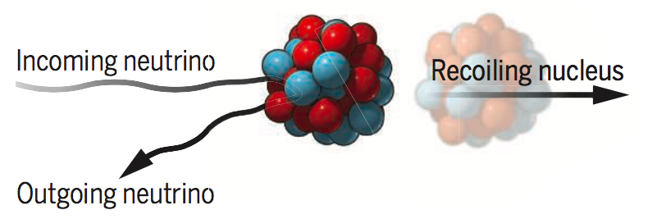
Coherent elastic
neutrino-nucleus scattering (CEvNS)
ν + A → ν + A
ν
ν
A neutrino smacks a nucleus
via exchange of a Z, and the
nucleus recoils as a whole;
coherent up to E_{ν}~ 50 MeV
Z⁰
A
A
Nucleon wavefunctions
in the target nucleus
are in phase with each other
at low momentum transfer
For
,
[total xscn] ~ A² * [single constituent xscn]
Image: J. Link Science Perspectives
Notes:
in phase
\frac{d \sigma}{d \Omega} \sim A^2 | {f}(\bf{k'},\bf{k})|^2
Q is 4-mon transfer

Slide 4
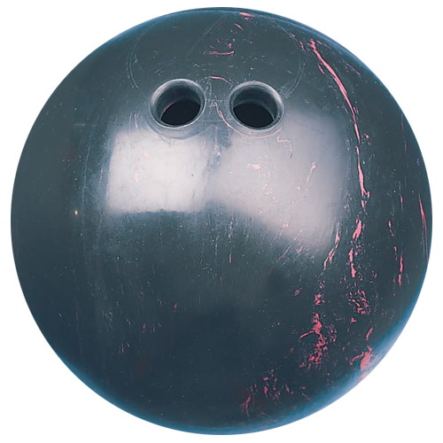
Standard Model prediction
for differential cross section
E_{ν}: neutrino energy
T: nuclear recoil energy
M: nuclear mass
Q = √ (2 M T):
momentum transfer
(probability of kicking a nucleus
with recoil energy T)
Fermi constant (SM parameter)
kinematics:
ping-pong
ball hits
bowling ball
Form factor: F=1 ➔ full coherence
weak
nuclear
charge
Notes:
\frac{d\sigma}{dT} = \frac{G_F^2 M}{2 \pi} \frac{Q_W^2}{4} F^2(Q)\left(2-\frac{M T}{E_{\nu}^2}\right)
Q_W = N-(1-4 \sin^2 \theta_W)Z
30 MeV nu for plot

Slide 5
Standard Model prediction
for differential cross section
E_{ν}: neutrino energy
T: nuclear recoil energy
M: nuclear mass
Q = √ (2 M T):
momentum transfer
(probability of kicking a nucleus
with recoil energy T)
No. of neutrons
No. of protons
weak
nuclear
charge
,
so protons unimportant
Notes:
\frac{d\sigma}{dT} = \frac{G_F^2 M}{2 \pi} \frac{Q_W^2}{4} F^2(Q)\left(2-\frac{M T}{E_{\nu}^2}\right)
Q_W = N-(1-4 \sin^2 \theta_W)Z
30 MeV nu for plot

Slide 6
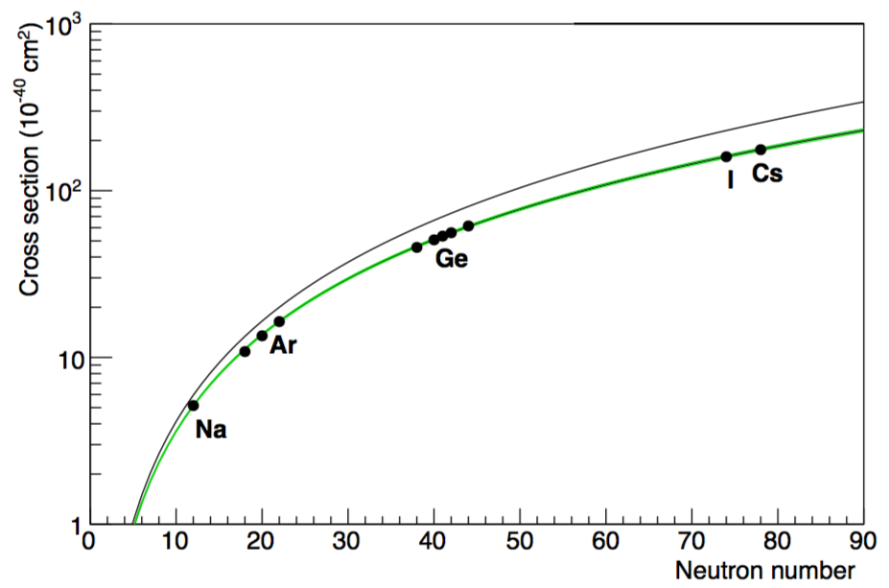
E_{ν}: neutrino energy
T: nuclear recoil energy
M: nuclear mass
Q = √ (2 M T):
momentum transfer
Form factor: F=1 ➔ full coherence
weak
nuclear
charge
Averaged over stopped-π ν flux
Line: F(Q)=1
Green: Klein-Nystrand FF w/uccty
Notes:
\frac{d\sigma}{dT} = \frac{G_F^2 M}{2 \pi} \frac{Q_W^2}{4} F^2(Q)\left(2-\frac{M T}{E_{\nu}^2}\right)
Q_W = N-(1-4 \sin^2 \theta_W)Z
30 MeV nu for plot

Slide 7
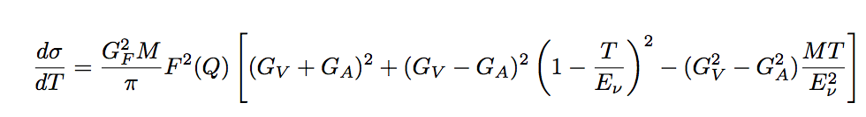

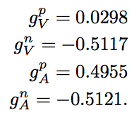
In a bit more detail: vector and axial contributions
E_{ν}: neutrino energy
T: nuclear recoil energy
M: nuclear mass
Q = √ (2 M T): momentum transfer
G_{V}, G_{A}: SM weak parameters
vector
dominates
axial
small for
most nuclei,
zero for
spin-zero
For the moment,
mostly ignoring
axial contributions

Slide 8
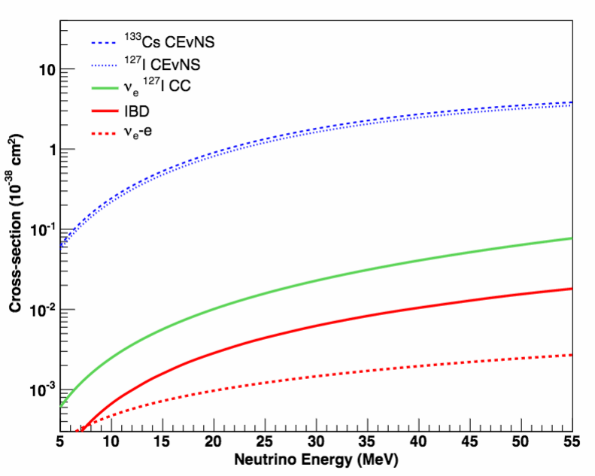
The cross section
is large
(by neutrino standards)
(per target atom in CsI)
Notes:
\sigma \propto Q_W^2 \propto (N-(1-4\sin^2 \theta_W)Z)^2 \sim N^2

Slide 9
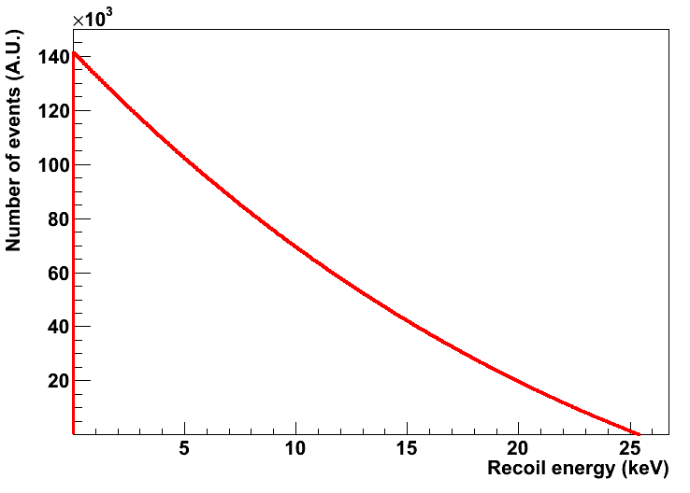
Large cross section (by neutrino standards) but hard to observe
due to tiny nuclear recoil energies:
Nuclear recoil energy spectrum in Ge for 30 MeV ν
Max recoil
energy is ~2E_{ν}²/M
(25 keV for Ge)

Slide 10
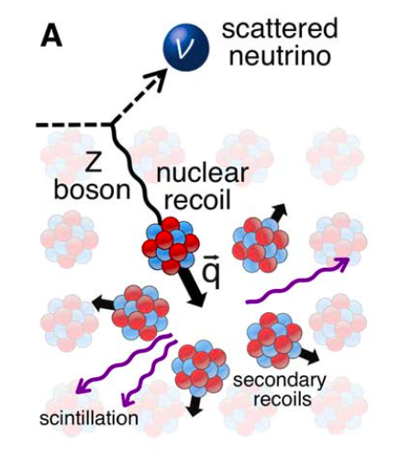
The only
experimental
signature:
tiny energy
deposited
by nuclear
recoils in the
target material
deposited energy
➔ WIMP dark matter detectors developed
over the last ~decade are sensitive
to ~ keV to 10’s of keV recoils

Slide 11
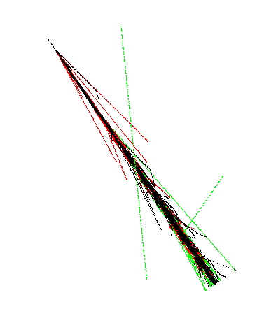
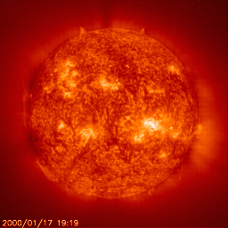
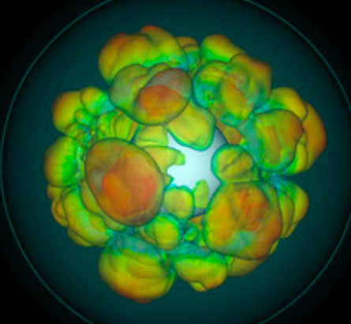
The so-called “neutrino floor” (signal!) for DM experiments
J. Monroe & P. Fisher, 2007
L. Strigari
atmospheric
ν’s
super
nova
ν’s
solar ν’s
Measure CEvNS to understand nature of background/astro signal
(& detector response, DM interaction)

Slide 12
The cross section is cleanly predicted
in the Standard Model
E_{ν}: neutrino energy
T: nuclear recoil energy
M: nuclear mass
Q = √ (2 M T): momentum transfer
G_{V}, G_{A}: SM weak parameters
vector
dominates
axial
small for
most nuclei,
zero for
spin-zero

Slide 13
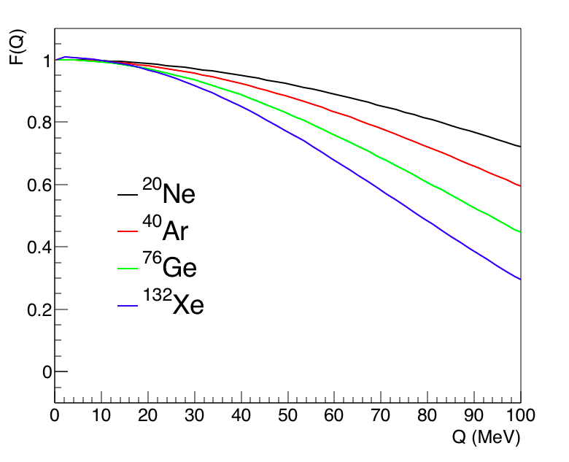
The cross section is cleanly predicted
in the Standard Model
E_{ν}: neutrino energy
T: nuclear recoil energy
M: nuclear mass
Q = √ (2 M T): momentum transfer
F(Q): nuclear form factor, <~5% uncertainty on event rate
form factor
suppresses
cross section
at large Q
Notes:
Fourier transform of the nucleon density distributions

Slide 14
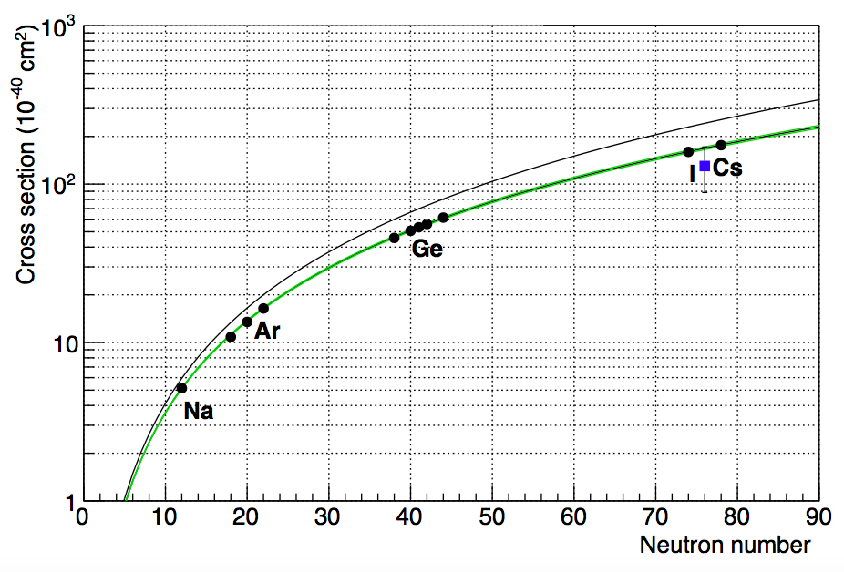
Need to measure N² dependence of the CEvNS xscn
Averaged over stopped-π ν flux
one down...
Line: F(Q)=1
Green: Klein-Nystrand FF w/uccty
more to go...
A deviation from α N² prediction can be
a signature of beyond-the-SM physics

Slide 15
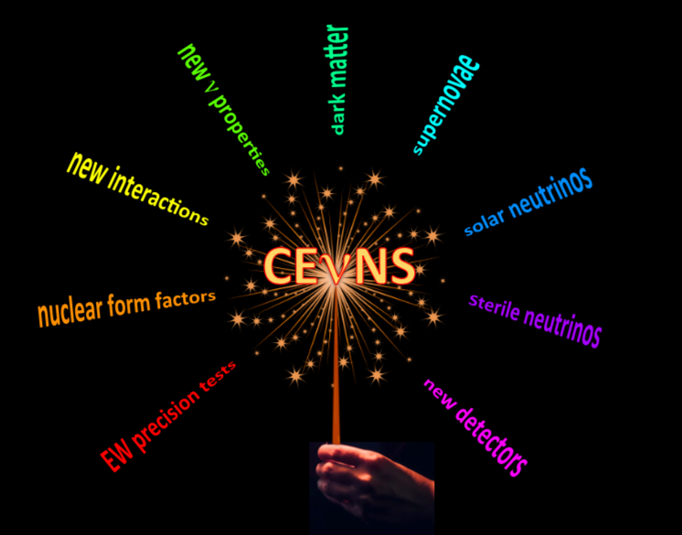
Why measure CEvNS?
E. Lisi
Neutrino 2018
A few examples...

Slide 16
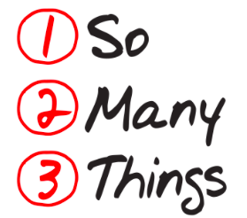
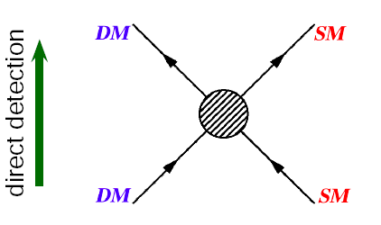
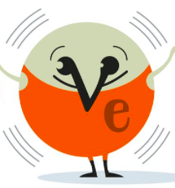

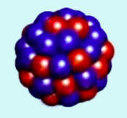
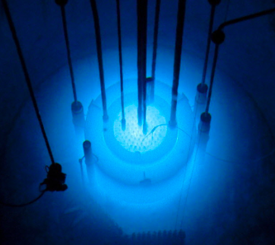
CEvNS: what’s it good for?
!
(not a
complete list!)
Dark matter direct-detection background
Well-calculable cross-section in SM:
  sin²θ_{Weff} at low Q
  Probe of BSM physics
    Non-standard interactions of neutrinos
    New NC mediators
    Neutrino magnetic moment
New tool for sterile neutrino oscillations
Astrophysical signals (solar & SN)
Supernova processes
Nuclear physics:
  Neutron form factors
  g_{A} quenching
Possible applications (reactor monitoring)

Slide 17
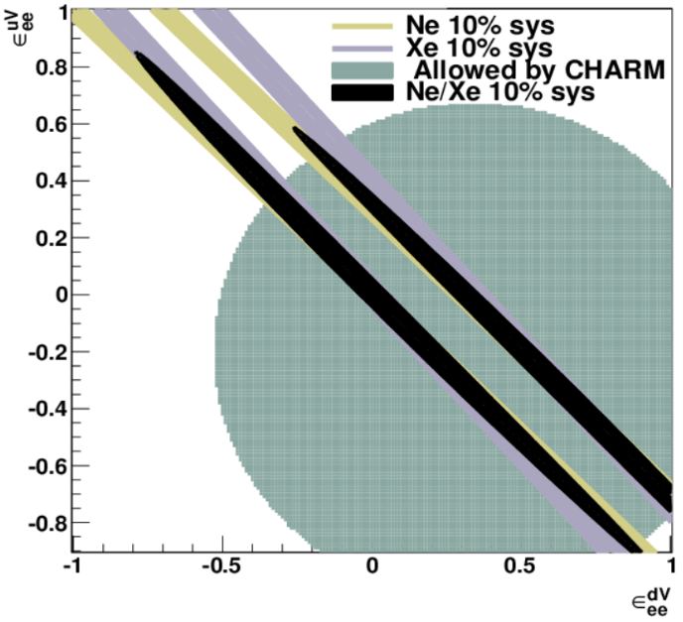
Non-Standard Interactions of Neutrinos:
new interaction specific to ν’s
If these ε’s are
~unity, there is
a new interaction
of ~Standard-model
size... many not
currently
well constrained
J. Barranco et al., JHEP 0512 (2005), K. Scholberg, PRD73, 033005 (2006), 021
Can improve ~order of magnitude beyond CHARM limits with a
first-generation experiment (for best sensitivity, want multiple targets)
More studies: see https://sites.duke.edu/nueclipse/files/2017/04/Dent-James-NuEclipse-August-2017.pdf

Slide 18
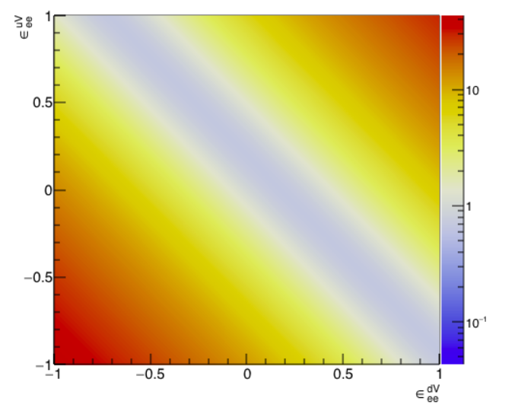
Signatures of Beyond-the-Standard-Model Physics
Look for a CEvNS excess or deficit wrt SM expectation
CsI
Ratio
wrt SM
Excess
New ν_{e}-u quark interaction
Match SM rate
Suppression
Match SM rate
Excess
New ν_{e}-d quark interaction
18

Slide 19
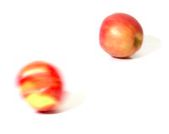

How to detect CEvNS?
ν
You need a neutrino source
and a detector
What do you want for your ν source?
High flux
Well understood spectrum
Multiple flavors (physics sensitivity)
Pulsed source if possible, for background rejection
Ability to get close
Practical things: access, control, ...

Slide 20
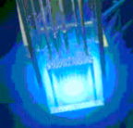
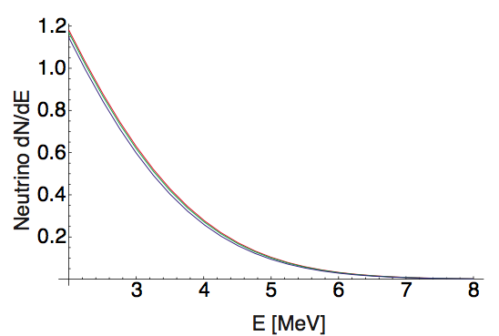
Neutrinos from nuclear reactors
ν energies up to
several MeV
ν_{e}-bar produced in fission reactions (one flavor)
huge fluxes possible: ~2x10²⁰ s⁻¹ per GW
several CEvNS searches past, current and future at
reactors, but recoil energies<keV and
backgrounds make this very challenging

Slide 21
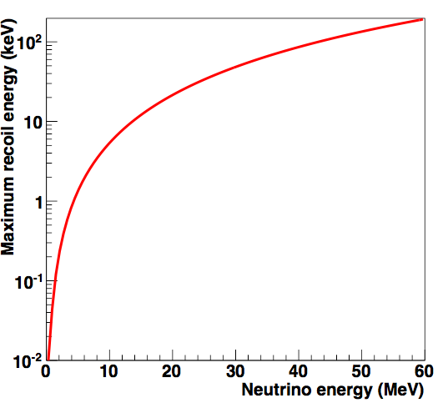
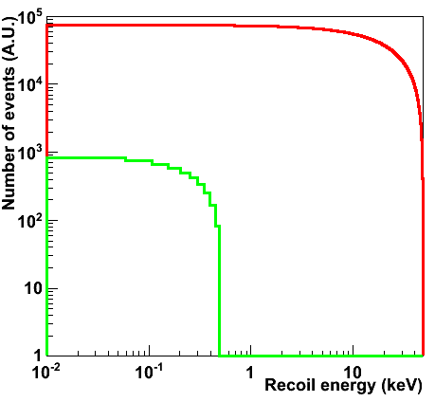
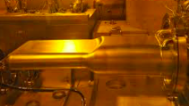

Both cross-section and maximum recoil energy
increase with neutrino energy:
30 MeV ν’s
stopped π
3 MeV ν’s
reactor
⁴⁰Ar target
for same flux
Want energy as large as possible while satisfying
coherence condition:
(<~ 50 MeV for medium A)
Notes:
T_{\rm max} \sim \frac{2 E_\nu^2}{M}

Slide 22
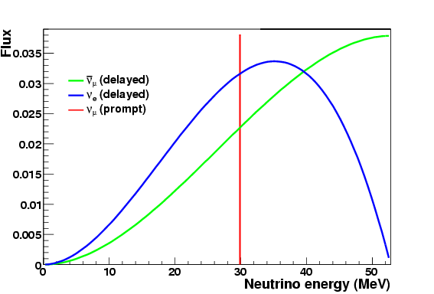
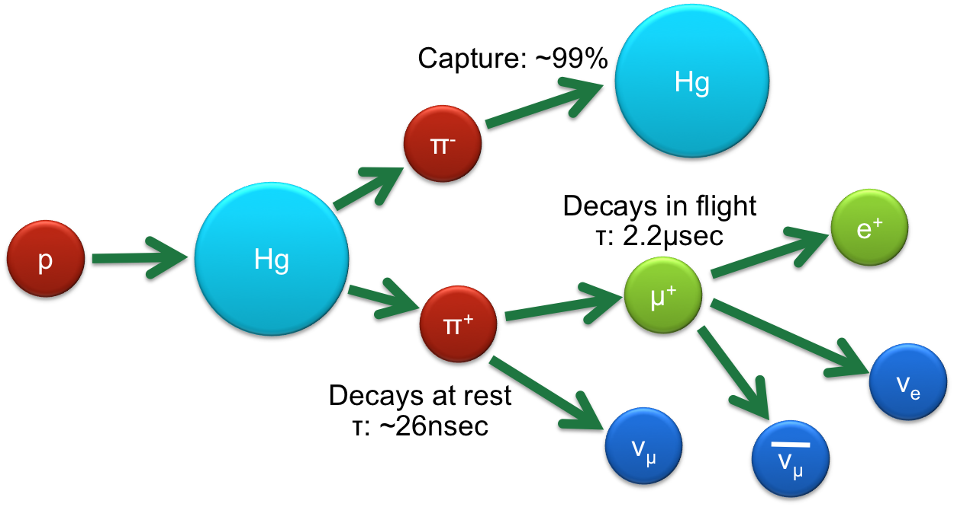
Stopped-Pion (πDAR) Neutrinos
at rest
2-body decay: monochromatic 29.9 MeV ν_{μ}
PROMPT
3-body decay: range of energies
between 0 and m_{μ}/2
DELAYED (2.2 μs)

Slide 23
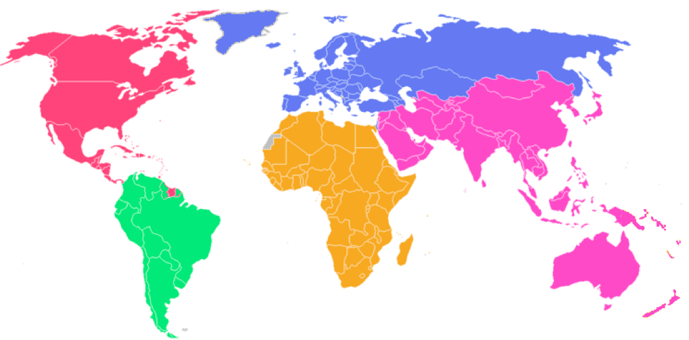
Stopped-Pion Neutrino Sources Worldwide
LANSCE
ISIS
BNB
CSNS
ESS
SNS
MLF
Past
Current
Future
DAEδALUS
?

Slide 24
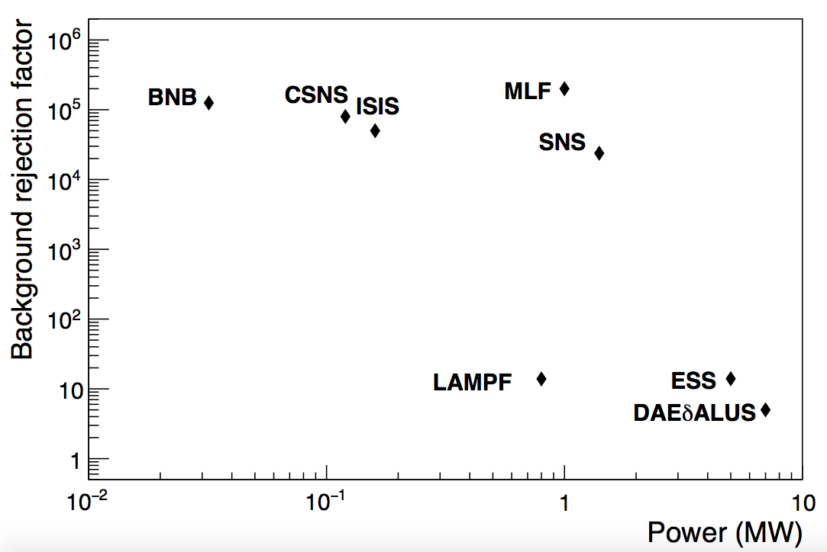
Comparison of pion decay-at-rest ν sources
from duty cycle
better

Slide 25
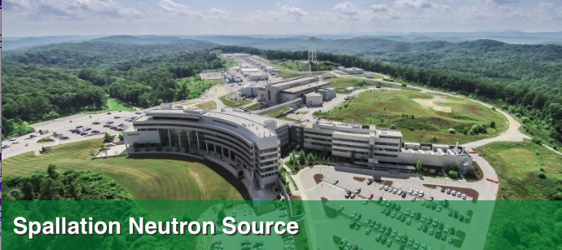
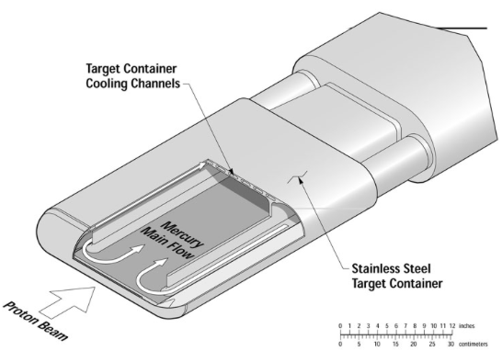
Oak Ridge National Laboratory, TN
Proton beam energy: 0.9-1.3 GeV
Total power: 0.9-1.4 MW
Pulse duration: 380 ns FWHM
Repetition rate: 60 Hz
Liquid mercury target
The neutrinos are free!

Slide 26
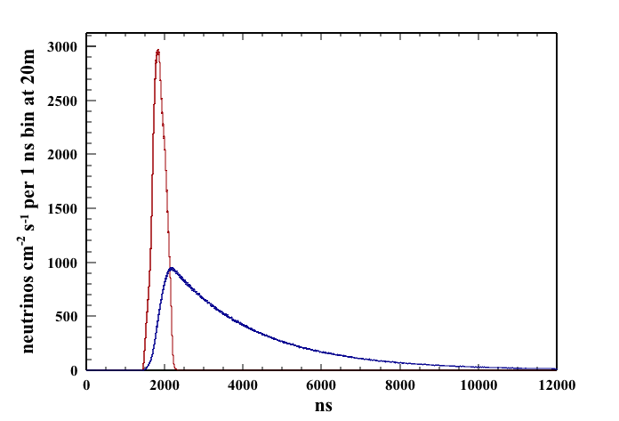
Time structure of the SNS source
60 Hz pulsed source
Prompt ν_{μ} from π decay in time with the proton pulse
Delayed anti-ν_{μ,} ν_{e}
on μ decay timescale
Background rejection factor ~few x 10⁻⁴

Slide 27
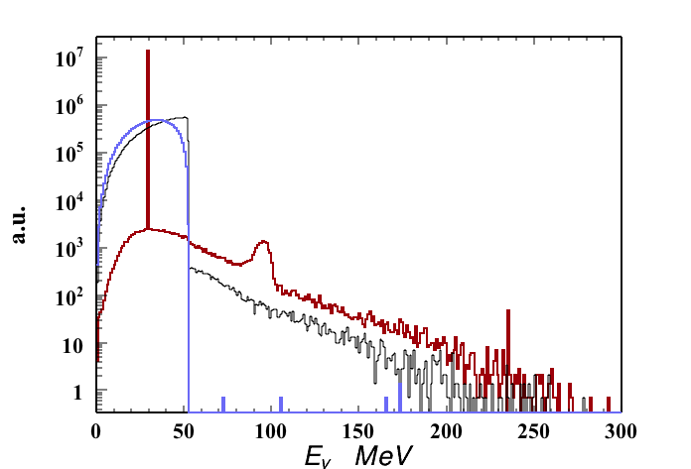
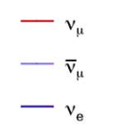
The SNS has large, extremely clean stopped-pion ν flux
0.08 neutrinos per flavor per proton on target
Note that contamination
from non π-decay at rest
(decay in flight,
kaon decay, μ capture...)
is down by several
orders of magnitude
SNS flux (1.4 MW):
430 x 10⁵ ν/cm²/s
@ 20 m
Notes:
Bottom plot not really AU, nu's /cm^2 /s at 20 m

Slide 28
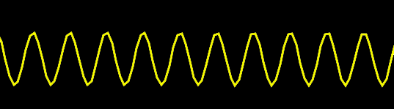
Now, detecting the tiny kick of the neutrino...
This is just like the tiny thump of a WIMP;
we benefit from the last few decades of low-energy nuclear recoil detectors
W
W
phonons
(heat)
photons
see a
flash
feel a warm pulse
+
+
+
+
-
-
-
scintillating crystal
noble liquid
-
Cryogenic
Ge, Si
2-phase
noble liquid
ionization
feel a zap
HPGe
http://dmrc.snu.ac.kr/english/intro/intro1.html

Slide 29
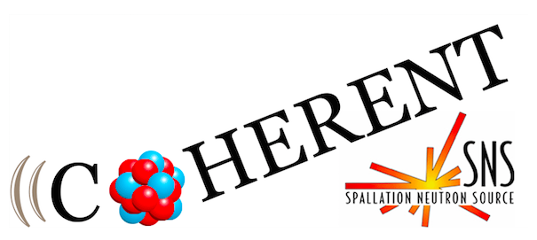
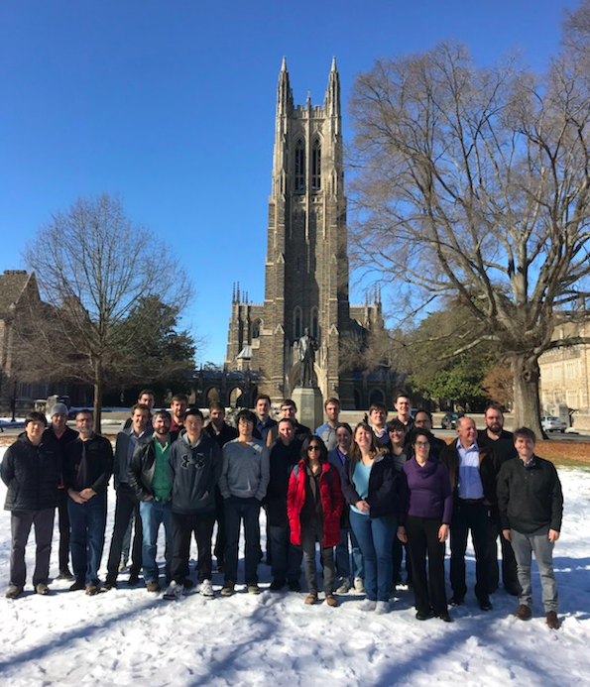








The COHERENT collaboration
http://sites.duke.edu/coherent
~90 members,
20 institutions
4 countries
arXiv:1509.08702

Slide 30
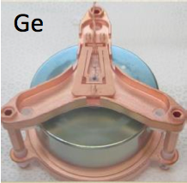
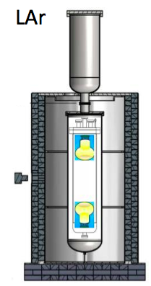
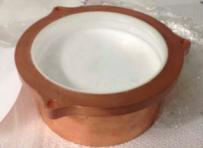
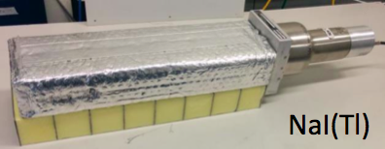
COHERENT CEvNS Detectors
Nuclear Target | Technology | Mass (kg) | Distance from source (m) | Recoil threshold (keVr)
CsI[Na] | Scintillating crystal | 14.6 | 19.3 | 6.5
Ge | HPGe PPC | 16 | 22 | <few
LAr | Single-phase | 22 | 29 | 20
NaI[Tl] | Scintillating crystal | 185*/3338 | 28 | 13
flash
zap
flash
flash
Multiple detectors for N² dependence of the cross section
CsI[Na]

Slide 31

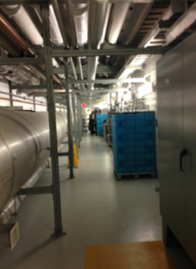
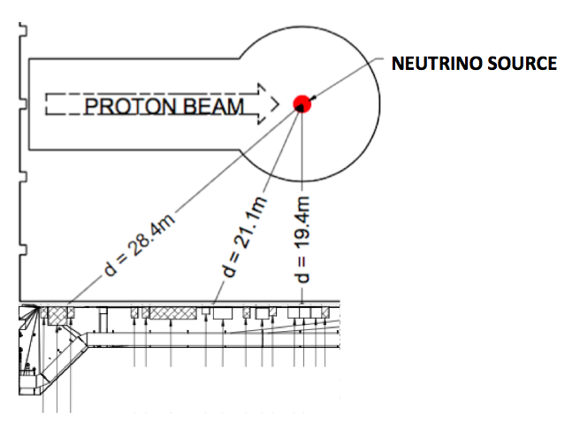
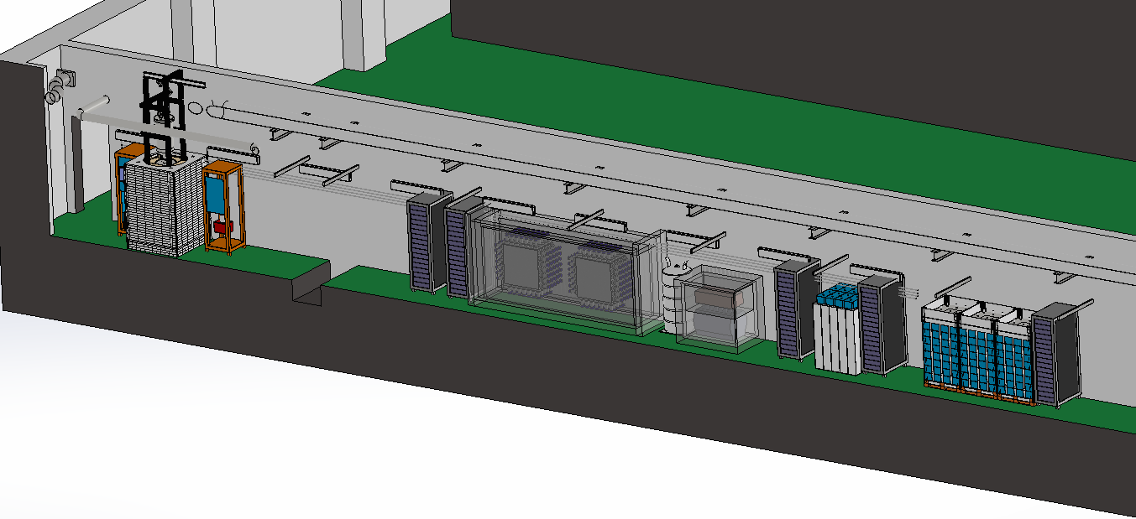
Siting for deployment in SNS basement
(measured neutron backgrounds low,
~ 8 mwe overburden)
View looking
down “Neutrino Alley”
LAr
NaI
Ge
NIN cubes
CsI
Isotropic ν glow from Hg SNS target

Slide 32
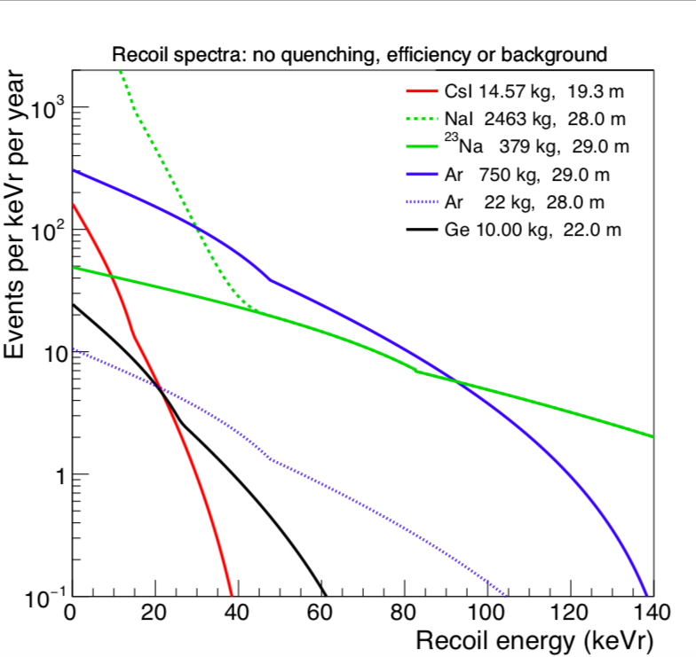
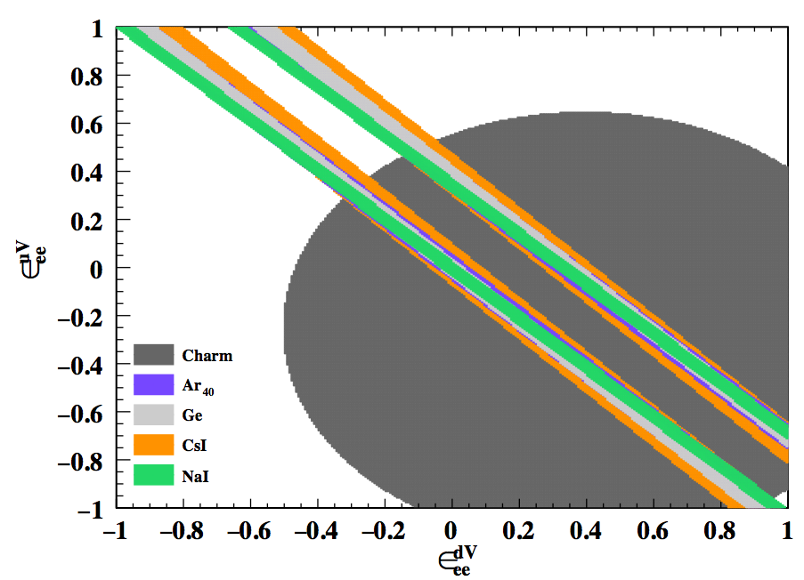
Expected recoil energy distribution
Lighter targets:
less rate per mass,
but kicked to
higher energy

Slide 33

Backgrounds
Usual suspects:
cosmogenics
ambient and intrinsic radioactivity
detector-specific noise and dark rate
Neutrons are especially not our friends*
+
+
+
+
-
-
-
-
Steady-state backgrounds can be measured off-beam-pulse
... in-time backgrounds must be carefully characterized
*Thanks to Robert Cooper for the “mean neutron”
Notes:
ss backgrounds are square-rootable

Slide 34
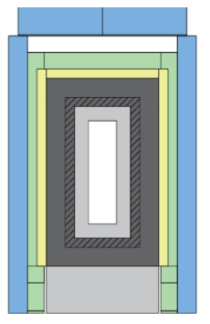
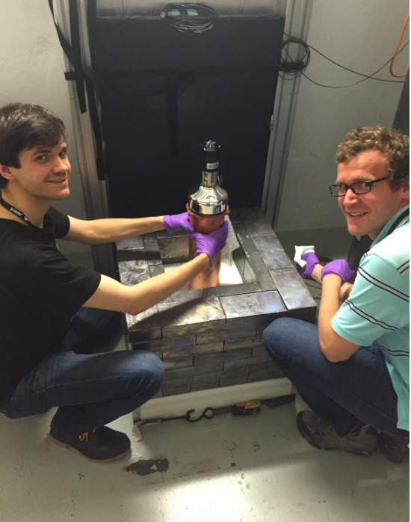


The CsI Detector in Shielding in Neutrino Alley at the SNS
A hand-held detector!
Almost wrapped up...
Notes:
Green: structural aluminum

Slide 35

COHERENT data taking
1.76 x10²³ POT delivered to CsI
(7.48 GWhr)
Neutron background data-taking for ~2 years before first CEvNS detectors
CsI data-taking starting summer 2015
Notes:
Nova: currently 6e20 pot

Slide 36



First light at the SNS (stopped-pion neutrinos)
with 14.6-kg CsI[Na] detector
Background-subtracted and
integrated over time
→ measure of the Q spectrum
DOI: 10.5281/zenodo.1228631
D. Akimov et al., Science, 2017
http://science.sciencemag.org/content/early/2017/08/02/science.aao0990
Notes:
{\rm pe} \propto T \propto Q^2

Slide 37

Signal, background, and uncertainty summary numbers
6 ≤ PE ≤ 30, 0 ≤ t ≤ 6000 ns
Beam ON coincidence window | 547 counts
Anticoincidence window | 405 counts
Beam-on bg: prompt beam neutrons | 7.0 ± 1.7
Beam-on bg: NINs (neglected) | 4.0 ± 1.3
Signal counts, single-bin counting | 136 ± 31
Signal counts, 2D likelihood fit | 134 ± 22
Predicted SM signal counts | 173 ± 48
Uncertainties on signal and background predictions
Event selection | 5%
Flux | 10%
Quenching factor | 25%
Form factor | 5%
Total uncertainty on signal | 28%
Beam-on neutron background | 25%
Dominant
uncertainty

Slide 38

Results of 2D
energy, time fit
SM prediction,
173 events
68% C.L.
5σ
2σ
1σ
Best fit: 134 ± 22 observed events
No CEvNS rejected at 6.7σ,
consistent w/SM within 1σ

Slide 39

Interpreting the rate in the context of SM parameters
B. Canas et al., arXiv:1608.0267
... our first measurement
does not look very good on
this plot... but...
Notes:
0.12-0.32

Slide 40

Neutrino non-standard interaction
constraints for current CsI data set:
Assume
all other ε’s
zero
Parameters describing beyond-the-SM interactions outside this region disfavored at 90%
*
See also
Coloma et al.,
arXiv:1708.02899
*CHARM constraints apply only to heavy mediators

Slide 41



Global fits to COHERENT
+ oscillation experiments
Solid: COHERENT
Dashed: COHERENT + osc
Blue: LMA (θ₁₂ < π/4)
Red: LMA-D (θ₁₂ > π/4)
(“dark side”, still allowed with NSI)
1σ, 2σ allowed
regions projected in
(ε_{ee}^{uV}, ε_{μμ}^{uV})
plane
Already
meaningful
constraints!
Notes:
∆χ2 as a function of NSI parameters εf,V , for a global fit to oscillation experiments (dashed curves) and for a fit αβ
to oscillations and COHERENT data (solid curves). Blue lines correspond to the LMA solution (θ12 < π/4), while the red lines correspond to the LMA-D solution (θ12 > π/4). We minimize the χ2 with respect to all oscillations parameters and all un-displayed NSI parameters in each panel.
Allowed regions in the plane of εu,V ee
and εu,V from μμ
the COHERENT experiment shown together with the allowed regions from the global oscillation analysis. Diagonal shaded bands correspond to the LMA and LMA-D regions as indi- cated, at 1σ, 2σ, 3σ (2 dof). The COHERENT regions are shown at 1σ and 2σ only because the 3σ region extends be- yond the boundaries of the figure.

Slide 42



Single-Phase Liquid Argon
~22 kg fiducial mass
2 x Hamamatsu 5912-02-MOD 8” PMTs
  8” borosilicate glass windown
  14 dynodes
  QE: 18%@ 400 nm
Wavelength shifter: TB-coated teflon walls and PMTs
Cryomech cryocooler – 90 Wt
  PT90 single-state pulse-tube cold head
IU, UT, ORNL
Detector from FNAL, previously built (J. Yoo et al.) for CENNS@BNB
(S. Brice, Phys.Rev. D89 (2014) no.7, 072004)

Slide 43

Matt Heath, APS April meeting

Slide 44

Matt Heath, APS April meeting

Slide 45

Matt Heath, APS April meeting

Slide 46





Another phenomenological
analysis, making use of spectral fit:
arXiv:1708.04255
Effective weak charge in presence
of light vector mediator Z’
SM weak charge
Q²-dependence ➔ affects recoil spectrum
2 parameters: g, M_{Z’}
explains g-2 anomaly
excluded at 2σ
Dashed: SM
Solid: NSI w/ M_{z’}= 10 MeV, g=10⁻⁴
Blue: ν_{μ}
Red: ν_{μ} + ν_{μ—}bar
Black: ν_{μ} + ν_{μ—}bar + ν_{e}

Slide 47

What’s Next for COHERENT?
One measurement so far! Want to map out N² dependence

Slide 48


Neutrino Alley Deployments: current & near future
CEvNS
CEvNS
Neutrino-induced neutrons
CEvNS
ν_{e}CC on ¹²⁷I
Neutron backgrounds
CEvNS

Slide 49

Lots more data in the can!
CEvNS
CEvNS
Neutrino-induced neutrons
CEvNS
ν_{e}CC on ¹²⁷I
Neutron backgrounds
CEvNS

Slide 50


COHERENT CEvNS Detector Status and Farther Future
Nuclear Target | Technology | Mass (kg) | Distance from source (m) | Recoil threshold (keVr) | Data-taking start date | Future
CsI[Na] | Scintillating crystal | 14.6 | 20 | 6.5 | 9/2015 | Finishing data-taking
Ge | HPGe PPC | 16 | 22 | <few | 2019
LAr | Single-phase | 22 | 29 | 20 | 12/2016, upgraded summer 2017 | Expansion to 750 kg scale
NaI[Tl] | Scintillating crystal | 185*/ 3388 | 28 | 13 | *high-threshold deployment summer 2016 | Expansion to 3.3 tonne, up to 9 tonnes
+ concepts
for other
targets

Slide 51

Tonne-scale LAr Detector
750-kg LAr will fit in the same place, will reuse part of existing infrastructure
Could potentially use depleted argon
CC/NC inelastic in argon of interest
for supernova neutrinos
CC ν_{e}+⁴⁰Ar → e⁻ + ⁴⁰K*
NC ν_{x}+⁴⁰Ar → ν_{x} + ⁴⁰Ar*

Slide 52


High-Purity Germanium Detectors
P-type Point Contact
Excellent low-energy resolution
Well-measured quenching factor
Reasonable timing
8 Canberra/Mirion 2 kg detectors
in multi-port dewar
Compact poly+Cu+Pb shield
Muon veto
Designed to enable additional detectors
Notes:
8 Canberra BeGes at SURF (5 kg)

Slide 53

Sodium Iodide (NaI[Tl]) Detectors (NaIvE)
up to 9 tons available,
2 tons in hand
QF measured
require PMT base
refurbishment
(dual gain) to
enable low threshold
for CEvNS on Na
measurement
development and
instrumentation tests
underway at UW, Duke
Multi-ton concept
In the meantime: 185 kg deployed at SNS to go after ν_{e}CC on ¹²⁷I
J.A. Formaggio and G. Zeller, RMP 84 (2012) 1307-1341

Slide 54

Estimated future sensitivities for NSI
Combination
of targets
improves
sensitivity

Slide 55

Neutrino magnetic moment
Signature is distortion at low recoil energy E
➔ very low
energy threshold
is desirable (i.e., Ge )
Note muon flavor
content @
stopped-π source
Notes:
\left(\frac{d\sigma}{dT}\right)_m = \frac{\pi \alpha^2 \mu_\nu^2 Z^2}{m_e^2}\left(\frac{1-T/E_\nu}{T}+ \frac{T}{4E_\nu^2} \right)

Slide 56


CEvNS vs ν-e Elastic Scattering
μ_{ν} in μ_{B}
CEvNS xscn larger by Z² than ES
But Z more electrons per target for ES, so xscn ~Z bigger
CEvNS magnetic scattering has higher rate, but more SM bg

Slide 57

@20 m
quite hard @ SNS...

Slide 58
Reducing systematic uncertainties
2017 CsI measurement
Dominant uncertainty
(detector-dependent)
Uncertainties on signal and background predictions
Event selection | 5%
Quenching factor | 25%
Flux | 10%
Form factor | 5%
Total uncertainty on signal | 28%
Beam-on neutron background | 25%
Next largest uncertainty
(affects all
detectors)
ancillary quenching factor measurements
are important for the physics program
D₂O for flux normalization also planned

Slide 59

Heavy water detector in Neutrino Alley
➔ ~few percent precision on flux normalization

Slide 60

Summary
CEvNS:
  large cross section, but tiny recoils, α N²
  accessible w/low-energy threshold detectors, plus extra
  oomph of stopped-pion neutrino source
First measurement by COHERENT CsI[Na] at the SNS
Meaningful bounds on beyond-the-SM physics
It’s just the beginning....
Multiple targets, upgrades and new ideas in the works!
Other CEvNS experiments at reactors are joining the fun
(CONUS, CONNIE, MINER, RED, Ricochet, Nu-cleus...)
Notes:
Also take away: it’s “CEvNS”

Slide 61





Phys.Rev. D94 (2016) no.5, 055005,
Erratum: Phys.Rev. D95 (2017) no.7, 079903
P. Coloma et al., JHEP 1704 (2017) 116
If you allow for NSI,
an ambiguity
exists in determining
mass ordering
w/ LBL experiments:
“LMA-Dark”
Normal ordering w/no NSI...
Same answer for
...looks just like inverted ordering w/NSI
Notes:
Results from a fit to simulated data for DUNE. We assume a true NO and no NSI, and perform a fit allowing for non-zero values of εee and εeτ . In the upper panel we fit with the correct mass spectrum, while in the lower panel we adopt IO and exchange sin θ12 ↔ cos θ12 . The shaded regions correspond to DUNE alone, whereas the contour curves include the constraints from global oscillation data [7] and from the CHARM experiment [20] on the NC cross section. We marginalize over ∆m231, δ, θ23 and the complex phase of εeτ .

Slide 62
Phys.Rev. D94 (2016) no.5, 055005,
Erratum: Phys.Rev. D95 (2017) no.7, 079903
P. Coloma et al., JHEP 1704 (2017) 116
CEvNS measurements
can place significant
constraints
to resolve the
LMA-D ambiguity
if SM rate is measured
Normal ordering w/no NSI...
...looks just like inverted ordering w/NSI
OR, could confirm
an NSI signature
observed by DUNE
Notes:
Results from a fit to simulated data for DUNE. We assume a true NO and no NSI, and perform a fit allowing for non-zero values of εee and εeτ . In the upper panel we fit with the correct mass spectrum, while in the lower panel we adopt IO and exchange sin θ12 ↔ cos θ12 . The shaded regions correspond to DUNE alone, whereas the contour curves include the constraints from global oscillation data [7] and from the CHARM experiment [20] on the NC cross section. We marginalize over ∆m231, δ, θ23 and the complex phase of εeτ .

Slide 63

CsI quenching factor measurements at TUNL w/ neutrons
Discrepancy between two measurements used to estimate systematic uncertainty
Flat 8.78%
22 cm³ crystal
from same
manufacturer
13.348 pe/keVee * 0.0878 keVee/keVr = 1.2 pe/keVr
ee light yield
QF
Notes:
We performed two new independent measurements using a monochromatic (3.8 ± 0.2 MeV) DD neutron beam (6

Slide 64


Another example: sterile neutrino oscillations
CEvNS is NC and doesn’t care about the flavor;
disappearance is “true” disappearance
Some neutrino spectral info in the recoil spectrum
Can cancel some systematics with multiple identical, or movable detectors
Assumptions:
!!!!
Even 100 kg of Ge is expensive/challenging, but multitons of
noble liquid is entirely thinkable
Kosmas et al., Phys.Rev. D96 (2017) no.6, 063013

Slide 65

Projections: Kosmas et al.,
arXiv:1505.03202,
1711.09773

Slide 66
Some experimental issues to keep in mind
Efficiency is a function of T, and has shape uncertainties
Low energy thresholds are hard to achieve
“Quenching factor” (observable recoil energy compared to electron energy deposition) and other detector response has T shape uncertainties
T shape uncertainties
have correlations
Energy resolution matters
Backgrounds matter (a lot)
There are flux normalization
and shape uncertainties*
All of these are very target-
and detector-dependent
It’s very hard work to get a handle
on these parameters
and their (correlated)
uncertainties
*Little flux shape uncertainty at SNS

Slide 67
Now, zoom in on the form factor(s)
Fourier transform of the nucleon distributions
encapsulates information about non-point-like-ness of the nucleus
E_{ν}: neutrino energy
T: nuclear recoil energy
M: nuclear mass
Q = √ (2 M T): momentum transfer
form factor
suppresses
cross section
at large Q
larger effect
for stopped-π, SN, atmν
than solar, reactor
Notes:
Fourier transform of the nucleon density distributions

Slide 68
One should write separate
F_{n}^{V}(Q), F_{n}^{A}(Q), F_{p}^{V}(Q), F_{p}^{A}(Q) form factors
Currently, assuming these are all the same,
except for extra neutron skin for F_{n}^{V}(Q)
- axial contributions are pretty tiny
- proton contributions also quite unimportant
Notes:
Fourier transform of the nucleon density distributions

Slide 69
Three form-factor functional forms studied in detail for COHERENT:
“Helm”
“Klein-Nystrand”
Numerical files from Chuck Horowitz,
“based on relativistic mean field interaction FSUgold
that does a good job reproducing the binding
energy and charge radii of many nuclei”
“Horowitz”
Neutron skin adjustment
also looked at: “solid sphere”, Lewin-Smith;
did not look at “symmetrized Fermi function”
Notes:
F(Q)= \frac{3(\sin(QR)-QR \cos(QR))}{(Q R)^3(1+a_{k}^2 Q^2)}
a=0.7
R=1.2 A^{1/3}
F(Q) = \frac{3}{Q R_0} \left(\frac{\sin{(Q R_0)}}{(Q R_0)^2}- \frac{\cos{(Q R_0)}}{Q R_0}\right) e^{-Q^2 s^2/2}
Symm. FF is FT of Woods-Saxon or standard Fermi, Helm is box+Gauss, Klein-Nystrand is Yukawa+sphere

Slide 70

Different parameterizations give very similar shapes
Cs133
Notes:
Fourier transform of the nucleon density distributions

Slide 71
Effect of the form factor on the flux-averaged xscns
Averaged over stopped-π ν flux
Line: F(Q)=1
Green: Klein-Nystrand FF w/uncertainty*
*will come back to this
Notes:
Fourier transform of the nucleon density distributions

Slide 72

Effect of the form factor on the recoil spectra
Notes:
Fourier transform of the nucleon density distributions

Slide 73



Approaching the form factor as
something to measure using CEvNS…
assume the SM is true, learn about the nucleus
(and astrophysics!)
Observable is
recoil
spectrum
shape
Notes:
Fourier transform of the nucleon density distributions

Slide 74




Approach: expand in moments of the neutron radius
Ar-C scattering
Example:
tonne-scale
experiment
at πDAR source
+: model
predictions
10% uncertainty
on rate
K. Patton et al., PRC86 (2012) 024612
Notes:
3.5 t of Ar 16 m from source

Slide 75



More studies with this approach
Lines: 2 tonnes @ 20 m
4th moment
Uses uncertainties uncorrelated bin by bin,
which is probably too conservative
Notes:
Fourier transform of the nucleon density distributions

Slide 76





First fit to the COHERENT CsI data
Helm functional form
Fit to neutron radius resulting in ~18% uncertainty, as
well as neutron skin measurement
Does not handle bin-by-bin correlation of systematics (e.g., from QF)
COHERENT will have better measurement soon,
+ handling of shape systematics w/ correlations

Slide 77


But now: suppose your physics goal is to
hunt for BSM effects in the recoil spectrum
understand an astrophysical CEvNS signal
understand an astrophysical CEvNS background
(DM floor)
then… uncertainties in the form factor are a nuisance!
There are degeneracies in the observables between
“old” (but still mysterious) physics
and “new” physics
We will need to think carefully about how to
disentangle these effects and understand uncertainties
Notes:
Like trying to build a Frank Gehry hotel at a great pyramid site

Slide 78
Initial COHERENT CsI result used Klein-Nystrand (no skin)
assumed +/-5% FF uncertainty on counts or 1-bin NSI analysis
conservative estimate based on variation of
integrated counts for different parameterizations
not the dominant uncertainty (which is QF-related, +/-25%)
Updated estimates of integrated event rates
w/FF variation are within this uncertainty

Slide 79

Current method of estimating FF uncertainty:
R_{n} scaling (via Q) by ±3% (C. Horowitz’s estimate of R_{n} uccty)
➔ ~4% effect on CsI number
CsI events
Horowitz | 171.72
Horowitz Rn+3% | 164.89
Horowitz Rn-3% | 178.64
The previously
estimated ~5% uccty
on CsI number from FF
is probably reasonable

Slide 80


Effect of FF uncertainty on the SNS recoil spectrum
(Klein-Nystrand FF)

Slide 81





New:
Helm form factor with R_{n} varied ~+/-9%
Notes:
Fourier transform of the nucleon density distributions

Slide 82


May make significant impact on BSM sensitivity:
But is +/-0.5 fm on R_{n} the right amount of uncertainty?
Is varying R_{n} even the right thing to do?
How to incorporate known nuclear structure physics?
Notes:
Fourier transform of the nucleon density distributions

