Slide 1
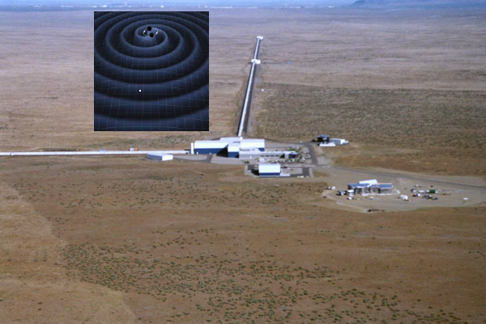
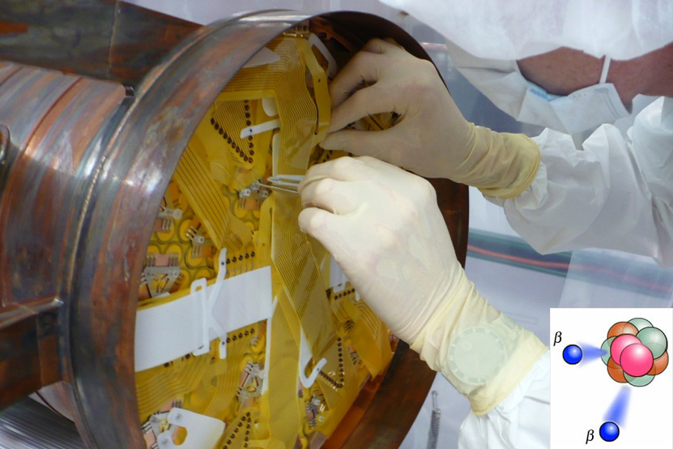
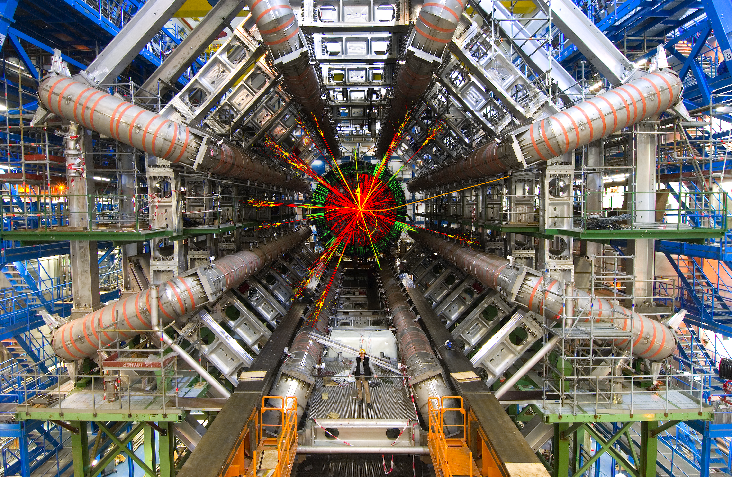
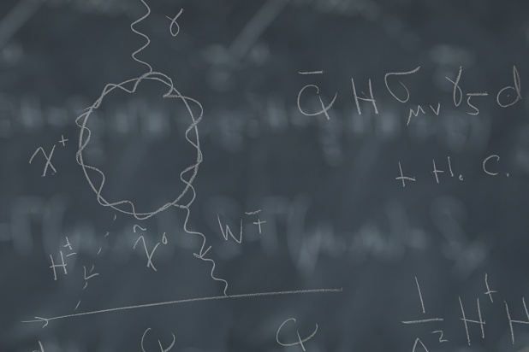
Welcome to the ACFI !
ATLAS
Theory
LIGO
EXO

Slide 2
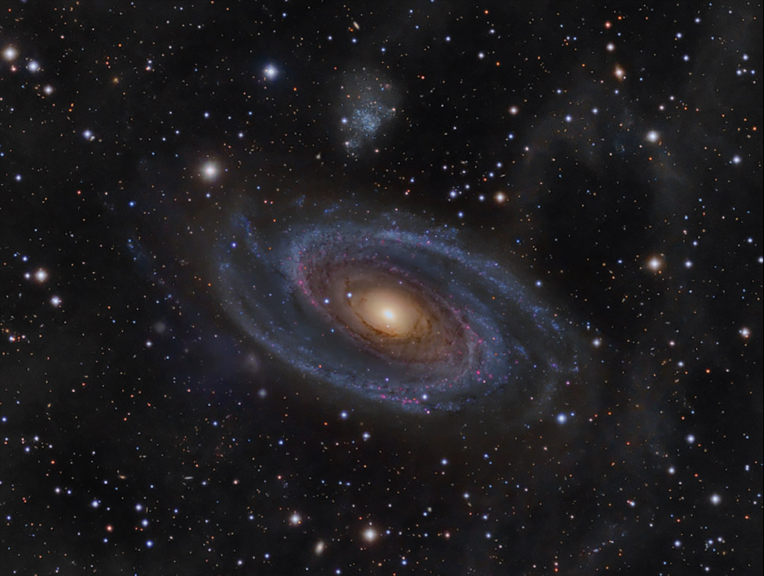
We seek answers to key open questions about nature’s fundamental interactions, such as:
Our mission:
Advancing research in theoretical and experimental physics at the interface of the Energy, Intensity, and Cosmic frontiers.
Why is there more matter than anti-matter in the Universe?
What additional forces were active during the first moments after the Big Bang?
How are protons and neutrons put together?
http://www.physics.umass.edu/acfi/

Slide 3
Activities
Core Research: ATLAS, EXO, J Lab parity & chiral, LIGO, RHIC Spin, Borexino, Theory
Targeted Workshops: Hadronic Probes, Lambda & Quasi Lambda, Higgs Portal,…
Visiting Researchers: Ph.D. students (Australia, China), post-docs, faculty & senior researchers

Slide 4
Upcoming Workshops
Hadronic Probes of Fundamental Symmetries
Joint ACFI-Jefferson Lab Workshop
March 6-8, 2014
U Mass Amherst

Slide 5
Upcoming Workshops
Lambda and Quasi-Lambda
ACFI Workshop
April 10-12, 2014
U Mass Amherst

Slide 6
Upcoming Workshops
Unlocking the Higgs Portal
ACFI Workshop
May 1-3, 2014
U Mass Amherst

Slide 7
Workshops Logistics
Wireless Network: UMASS (usr & pw in packet)
Lunches on Campus: Campus Center or Worcester Dining Commons (~ 5 minutes walk)
Dinners: Thursday in Amherst Center, Friday Workshop Dinner @ Monkey Bar
Schedule
People: students, post-docs, staff

Slide 8
Hadronic Probes: Scientific Questions
What are the possible new opportunities for probing physics beyond the Standard Model (BSM) with low-energy hadronic probes? Special emphasis on rare η decays (GLUE X)
How can refined tests of chiral symmetry sharpen the theoretical interpretation of other low-energy BSM probes? Special emphases on (1) η decays & (2) muon g-2 & hadronic light-by-light

Slide 9
Hadronic Probes: Scientific Questions
What are the key future tests of chiral symmetry that can be performed at Jefferson Lab? Special emphasis on allowed η decays (GLUE X)

