Slide 1
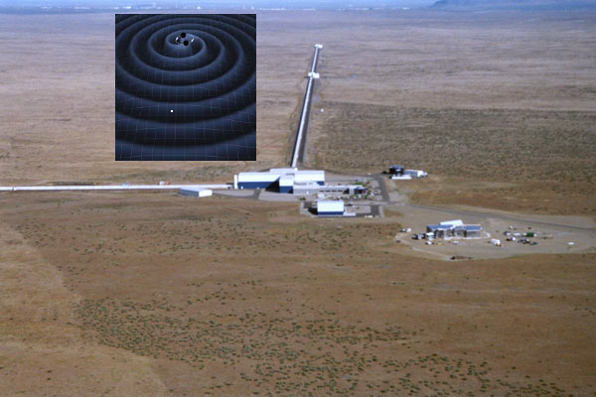
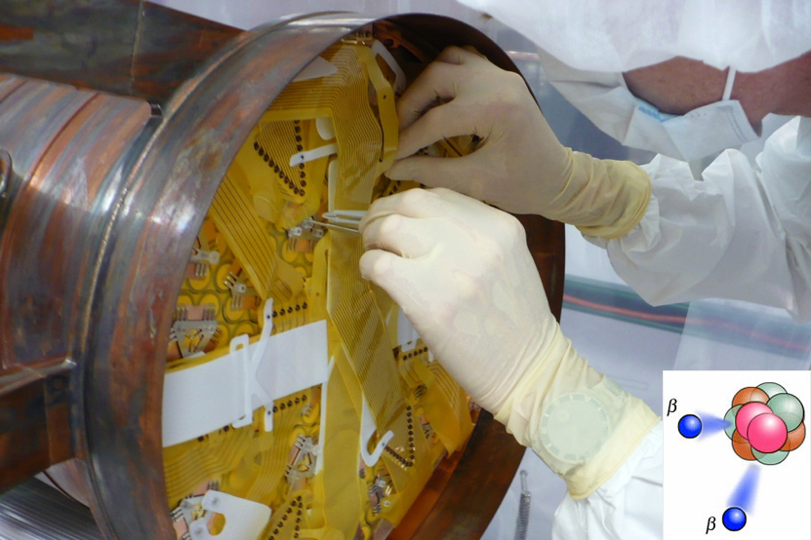
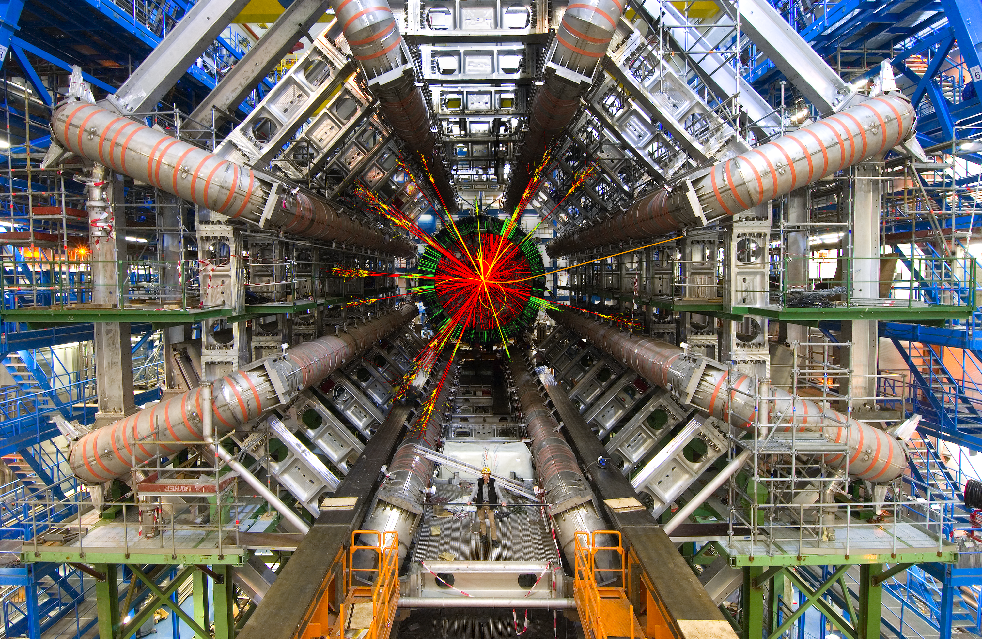
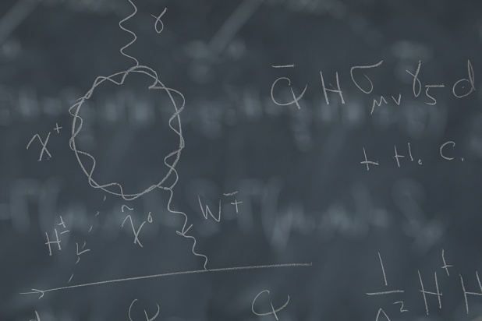
Welcome to the ACFI !
ATLAS
Theory
LIGO
EXO

Slide 2
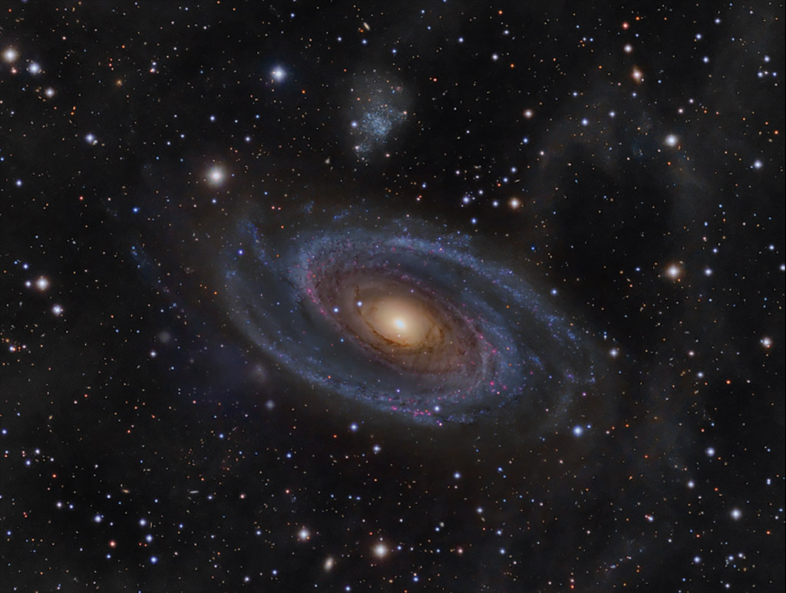
We seek answers to key open questions about nature’s fundamental interactions, such as:
Our mission:
Advancing research in theoretical and experimental physics at the interface of the Energy, Intensity, and Cosmic frontiers.
Why is there more matter than anti-matter in the Universe?
What additional forces were active during the first moments after the Big Bang?
How are protons and neutrons put together?
http://www.physics.umass.edu/acfi/

Slide 3
Activities
Core Research (in house): ATLAS, EXO, J Lab parity & chiral, LIGO, RHIC Spin, Borexino, Theory
Targeted Workshops: Hadronic Probes, Lambda & Quasi Lambda, Higgs Portal,…
Visiting Researchers: Ph.D. students (Australia, China), post-docs, faculty & senior researchers

Slide 4
Past Workshops
Hadronic Probes of Fundamental Symmetries
Joint ACFI-Jefferson Lab Workshop
March 6-8, 2014
U Mass Amherst

Slide 5
Past Workshops
Lambda and Quasi-Lambda
ACFI Workshop
April 10-12, 2014
U Mass Amherst

Slide 6
Past Workshops
Unlocking the Higgs Portal
ACFI Workshop
May 1-3, 2014
U Mass Amherst

Slide 7
Past Workshops
Measuring the Neutron Lifetime
ACFI Workshop
September 19-21 , 2014
U Mass Amherst

Slide 8
Past Workshops
Fundamental Symmetry Tests with Rare Isotopes
Joint ACFI-FRIB Workshop
October 23-25, 2014
U Mass Amherst

Slide 9
Upcoming Workshops
Time-Reversal Tests in Nuclear and Hadronic Processes
ACFI Workshop
November 6-8, 2014
U Mass Amherst

Slide 10
Upcoming Workshops
Hadronic Matrix Elements for Electric Dipole Moments
ACFI Workshop
Winter-Spring, 2015
U Mass Amherst

Slide 11
Upcoming Workshops
International Workshop on Baryon & Lepton Number Violation
ACFI Workshop/Conference
April 26-30, 2015
U Mass Amherst

Slide 12
Meeting Logistics
Wireless Network: UMASS (usr & pw in packet)
Lunch: on campus
Workshop Dinner: Thurs @ Johnny’s Tavern, 6:30 pm Friday: on own in Amherst Ctr
Schedule: online
People: students, post-docs, staff
Espresso !

Slide 13
Workshop Scientific Goals & Questions
What are the compelling opportunities for hadronic and nuclear probes of T- and C-violation ?
Is there a window for relevant new studies of P-conserving T-violation or P-conserving C-violation in light of present & prospective EDM experiments?
What are the new opportunities for hadronic probes of ultralight weakly coupled particles ?
What follow up studies should be undertaken to address these questions ?

