Slide 1
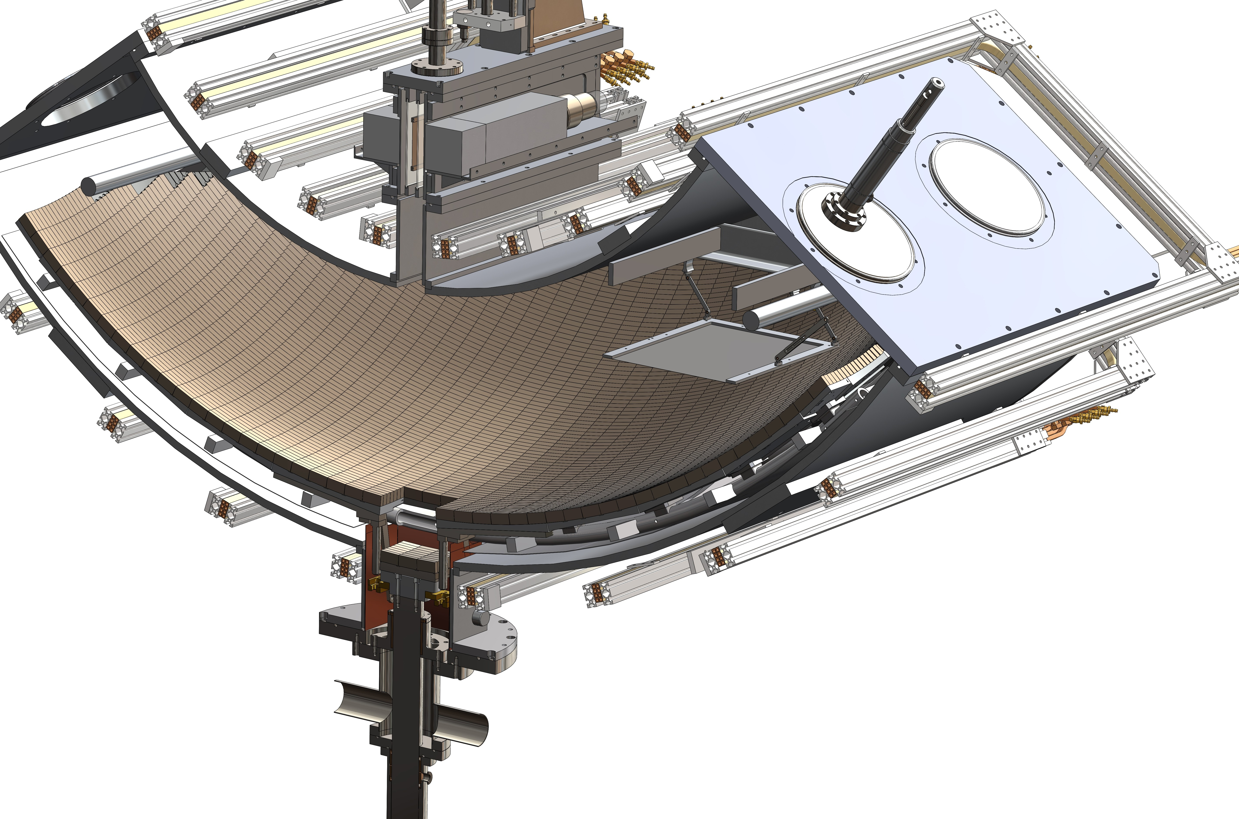

UCNτ Overview
UCN trap with very low intrinsic losses
  Magneto-gravitational trap
  Superposed holding field to eliminate B-field zeros (no depolarization losses)
  Fast removal of quasi-bound UCNs possible through trap asymmetry and field ripple
High statistics are achievable
  Large volume
  In situ UCN detector
    High overall efficiency
    Also: Less sensitive to phase-space evolution than draining
Based on original concept: P.L. Walstrom, J.D. Bowman, S.I. Penttila, C. Morris, A. Saunders, NIMA 599 (2009) 82-92
Notes:
Scale of apparatus: ~2 m.
No material interactions.
No field zeros where Majorana spin flips could otherwise occur.
Mechanism to remove quasi-bound UCNs that would otherwise slowly leak out.
Large volume so statistics are achievable in a reasonable time.
Original concept was to detect betas that are guided by the holding field to detectors at the ends. Tests indicate the background is probably too high for this to be feasible. A new idea (besides the standard method of draining UCN into an external counter) is an “in situ” detector.
Details of prototype construction in next talk.
The prototype will serve as a test bed of the trap concept, detection schemes, and systematic effects.

Slide 2

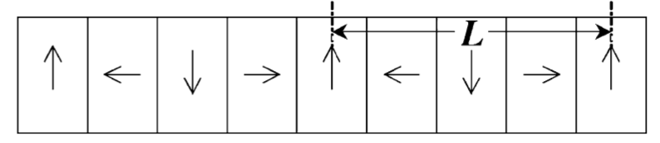
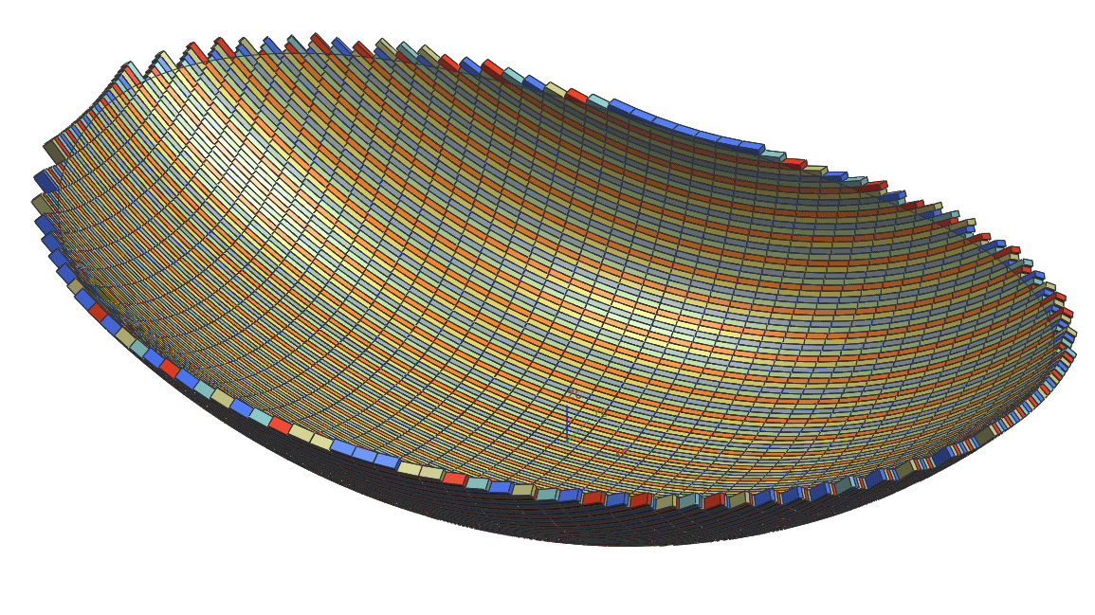
Halbach Array + Holding Field
(if continuous rotation of M)
ζ
Holding field eliminates field zeros
η
d
w
Parameters:
d = 2.54 cm, w = 1.27 cm, B_{rem} = 1.3 T
min. trapping field 0.82 T at 2 mm,
corresponds to mgh = |μ_{n}B| with
h = 0.48 m
Notes:
Exponential fall off of |B| from trap surface: Large effective volume for low-field seeking UCN. External electromagnetic coils provide a holding field everywhere normal to the Halbach array field: no field zeros. Walstrom et al. calculated completely negligible depolarization losses. Recent analysis by Steyrl which accounted for transverse velocities found much higher depolarization loss, but still negligible for a 0.1-s measurement.

Slide 3
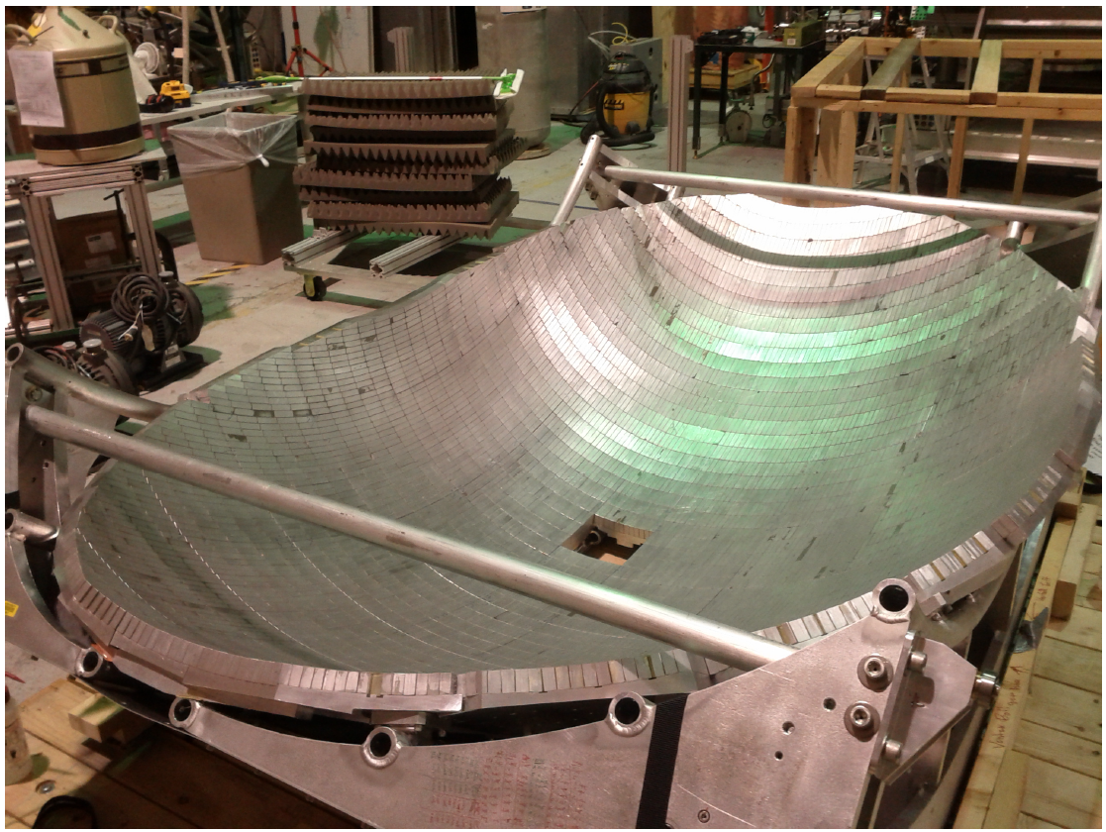
The UCNτ experiment trap is formed by an array of ~5000 permanent magnets forming a “bathtub”

Slide 4
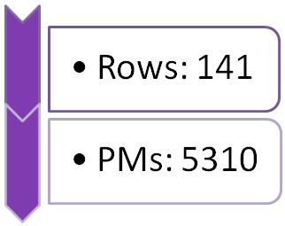

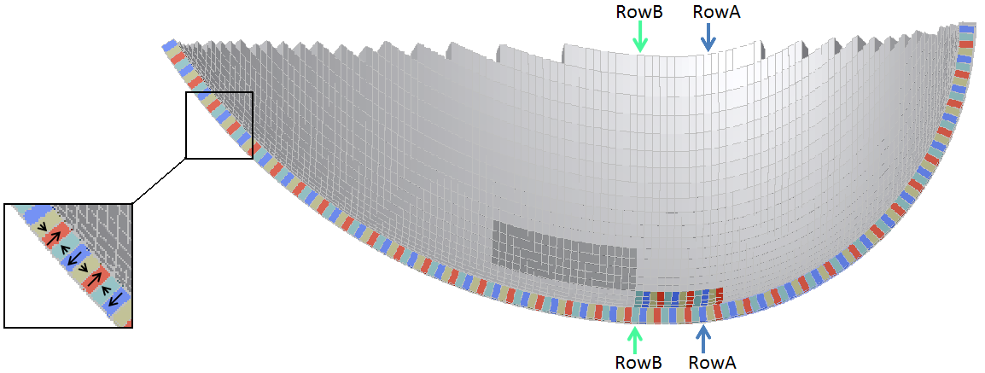
Asymmetric Trap induces Phase Space Mixing
Low symmetry, together with field ripples, enhance states mixing between (quasi)-periodic orbits through chaotic motion.
→ quick cleaning (~ 10s of seconds) of the ‘quasi-bound’ UCN with large tangential velocities.
Adjacent Magnetization
out of phase
PMs in a given row share same M alignment
Higher
Curvature
Two torus patches of different curvatures join along middle row
Notes:
In fact, the main feature, other than the Halbach array, is the asymmetric geometry of the trap.
This asymmetry enhances mixing between periodic orbit, to accelerate the draining of the over-the-threshold, quasi-bound neutrons.
Magnets are lined on inner surfaces of two toroidal patches (with different radius of curvatures) pieced together along the middle row.
We only built the trap to 0.5 m high (due to budget constraint).
UCN trapping potential ≅ 50 neV
H=0.5 m in Earth gravity.
A matching B=0.8 T. (2 mm away from the array surface)

Slide 5
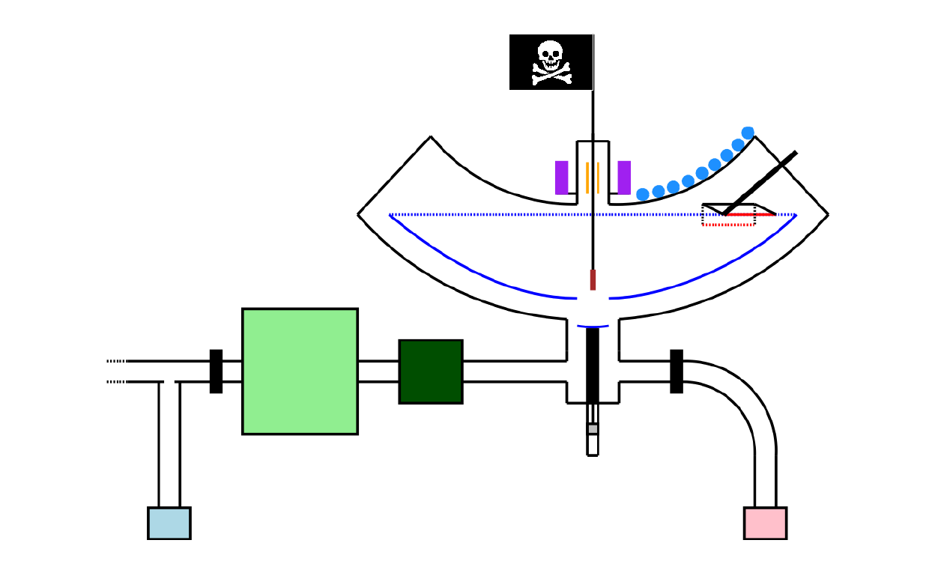
UCNτ Testbed: Magneto-gravitational storage vessel
Halbach array of permanent magnets
No material interactions during storage period
In situ (V-foil activation) or ex situ (fill and dump) neutron detection possible
In situ detector
Halbach array
Cleaner
UCNs
Polarizer
Spin flipper
Al shutter
Ex situ monitor (¹⁰B)

Slide 6
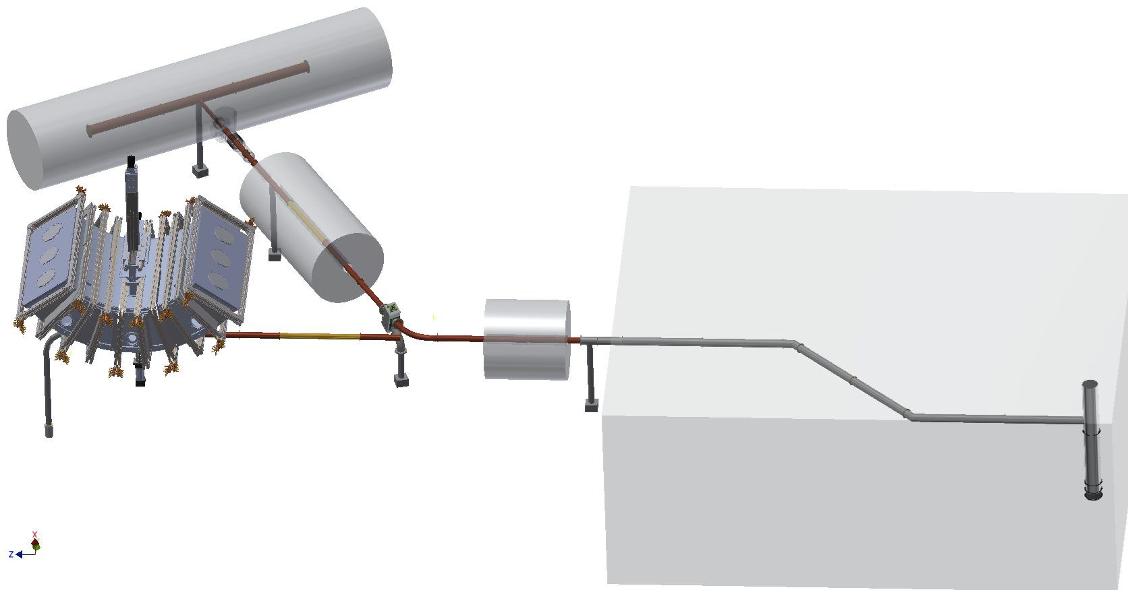
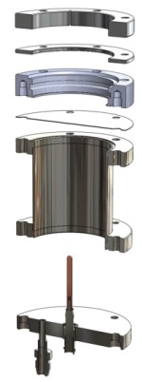
The UCNτ Experiment at LANSCE
UCNA Spectrometer (1 UCN/c.c.)
7T Polarizer Field
Zr Vacuum Separation Foil
Radiation Shielding
Gate Valve (80 UCN/c.c.)
1m
UCNτ Magneto-Gravitational Trap
6T Pre-Polarizer Magnet (PPM)
Gate Valve
³He UCN Detector
UCNτ
¹⁰B UCN Detector
UCN SD₂ Source
Spallation driven by LANSCE 800 MeV proton accelerator
Notes:
The UCNtau experiment shared the UCN beam with the UCNA/B experiment.
Polarized UCN come down the guide after the pre-polarizing magnet. A spin-flipper was used to turn them into the low field seekers, that can be loaded inside the UCNtau trap.
We used various UCN flux monitor to measure the UCN flux, that will be used for N₀ normalization.

Slide 7
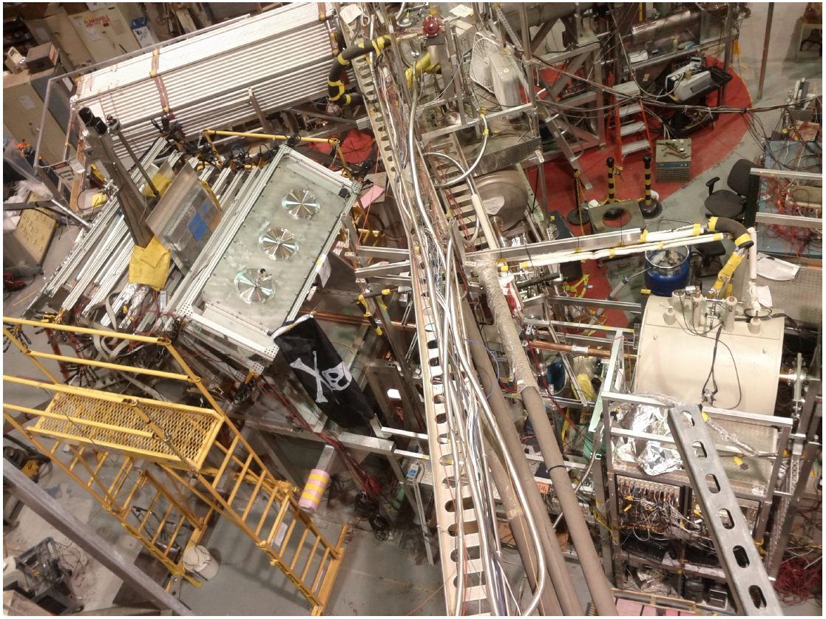
The UCNτ experiment is installed in the UCN facility at Los Alamos’s LANSCE accelerator

Slide 8
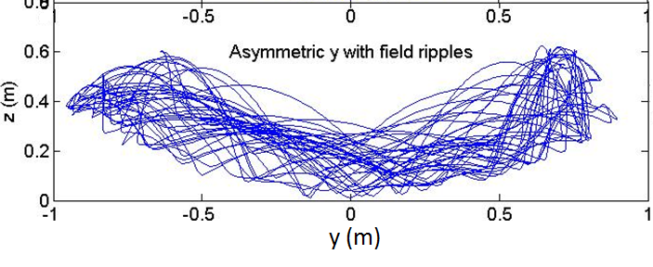
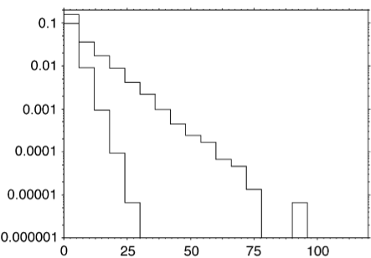
Removal of “Quasi-bound” UCNs
Quasi-bound (superbarrier) UCNs have energy above the trap potential but leak out slowly.
Trap asymmetry + field ripple from the array induces phase-space mixing.
An absorber placed near the top of the trap quickly removes the superbarrier UCNs.
Movable Absorber for trap “cleaning”
Simulation of trap cleaning
[Walstrom et al., NIMA 599 (2009) 82-92.]
h_{clean} = 44 cm
h_{clean} = 42 cm
Absorption time (s)
Notes:
An absorber is lowered into the trap after filling, then retracted after some period << tau_n. Ideally the absorber covers the entire trap. In reality covering just part of the trap near one side may be good enough. (The trajectories shown are actually from Chen-Yu’s simulation.) [Key points: UCN are a non-interacting gas (non-ergotic); phase-space evolution; quasi-bound orbits and how that affects the measurement.]

Slide 9

Measurement Cycle
Load the trap
Remove quasi-bound UCNs
Hold UCNs in the trap for time t
Count the surviving UCN population N
Using two different cycles with holding times t₁ and t₂,
Statistically most efficient if t₂≈t₁+2.2τ_{n}; then
UCN absorber
Trap door
UCN
Al shutter
UCN monitor
Notes:
Explain “Holding time” vs. “Storage time”.
N1 and N2 must be normalized to the initially trapped population (post-cleaning), and detection efficiency must be the same for both cycles.

Slide 10
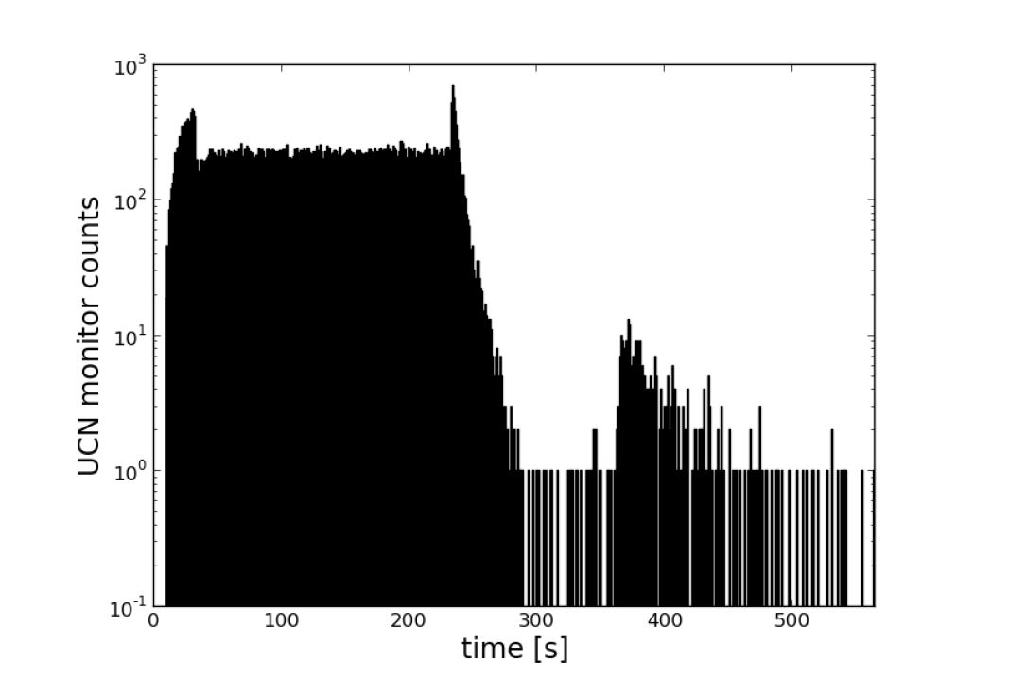
“Fill and dump” measurement cycle: UCNs detected in ex situ monitor
0
1
2
3
4
5
6
0: Start UCN flow: beam on, shutter open, trap door open; cleaner inserted
1: Shutter closes
2: Filling and cleaning; superbarrier UCNs to monitor
3: Trap door closes, shutter opens; beam off; UCNs in guide to monitor; cleaning
4: Cleaner retracted; storage begins
5: Storage
6: Trap door opens; UCNs in trap to monitor

Slide 11
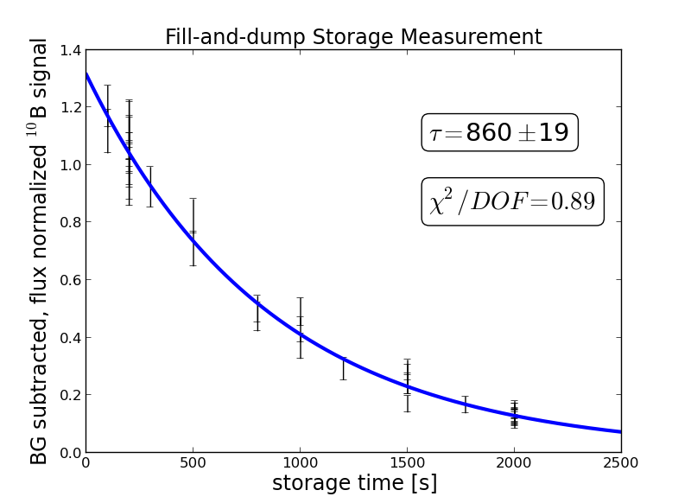
First Storage Time Data (Feb. 2013)
(Draining method)
τ = 860 ± 19 s
Salvat et al., PRC 89, 052501 (2014).

Slide 12
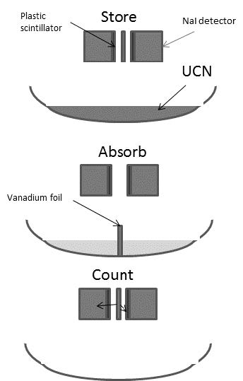
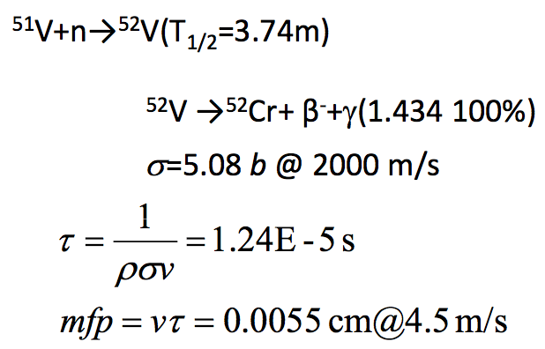
Alternative to Draining: in situ Detection
Plastic scintillator
Store
Draining time could depend on holding time, causing systematic error.
In situ detection avoids transport losses to external detector.
A candidate in situ detector for UCNτ is based on neutron absorption on vanadium.
Comparing lifetime measurements with the two methods could expose an otherwise elusive systematic effect.
NaI detector
UCN
Absorb
V foil
Count
Notes:
Details in CY talk.

Slide 13
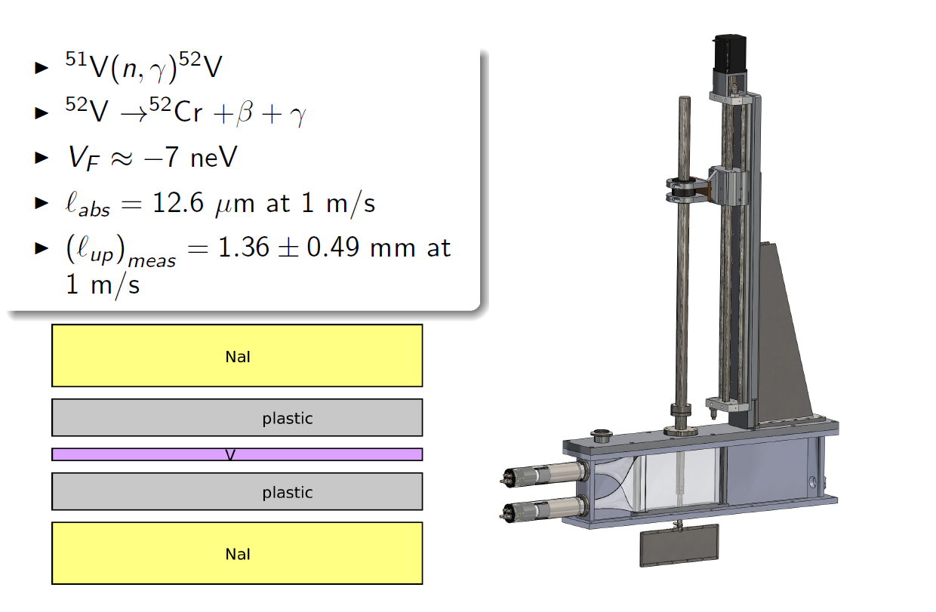
The next step: in situ detection of surviving neutrons

Slide 14
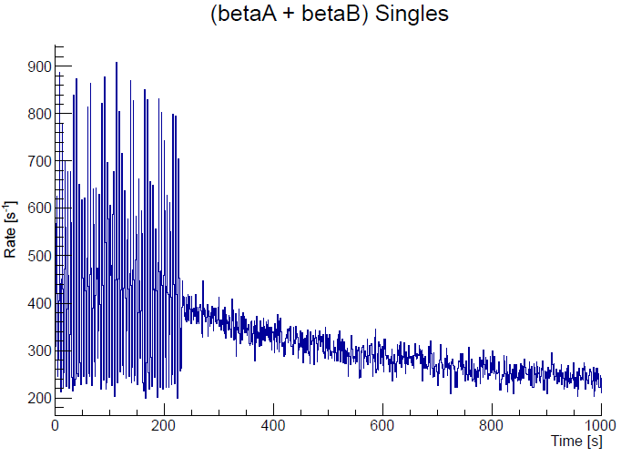
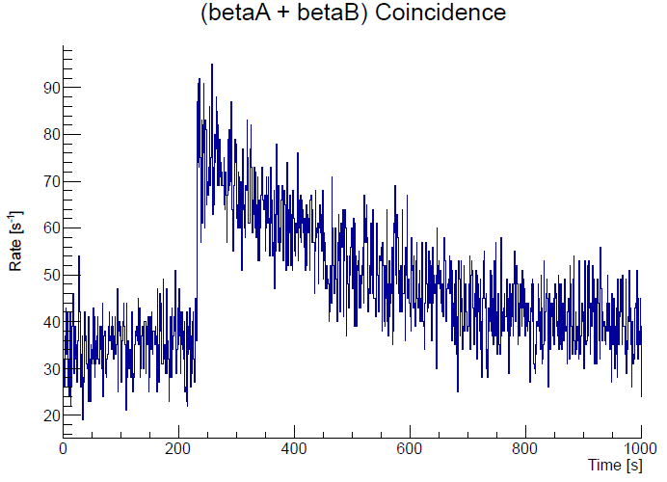
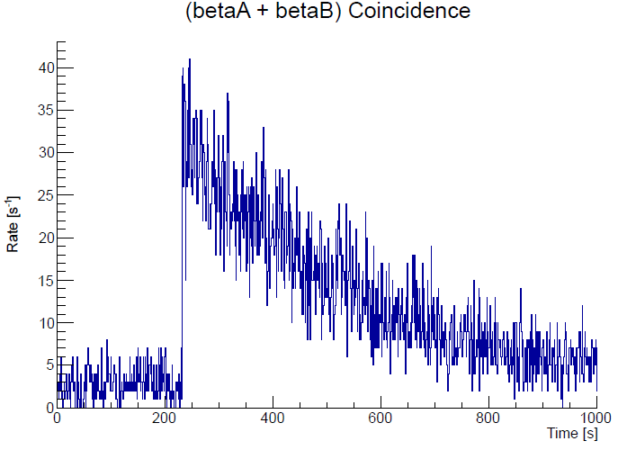
Beam On
Beam Off
anti-coincidence w/ other beta
a pulse-height cut on the beta spec.
Coincidence w/ NaI
S/N= 2.28
ε_{β}=0.8
ε_{γ}=0.3
Cut Criteria:
beta event is not coincident with a beta event in the other detector
beta event pulse-height (460~8000).
beta event is coincident with an NaI event
NaI event a pulse-height (2500~3500)
S/N= 10
ε_{β}=0.8
ε_{γ}=0.21
Notes:
Currently, we are optimizing the detector performance to increases the S/N ratio, without sacrificing the signal rate.
With the V detector working, we can perform meaningful studies on the
time-dep. BG
N₀ Normalization
The evolution of the UCN energy spectrum, by placing V at different height at the end of different storage time.

Slide 15
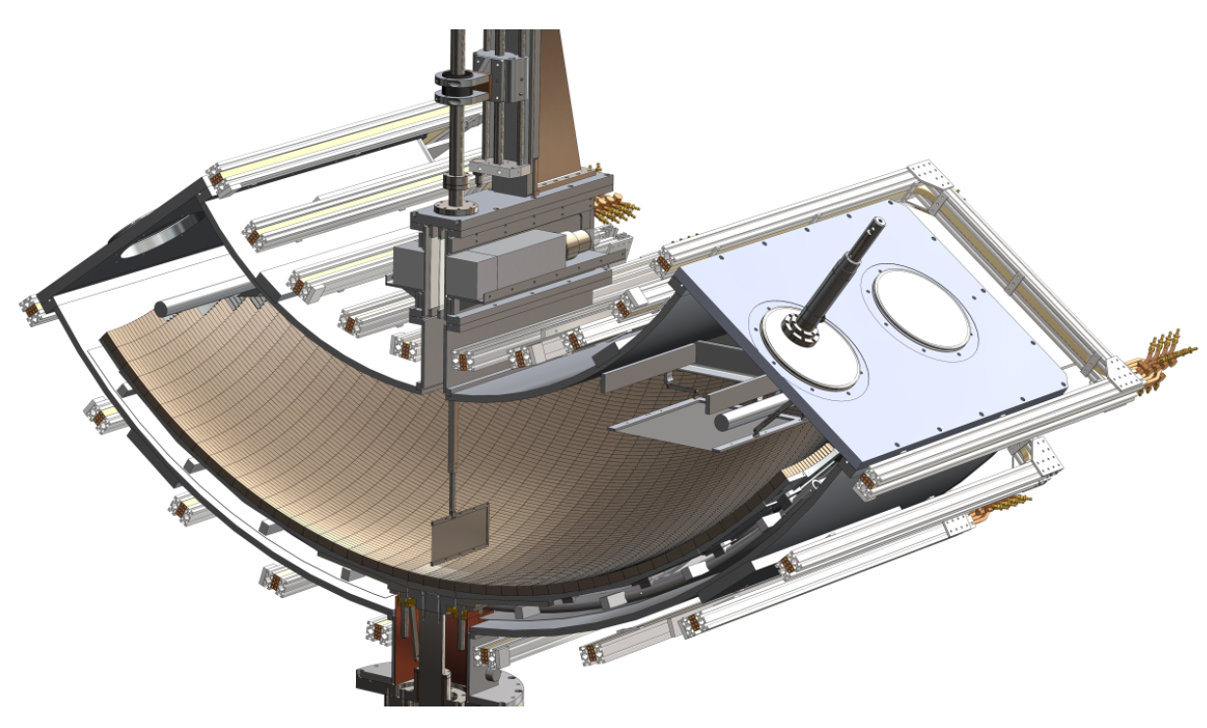
The neutron absorber/detector in the lowered position

Slide 16
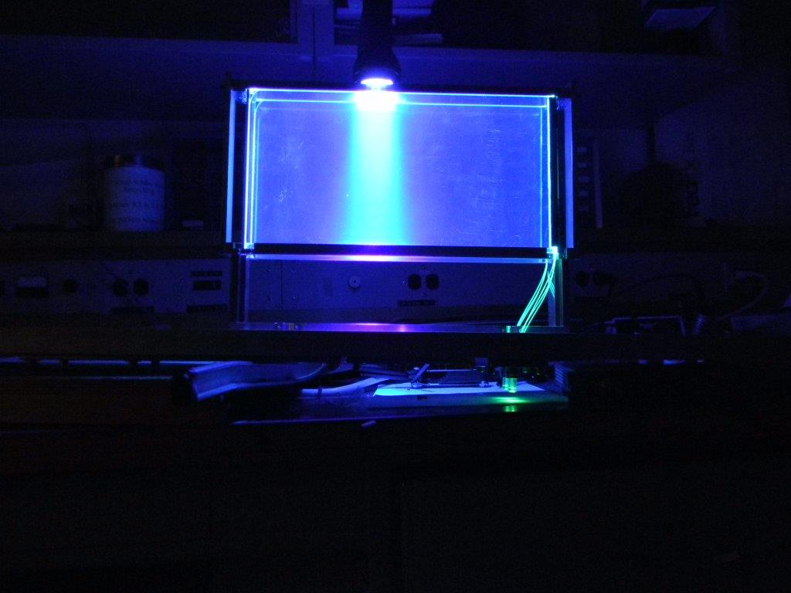
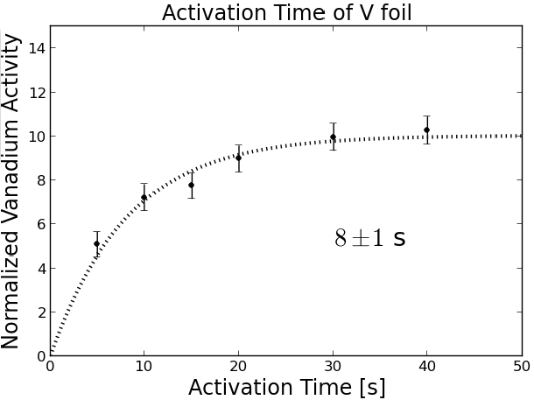
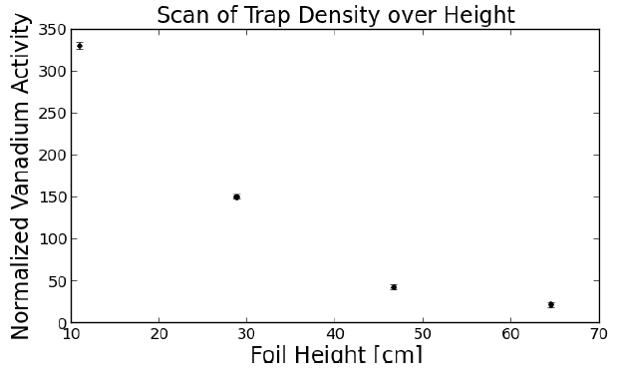
The V absorber can rapidly count all the neutrons in the trap
Absorption time is at least an order of magnitude less than trap draining time
Can be reduced further by installing larger V foil, also testing systematic variations
Absorber can be positioned at different heights in the trap
Distribution of neutrons can be compared to MC models
Efficiency of cleaning can be tested by positioning foil above cleaning height

Slide 17
Anticipated Statistical Reach
With present LANL source performance, we estimate up to ~10⁵ UCN per fill (0.2 UCN/cc density).
Assume 50% detection efficiency: then ~50,000 detected UCN per fill.
Assume 3800 s per complete τ_{n} measurement (two complete cycles: one short, one long)
  Cycle time includes filling, cleaning, holding, and detection times.
Result: 44 hours live time required for δτ_{n}/τ_{n} ~ 0.1% (i.e., ~1 s statistical precision).
Enables precision studies of systematics.
Notes:
If trap loading can be made very efficient. Need long guide lifetimes and low depolarization on the way into the trap. Projection based on experience acquired with UCNA. [Don’t read details; just conclusion. …this makes it possible to study systematics with precision.]

Slide 18
Short-term UCNτ R&D Goals
Statistics:
  Can we load enough UCNs into the trap?
  Can we detect surviving UCNs efficiently?
Systematics:
  Can we clean quasi-bound UCNs sufficiently?
  Can we accurately normalize the initial (cleaned) UCN population?
  Are there losses in the trap (e.g., heating or spin-flips)?
  Can we detect surviving UCNs without bias?
Our longer-term approach:
  Study the existing prototype apparatus to determine its ultimate reach.
  Explore possible upgrades to the existing prototype, or new ideas relevant for a next-generation experiment.
  Study systematic effects relevant for a next-generation experiment (e.g., by exaggerating an effect so it’s discernable at ~1-second precision).
  Develop high-fidelity UCN simulations to evaluate new designs.
Notes:
Ultimate precision of prototype: probably at least ~1 second; what’s the limiting factor? Statistics? Some systematic effect that can’t be sufficiently characterized? Example possible upgrades to the prototype: active in-situ detector (to remove absorption-time and background issues); new ideas for UCN population normalization. Mention R&D proposal here?
Note from Mark on how to study heating: “The way heating has been studied in the past is by watching UCN boil out of an open topped vessel after it is cleaned down to some level. For the lifetime trap I proposed using an active cleaner as a detector. So first clean the trap to some depth. Then after varying amounts of time drop the cleaner back in and look for signals above the cleaned level. This could be done while manually adding vibrations to the system at different amplitudes and frequencies. You would also want to add electronic noise to the holding field and look for heating the same way.”

Slide 19
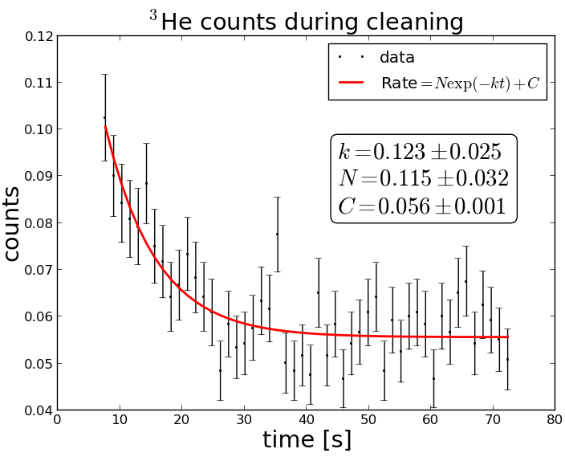
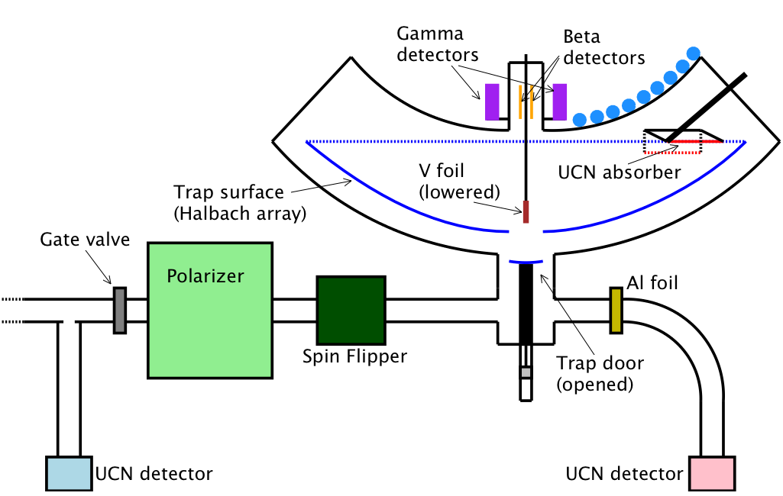
Study Cleaning of Quasi-bound UCNs
Proof of principle detection of upscattering was done.
Things to be studied include:
  How to improve upscatter detection efficiency and background.
  Varying cleaner height and material
  Computer simulations of UCN trajectories in the trap
  Intentionally load a harder UCN spectrum; check for effect on storage time measurement.
³He detectors
Notes:
Some 3He drift tubes were instrumented for first test run. We could e.g. look for any long-lifetime component in the observed upscattering time spectrum. Quasi-bound cleaning is a topic of Mark’s EC proposal.

Slide 20
Timeline
FY9 | FY10 | FY11 | FY12 | FY13 | FY14 | FY15 | FY16 | FY17 | FY18 | FY19 | FY20 | FY21
Improved τ
~ 1 sec τ
DAQ
UCN Depol
UCN Heating
UCN Cleaning
UCN Storage
Detectors
UCN Transport
Trap Design & Construction
Simulations
Simulations
Notes:
Simulations 1,2 5 13
Trap Design& Construction 2 4
UCN Transport 5 8
Detectors 5 8
UCN Storage6 8
UCN Cleaning 7 9
UCN Heating 7 9
UCN Depolarization7 9
DAQ 7 9
~1 sec Lifetime Measurement 8 10
Improved Lifetine 9 13

Slide 21
Anticipated R&D Milestones
Milestone | Due Date
Demonstrate working vanadium detector and neutron transport simulations. | FY2015 Q1
Achieve sufficient UCN density in the trap for rapid 1 s measurements and an ultimate sub-1 s measurement. | FY2016 Q1
Complete DAQ for 1 s measurement; plan for control of all sub-1 s systematics. | FY2017 Q1
Publish 1 s measurement. | FY2017 Q3
Submit sub-1 s construction project proposal (if necessary). | FY2017 Q4
Notes:
If no Mark EC award, the schedule will have to be delayed.

Slide 22
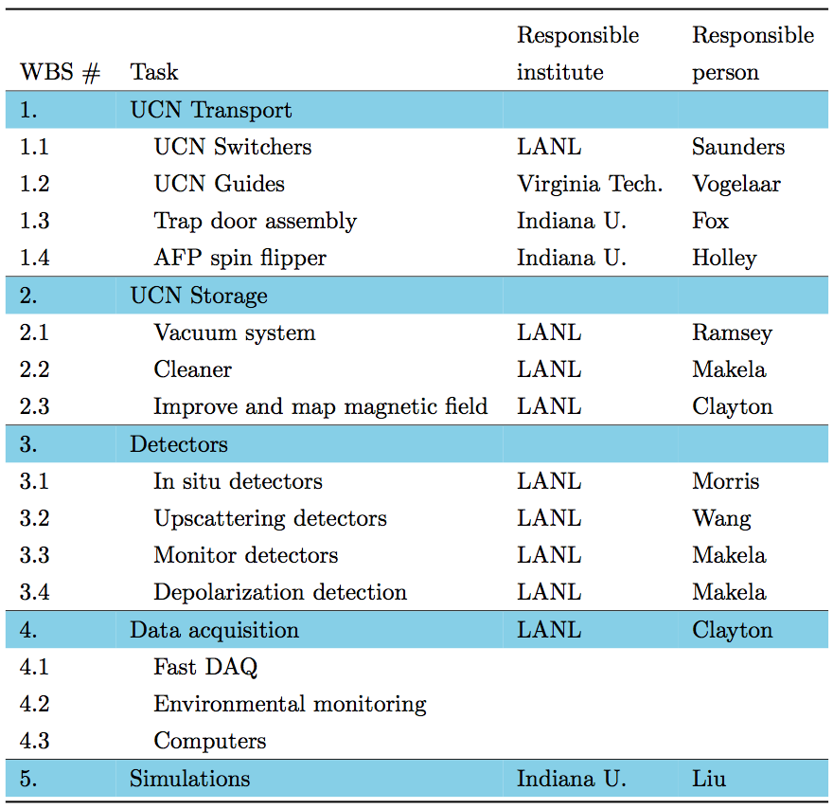
High-level WBS for R&D Effort
Notes:
The “Responsible Person/Institutes” may change for some tasks; we’re discussing this within the collaboration. Furthermore, we are actively recruiting new members to the collaboration [who have we approached?]; the R&D proposal document will serve as a convenient way to explain the R&D effort to a potential new collaborator.

Slide 23
UCNτ Collaboration
DePauw University
A. Komives
Hamilton College
G. Jones
Indiana University
E. R. Adamek, N. B. Callahan, W. Fox, C.-Y. Liu, D. J. Salvat, B. A. Slaughter, W. M. Snow, K. Solberg, J. Vanderwerp
JINR
E. I. Sharapov
LANL
D. Barlow, M. Blatnik, L. J. Broussard, S. M. Clayton, T. M. Ito, M. Makela, J. Medina, D. J. Morley, C. L. Morris, R. W. Pattie, J. Ramsey, A. Saunders, S. J. Seestrom, S. K. L. Sjue, P. Walstrom, Z. Wang, T. L. Womack
North Carolina State University
C. Cude-Woods, E. B. Dees, B. vornDick, A. R. Young, B. A. Zeck
ORNL
J. D. Bowman, S. I. Penttila
Tennessee Tech.
A. T. Holley
UCLA
K. P. Hickerson
Virginia Tech
X. Ding, B. Vogelaar
And special thanks to S. Clayton, C.-Y. Liu, and D. Salvat

Slide 24
Extra Slides

Slide 25
Possible budget scenarios
Shifting from LANL Internal to DOE R&D to DOE Project
Development -> 1 s -> sub 1 s
DOE operations contributes to running UCN source

Slide 26
Test setup (Feb. 2013)
Not shown: holding field coils
Al shutter
UCN

Slide 27
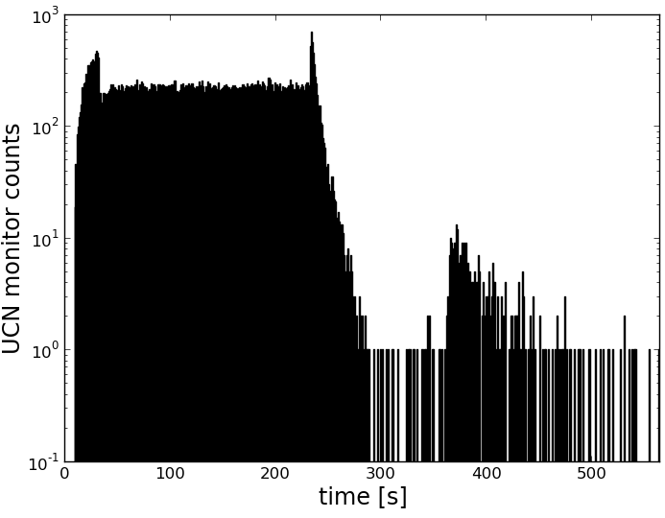
Fill-and-Empty Measurement
UCN absorber
UCN
Al shutter
UCN monitor
Notes:
Get rid of this sequence.

Slide 28
Fill-and-Empty Measurement
UCN absorber
Close shutter
UCN
Al shutter
UCN monitor

Slide 29
Fill-and-Empty Measurement
UCN absorber
Beam off, close trap door, open shutter
Close shutter
Al shutter
UCN monitor

Slide 30
Fill-and-Empty Measurement
UCN absorber
Beam off, close trap door, open shutter
Raise cleaner
Close shutter
Al shutter
UCN monitor

Slide 31
Fill-and-Empty Measurement
UCN absorber
Beam off, close trap door, open shutter
Drain trap
Raise cleaner
Close shutter
Storage time
Al shutter
UCN monitor
Notes:
In this first UCNs data: loading efficiency is obviously not good. This is an R&D topic.

Slide 32
Fill-and-Detect Measurement
β and γ detectors
UCN absorber
Beam off, close trap door, open shutter
Raise cleaner
Close shutter
Al shutter
UCN monitor

Slide 33
Fill-and-Detect Measurement
β and γ detectors
UCN absorber
Beam off, close trap door, open shutter
Lower V foil, then raise V foil into det.
Raise cleaner
Close shutter
Storage time
Al shutter
UCN monitor

Slide 34
Fill-and-Detect Measurement
β and γ detectors
UCN absorber
Beam off, close trap door, open shutter
Lower V foil, then raise V foil into det.
Raise cleaner
Close shutter
Storage time
Al shutter
UCN monitor

Slide 35
Fill-and-Detect Measurement
β and γ detectors
UCN absorber
Beam off, close trap door, open shutter
Lower V foil, then raise V foil into det.
Raise cleaner
Close shutter
Storage time
Al shutter
⁵²V Decays (simulated)
UCN monitor
Time
Notes:
Replace 52V decay plot with simulated data, rather than show the data w/out the coincidence cut; we can fit exponential decay to get the initial number of parents and thus the number of absorbed UCNs.

Slide 36
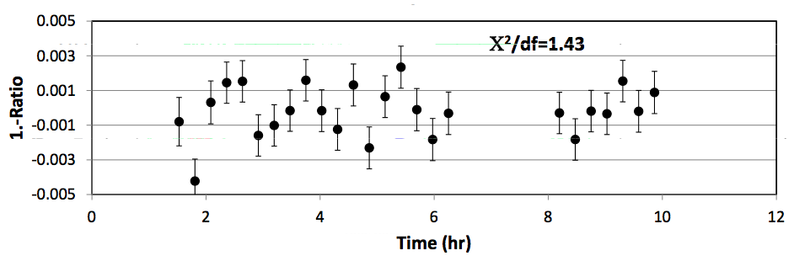
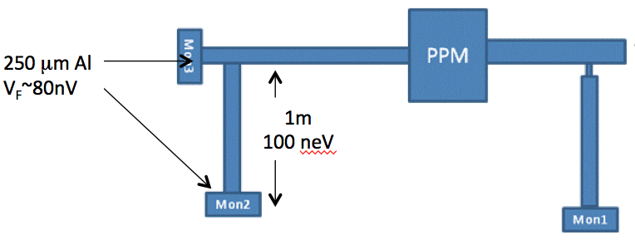
R&D for Trap Population Normalization
Test of UCN beam spectral stability:
Stability on the 0.1% level appears straightforward, but
How well does this test relate to the trapped population?
Further tests:
Implement a higher-resolution spectrum monitor
Test correlation of external monitors with post-cleaning trapped population (e.g., do many measurement cycles with the same holding time).
Use vanadium detector positioned at the top of the trap to count superbarrier UCNs; check if this can be a reliable normalization method.
From source
1000 second bins, linear drift
Notes:
Test was effectively a very low resolution (3-level) spectrometer. Not sensitive to e.g. changes in polarization fraction or anything else that might affect the trap loading efficiency. Topic of Mark’s EC proposal.

Slide 37
Study UCN Depolarization in the Trap
Can be data-driven:
  Compare 1-s lifetime measurements with
    holding field reduced;
    different trap surface coatings (copper vs. a UCN absorber?);
Active trap surface to directly detect high-field seekers?
Map the B-field inside the trap; run computer simulations of UCNs in the measured field (requires high-fidelity simulations).
Notes:
Topic of Mark’s EC proposal.

Slide 38
Develop High-Fidelity UCN Simulations
Two types of simulations
  Transport: track UCNs from the source to see how many trappable UCNs (low-field-seeking, sub-barrier) make it into the trap.
  Motion in Trap: track UCNs (position, polarization) within the trap for long periods (>2.2τ_{n}).
    Study phase-space evolution, Cleaning, Depolarization, Detection.
    High statistics may be required for subtle effects.
Strategy: develop high-fidelity simulations and validate them with measurements (e.g., with experimental parameters that enhance a systematic effect).
Long-term Goal: develop a predictive capability to reliably evaluate new designs before construction.
Notes:
Led by Indiana University contingent. Re long-term goal: “new designs” could be for a novel detector, a new cross assembly, different trap geometry, different holding field, etc.

Slide 39
R&D Scenarios for a Sub-1 s Experiment
We find systematic errors in the existing prototype can controlled to a level <0.01%, and loading efficiency is adequate.
  Proceed with sub-1 s measurement.
Same as 1, but we find the loading efficiency can not be improved enough for the desired statistical precision.
  Look for much more intense UCN source (if any successfully come online…)?
Same as 1, except we find some limiting systematic with the in situ vanadium detector technique (e.g., too sensitive to background drifts).
  Devise alternative in situ detector.
We find the UCNτ method is sound, but major modification to the existing apparatus (or an entirely new apparatus) is required.
  Design an improved UCNτ apparatus.
We find some fundamental problem with the UCNτ concept.
  Study alternative experimental concepts; use computer simulations to evaluate them.
Notes:
Delete. Scott will cover this.

Slide 40
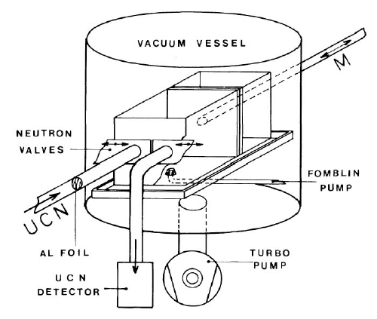
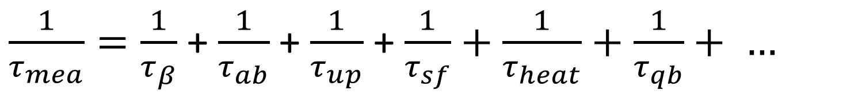
Neutron Trap Experiments
Mambo (Mampe’s bottle)
Fomblin Oil
Vary V/A ratio
Mambo II: prespectrum
Measures the Storage Time
+ + +
Notes:
There are two ways to measure the neutron lifetime, however the averaged results from the two methods don’t agree with each other. The difference is larger than the error bars quoted by each class of experiment.
In this talk, I will focus on the means to trap low-energy neutrons, and measure its exponential decay time constant to infer the beta-decay lifetime.
The trouble is the neutron lifetime is just long enough, which is 15 mins, that its environment also impact strongly in how long they can live.
Neutrons can be absorbed by other nuclide, scattered and heated to gain enough energy to escape the trap, and there are also the subtle effect of the slow escape of quasi-bound neutrons that obscure extraction of the true beta-decay lifetime.

Slide 41
International competition in UCN production
Courtesy: O. Zimmer
Source location | Source type | UCN density [cm⁻³] | comment | when?
ILL Grenoble, PF2 | LD₂ + turbine | 50 | still THE source | > 1985
Los Alamos, 2.4 kW_{av} proton | SD₂ | 120 | in source | now
Mainz TRIGA upgraded | SD₂ | 20 ∼ 200 | in V = 10 l | now 2009
ILL Grenoble, H172 upgraded + magnetic trap | He-II (0.5 K) | > 1000 2000 polarised | in V = 6.4 l up to 40 l | 2009 > 2011
PSI, 12 kW_{av} proton | SD₂ | > 1000 | in V = 2000 l | 2010
North Carolina, 1 MW reactor | SD₂ | 1300 | in source | 2011
Munich, 20 MW reactor | SD₂ | ∼ 10000 | in source | 2011
PNPI, 16 MW reactor | He-II (1.2 K) | 13000 7700 | in 35 l exp. bottle in 350 l exp. bottle | 2012
TRIUMF, 5 kW_{av} proton | He-II (0.8 K) | 18000 | at exp. port | proposal
+ insitu He-II UCN sources at ILL (Cryo-EDM), NIST (n-lifetime), and SNS (EDM)

Slide 42
C. Y. Liu: UCNτ Systematics

Slide 43
Systematic Effects in the next Bottle Experiment
Chen-Yu Liu
Neutron Lifetime Workshop
Amherst
9/19/2014

Slide 44
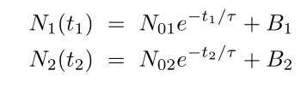
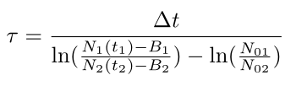

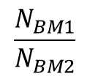
Bottle Technique
Survived UCN:
Measured by a UCN detector.
Lifetime extracted from the two-point measurement:
Equilibrium # of UCN in the trap:
inferred by a beam monitor (BM).
$$\frac{N_{BM1}}{N_{BM2}}$$
Unpolarized
All E
Response time ~ 10m/(5m/s)~ 2 s
polarized
E < Ec
Response time ~ fill time~ 200 s
e_{p}: polarization efficiency
e_{g}: geometrical efficiency
e_{e}: energy efficiency

Slide 45
“Fill and dump” measurement cycle: UCNs detected in ex situ monitor
0
1
2
3
4
5
6

Slide 46





Normalization
Does the BM measure the right thing?
a geometrical factor:
Not exactly ¼.
For constant flux ψ(t) = ψ₀
Fill time constant:
: equilibrium number of UCN in the trap

Slide 47

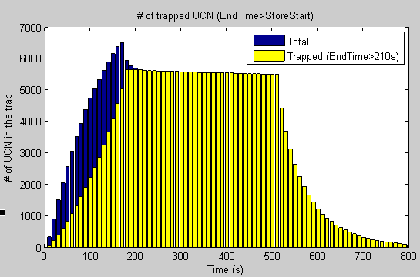
A Proper Normalization Scheme
ψ(t) right before the trapdoor closes weigh more heavily to the trapped population.
A simulation result:

Slide 48
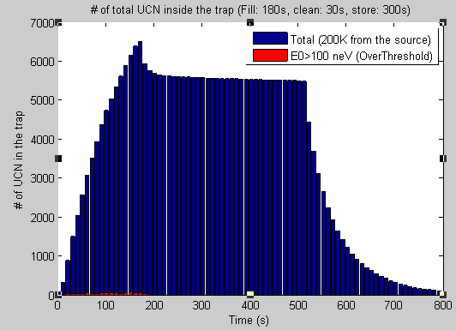
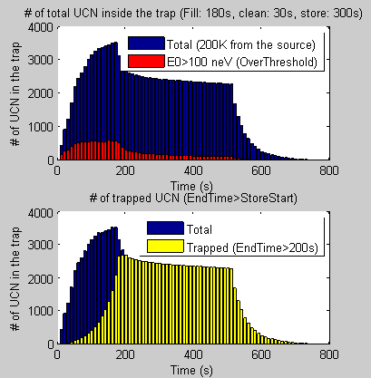
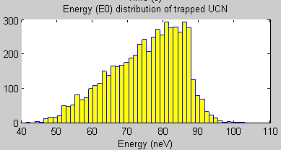
Monte-Carlo Simulations
Another geometry with more quasi-bound neutrons:

Slide 49




Quasi-bound Neutrons
If the QB neutrons are not sufficiently cleaned, they will leak out of the trap with its own characteristic time constant τ_{qb}. The resulting correction time is:
t₂ = 2000 s
t₁ = 200 s
ε = 0.01
To limit Δt < 0.1 s for all τ_{qb} ,
need ε < 3e-4
Δt = 0.1 s

Slide 50
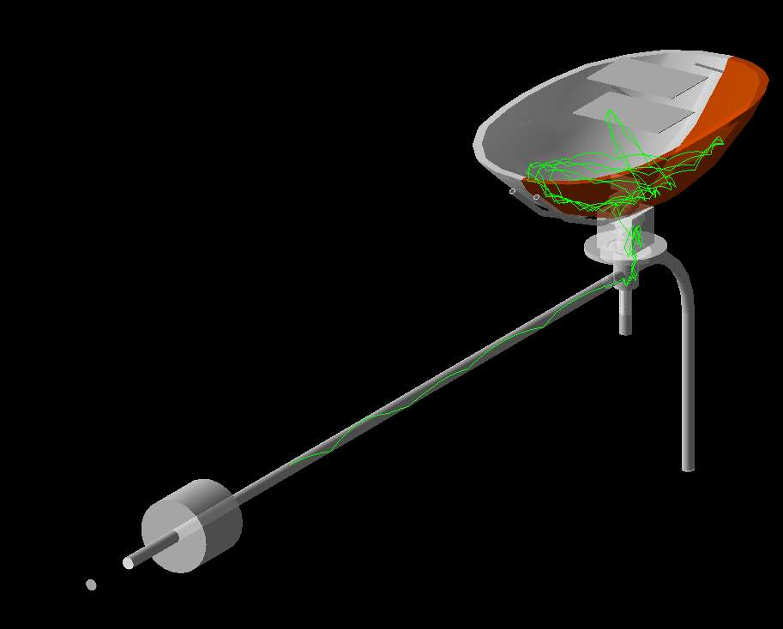
For UCN, the Halbach trap serves as a perfect mirror-like reflecting surface.
→ Typical intuition with gas diffusion does not work.

Slide 51
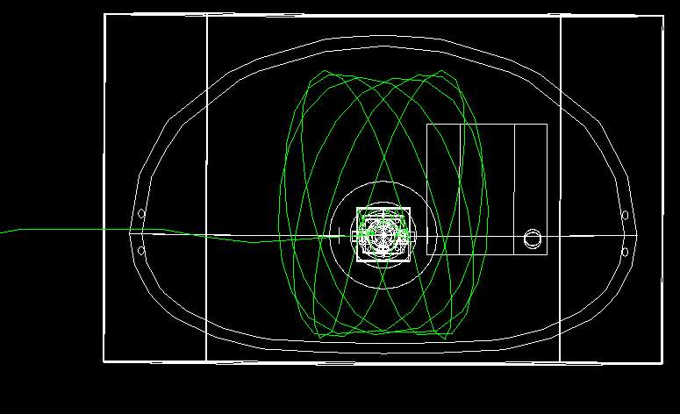
Easy in, easy out
Qausi-periodic trajectories

Slide 52
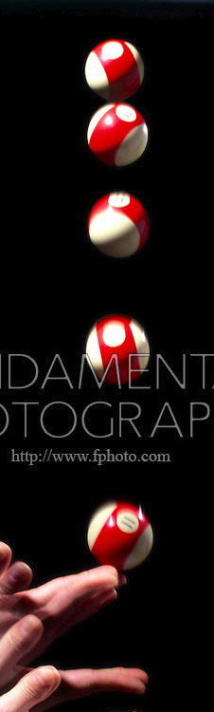
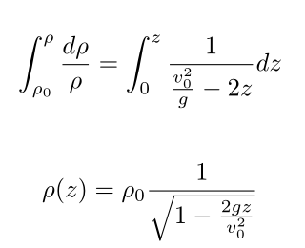
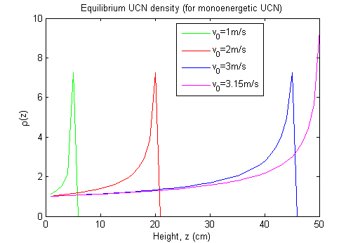
UCN density vs. Height
For mono-energetic UCN:
ρ₀

Slide 53
UCN Spectrum (C. Morris)
v³dv distribution, due to absorption and
other losses in a thick D₂ source.
Raise the experiment by 1 m
SS guide: 190 neV

Slide 54
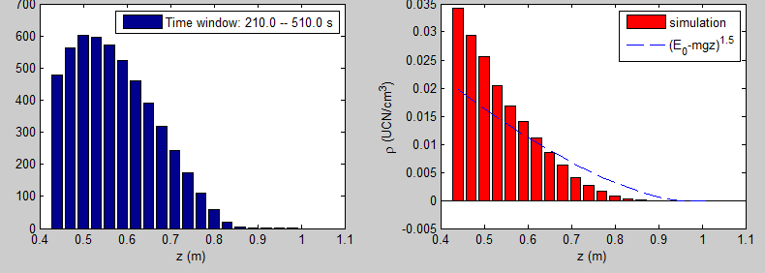
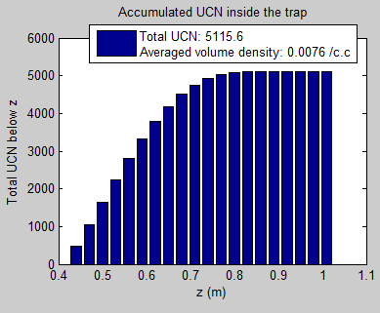
UCN Density inside the Trap
Factor to 3.3
A major UCNtau goal in 2014:
- Up the UCN statistics
  100,000 trapped inside the trap.
  1 UCN/c.c. at the trap door opening, → 0.3 UCN/c.c averaged inside the trap.

Slide 55

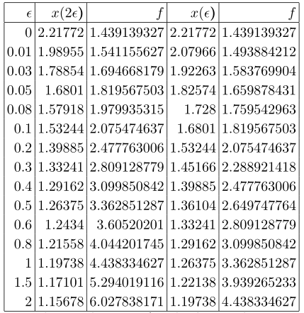
Sensitivity Optimization (with a constant BG)
Background subtracted signal
x = Δt/τ = (t₂-t₁)/τ
No BG
Constant background:
B₁= B₂ = ε N₀
S/N = 1

Slide 56
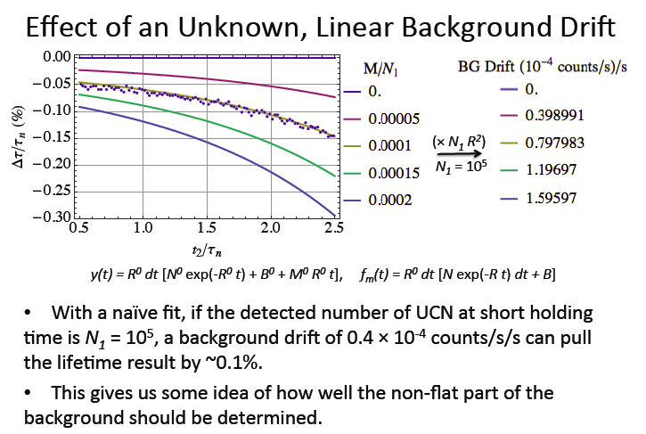

Slide 57
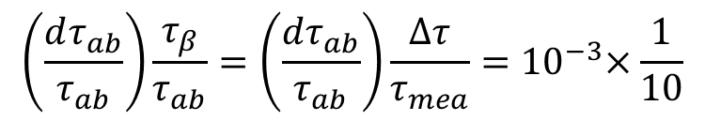
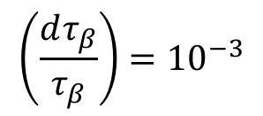



How well to measure each non-beta-decay loss?
$\frac{1}{τ_{mea}}=\frac{1}{τ_{β}}$ +$\frac{1}{τ_{ab}}$ + $\frac{1}{τ_{up}}$ + $\frac{1}{τ_{sf}}+\frac{1}{τ_{heat}}+\frac{1}{τ_{qb}}+ …$
Each loss is a new degree of freedom, so this is a vector sum.
$$\left(\frac{dτ_{β}}{τ_{β}}\right) =\sqrt{{\left[\left(\frac{dτ_{mea}}{τ_{mea}}\right)\frac{τ_{β}}{τ_{mea}}\right]}^{2}+{\left[\left(\frac{dτ_{ab}}{τ_{ab}}\right)\frac{τ_{β}}{τ_{ab}}\right]}^{2} + … }$$
To achieve a correction time of 1 s:
Set to be 1/10 of the desired uncertainty.
$$τ_{β}−τ_{mea}=∆τ=1 s$$
$τ_{ab}=\frac{τ_{mea}τ_{β}}{τ_{β}−τ_{mea}}=\frac{τ_{mea}}{∆τ}τ_{β}≈ {10}^{6}s$
12 days!
$$\left(\frac{dτ_{β}}{τ_{β}}\right)={10}^{−3}$$
$$\left(\frac{dτ_{ab}}{τ_{ab}}\right)\frac{τ_{β}}{τ_{ab}}=\left(\frac{dτ_{ab}}{τ_{ab}}\right)\frac{∆τ}{τ_{mea}}{=10}^{−3}×\frac{1}{10}$$
need to measure τ_{abs} at the 10% level of precision.
Notes:
If the correction delta t = 100 sec, needs to measure at 1e-3 level.

Slide 58

Polyatomic Gas cross sections
Seestrom et al. (2014) to be submitted.
Include first order error from fitting.

Slide 59

Halbach Array Trap + ε (copper tape)
ε = (42.2 ± 0.5) /33,632 = 0.1%
Cu loss per bounce: 1.55e-4
Notes:
We have plans to patch up the missing magnet corners by grinding up our spare magnets to the exact shape.
For now, they are covered by copper tapes (with a total surface area about 40 cm^2, that 0.1% of the total surface area, with loss per bounce probability of 1e-4).
However, we estimate that the presence of these copper tapes can introduce a correction of lifetime to 0.5 sec.

Slide 60

Material Loss
Average collision time: 0.51 s
The time it takes a UCN to find Cu surface ~ 500 s, the time it takes to be absorbed by Cu ~ 10⁵ to 10⁶ s.
Spectrum averaged correction time:
Δt = 0.3 s
200s storage

Slide 61

Fermi potential vs thin-film oxide layer
Calculated without loss
in the film

Slide 62
Systematic Effects
N₀ normalization
  Source: intensity fluctuation, spectral change.
  N0 detector: efficiency change
  Polarization fluctuation
  Cleaner: height, timing fluctuation
  Insufficient filltime
Losses inside the trap
  Residual gas upscattering /absorption
  Depolarization: gradient depolarization, field-zero crossing, AFP spin flip
  UCN heating (mechanical vibrations)
  UCN heating (RF noise in the B₀ field)
  Field holes (trap defect)
  Material interaction inside the trap.
  Leak through trapdoor
Phase space evolution
  Quasi-bound (marginally trapped) UCN: measure τ vs cleaner height

Slide 63

Work in progress !!!

Slide 64
Backup Slides

Slide 65









Poincare’s Section of Surface
Two degrees of freedom
Notes:
In fact, the neutron trajectories are far more complex and interesting.
We use Poincare maps to study the UCN dynamics, by plotting the transverse velocity and radial velocity every time the neutrons collides the trap wall.
For a neutron with a fixed incoming energy, a series of curves plotted here representing varying incident polar angle. The azimuthal angle is fixed at 90 degrees, i.e., UCNs are coming in along the narrow side of the toroid.
The history of neutron on the Poincare map is confined by the continuous curve, and we call these quasi-periodic orbits.
If the neutron energy increases, these curves distort, and develop regions of stochastic behavior.
Chaos starts when the UCN reaches the focal point (~ R/2) of a circular concave mirror.
In fact, it is a symmetric bowl with (R_minor=0.5 m, R_major=1.0m). It is shown that Chaos exists even in a symmetric trap.

Slide 66


Adiabatic Fast Passage (AFP) Spin Flipper Coils
Low field spin flipper
(low-pass bird cage resonator)
B0: 140 gauss
Resonant frequency: 400 kHz
Power: 1W

Slide 67

Adiabatic Fast Passage Spin Flip Coils
Low field AFP spin flipper
B0 = 140 Gauss
RF frequency = 400 kHz
RF power = 4 W
B1 = 1.7 gauss

Slide 68

RF power fluctuation
At 1.7 gauss, Δε= 0.0036/gauss
Δε= 0.0029/W

Slide 69
Change in Ambient Field
At B_{RF} = 1.7 gauss, Δε= 0.0055/(dH/dz)

Slide 70

Bailey inside the Halbach array performing field mapping (before Christmas 2012)

Slide 71

Quality Assurance
Scan across the array surface along the short axis of the array:
Trap door (6”x6” = 12x3 PMs)
0.8 T
Notes:
We then put an IU undergraduate student in the trap to measure the magnetic field. She manually scan and measure the field at every 1 mm intervel.

Slide 72



Characterizations of the Magnetic Trap
Planar Halbach with discrete magnetization components modeled by
B_{rem} is the remanence of the PMs (1.35 T): NdFeB
Each PM is 1” (height) x 0.5” (width) x 2” (length)
Magnetic viewing film placed on the cross-section of the PM array.
Field falloff from
the array surface
k = 0.1228/mm → λ = 51.14 mm
d = 12.78 mm = 0.503 in
Gap between magnets = 0.003 in
Notes:
Ripples due to the discrete element of the PM.
Exponential decay constant tells use the periodicity of the array.
The gap size is 3 mils, within the specification of mechanical design.

Slide 73



Imperfections
Defects in Magnet Array
(~ 20 spots)
By
Bz
|B|
Field mapping (3D Hall probe)
y
x
1. P.L. Walstrom et al. Nucl. Instr. and Methods in Phys. Res. A 599 (2009) 82–92
Notes:
Local dip in the magnetic field strength, that don’t quite recover to the required 0.8 T.

Slide 74


Simulation on Defects
Comsol simulation
Chip on vertical M
Comsol:
Chip on horizontal M

Slide 75



Slide 76

UCN trapping potential ≅ 50 neV
H=0.5 m in Earth gravity.
B=0.8 T (2 mm away from the array surface)

Slide 77


Magnetic Field Simulations
Comsol Software (Finite Element Analysis): Geometry Creation, Mesh generation, Field solution, PMs modeled as ideal magnets (χ_{m} = 0); Guide Coils carry 300 Amps. Use IU supercomputer cluster (Mason), each node has 512 Gb of RAM.
Field In the vicinity of the Trap door (maximum mesh: 5 mm)

Slide 78

UCN Spectrum (C. Morris)
v³dv distribution, due to absorption and
other losses in a thick D₂ source.
Raise the experiment by 1 m
SS guide: 190 neV

Slide 79
V detector
Fill’n Dump
E-dependent draining time
  E-dep. Absorption, slow oxidation of V foil: measure V draining time.
  E-dep. collision rate
  Uncertainties in deciding the “t_measure”.
  Change of draining time (phase space evolution)
  Height scan (UCN E spec.)
Small S/N, low gamma efficiency (due to non-uniform foil exposure, phase space evolution).
T-dep. Background
  Iodine thermal neutron activation
Gain drift
  B field (Hall probe monitoring)
  Calibration sources: LED pulser (beta scintillator)
  Monitor PHS for 1.4 MeV gamma (NaI)
E-dependent draining time & detection efficiency
  Loss in the draining channel
  E-dep. draining time from the trap: monitored using MCS spectrum
  Uncertainties in deciding the “t_measure”.
Large S/N, low neutron background
  Thermal neutron efficiency & background
Gain drift
  long-term drift of PHS due to air contamination: monitor PHS

Slide 80
Fermi potential vs thin-film oxide layer
Calculated without loss
in the film

Slide 81


Loss in the thin film
V51
σ_{abs} = 4.9 barns
V = -7.5 neV
Au197
σ_{abs} = 98.65 barns
V = 116.54 neV
Ni
σ_{abs} = 4.49 barns
V = 243 neV

Slide 82

51V neutron activation
β: E_{max}= 2541.5 keV

Slide 83


Iodine background
Iodine (I127 is the only stable isotope) decays. It has both beta decay (93.1%) and electron capture (6.90%) channels. The decay lifetime is 25min, comparable to our run cycle time.

