Slide 1
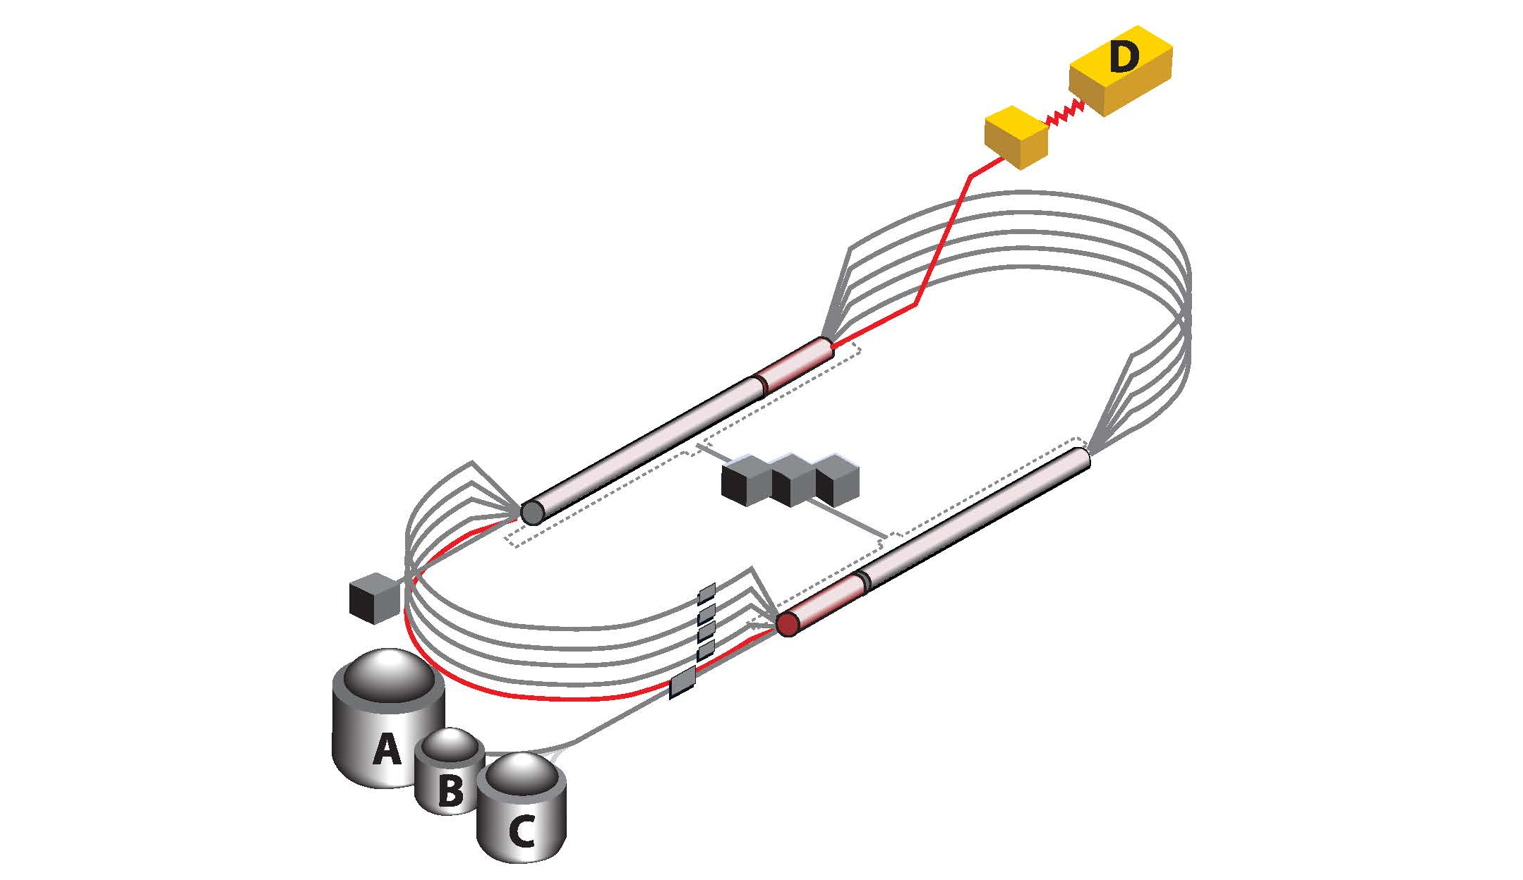

Positrons at 12 GeV JLab
Preliminary Studies
R. D. McKeown
Jefferson Lab
Contributions from:
J. Grames
Y. Roblin
V. Burkert
Electroweak Box Workshop
Amherst Center for Fundamental Interactions
September 28-30, 2017

Slide 2
Why Positrons?
Much of the science program in nuclear/hadron physics with external lepton beams can be obtained more easily with electrons than with positrons
  e⁺ obtained through secondary process, e.g. e⁻+X-> e⁻+γ ->e⁺ e⁻ X positron beam current much lower
  e⁺ polarization obtained through polarization transfer
  e⁻ X -> e⁻ γ_{p} X …; γ_{p} -> e⁺_{p} e⁻ X, so typically lower, but can be high for high e⁺ energy.
In some cases low or modest positron beam currents may be sufficient to access high impact science that is not accessible (or is more difficult to access) with electron beam alone.
Opportunities if large acceptance detectors can be employed.
V. Burkert

Slide 3
High Impact Science Program for Positrons?
Deeply Virtual Compton Scattering (DVCS)
  Extraction of all contributing Compton Form Factors (CFF) and GPDs
  Full 3D-imaging of quarks in proton
  Access the gravitational form factors - quark confinement forces, spin distribution, mass distribution in protons
Two-photon contributions to electron-proton elastic scattering
  How well do we know the fundamental electromagnetic elastic proton form factors?
  What can we do better with positron beams?
What are the equipment options in the near/medium term O(5) years for nuclear/hadron physics experiments with positron beams?
Long term options? Positron Science @ EIC, e.g. measurement of charge asymmetry xF₃(Q²), …
V. Burkert

Slide 4


Polarized Electrons for Polarized Positrons
electron beam polarization
85.2 ± 0.6 ± 0.7 %
Bremsstrahlung produced by polarized electrons results in efficient production of polarized positrons
PEPPo’s success suggests nanoAmps of polarized positrons for CEBAF using milliamperes of polarized electrons
D. Abbott et al, "Production of Highly Polarized Positrons Using Polarized Electrons at MeV Energies", Phys. Rev. Lett, 116, 214801 (2016)
J. Grames

Slide 5
Machine Layout for 1GeV option
e- injector 123 MeV/c
Y. Roblin
Notes:
e- generated in a separate injector, accelerated to 1.2GeV/c thru south linac, transported by arc10 to generate a 123 MeV/c positron beam which is then injected into the north linac. This allows e+ to use the entire machine with the exception of Hall D.

Slide 6
South Linac Optics
Linac lattice usually set to be a 120 Degrees FODO. The e- beam would be severely off-momentum.
Need for an alternate south linac optics which allows for both the e- (from 123→ 1213 MeV) and e+ (from 1213 to 2303 MeV) to be transported.
This is a limiting factor regarding the emittance that the incoming e+ beam can have and still transport, as well as the ability to keep the e- beam focused enough to get to the SW spreader modified magnet (more on this later)
Y. Roblin

Slide 7
SW BCOM modifications
Concept:
Reverse polarity of the SW spreader in order for e+ to be transported correctly.
Consequence:
Incoming 1.2GeV/c e- beam will be
bend downwards in the BCOM.
Remedies:
  Dig into the concrete floor and create a transport line to capture the e- and feed it into ARC 10.
  OR
  Modify the BCOM and raise it by an inch (M.Tiefenback, J. Benesch suggestions). This might avoid having to do civil engineering.
Y. Roblin
Notes:
The SW corner spreader has to be reversed in polarity since it will transport the e+ . Hence, the incoming e- will be deflected downward.

Slide 8
BCOM Modifications
e+
e+ goes to 2S (+18.6 degs)
Modifying the pole shape for the BCOM
Would allow for controlling the downward
bend of the e- beam
e-
e-
e- (1.2GeV/c) bends down
Another dipole pair needed to
complete the spreader and inject into MXAAS05
Dispersion correction probably not needed
Y. Roblin

Slide 9
Shunt and Power Requirements for ARC10
ARC10 will be configured to transport 1.213 GeV/c e- beam instead of 11023 GeV/c e- beam.
Consequently, the power supplies will have to be modified to allow for regulating in this regime or an alternate one used.
MXXAS05 connected to MARC8, MZAAS04 to RSEP8A. We need to consider that when designing the e- transport (since RSEP8A and MARC8 have to be set for e+ energy).
Y. Roblin

Slide 10
Magnet Polarity Reversal
With the exception of ARC10, every magnet needs to have its leads reversed in order to transport the e+.
Machine setup:
  Configure the machine for 5 pass running, including the special south linac optics using e-
  Stop beam delivery, reverse magnet polarities
  Quadrupole leads also need to be reversed (instead of reversing setpoints in order to cancel systematic offsets).
  Using SLM’s and viewers adjust steering with e+
Y. Roblin
Notes:
Mike T. will discuss this in detail in his talk. Note that configuring for e+ by reversing the polarity of a machine tuned for e- is not perfect. Earth magnetic field kicks are opposite for e+ and thus ,we will have to do some steering with e+. Likely the viewers will be sufficient for that.

Slide 11
Accelerator Summary
A proof of principle polarized positron source has been demonstrated.
Several options are being considered to use CEBAF as a positron machine
R&D is needed to flesh out a complete option
No fundamental show stopper, most issues can be resolved by modifying existing machine
Choice will be driven by the physics needs (polarized, unpolarized, intensity, etc..)
Y. Roblin
Notes:
In short, I don’t have the time and resources to spend on this project unless its lab funded …

Slide 12
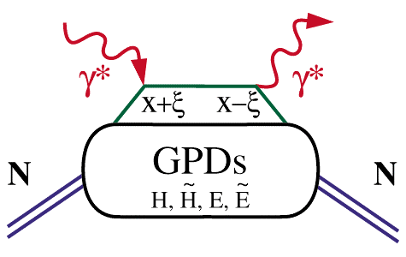
The GPD Program with DVCS
GPDs depend on 3 variables, e.g. E(x, ξ, t). They probe the quark structure at the amplitude level.
Deeply Virtual Compton Scattering (DVCS)
x
hard vertices
x – longitudinal quark
momentum fraction
γ
2ξ – longitudinal
momentum transfer
x+ξ
x-ξ
ξ
x_{B}
=
2-x_{B}
–t – Fourier conjugate
to transverse impact
parameter
t
How to access the GPDs/CFFs?
V. Burkert
Notes:
The basic process in accessing the proton structure through exclusive processes is the “handbag” mechanism. Here shown for the DVCS process.
The important aspects is that we have hard scattering vertices here and here and the soft part is described by the GPDs. The upper and lower part factorize which allow us to probe GPDs in hard scattering processes with photons. There are 4 GPDs which depend on 3 kinematics quantities: the quark longitudinal momentum fraction x, the longitudinal momentum transfer to the quark xi and the 4-momentum transfer to the proton. What is the physical content of the GPDs ?

Slide 13
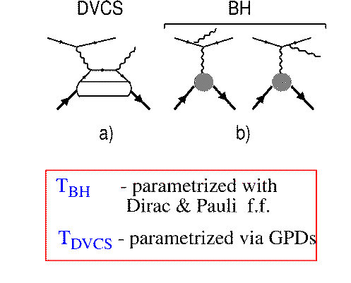
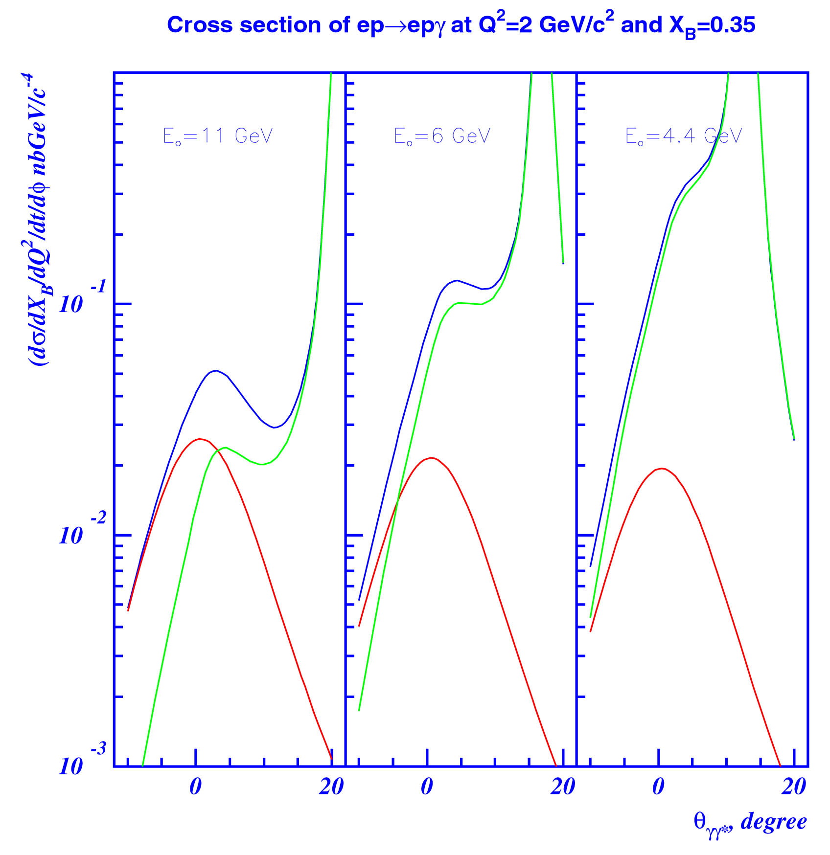
Accessing GPD through DVCS
DVCS
e
e
BH
E_{o} = 11 GeV
E_{o}= 6 GeV
E_{o}= 4 GeV
p
p
d⁴σ
~ |A^{DVCS} + A^{BH}|²
dQ²dx_{B}dtdφ
BH
A^{BH :} given by elastic form factors F₁, F₂
A^{DVCS}: determined by GPDs
DVCS
I ~ 2(A^{BH})Im(A^{DVCS})
BH-DVCS interference generates spin-dependent and charge-dependent cross section differences => use spin-polarized electrons/positrons and polarized targets.
V. Burkert
Notes:
DVCS is not the only process generating high energy photons. At lower energies and for specific kinematics the cross section is dominated by photons emitted from the electron line, the well known Bethe-Heitler process. The cross section is given by sum of the two amplitudes squared, where the BH contribution only depends on the two elastic form factors and is real, while the DVCS contribution is given by the unknown GPDs and has an imaginary part. The relative importance of the two processes is very much dependent on the beam energy and on the scattering angle as shown in these graphs. DVCS photons are emitted mostly along the direction of the virtual photon while the Bethe-Heitler process dominates at very small angles relative to the incoming electron. With increasing beam energy, the two processes are increasingly separated in kinematics as can also be seen in these graphs. While at small energies BH is expected to dominate in nearly the entire kinematics, at high energies DVCS becomes dominant. If we can isolate the interference part we access GPDs directly. This is possible by using spin polarized electron beam or spin polarized targets.

Slide 14
Structure of Differential Cross Section
Polarized Beam, unpolarized Target:
V. Burkert

Slide 15
Structure of Differential Cross Section
Polarized Target:
V. Burkert

Slide 16
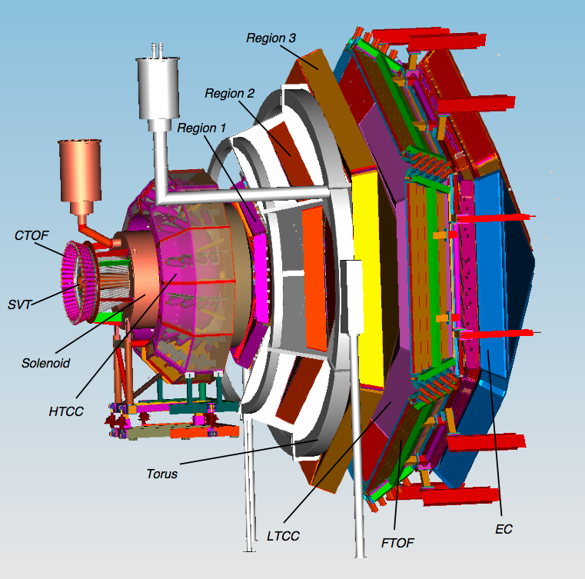
CLAS12
DVCS kinematics:
e⁻p -> e⁻pγ
Central
Detector
e⁺p -> e⁺pγ
beam
Forward
Detector
e⁻/e⁺ scattered to small angles
detected in CLAS12 FD
θ_{e-} = 6º–35º / θ_{e+} 6º–35º
(reverse Torus field)
Proton in full CLAS12 CD/FD
θ_{p} = 10 -70º
V. Burkert

Slide 17
CLAS12 e⁺p/e⁻p Experiment (generic)
Forward Detector
Central
Detector
DCs
p
P
p
TOF
PCAL/EC
γ
Solenoid
HTCC
e⁻/e⁺
e-/e+
Torus
Central Detector:
Charged particle tracking in solenoid field
Polar angle range θ = 35 - 125º
Azimuthal angle range Δφ= 360º
Particle ID by TOF for p < 1.5 GeV/c
Forward Detector:
Charged particle tracking in Torus field
Polar angle range θ = 6 - 35º
Azimuthal angle range (0.6 – 0.9)x2π
e⁺/e⁻ ID in HTCC & ECAL
Event selection:
Detect/identify all particles -> exclusivity
V. Burkert

Slide 18
DVCS Summary
DVCS is a crucial part of the JLab physics program at 12 GeV. It provides the cleanest access to the GPDs and is the basis for the 3D imaging of the nucleon.
Positron beams (polarized/unpolarized) of the same energy as electrons will significantly enhance the GPD program by allowing the separation of different combination of GPDs in the charge-dependent interference terms of the cross section.
Positron beams will directly address questions regarding quark confinement forces and the angular momentum distribution in protons.
A positron current of ~10nA and P_{e+} = ~0.6 is required for an initial GPD program with positrons.
V. Burkert

Slide 19
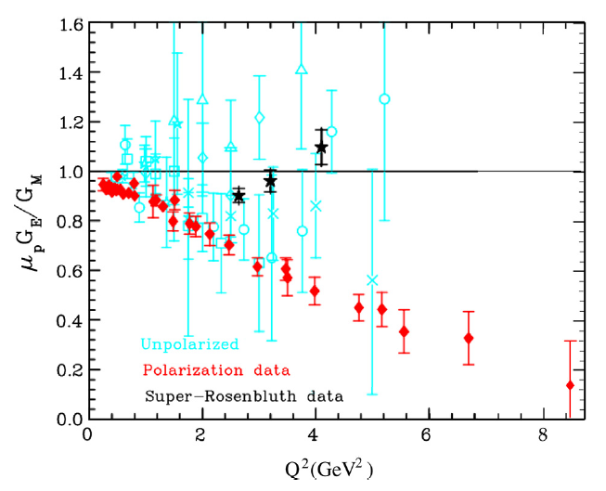
Two-photon Effects in Elastic ep Scattering
2γ effects are significant in cross section differences but largely cancel in the G_{E}/G_{M} ratio from polarization measurements.
Can the full discrepancy between the polarization data and the Rosenbluth data be explained with contributions from 2γ effects alone?
=> Measure 2γ effects in elastic cross section ratio of e⁺p/e⁻p
R_{2γ} ≈ 1 - 2δ_{γγ}
(δ_{γγ} is 2γ correction from interference of 1γ and 2γ amplitudes)
Expected effects are small O(%), making experiments challenging to
1) get sufficient statistics and 2) to keep systematic uncertainties at < 1%.
V. Burkert

Slide 20
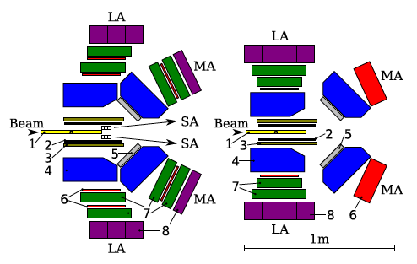
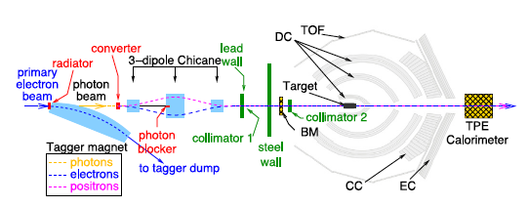
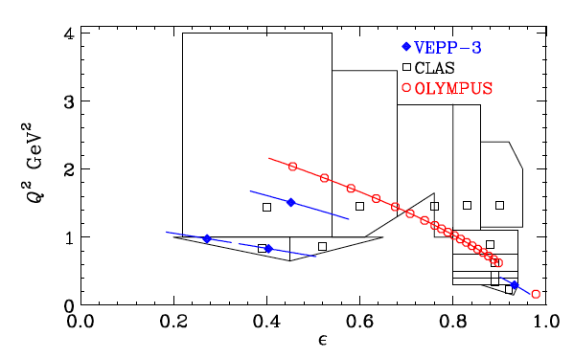
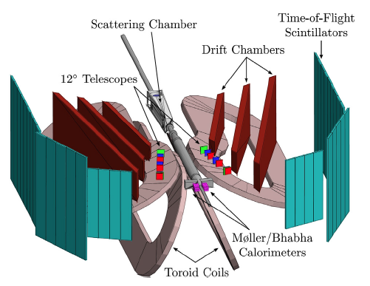
Three Recent e⁺/e⁻ Experiments
Review article “Two-photon exchange in elastic electron-proton scattering”, A.Afanasev, P.G. Blunden, D. Hassel, B.A. Raue, PPNP 95 (2017) 245-278
1.6GeV
VEPP-3
1.0GeV
CLAS
Olympus
V. Burkert

Slide 21
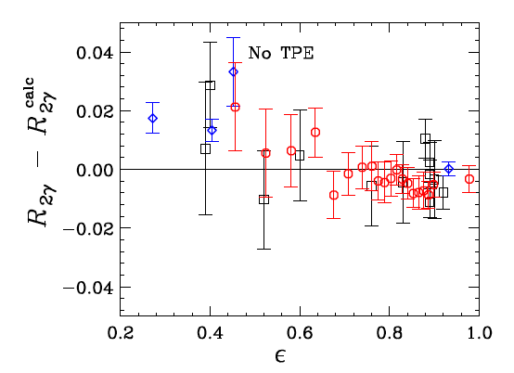
Conclusions from Direct 2γ Searches
The 3 experiments are in reasonable
agreement with several theoretical
calculations that include different
models for 2γ effects.
Caveat: Agreement requires shifting the CLAS and the Olympus results by one and two times their correlated uncertainties.
“ The δ_{γγ} = 0 hypothesis is ruled out
at greater than 99.5% confidence level”
“The results of these experiments are by no means definitive. Most of the data are well below where the form factor discrepancy is significant (Q² > 2GeV²). Questions regarding the sources of the discrepancy remain largely unanswered” (my emphasis)
“There is a clear need for similar experiments at larger Q² and at ε <0.5”.
V. Burkert

Slide 22
What to Do?
After 3 dedicated recent experiments (one making use of CLAS), and after many earlier attempts to measure 2γ exchange contribution we only know that they do exists and that the results are not inconsistent with the discrepancy observed in elastic ep scattering.
What are the contributing factors to the limited success?
Kinematics coverage in Q² and in ε are mostly where effects are expected to be small
Systematic uncertainties are marginal in some cases
Rates at higher Q² and smaller ε are low, corresponding to high energy and large electron scattering angles.
Can we do better at JLab ?
V. Burkert

Slide 23
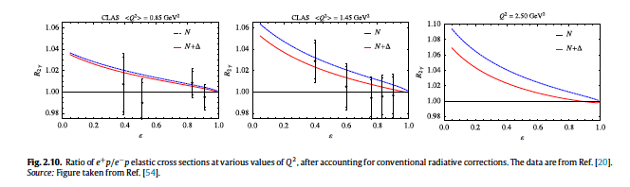
CLAS Data & Predictions
At fixed low value of ε,
R_{2γ} should increase with Q².
V. Burkert

Slide 24
A Possible Scenario with CLAS12
Assumptions on beam properties
Positron beam current: I_{e+} ≈ 60 nA
Beam profile: σ_{x}, σ_{y} < 0.4mm
Polarization: not needed, so phase space at e⁺ source can be chosen for maximum yield
Extract electron beam from same source to keep systematic effects low ?
Switching from e⁺ to e⁻ beam in ≤ 1 day (keep machine stable, control of systematic errors)
Luminosity (5 cm lH₂ target): 0.8x10³⁵cm⁻²s⁻¹
Use Central Detector for e⁺/e⁻ detection θ_{e}=40-125º
Use Forward Detector for proton detection θ_{p}=7-35º
V. Burkert

Slide 25
CLAS12 e^{+/-}p/e^{+/-}p experiment (generic)
Forward Detector
Central
Detector
DCs
e⁻/e⁺
e⁻/e⁺
TOF
PCAL/EC
Solenoid
HTCC
proton
proton
Torus
Central Detector:
Charged particle tracking in solenoid field
Polar angle range θ = 35 - 125º
Azimuthal angle range Δφ= 360º
Particle ID by TOF for p < 1.5 GeV/c
No direct electron/positron ID
Forward Detector:
Charged particle tracking in Torus field
Polar angle range θ = 6 - 35º
Azimuthal angle range (0.6 – 0.9)x2π
Particle ID by TOF for p < 6 GeV/c
e⁻/e⁺ rejection in HTCC
Event selection:
-> back-to-back e-p kinematics
- > ep -> eX missing mass: M_{x} = M_{p}
If direct electron/positron ID needed:
=> replace Central Neutron Detector with e.m. calorimeter
V. Burkert

Slide 26
Design Parameters
CLAS12
Forward Central
Detector Detector
Angular range
Tracks 5⁰ – 35⁰ 35⁰ – 125⁰
Photons 2.5⁰ – 35⁰ ---
Resolution
δp/p (%) 0.3 @ 5 GeV/c 2 @ 1 GeV/c
δθ (mr) 1 3
Δφ (mr) 3 1.5
Photon detection
Energy (MeV) >150 ---
δθ (mr) 4 @ 1 GeV ---
Neutron detection
N_{eff} < 0.7 (EC+PCAL) 0.1 (CND)
Particle ID
e/π Full range ---
π/p < 5 GeV/c < 1.25 GeV/c
π/K < 2.5 GeV/c < 0.65 GeV/c
K/p < 4 GeV/c < 1.0 GeV/c
π⁰→γγ Full range ---
V. Burkert

Slide 27
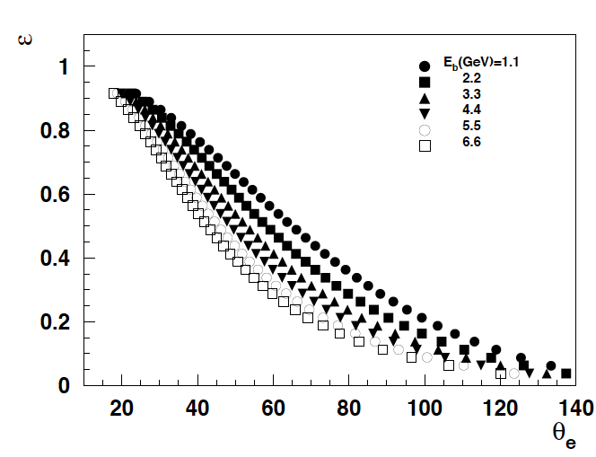
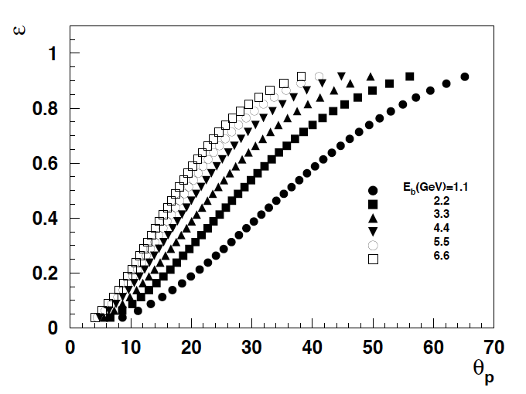
Limits in Scattering Angles
Kinematics graphs and rate estimates by Harut Avakian
electron scattering angle range
proton scattering angle range
V. Burkert

Slide 28
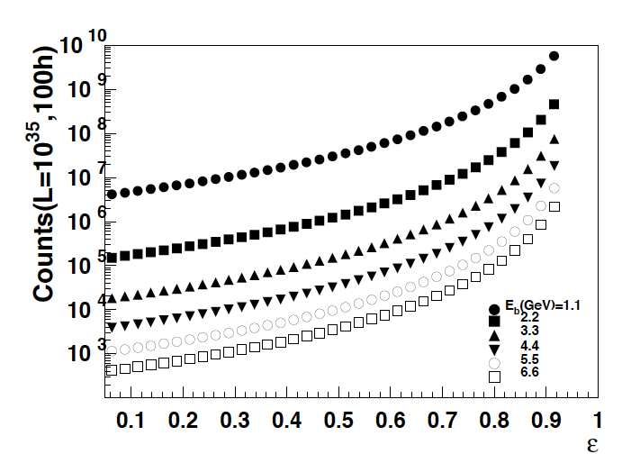
Rate Calculations
Δε = 0.025
ΔQ² = 0.25GeV²
1% stat.
V. Burkert

Slide 29
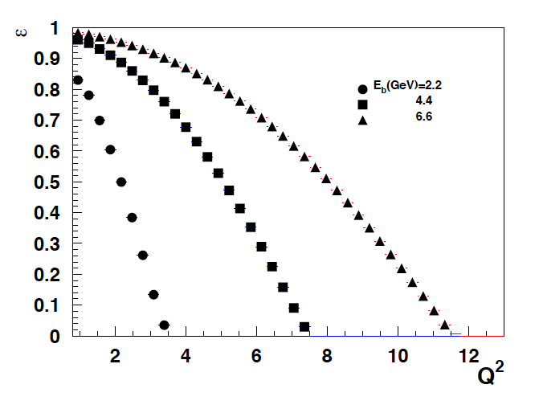
Event Rates for e^{+/-}p -> e^{+/-}p with CLAS12
L=10³⁵cm⁻²s⁻¹
Events/hr
Δε=0.025 ΔQ²=0.25GeV²
7x10⁴
10³
10²
ε=0.6
6.6 GeV
θ_{e} = 125º
4.4GeV
2.2 GeV
10
10²
10⁴
V. Burkert

Slide 30
Other Equipment Option – Hall A / C
Detector | Beam current (nA) | Target length (cm) | Luminosity (10³⁵) | e⁺/e⁻ ΔΩ (sterad) | FOM | FOM/FOM(CLAS12)
HRS | 60 | 10 | 1.6 | 0.006 | 0.0096 | 0.0024
HMS | 60 | 10 | 1.6 | 0.006 | 0.0096 | 0.0024
BigBite | 60 | 20 | 3.2 | 0.080 | 0.26 | 0.065
SBS | 60 | 20 | 3.2 | 0.070 | 0.22 | 0.055
CLAS12 | 60 | 5 | 0.8 | 5.0* | 4.0 | 1
FOM =
L x ΔΩ_{ep}
HRS/HMS – due to limited solid angle may be competitive for positron currents I_{e+} >> 1 μA or if high resolution is needed.
BigBite Spectrometer or SBS – may be used as electron spectrometer with large solid angles.
*) includes a factor 2/3 for proton detection
V. Burkert

Slide 31
Summary of 2-photon Physics
Positron beams (unpolarized) of ~60nA will enable a 2-γ program in elastic e^{+/-}p scattering to significantly extend previous measurements at VEPP-3, CLAS, Olympus.
As polarization is not required positrons may be drawn from the source in phase space where the unpolarized yield is maximum.
Such data may resolve the discrepancy between Rosenbluth separation and polarization transfer elastic form factor measurements.
CLAS12 can be used with additional electron trigger at large angles to reach low ε kinematics.
Physics with positrons in the high luminosity halls may require currents O(1 μA), assuming currently available equipment options.
V. Burkert

Slide 32
Conclusions
Studies of options for positron beams (polarized and unpolarized) at 12 GeV Jlab have been started
JLab12 could enable nuclear/hadronic science with positrons/electrons beam that promises high impact in two areas:
  The extension of the GPD program in DVCS with strong sensitivity to the real part of scattering amplitude {A}, which enables more direct access to the gravitational form factors that relate to fundamental properties of the nucleon.
  The quantitative assessment of the 2-photon contributions in elastic ep scattering, with high statistics data in a large kinematic range.
Many details remain to be worked out.
Many thanks to:
V. Burkert
Y. Roblin
J. Grames

Slide 34
EC for Electron Detection in CLAS12 CD
W-powder, embedded optical fiber
light readout
~10 r.l.
beamline

Slide 36
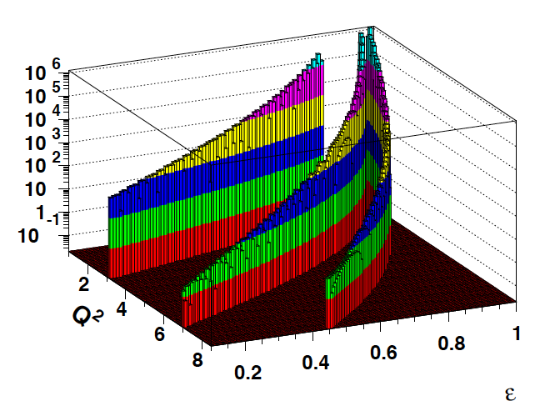
E=2.2, 4.4, 6.6 GeV

Slide 37
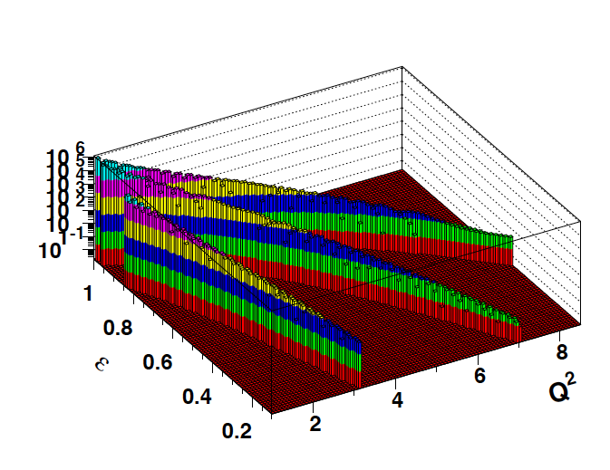

Slide 38
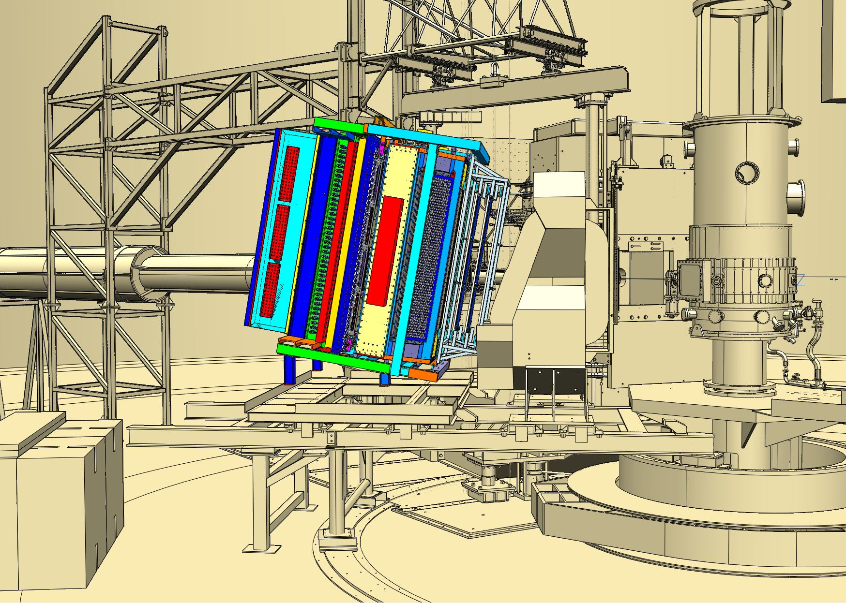
BigBite
BigBite detector frame modifications are defined to include GEMs and GRINCH.
Drawings being detailed.
BigBite magnet operates at 710A for integral of 1.1 T-m

Slide 39
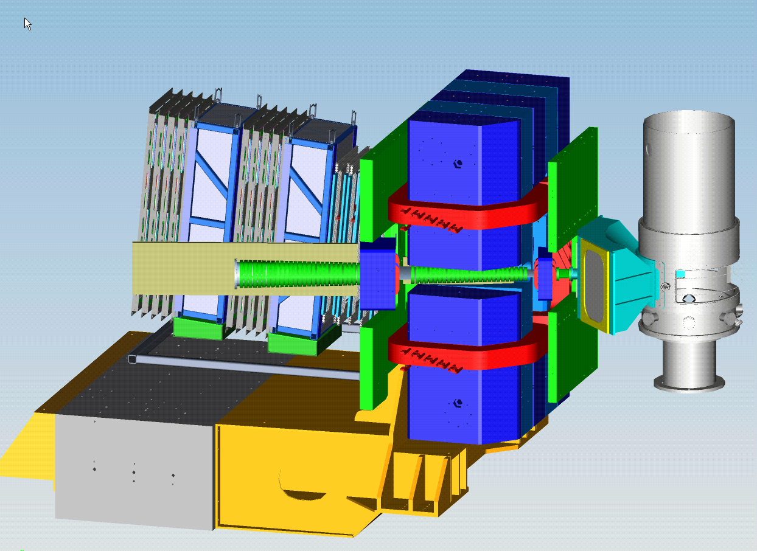
SBS Equipment
Plastic Analyzers-in storage
48D48 Magnet-in storage
Rear Field Clamp-in storage
Front Field Clamp-in storage
GEMs frame-parts in storage
Exit Beam Pipe-parts in storage
Scattering Chamber & Vacuum Snout-in storage
Counterweight Support Structure-in storage
Corrector Magnets-in storage

Slide 40
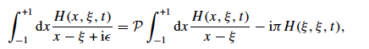
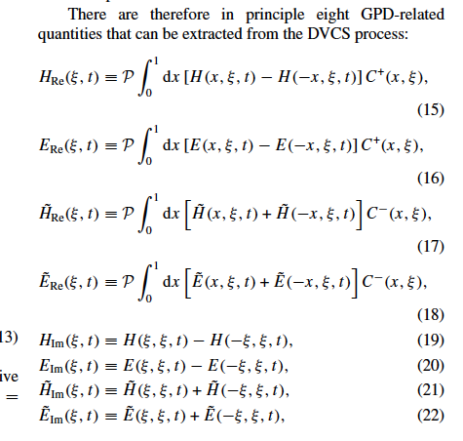

GPDs & Compton FFs
DVCS amplitude contains convolution integrals of the form
There are 8 GPD-related quantities that can be extracted from the DVCS process:
with:
Compton Form Factors (CFF)

Slide 41
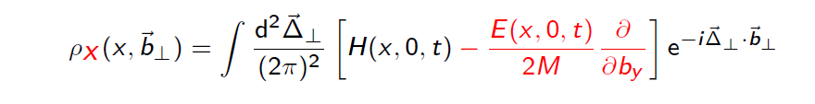
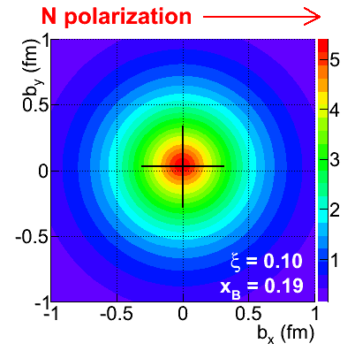
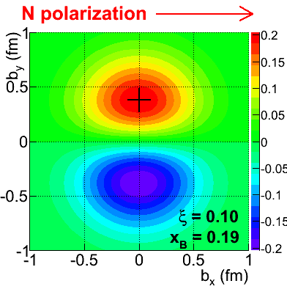
GPDs and Imaging in Transverse Space
The GPD can be accessed in DVCS processes with polarized beam and/or target.
Fourier transform in Mandelstam variable t ➔ charge densities in b space.
Contribution of H+E
Contribution of E

Slide 42
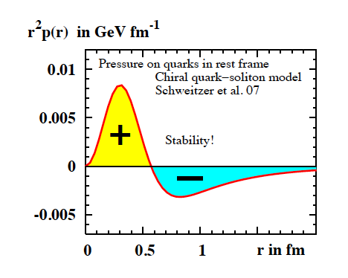
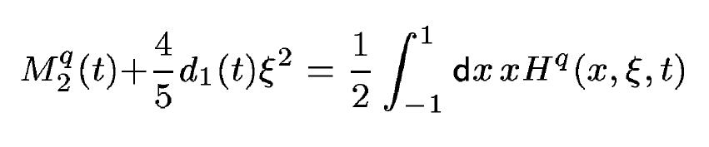
Accessing the Forces & Pressure on Quarks
Nucleon matrix element of EMT contains:
M₂(t) : Mass distribution inside the nucleon
J (t) : Angular momentum distribution
d₁(t) : Shear forces and pressure distribution
P. Schweitzer et al.
To determine d₁(t) we need Re{H^{q}} and Im{H^{q}}
Measuring d₁(t) will access the pressure distribution and shear forces on quarks in protons => how is confinement realized.
High-impact part of the GPD program. Form factors M₂(t) and J(t) may also be accessed.
Notes:
The nucleon matrix element of the energy-momentum tensor is known to contain 3 form factors. They describe ….. and can only be measured directly in elastic graviton-nucleon scattering. However, these form factors appear as moments of the unpolarized GPDs as shown here. The quark angular momentum in the nucleon is given by the 2nd moment of the sum of GPD H and E. The mass and pressure distribution of the quarks are given by the 2nd moment of H where the pressure is probed by parameter xi.

Slide 43
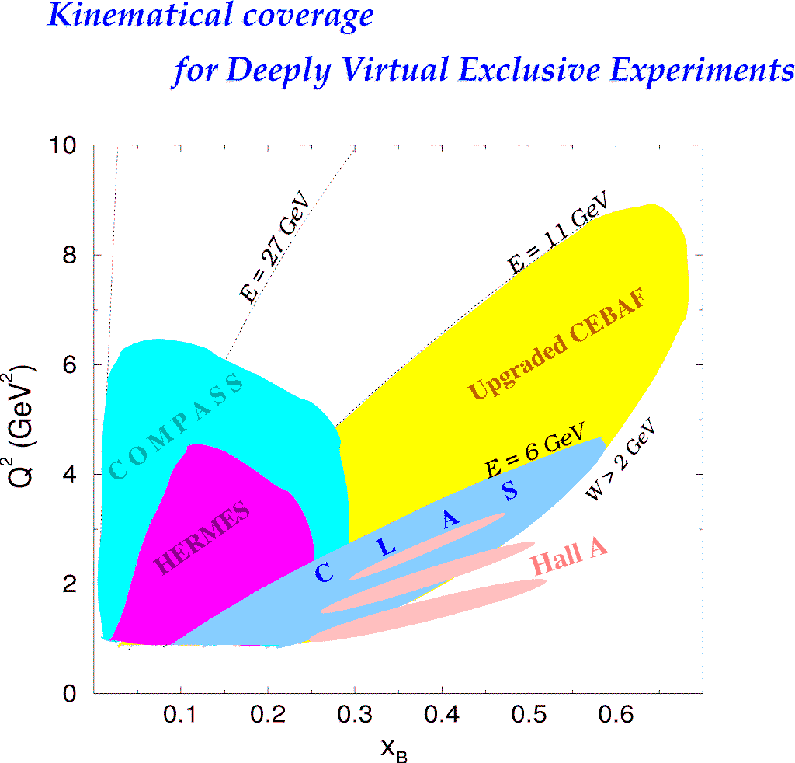
Coverage of DVCS @ 11GeV
e⁻p -> e⁻pγ
H1, ZEUS
H1, ZEUS
27 GeV
11 GeV
e⁺p -> e⁺pγ
200 GeV
11 GeV
JLab Upgrade
JLab @ 11 GeV
COMPASS
W = 2 GeV
HERMES
0.7
0.7
Large range in x and in –t is essential for imaging => high luminosity, large acceptance
Notes:
The kinematics range that can be covered in exclusive processes with high precision data is shown with this yellow area. This will be the only accelerator where rhe valence quark regime can be fully covered with high precision data. other existing machines, even at much higher energies can not cover this regime due to the much lower luminosity at HERA or COMPASS.
My own personal view is that several experiments, in some of which I participated, eg EMC and E665, but also HERA, the physics, especially at high x was limited by the lack of luminosity.
Jefferson Lab has luminosity, also good spin control in both beam and targets.
So high x is (still) there for the taking and given 12 GeV, it is accessible kinematically.

Slide 44
A_{LU} Projections for JLab@12GeV
~
e⁻p --> e⁻pγ
Δσ_{LU} ~ sinφ {F₁H + ξ(F₁+F₂)H +kF₂E}dφ
L =10³⁵ cm⁻²s⁻¹
T = 1000 hrs
A_{LU}
E12-06-119
With e⁺ beams of same luminosity larger errors from lower polarization.
FOM ~ (P_{e+}/P_{e}-)²
≈ 1/2

Slide 45
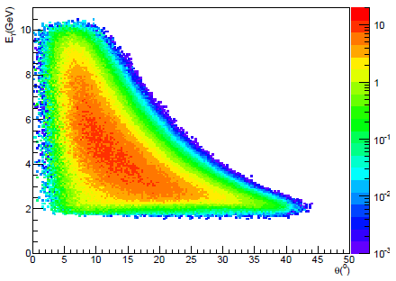
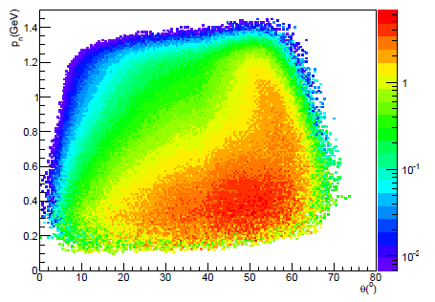
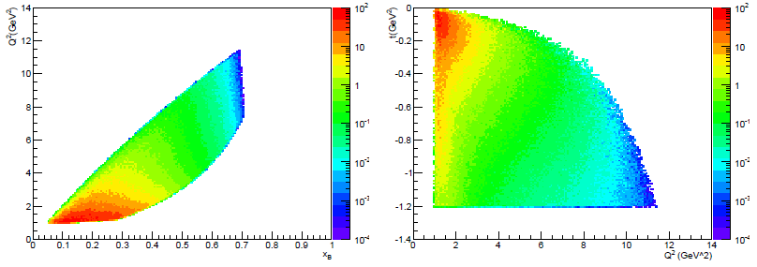
DVCS Kinematics E_{e+/e-} = 11 GeV
p
accessible
γ
accessible
e⁻/e⁺

Slide 46
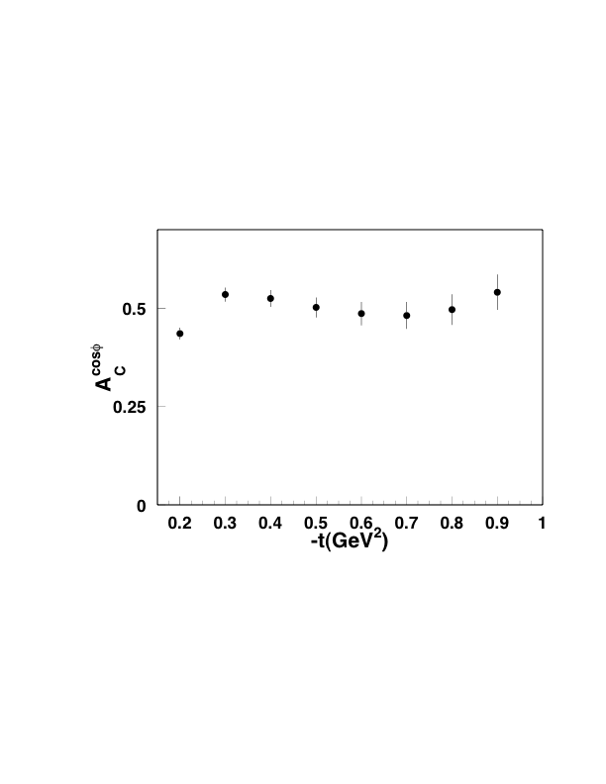
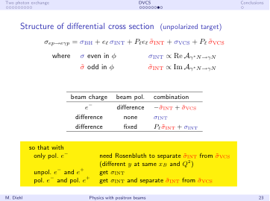
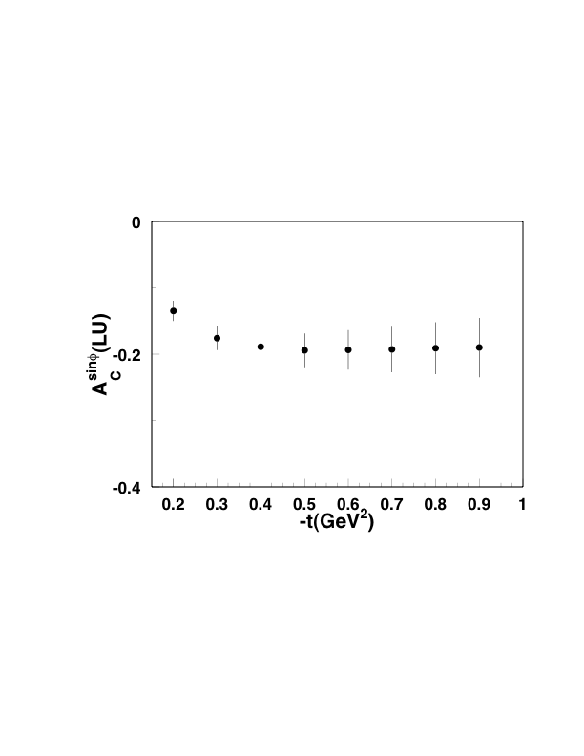
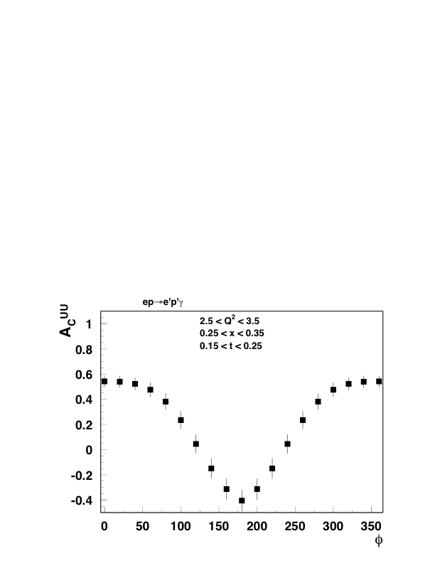
Charge Asymmetries – Target Unpolarized
Positrons: L = 2x10³⁴cm⁻²s⁻¹; P=0.6
Electrons: L = 10³⁵cm⁻²s⁻¹; P=0.8
E=11 GeV, 1000hrs.
Dual model: V. Guzey (2009)
Charge asymmetries A_{c} = e⁺-e⁻/e⁺+e⁻ in VCS are
large and show strong azimuthal modulations.
They can be measured with good accuracy.

Slide 47
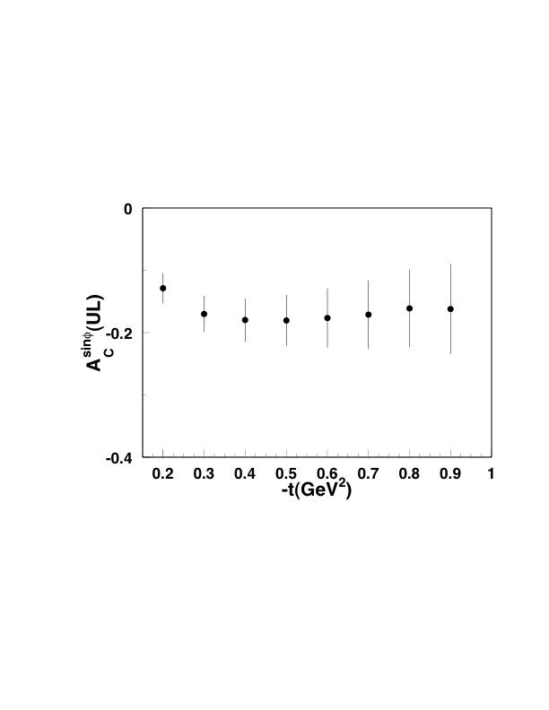
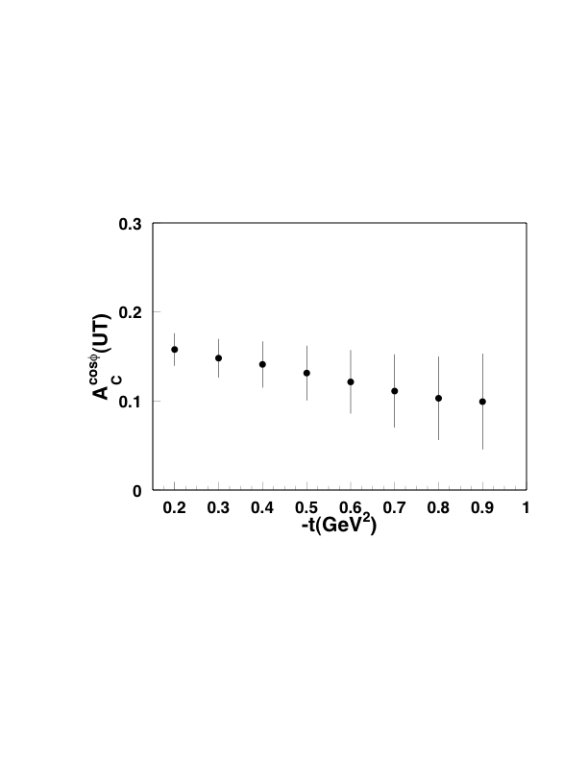
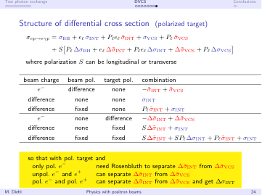
Charge Asymmetries – Target Polarized
Other bins in Q² and x are measured simultaneously.
Errors on polarized target asymmetries marginal, would benefit from higher positron luminosity.

