Slide 1

Searches for Higgs Decays into New Light Bosons
Alexei Safonov
Texas A&M University
Higgs Portal Workshop, U Mass, Amherst, April 2014

Slide 2


The Hunt for Higgs is Officially Over
The 4th of July, Physicists’ Style
… or is it not?

Slide 3
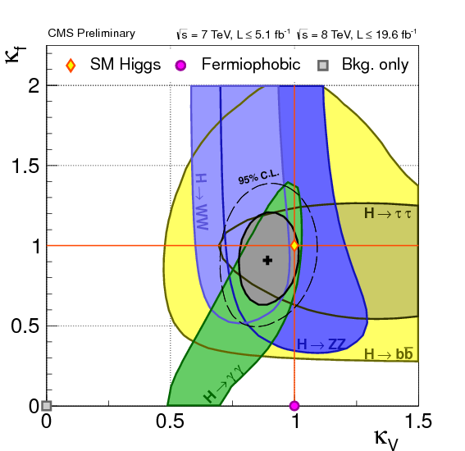
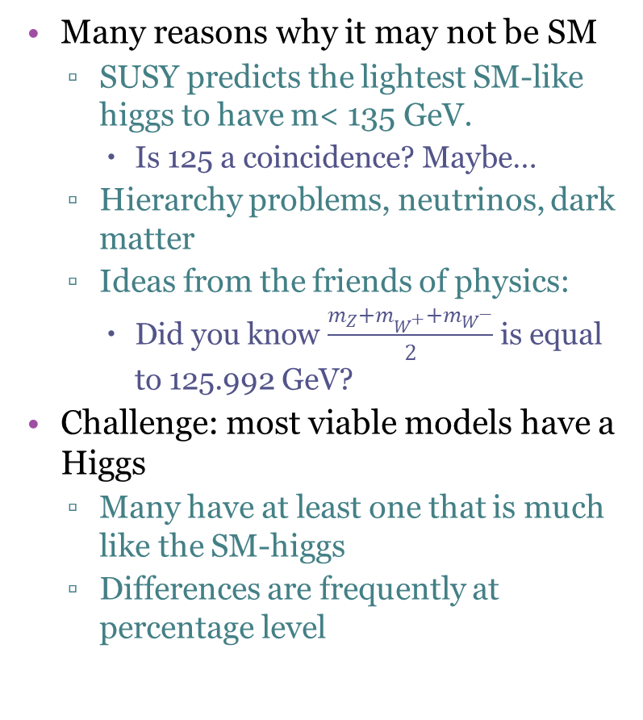
Figuring Out the Higgses
Many reasons why it may not be SM
  SUSY predicts the lightest SM-like higgs to have m< 135 GeV.
    Is 125 a coincidence? Maybe…
  Hierarchy problems, neutrinos, dark matter
  Ideas from the friends of physics:
    Did you know $\frac{m_{Z}+m_{W^{+}}+m_{W^{−}}}{2}$ is equal to 125.992 GeV?
Challenge: most viable models have a Higgs
  Many have at least one that is much like the SM-higgs
  Differences are frequently at percentage level
Two paths:
  Long and tedious precision measurements of couplings
  Look for viable alternatives
    Can make a quick discovery, but need to know what to look for

Slide 4
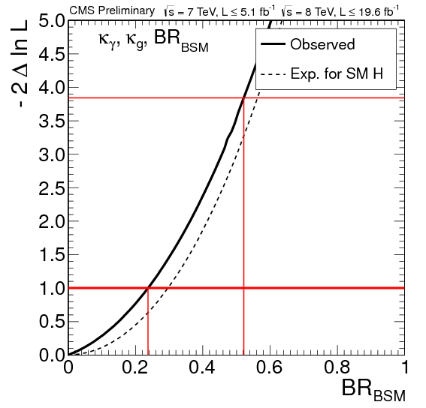
“A Higgs” vs “The Higgs” the Hard Way
Can conclude that this is the SM Higgs if it has all correct couplings
  Not easy as all measurement depend on combinations of couplings
    Can also miss couplings responsible for rare decays that don’t contribute to production
Simplify: assume all couplings to fermions (taus, tops, b’s) can at most be off from SM by a common factor k_{f}; assume the same for all bosonic couplings - k_{V}
  Even in this case fermionic couplings are measured to ~30% level, bosonic to ~10%
Ask a different question: how much the accounted Higgs decays allow to say about hypothetical non-SM decays of higgs
  Higgs can be decaying 40% of the time into something new and we wouldn’t know

Slide 5
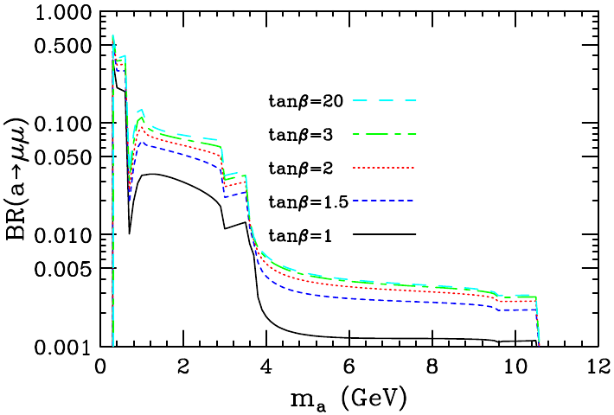


An Easy Way: A New Very Light Higgs?
NMSSM: a new singlet field $Δℒ\sim λSH_{u}H_{d}+\frac{1}{3}κS^{3}$
  $\left\langle λS\right\rangle$ explains μ in the MSSM lagrangian $μH_{u}H_{d}$
Two possibilities
  m(h₁)< m(h₂~h_{SM})=125 GeV or 125 GeV=m(h₁~h_{SM})< m(h₂)
    Both are “hidden”:
      SM-like Higgs with SM production x-section and small B(h→aa)
      The other one has large B(h→aa) but small production cross-section
Extended Higgs sector:
  A new CP-odd Higgs a₁ coming from the new singlet
    Weakly couples to SM (very hard to produce directly), but strongly couples to some of the other Higgs bosons
        If produced, will have no choice but decay to SM particles
  Two Higgs “cousins”: CP-even h₁ and h₂
Branching fraction of $a_{1}→μμ$
Dermisec & Gunion, Phys.Rev. D81 (2010), 075003

Slide 6
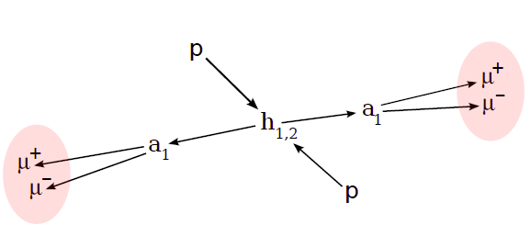
NMSSM: A Hidden Higgs Portal
Potentially spectacular signatures
  If a₁ is heavy-ish, e.g. above 2m_{τ} or 2m_{b}, can be on the challenging side experimentally
  But can be easy if light enough – “lepton jets”
  If too light (<2m_{μ}), can look for a₁ decays to photons
No contradiction with current knowledge because a’s couple very weakly to SM particles
    It could be that the only way to see it is to make a heavier higgs first and then watch it decay
      Only nature and the LHC can do that

Slide 7
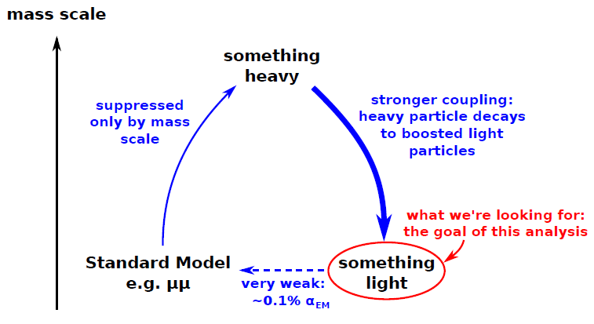
Searching for Light Hidden Things
Generalize for many classes of new physics searches:
  High energy colliders can have enough energy to make the heavy stuff that couples to new hidden particles
  They will eventually decay to SM particles
    All you have to do is sit back and watch
“Something heavy” can be e.g. SUSY partners
Or it can be Higgs opening a new portal at the LHC

Slide 8
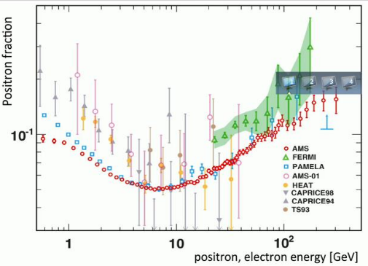
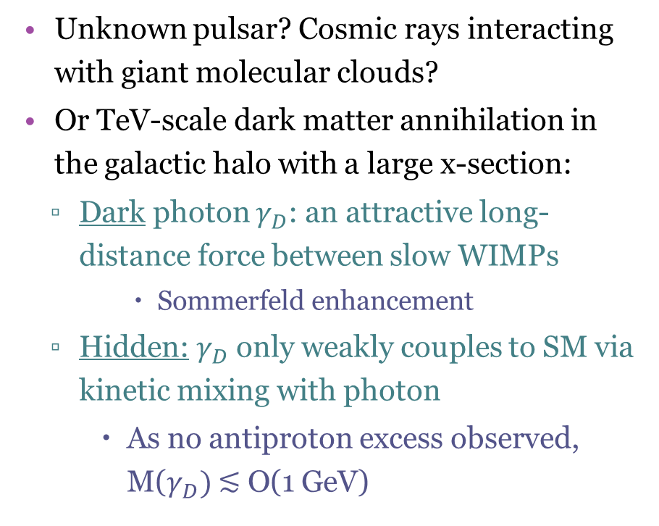
Another Example: Dark Photons
Motivated by the measured by satellite experiments rising positron fraction towards higher energy
Unknown pulsar? Cosmic rays interacting with giant molecular clouds?
Or TeV-scale dark matter annihilation in the galactic halo with a large x-section:
  Dark photon $γ_{D}$: an attractive long-distance force between slow WIMPs
      Sommerfeld enhancement
  Hidden: $γ_{D}$ only weakly couples to SM via kinetic mixing with photon
    As no antiproton excess observed, M($γ_{D})$ ≲ O(1 GeV)
μ⁺, e⁺
X
φ
μ⁻, e⁻
φ
μ⁺, e⁺
X
φ
μ⁻, e⁻

Slide 9
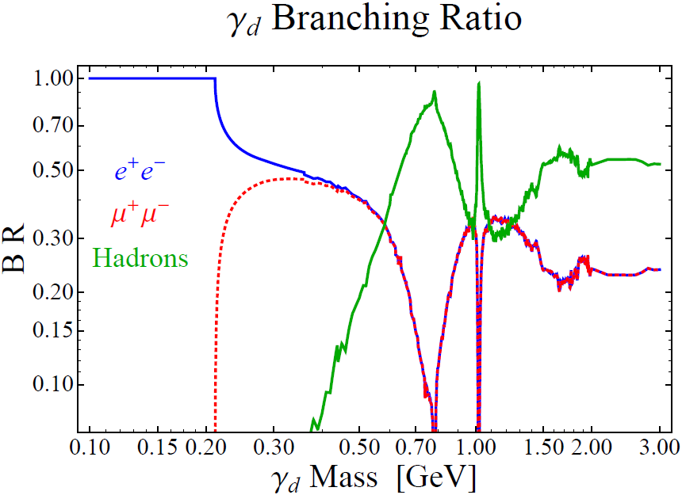
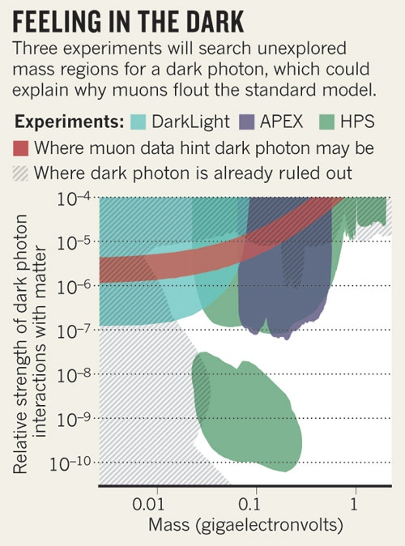
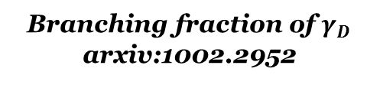
A New Low Mass Photon?
Shouldn’t we have seen it by now?
  E.g. ee →φ→ee
The problem is the incredibly weak coupling to SM particles
  They decay to them because they got no choice, but producing them can be very hard
  We may have never seen them because we can’t make them
Gaining reasonable sensitivity requires enormous luminosity
  E.g. low energy super high intensity experiments
Can still be not enough to go low enough in couplings
Branching fraction of $γ_{D}$
arxiv:1002.2952

Slide 10
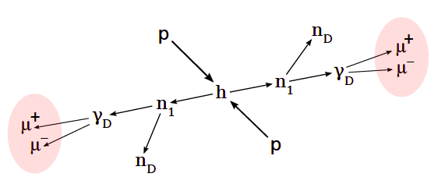
Higgs Window on Dark SUSY
One example scenario that can be within the LHC reach:
In this model, Higgs is just like SM Higgs except that a fraction of time it decays to pairs of neutralinos, which decay into the dark sector:
  Light dark neutralinos escape, but dark photon decays can be experimentally detectable
    Muon channels are easiest, but other modes are possible too
      Remember that if coupling is too small, dark photons may be long living

Slide 11
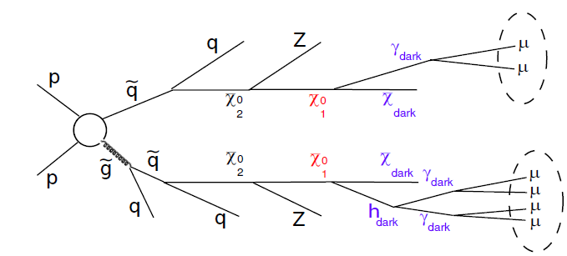
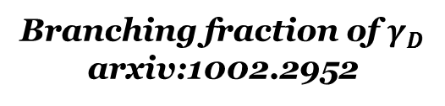
Dark Photons in SUSY Cascades
SUSY with squarks/gluinos accessible by LHC:
Or Higgs decay via hidden sector cascades
Dark photons decay as SM γ
  MSSM LSP is a neutralino decaying to dark neutralino and light γ^{dark}/h^{dark}
  MSSM LSP is a squark decaying to q and light dark fermion and γ^{dark}/h^{dark}
Branching fraction of $γ_{D}$
arxiv:1002.2952

Slide 12
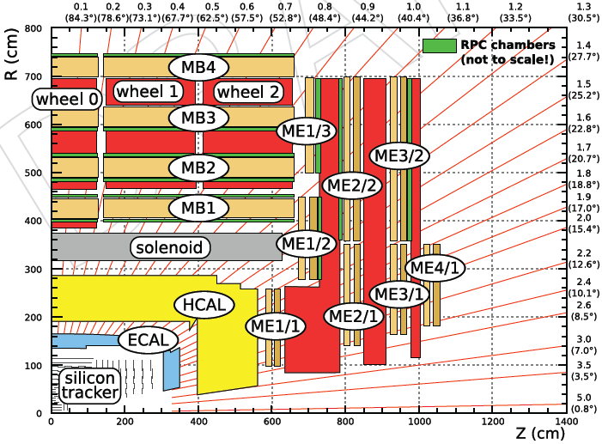
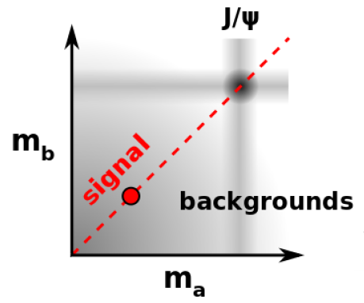
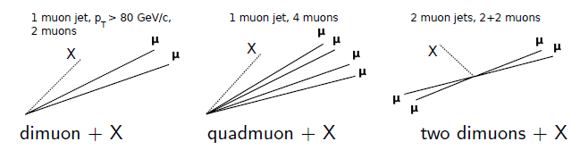
CMS Muon Jets Analysis
The first LHC analysis of this type:
  35 pb⁻¹ of 2010 LHC data
  Inclusive muon trigger p_{T}>15 GeV
Offline:
  Require at least 1 muon with p_{T}>15 GeV, |η|<0.9
  Identify all other muons with p_{T}>5 GeV, |η|<2.4
  Reconstruct muon jets and categorize
  No isolations, cluster using pairwise mass of muons
Assume new bosons produced on-shell:

Slide 13
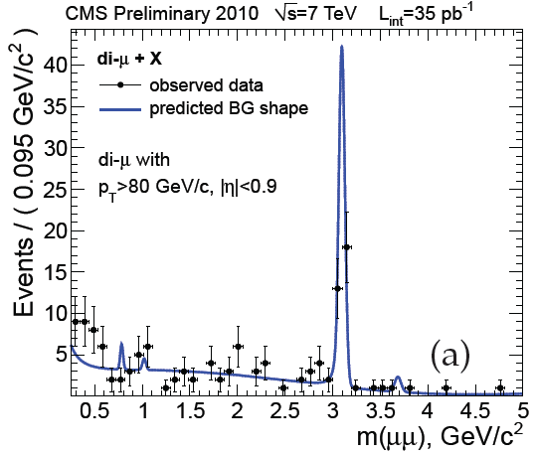
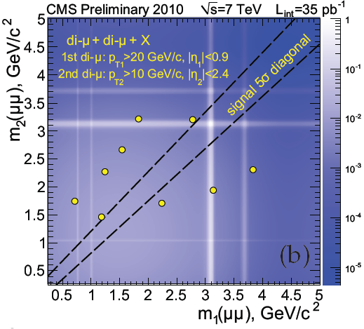
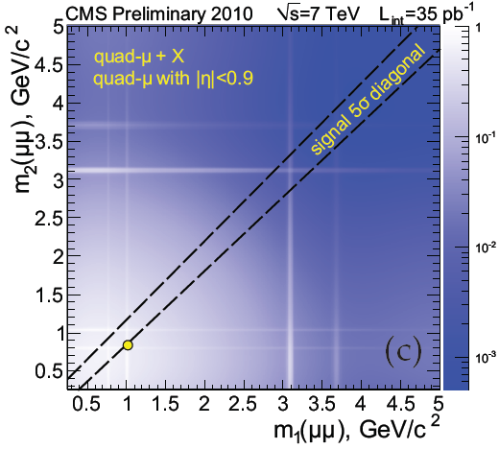
Topologies: Data and Backgrounds
name | description | Lead μ-Jet p_{T} | Backgrounds
R¹₂ | Single dimuon+X | >80 GeV/c | 2μ’s from a b-jet, Drell Yan
R¹₄ | Single quadmuon+X | no explicit cut | 2μ’s from a b-jet + 2 fakes
R²₂ ₂ | Two dimuons+X | no explicit cut | bb-bar+X, 2μ’s from each b
R^{N}₅ ₊ | All other categories | no explicit cut | Rare, from bb-bar+X/fakes
No events with consistent masses of dimuons in higher order categories

Slide 14
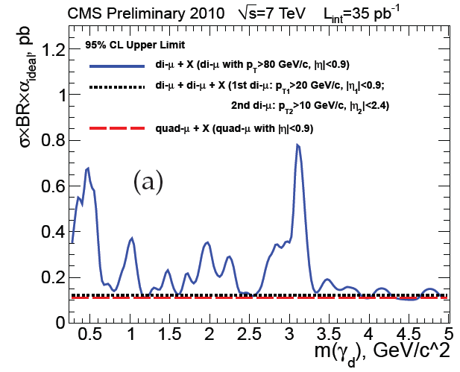
Model-Independent Interpretation
Use three simplest topologies to set “conservative” model independent limits:
  Dimuon+X
  Two-dimuon+X
  Quadmuon+X
Limits of applicability:
  Mean p_{T}(μ-jet)≤250GeV
Easy to apply to other models:
  Follow analysis steps to calculate branching and acceptance for a specific final state assuming an ideal detector
  Compare with the limit plot
    Complex topologies can be reduced to one of these three

Slide 15
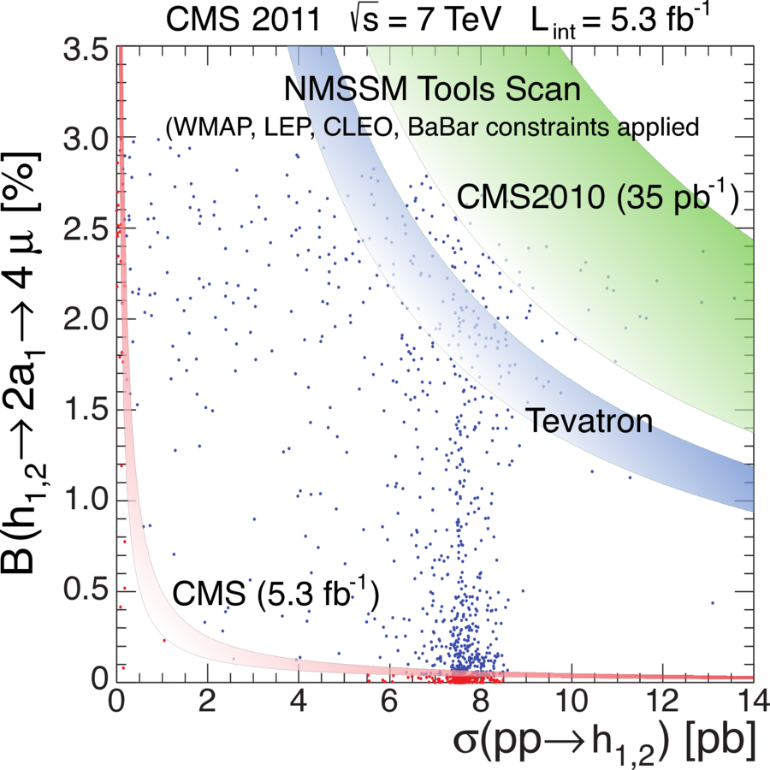
35 pb-1 Analysis and NMSSM
Primary results of the 35 pb⁻¹ analysis were limits on models with strong production followed by dark cascades
Sensitivity to NMSSM required more data and changes to analysis
  Require two pairs of leptons, apply isolation to keep backgrounds low
  Follow up version lost sensitivity to multi-lepton topologies

Slide 16
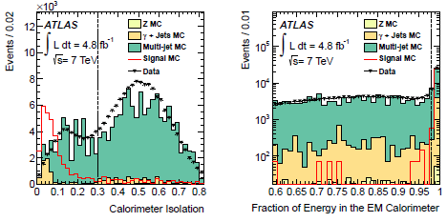
ATLAS Lepton Jets Search
Newer but still a relatively old analysis
  L=5 fb⁻¹ of 7 TeV data
  Topologies allowed:
    One jet with 4+ muons
    Pairs of jets with 2+ muons or 2+ electrons
Selections:
  Electron channel
    Leading electron p_{T}>35
    Jets built from EM clusters E_{T}>10 GeV and 2+ tracks of p_{T}>10 GeV
  Muon channel:
    Single muon jet: p_{T}>19/16/14/4 GeV
    Double muon jet: p_{T}>11 GeV each (one with 23 if from single muon trigger)
Benchmark model: strong SUSY production followed by cascade decays
  Parameterize with dark sector gauge couplings α_{d} which drives multiplicity of dark photons

Slide 17
ATLAS Lepton Jets Search
This analysis should be sensitive to models with Higgs decays, but reinterpretation is not straightforward
  Acceptance is for the specific model (strong SUSY production)
  Fractions of events with different true number of dark photons is convoluted
        Migrations between channels etc.
Thresholds higher than in CMS analysis, so likely the sensitivity to NMSSM-like signatures is lower
  For Higgs dark decays electron channel should increase sensitivity

Slide 18
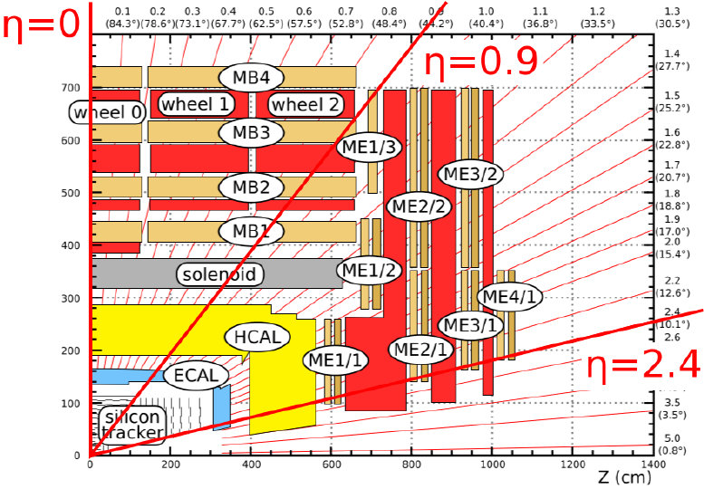
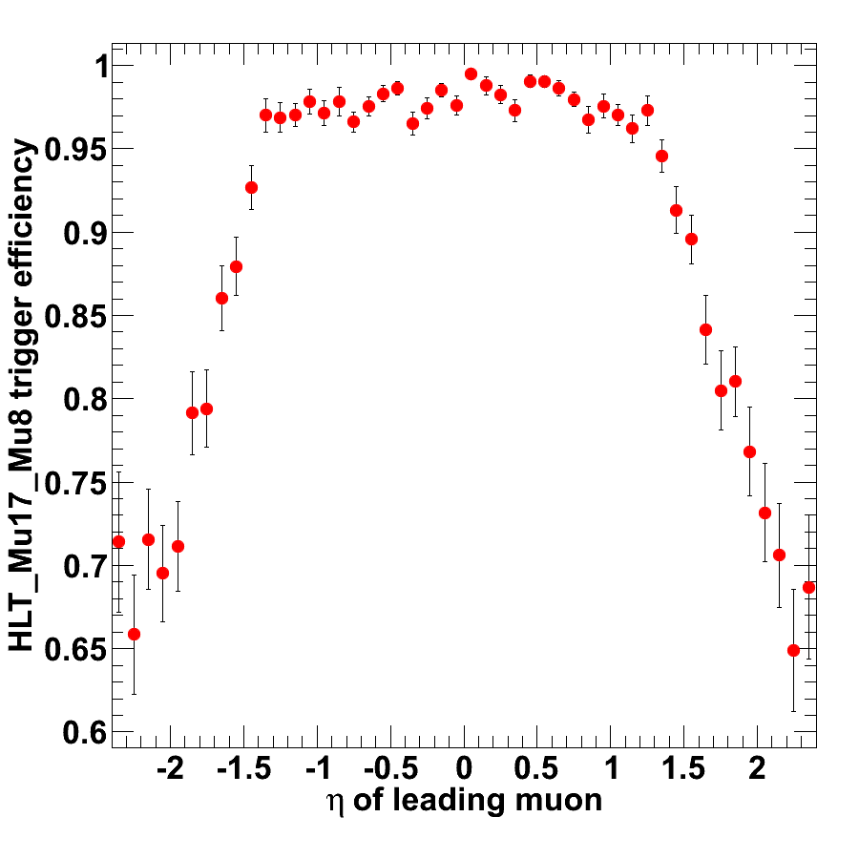
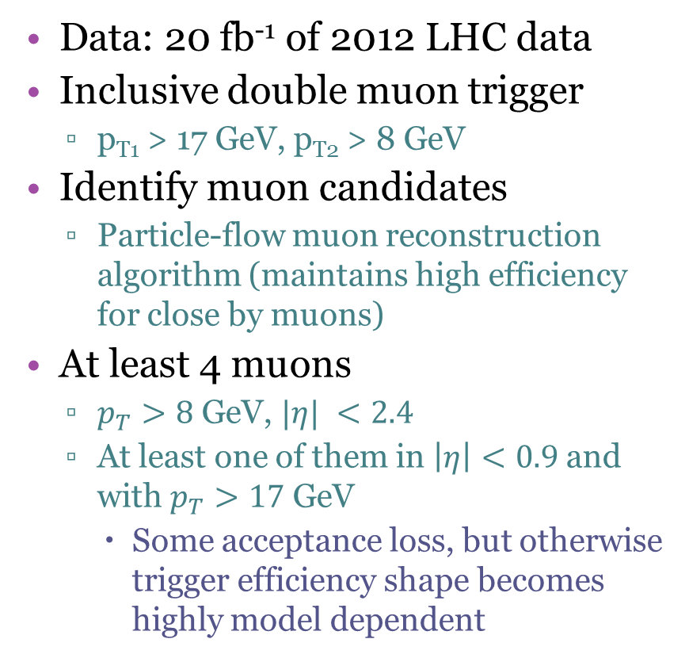
CMS Lepton Jets in Higgs Decays
Data: 20 fb⁻¹ of 2012 LHC data
Inclusive double muon trigger
  p_{T1} > 17 GeV, p_{T2} > 8 GeV
Identify muon candidates
  Particle-flow muon reconstruction algorithm (maintains high efficiency for close by muons)
At least 4 muons
  $p_{T}>8$ GeV, $|η| <2.4$
  At least one of them in $\left|η\right|<0.9$and with $p_{T}>17$ GeV
    Some acceptance loss, but otherwise trigger efficiency shape becomes highly model dependent
NMSSM MC 8 TeV
m(h)=125 GeV
m(a)=2 GeV
Double Muon Trigger Efficiency

Slide 19
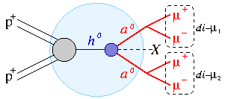
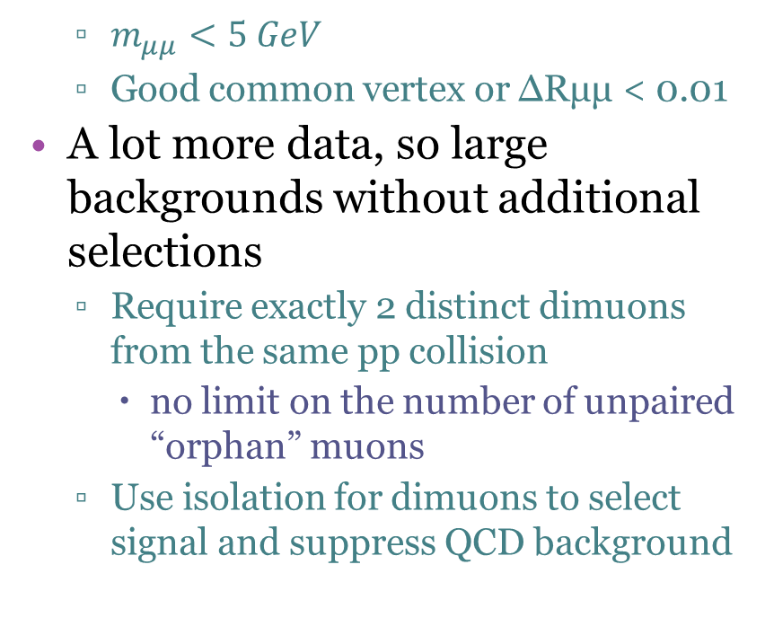



Analysis Strategy
Cluster all muons into nearby oppositely charged light dimuons
  $m_{μμ}<5 GeV$
  Good common vertex or ∆Rμμ < 0.01
A lot more data, so large backgrounds without additional selections
  Require exactly 2 distinct dimuons from the same pp collision
    no limit on the number of unpaired “orphan” muons
  Use isolation for dimuons to select signal and suppress QCD background
track
$ΔZ<0.1$ cm
dimuon
$$z_{trk}$$
$$z_{μμ}$$
beam line

Slide 20
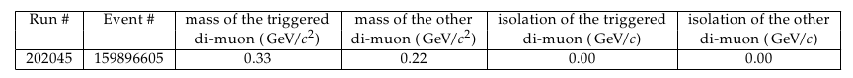
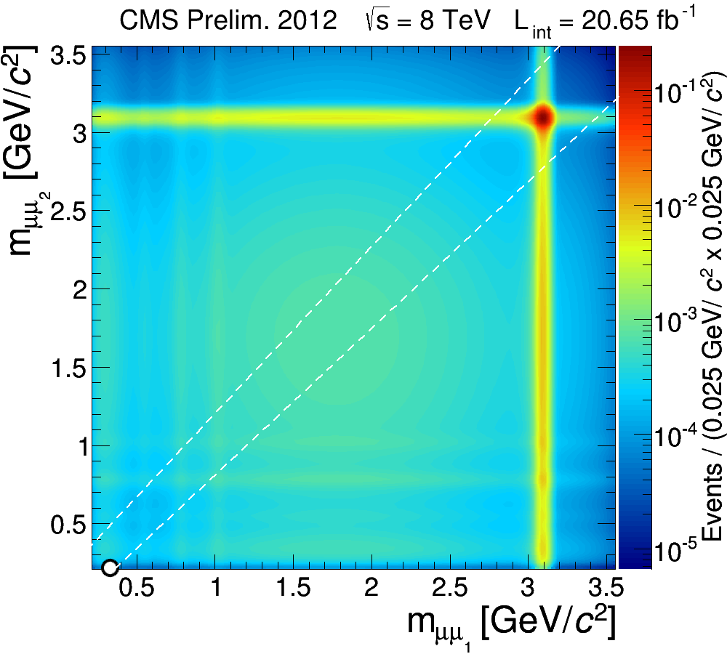
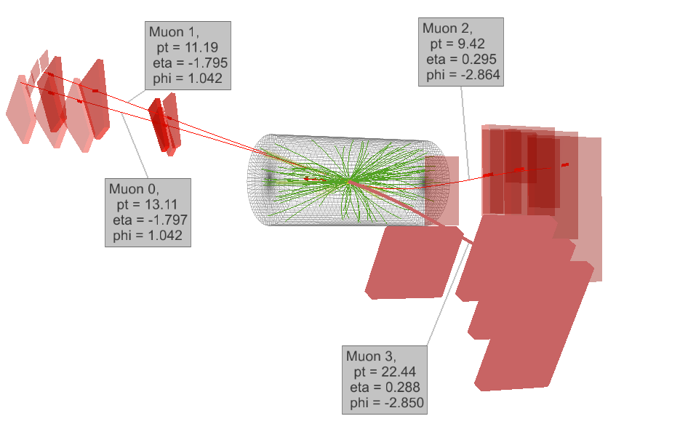
The Signal Region
Open the signal region: one event observed
1
Signal region data event
2
3
Expected 1.8±0.6 background events

Slide 21
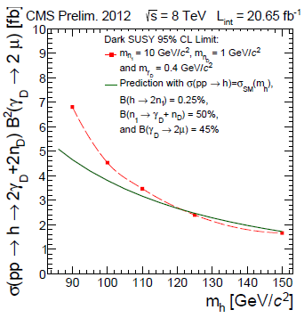
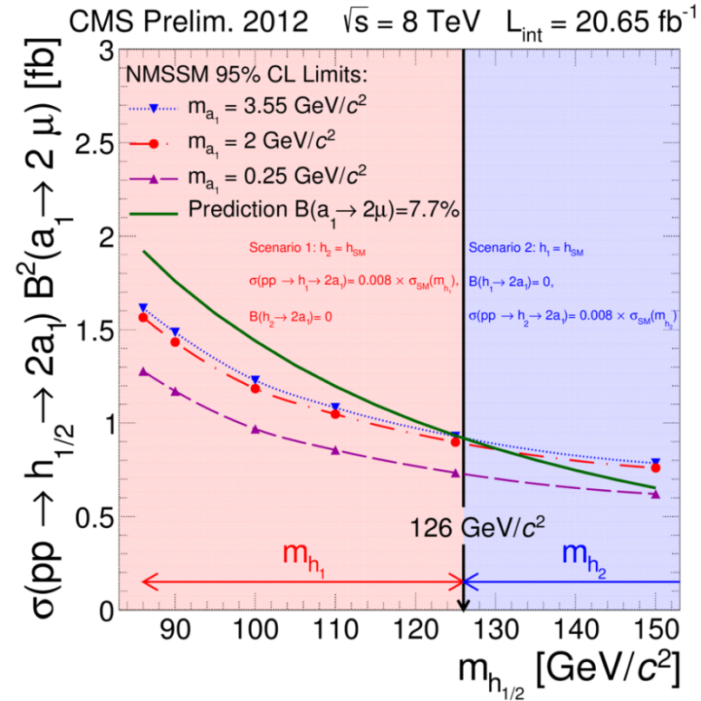
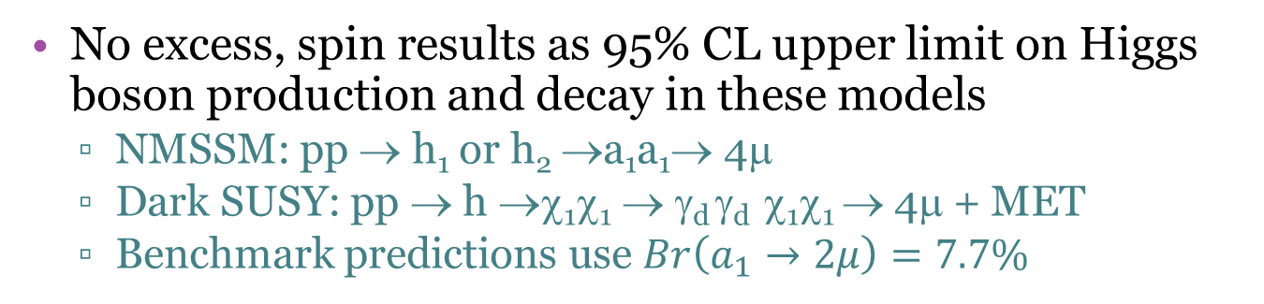
Limits on New Physics
No excess, spin results as 95% CL upper limit on Higgs boson production and decay in these models
  NMSSM: pp → h₁ or h₂ →a₁a₁→ 4μ
  Dark SUSY: pp → h →χ₁χ₁ → γ_{d} γ_{d} χ₁χ₁ → 4μ + MET
  Benchmark predictions use $Br\left(a_{1}→2μ\right)=7.7\%$

Slide 22
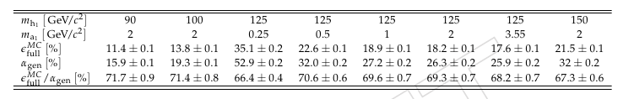
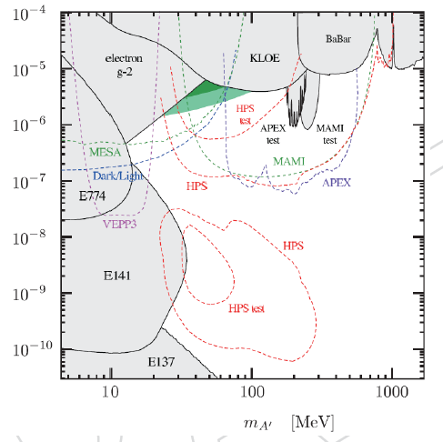
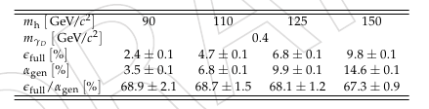
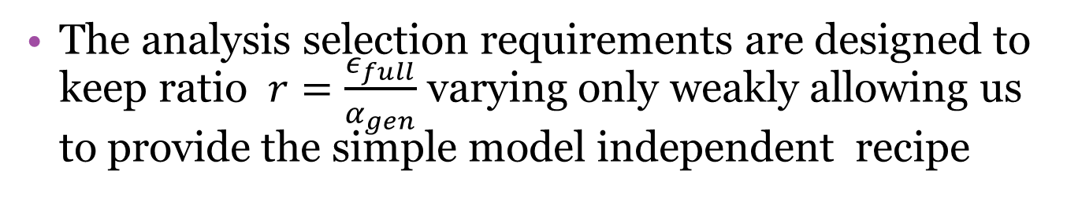

Reinterpretations
The analysis selection requirements are designed to keep ratio $r=\frac{ε_{full}}{α_{gen}}$ varying only weakly allowing us to provide the simple model independent recipe
NMSSM
  $$r=\frac{ε_{full}}{α_{gen}}=0.68±0.05$$
Dark SUSY
Can set limits on the coupling of dark photons by allowing them to have non-zero lifetime
  Model-dependent though, as need to assume these couple to Higgs at 125 GeV

Slide 23
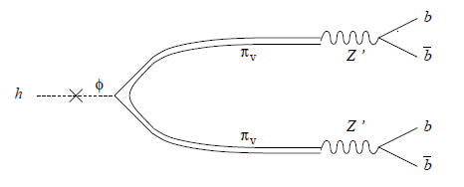
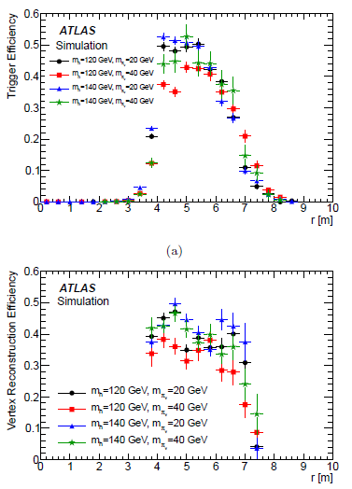
ATLAS Displaced Jets from h→π_{v}π_{v}
Models where Higgs mixes with the hidden sector yielding pairs of hidden bosons with possibly long lifetimes
  Can mix with Z’ or higgs pseudoscalars (branching fractions will vary)
An early ATLAS analysis looking at decays meters from the interaction point
  Use muon system to trigger on clusters of “muons” (in this case tracks produced behind the absorber) within ΔR=0.4
    Require two such clusters far away from each other, veto if cluster is pointed at by:
      a calorimeter jet with E_{T}>30 GeV or
      a tracker track with p_{T}>5 GeV
  Run specially developed tracking/vertexing to reconstruct jets in the muon system

Slide 24
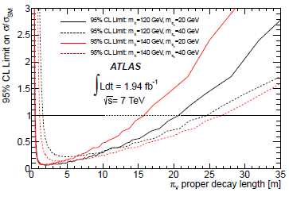
ATLAS Displaced Jets From h→π_{v}π_{v}
No data events passing selections
Set limits on the production rate, assuming BR(h→ππ)=100%
  Easy to rescale to arbitrary BR as the limit is completely driven by acceptance
Would be interesting to see an update to this analysis
  CMS displaced jets search is complementary covering scenarios with stronger couplings

Slide 25
CMS Displaced Lepton Pairs
Generic search for H⁰→XX, using leptonic decays X→ll, with X having substantial lifetime
  2012 data: L=20 fb⁻¹ at 8 TeV
  Re-spinned 7 TeV analysis
E.g. a separate hidden strongly interacting sector coupling to SM only through a heavy Z’
  Visible higgs(es) can naturally mix with the hidden higgs
  If Z’ is heavy, “hidden pions” can easily have decay lengths O(0-100 cm)
Selections:
  Electron/muon candidates are tracks with d₀/σ_{d}>12 matching to either “photons” or standalone muon trigger candidates
  Di-e/Di-μ candidates defined as pairs of tracks within |η|<2 with E_{T}/p_{T}>40(25)/26(26) GeV for first (second) track in a pair
    In di-e channel associated tracks must have pT>36/21 GeV

Slide 26
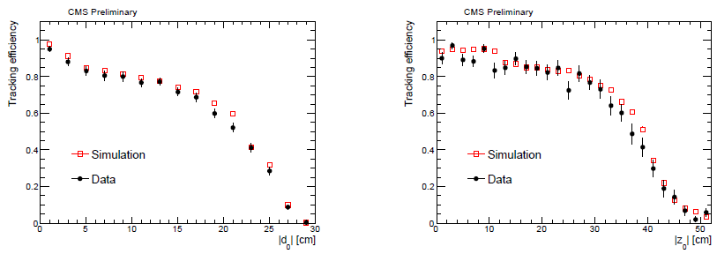
Search for Displaced Lepton Pairs
Avoid standard lepton ID:
  Inefficient for displaced tracks
Efficiency driven by track reconstruction efficiency
  Cross-checked with cosmic muon data
  Require at least one X-candidate per event:
    A common vertex with χ²/ndf<10(5) for e(μ) channel
    M(ee/μμ)>15 GeV, ΔR(μμ)>0.2, p_{T}(e) from ECAL
    Isolation: Σp_{T} /p_{T}<0.1 counting tracks w/ p_{T}>1 GeV in ΔR(trk,e/μ)<0.3 around each lepton (not counting the other lepton in the X-candidate)

Slide 27
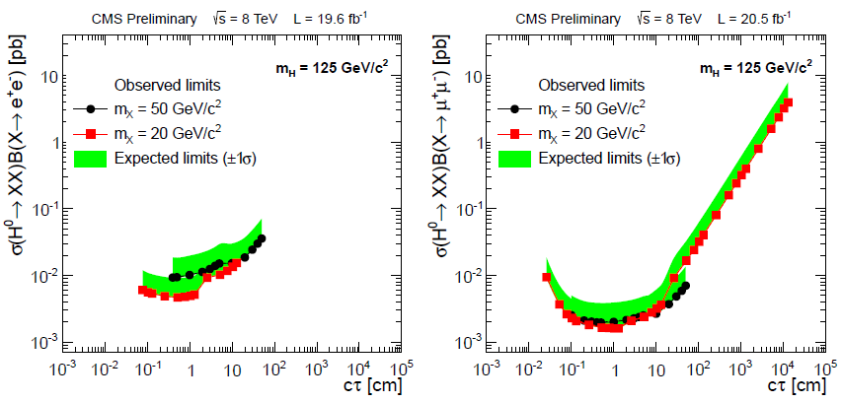
Search for Displaced Lepton Pairs
Limits as a function of the new boson’s lifetime
    Reflect track reconstruction efficiency dependence on decay path length

Slide 28
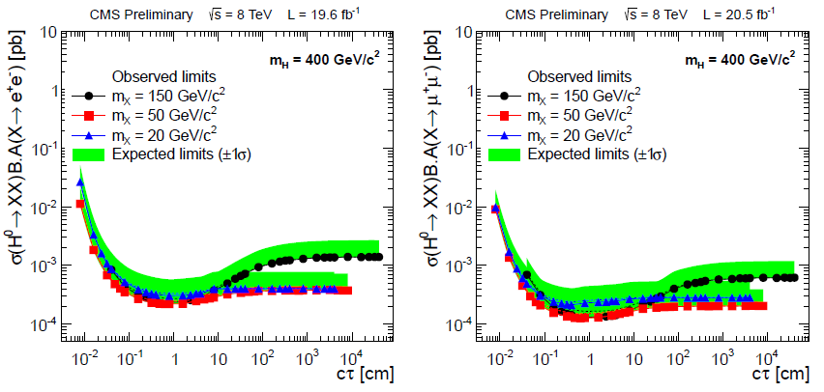
Search for Displaced Lepton Pairs
Limits also available with acceptance included to allow easy re-interpretation
  More details (also heavy Higgs and strong SUSY production) in CMS-EXO-12-037 (public)

Slide 29
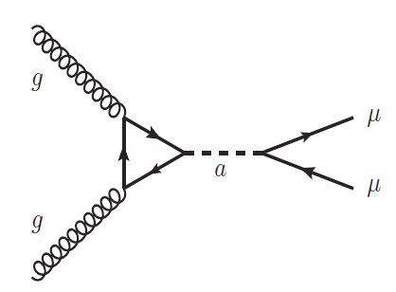
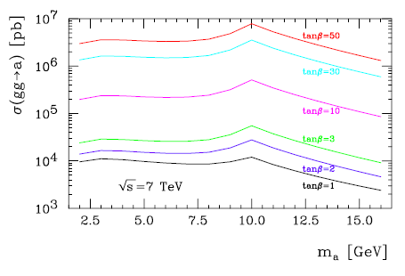
Search for Direct NMSSM a₁ Production
Production via gluon fusion
  Large cross-section if mixing with MSSM A is large
    Suppressed as a₁ has to be highly singlet to abide experimental constraints (cos²θ_{A} <1)
  Usual enhancement with tanβ
Search for resonances in dimuon spectrum
  5.5<m<8.8 and 11.5<m<14 GeV
    Avoid region dominated by large Upsilon backgrounds
  Early 2011 data (1.3 fb-1)
    Had a dedicated very low p_{T} di-muon trigger (prescale = 2)
cos²θ_{A} =1

Slide 30

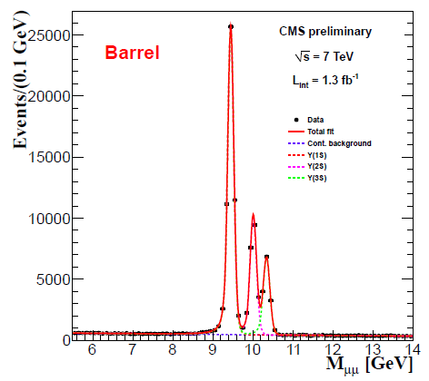
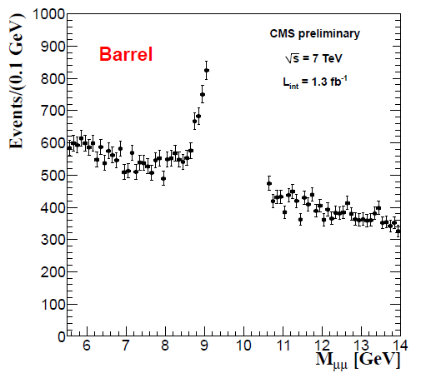
Search for Direct NMSSM a₁ Production
Analysis selections:
  Muon p_{T}>5.5 GeV and |η|<2.4
  Isolation (per muon):
In the two signal regions, fit for the sum of Crystal Ball (signal) and a 1st order polynomial (background)
  Plus the radiative tail of Upsilon for the low mass region

Slide 31
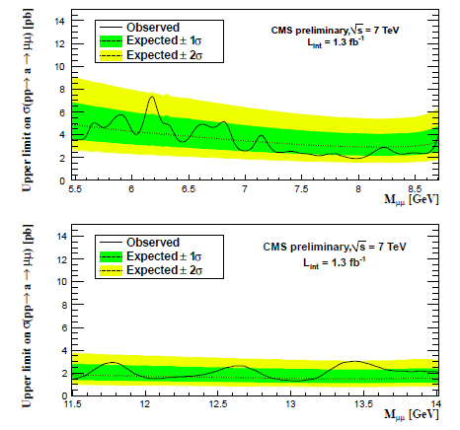

Search for Direct NMSSM a₁ Production
No significant excesses in data
Limits vs m(a) on the production rate
  Further interpretation in terms of cosθ_{A} and tanβ
LHC limits start superseding those from BaBar

Slide 32



ATLAS: NMSSM h→2a→4γ
“Almost unresolved” photon pairs
  L=5 fb⁻¹ of 7 TeV data
Selections:
  E_{T}(“γ₁”)>40 GeV E_{T}(“γ₂”)> 25 GeV in |η|<2.4
Mostly standard photon ID, but drop some of the shape variables
  Keep “slightly resolved” photon pairs
  Also reduces systematics
Full selection efficiency ranges within 20-30% for m(h)=100-150 GeV and m(a)=100-400 MeV
  Similar bump-hunting technique and fit procedure to h→γγ

Slide 33

NMSSM h→2a→4γ
Limits assume SM production mechanism
  SM higgs is used to model production
Results presented as 95%. C.L. limits on σ(pp→h→2a→4γ)
  Br(a→2γ) large at low mass because 2π is not allowed, compete with ee and μμ channels
Should be easily reinterpretable with other models
  Model dependency comes mainly through
    Isolations, which should be stable for most Higgs signatures
    Photon momentum thresholds
      If Higgs decays to a light boson and something else, acceptance will get reduced

Slide 34
Summary
Several CMS and ATLAS analyses either aim at searches for evidence of Higgs decays into “hidden” bosons or can be interpreted that way
  Sensitive to a range of couplings of new hidden bosons to SM
    Long and short-lived final states searched for
  Electron channels starting gaining ground
  In the context of NMSSM pseudoscalars a1, photons allow to cover low mass region below dimuon mass
When possible, results presented in a quasi model independent fashion to allow future interpretations
  Not much coherency due to lack of common benchmarks

