Slide 1
New physics hiding in low energy QCD
Sean Tulin
University of Michigan

Slide 2
Outline
Some thoughts on sensitivities of η decays to new physics
Two parts to this talk:
CP violation beyond the standard model (η → ππ)
How do η decays compare to EDM limits?
New weakly-coupled light forces
Are there new gauge forces “hiding” under QCD?

Slide 3
Part 1
CP violation and η → ππ

Slide 4
CP violation (CPV): motivation
Cosmology (baryon asymmetry):
Sakharov conditions for baryogenesis (Sakharov 1967)
1. Baryon number violation
2. C- and CP-violation
3. Departure from equilibrium or CPT violation
CP violation in the Standard Model (SM) insufficient to explain baryon asymmetry (Gavela et al 1993, Huet & Sather 1994)
Particle physics
CPV is a generic feature of particle physics theories beyond the SM e.g. Supersymmetry or neutrino see-saw models: theories have new phases that can give successful baryogenesis

Slide 5
CPV decay η ◊ ππ
Current limit: BR(η ◊ π⁰π⁰) < 3.4 x 10⁻⁴ (GAMS-4π)
Standard model (Jarlskog & Shabalin 1995)
CKM phase: BR(η ◊ π⁰π⁰) < 10⁻²⁷
θ_{QCD} phase: BR(η ◊ π⁰π⁰) < 10⁻¹⁸ x (θ_{QCD} /10⁻¹⁰)²
Neutron electric dipole moment (EDM) constraint:
(Crewther et al 1979, Pospelov & Ritz 1999; Baker et al 2006)
d_{n} = 2.4 x 10⁻¹⁶ e cm x θ_{QCD} < 2.9 x 10⁻²⁶ e cm [90% limit]
Otherwise BR(η ◊ π⁰π⁰) could have been sizable in SM!

Slide 6
CPV decay η ◊ ππ
BR(η ◊ π⁰π⁰) unambiguous probe for new CPV
Caveat:
Any contribution to BR(η ◊ π⁰π⁰) also generates a nonzero neutron EDM. Can use neutron EDM to limit BR(η ◊ π⁰π⁰).
Gorchtein bound: (Gorchtein 2008)
BR(η ◊ π⁰π⁰) < 3.5 x 10⁻¹⁴ for d_{n} < 2.9 x 10⁻²⁶ e cm

Slide 7
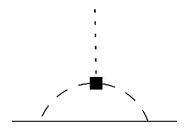
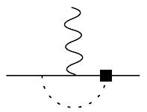
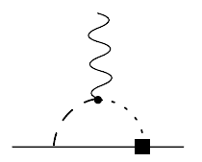
Gorchtein bound
g_{ηππ}
π
CP-odd ηππ coupling
= CPV vertex
CP-odd ηNN coupling
Integrate out pions
CP-odd NNγ coupling
Integrate out η, ρ/ω
η
π
η
π
π
N
N
γ
γ
N
N
ρ/ω
η
N
N
η
d_{n} ∼ 2.5 x 10⁻¹⁷ e cm x (g_{ηππ} /GeV)
Order-of-magnitude estimate only
(Gorchstein 2008)

Slide 8
Gorchtein bound (revisited?)
Can this bound be made more rigorous? Some ideas…
g_{ηππ}
π
CP-odd ηππ coupling
= CPV vertex
CP-odd πNN coupling
Match onto π-N EFT by integrating out η.
Generate CP-odd (isoscalar) coupling.
CP-odd NNγ coupling
Match onto γ-N EFT by integrating out π.
n EDM
η
π
π
η
π
N
N
γ
(Crewther et al 1979)
N
N
π

Slide 9
Conclusions: CPV decay η ◊ ππ
BR(η ◊ ππ) must be far below experimental sensitivities due to stringent n EDM limit:
Current limit: d_{n} < 2.9 x 10⁻²⁶ e cm (Baker et al 2006)
Gorchtein bound: BR(η ◊ π⁰π⁰) < 3.5 x 10⁻¹⁴
Independent of particle physics model for new CPV
Caveat: Bound is approximate (order of magnitude only)
Worthwhile to revisit this bound to make it more precise
BUT cannot avoid generating d_{n} at two loop order:
d_{n} ∼ e g_{ηππ} / ((4π)⁴ M_{QCD}²) ∼ 10⁻¹⁸ e cm x (g_{ηππ} /GeV)
Very naïve estimate

Slide 10
Conclusions: CPV decay η ◊ ππ
Another caveat: n EDM and BR(η ◊ ππ) sensitive to different linear combinations of new physics CPV phases
Can have fine-tuned cancellations between phases contributing to d_{n} but not BR(η ◊ ππ)
10⁻⁵ cancellation in d_{n} → BR < 3.5 x 10⁻⁴
10⁻⁴ cancellation in d_{n} → BR < 3.5 x 10⁻⁶
What is the constraint on BR(η ◊ ππ) from d_{Hg}?
Likely requires fine-tuning to evade d_{Hg} limit also
BUT BR(η ◊ ππ) should be measured anyway

Slide 11
Part 2
Searching for new light forces

Slide 12
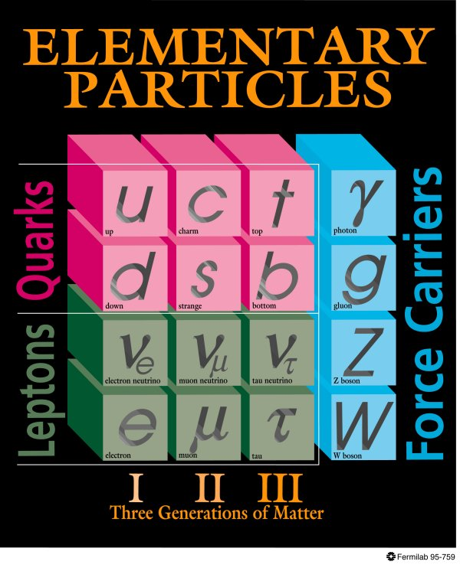
Motivation for new forces
SM based on SU(3)_{C} x SU(2)_{L} x U(1)_{Y} gauge symmetry. Are there any additional gauge symmetries? Look for new gauge bosons.
Motivations:
Grand unified theories: Generically have additional gauge bosons, but typically very heavy (10¹⁶ GeV).
Dark matter: Stability of dark matter related to new gauge symmetry?
Intensity frontier
α⁻¹ (1/coupling)
LHC
mass

Slide 13
Motivation for new forces
New light (MeV–GeV) forces associated with dark matter (DM) have received much attention in the past few years.
Sommerfeld-enhancement models of DM and indirect detection anomalies (e.g. PAMELA)
Self-interacting DM and explaining small scale structure anomalies in dwarf galaxies
Asymmetric DM models
Hidden sector DM and relic density
(g-2)_{μ} anomaly
GeV-scale experimental searches for new weakly-coupled light vector bosons from a new force (“dark photon”)
Pospelov & Ritz (2008); Arkani-Hamed et al (2008)
e.g. Lin et al (2011)
Feng et al (2009)
Pospelov (2008)
Bjorken et al (2009), Reece and Wang (2009)

Slide 14
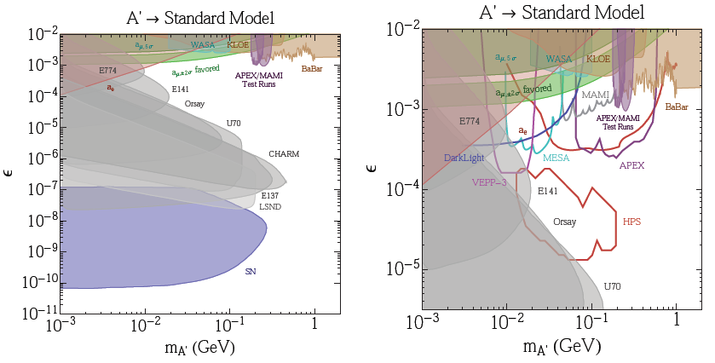
Searches for dark photons
Ongoing experimental efforts to discover new gauge bosons
Largely focused on kinetic-mixing “dark photon” models (A’)
Relies on A’ leptonic coupling to with strength eε
Essig et al (2013)
Coupling
Mass
Mass

Slide 15
New baryonic force
Dark photon limits are for a specific model where A’ couples to electrons. But there may be new forces that do not couple to leptons. How do we search for these types of new forces?
Simplest example: Gauge boson (B) coupled to baryon number
Assume B couples to quarks only but not leptons (leptophobic Z’).
Literature: Radjoot (1989), Foot, et al (1989), He & Rajpoot (1990), Carone & Murayama (1995), Bailey & Davidson (1995), Aranda & Carone (1998), Fileviez Perez & Wise (2010), Graesser et al (2011), …
Flavor-universal vector coupling g_{B} to all quarks

Slide 16
New baryonic force
B = gauge boson coupled to baryon number
Discovery signals depend on the B mass
Meson physics
Nelson & Tetradis (1989), Carone & Murayama (1995)
Departures from inverse square law
Adelberger et al (2003)
Low-energy n scattering
Barbieri & Ericson (1975); Leeb & Schmiedmayer (1991)
Colliders: hadronic Z, dijet resonances, …
m_{B}
meV
eV
MeV
GeV
TeV
Long range nuclear forces > 1/m_{π}
Tests of perturbative QCD at colliders
Is it possible to discover light weakly-coupled forces hiding in nonperturbative QCD regime?

Slide 17
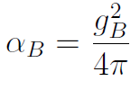
Constraints on new baryonic force
Focus on m_{B} ∼ MeV – GeV range of interest for physics of light mesons
Range of interest for η decays: m_{π} < m_{B} < m_{η}
How does B modify η decay properties?
What are the constraints on the coupling?
“Baryonic” fine structure constant

Slide 18
η decay
New baryonic forces observed through light meson decays (Nelson & Tetradis 1989)
→ Bγ decay (m_{B} < m_{η})
Decay rate related to η → γγ rate
B
η
u,d,s
γ
Triangle diagram
Tr = trace over SU(3) flavors (u,d,s)
λ⁸ (λ⁰) = octet (singlet) SU(3) generator, θ = singlet-octet mixing angle, Q = electric charge

Slide 19
B decay
How does B vector boson decay? Depends on mass…
3m_{π} < m_{B} < ∼GeV : B → π⁺ π⁻ π⁰
m_{π} < m_{B} < 3m_{π} : B → π⁰ γ
MeV < m_{B} < m_{π} : B ◊ e⁺e⁻, γγγ
Why no B → ππ?
π⁰
B
u,d,s
γ

Slide 20
Decay channels of B boson
B has same quantum numbers as ω vector meson
Assume its decay properties are similar
Particle Data Book

Slide 21
Decay channels of B boson
B has same quantum numbers as ω vector meson
Assume its decay properties are similar
Particle Data Book
Violates G-parity

Slide 22
Decay channels of B boson
B has same quantum numbers as ω vector meson
Assume its decay properties are similar
Particle Data Book
Dominant above 3m_{π}
Dominant between m_{π} – 3m_{π}
Violates G-parity

Slide 23
η decay
m_{B} range Signature
415 – 550 MeV η → B γ → π⁺ π⁻ π⁰ γ
130 – 415 MeV η → B γ → π⁰ γ γ
0 – 130 MeV η → B γ → (e⁺e⁻ / γγγ / invis.) + γ
3m_{π}
m_{η}
m_{π}
3m_{π}
m_{π}
Note: for m_{B} < m_{π}, constraints from π⁰ → (e⁺e⁻ / γγγ / invis.) + γ

Slide 24
η decay
m_{B} range Signature
415 – 550 MeV η → B γ → π⁺ π⁻ π⁰ γ
130 – 415 MeV η → B γ → π⁰ γ γ
0 – 130 MeV η → B γ → (e⁺e⁻ / γγγ / invis.) + γ
3m_{π}
m_{η}
Focus on this case
m_{π}
3m_{π}
m_{π}
Note: for m_{B} < m_{π}, constraints from π⁰ → (e⁺e⁻ / γγγ / invis.) + γ

Slide 25
New physics in η ◊ π⁰γγ
Decay rate:

Slide 26
New physics in η ◊ π⁰γγ
Decay rate:

Slide 27
New physics in η ◊ π⁰γγ
Decay rate:
Observed BR(η → π⁰γγ) << BR(η → γγ)
Constrains α_{B} << α_{em} ∼ 1/137
η decays provide the strongest limit on vector boson in the 130—415 MeV range
New baryonic force must be much weaker than the electromagnetic interaction!

Slide 28
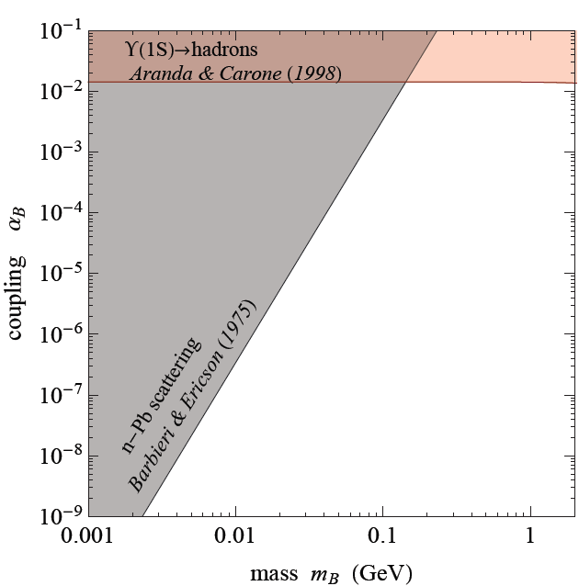
Constraints on a new baryonic force
ϒ(1S)→hadrons
Low-energy n-Pb scattering
Excludes nuclear forces with range > 1/m_{π}
b
q
B
ϒ(1S)
b
q

Slide 29
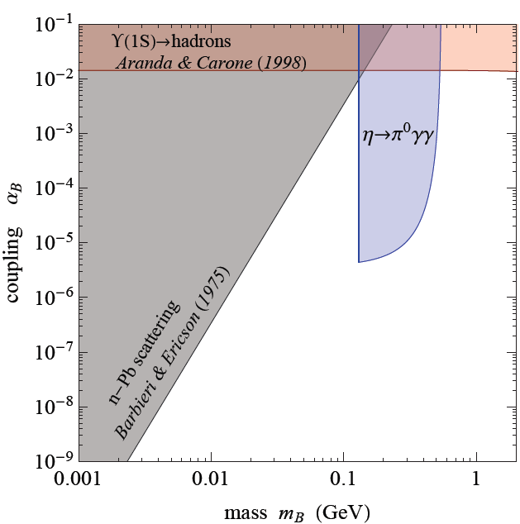
Constraints on a new baryonic force
η ◊ π⁰γγ constraint
Limit assuming new physics (NP) contribution to BR satisfies:
δBR(η◊π⁰γγ) < 10⁻⁴
Approximate current limit
Note: neglecting interference with SM decay in narrow width approximation

Slide 30
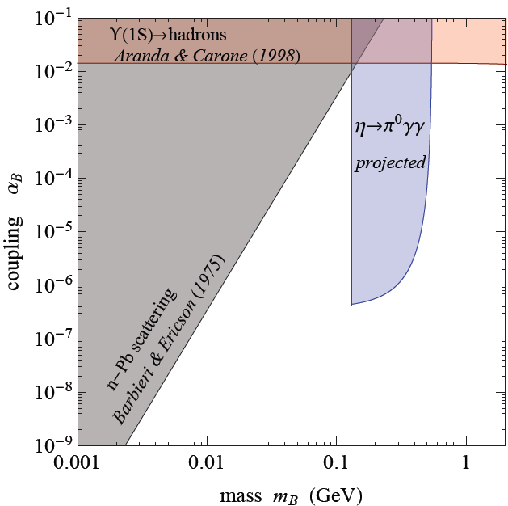
Constraints on a new baryonic force
η ◊ π⁰γγ constraint
Limit assuming new physics (NP) contribution to BR satisfies:
δBR(η◊π⁰γγ) < 10⁻⁵
Projected limit (?)
Note: neglecting interference with SM decay in narrow width approximation

Slide 31
Constraints on a new baryonic force
Pion decay constraints for m_{B} < m_{π}
Decay rate:
How does B decay? Not sure… (needs more detailed calculation)
B → e⁺e⁻ (via B-γ mixing)
B → γγγ
B → invisible (long-lived on detector timescale)
BR(π⁰ → e⁺e⁻ γ) = (1.174 ± 0.035)% (PDG)
Agrees with SM value (Joseph 1960)
Take δBR(π⁰ → e⁺e⁻ γ) < 7 x 10⁻⁴
BR(π⁰ → γγγγ) < 2 x 10⁻⁸ (McDonough et al 1988)
Expected to be very long-lived (Nelson & Tetradis 1989)
Use limit from neutrino decays: BR(π⁰ → γνν) < 6 x 10⁻⁴ (PDG)

Slide 32
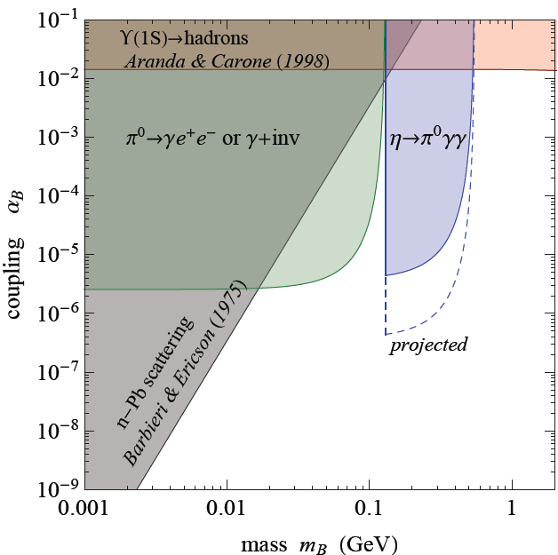
Constraints on a new baryonic force
π⁰ decay constraints
for m_{B} < m_{π}
Consider either π⁰ ◊ γee or γ + inv (comparable limits)
If π₀ ◊ γγγγ is prompt on detector timescales, limit on α_{B} is ∼10⁴ times stronger

Slide 33
Constraints on a new baryonic force
Heavy B regime
∼ 500 MeV < m_{B} < ∼GeV
Search for:
η’ ◊B γ ◊ π⁰π⁺π⁻γ or π⁰γγ (suppressed)
η’ ◊ Bγ

Slide 34
η ◊ π⁰γγ kinematics
New physics decay is two 2-body decays while SM decay is 3-body decay.
So far, only considered constraint on total rate.
Can kinematic information be used to enhance the sensitivity of η ◊ π⁰γγ to new physics?

Slide 35
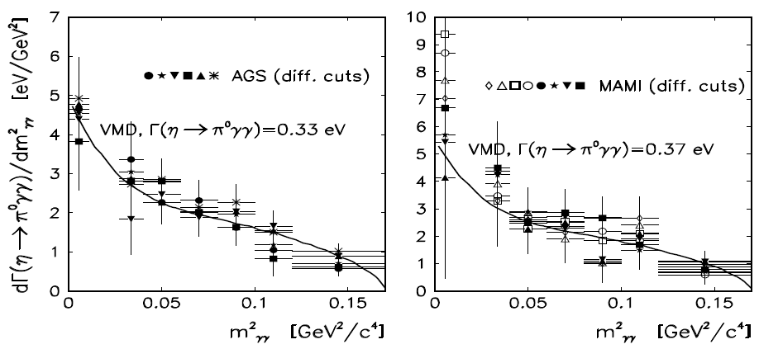
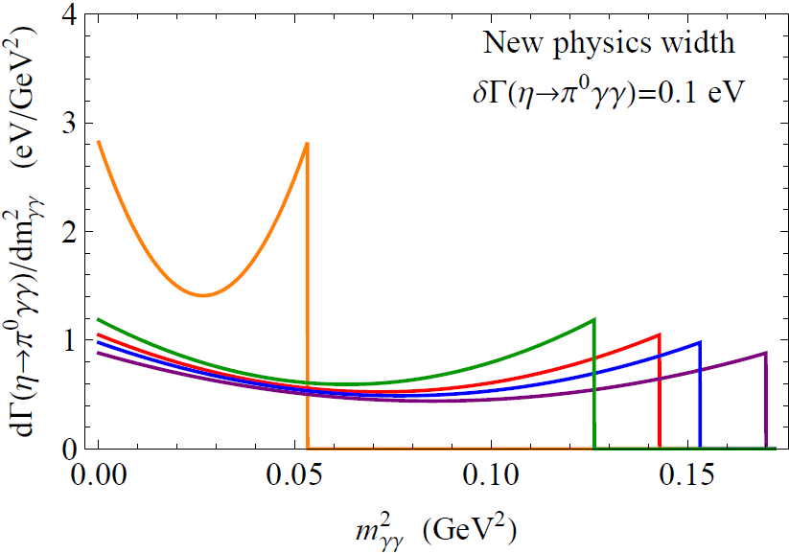
η ◊ π⁰γγ kinematics
Prakhov (2007)
γγ invariant mass distribution
m_{B} = 150 MeV
400 MeV
350 MeV
200 MeV
250 MeV
Endpoint:

Slide 36
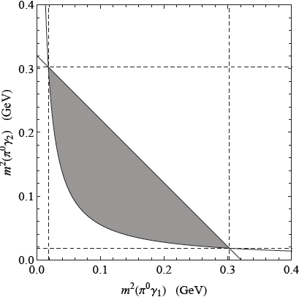
η ◊ π⁰γγ kinematics
Dalitz plot:
m²(π⁰γ₁) vs m²(π⁰γ₂)
Decays have either m²(π⁰γ₁) or m²(π⁰γ₂) = m_{B}² if new particle B involved in η decay
3-body allowed

Slide 37
Conclusions
CP-violating η ◊ ππ decay
Strongly constrained by nEDM limit (BR < ∼ 3x10⁻¹⁴)
Important to revisit this limit theoretically
New hidden forces
Searches for new light forces are a hot topic with a lot of experimental interest, but all searches are focusing on the “dark photon” model
η decays are a fantastic probe for a new light baryonic force that couples to quarks only. Precision tests of a new force “hidden” in nonperturbative QCD.
η ◊ π⁰γγ gives strongest limit for few*100 MeV mass
Current limit: baryonic force is 2000 times weaker than electromagnetism!
Better limits from kinematic analysis of η ◊ π⁰γγ? This has not been done!

