Slide 1
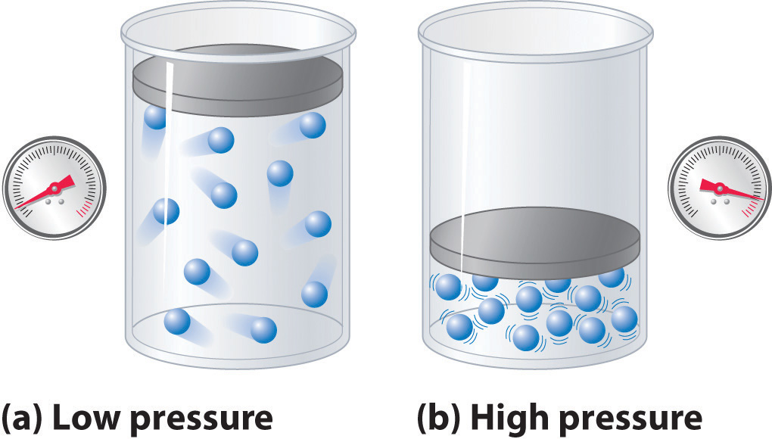
Black Hole Thermodynamics with Lambda: Some Consequences
David Kubizňák
(Perimeter Institute)
Λ
Lambda and Quasi-Lambda workshop
University of Massachusetts, Amherst, MA, USA
April 10 – April 12, 2014

Slide 2
Plan of the talk
Black holes as thermodynamic objects
Cosmological constant: thermodynamic pressure and volume
AdS analogue of “everyday thermodynamics of simple substances”
Hawking-Page transition
VdW fluid and charged AdS black holes
Reentrant phase transition
Triple point and solid/liquid/gas analogue
Conclusions
Friends: N. Altamirano, M. Cvetic, B. Dolan, G. Gibbons, S. Gunasekaran, D. Kastor, R. Mann, Z. Sherkatghanad, J. Traschen

Slide 3
Black holes as thermodynamic objects
If someone points out to you that your pet theory of the universe is in disagreement with Maxwell's equations-then so much the worse for Maxwell's equations. If it is found to be contradicted by observation-well these experimentalists do bungle things sometimes. But if your theory is found to be against the second law of thermodynamics I can give you no hope; there is nothing for it but to collapse in deepest humiliation.
Sir Arthur Stanley Eddington
Gifford Lectures (1927), The Nature of the Physical World (1928), 74.

Slide 4
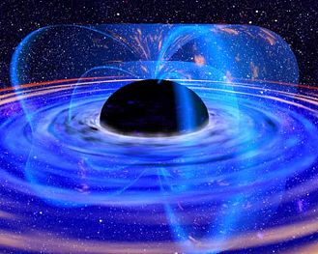
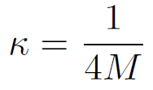
Schwarzschild black hole:
asymptotic mass (total energy)
black hole horizon: (radius rh=2M)
surface gravity
surface area
never decreases
Bekenstein?

Slide 5
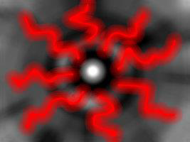
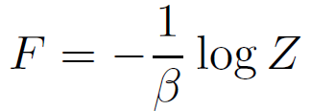
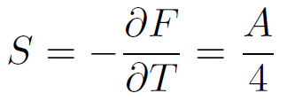
Hawking (1974):
derivation used QFT in curved spacetime
Other approaches:
Euclidean path integral approach (Gibbons & Hawking-1977)
Euclidean manifold non-singular if the imaginary time τ identified with a certain period Δτ. In QFT this corresponds to a finite temperature
Tunneling approach, LQG, String theory, ….

Slide 6
Black hole thermodynamics
First law of black hole thermodynamics:
Smarr-Gibbs-Duhem relation:
Specific heat of AF Schwarzschild BH is negative
(cannot have thermal equilibrium)
Where is the PdV term?

Slide 7
Λ as thermodynamic pressure & thermodynamic volume
Λ

Slide 8
Proposal
Consider an asymptotically AdS black hole spacetime
Identify the cosmological constant with a thermodynamic pressure
Allow this to be a “dynamical” quantity

Slide 9
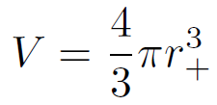
First law of black hole thermodynamics in AdS:
D.Kastor, S.Ray, and J.Traschen, Enthalpy and the Mechanics of AdS Black Holes, Class. Quant. Grav. 26 (2009) 195011, [arXiv:0904.2765].
Introduces PdV term into black hole thermodynamics
Mass M interpreted as enthalpy rather than energy
The formula can be used to calculate the thermodynamic volume associated with the black hole
for example, for Schwarzschild:

Slide 10
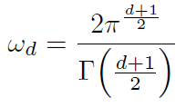
Good definition of volume: isoperimetric ineguality
Isoperimetric Inequalities (analogue of Penrose inequalities)
M. Cvetic, G.W Gibbons, DK, C.N. Pope, Black hole enthalpy and an entropy inequality for the thermodynamic volume, Phys. Rev. D84 (2011) 024037, [arXiv:1012.2888].
Conjecture: for any AdS black hole
“For a black hole of given thermodynamic volume V, the entropy is maximised for Schwarzschild-AdS”

Slide 11
Allows one to derive the valid Smarr relation (scaling argument)
Euler’s theorem:
Mass of black hole:
since
Smarr relation:

Slide 12
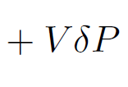
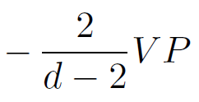
Black hole thermodynamics in AdS
First law of black hole thermodynamics:
Smarr-Gibbs-Duhem relation:
Generalization: Extra term for any dimensionful parameter
D.Kastor, S.Ray, and J.Traschen, Smarr Formula and an Extended First Law for Lovelock Gravity, Class. Quant. Grav. 27 (2010) 235014, [arXiv:1005.5053].

Slide 13
Thermodynamic machinery
Study: charged and rotating AdS black holes in a canonical
(fixed Q or J) ensemble. Relate to fluid thermodynamics, by comparing the “same physical quantities”
The corresponding thermodynamic potential is Gibbs free energy
equilibrium state corresponds to the global minimum of G.
Local thermodynamic stability: positivity of the specific heat
Phase diagrams: P-T diagrams
Critical points: calculate critical exponents,….

Slide 14
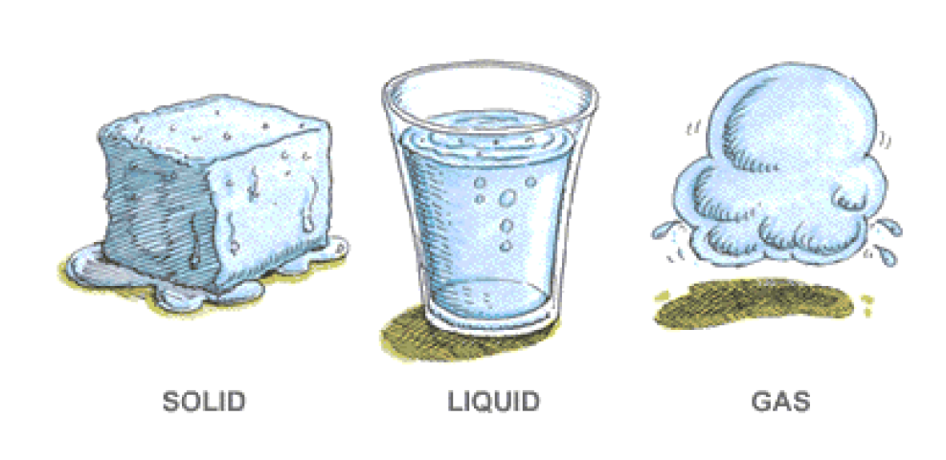
AdS analogue of “everyday thermodynamics of simple substances”

Slide 15
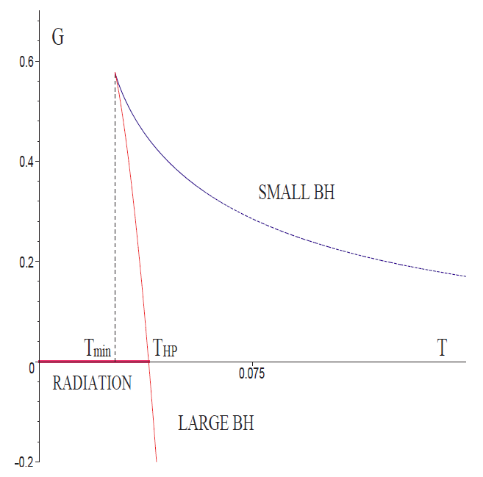
a) Schwarzschild-AdS black hole
Hawking-Page transition:
S.W. Hawking & D.N. Page, Thermodynamics of black holes in anti-de-Sitter space, Commun. Math. Phys. 87, 577 (1983).
AF black holes evaporate by Hawking radiation. AdS has constant negative curvature which acts like a confining box, there are static black holes in thermal equilibrium.
Black holes have minimal temperature T=Tmin~1/l. For T<Tmin gas of particles in AdS.
Large black holes have positive specific heat, equilibrium configuration is stable.
There is a 1st order transition between gas of particles and large black holes at Tc

Slide 16
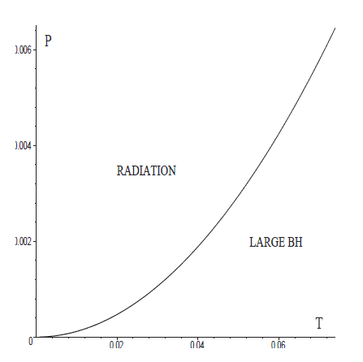
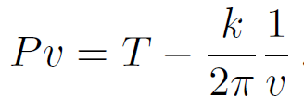
Hawking-Page transition
Witten (1998): phase transition in dual CFT (quark-gluon plasma)
“fluid interpretation”: solid/liquid PT (infinite coexistence line)
Equation of state: depends on the horizon topology
Planar black holes correspond to ideal gas! Can we go beyond?

Slide 17
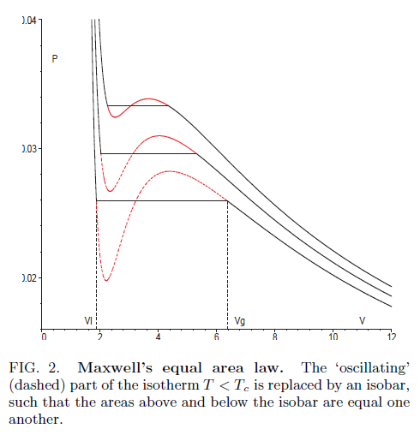
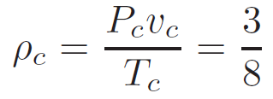
b) Van der Waals fluid and charged AdS BHs
Chamblin, Emparan, Johnson, Myers, Charged AdS black holes and catastrophic holography, Phys.Rev. D60 (1999) 064018, [hep-th/9902170].
DK, R.B. Mann, P-V criticality of charged AdS black holes, JHEP 1207 (2012) 033.
Van der Waals fluid
Parameter a measures the attraction between particles (a>0) and b corresponds to “volume of fluid particles”.
Critical point:

Slide 18
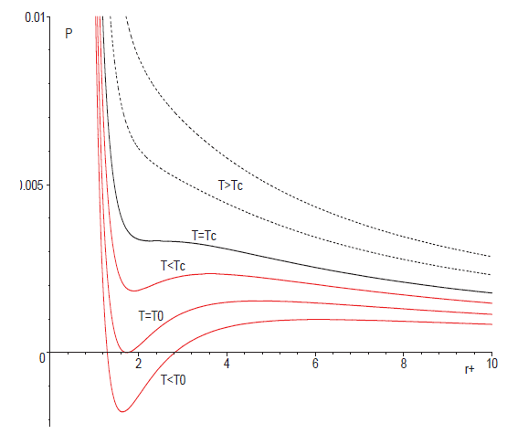
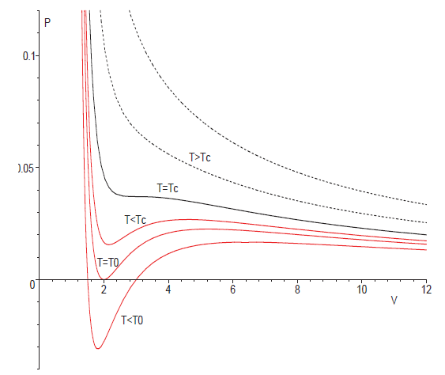
Analogy complete?
Equation of state:
charged AdS BH:
(fixed Q)
VdW fluid:
vs.

Slide 19
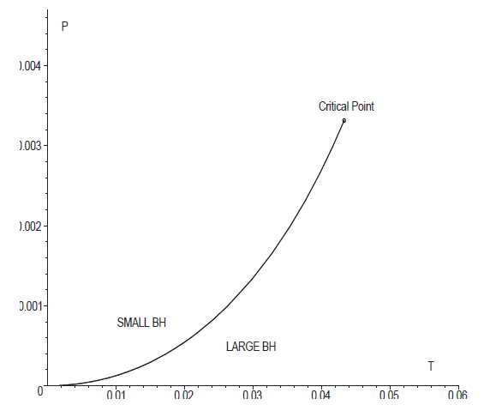
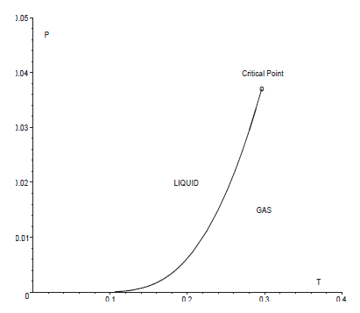
Coexistence line
vs.
MFT critical exponents
govern specific heat, volume, compressibility and pressure at the vicinity of critical point.

Slide 20
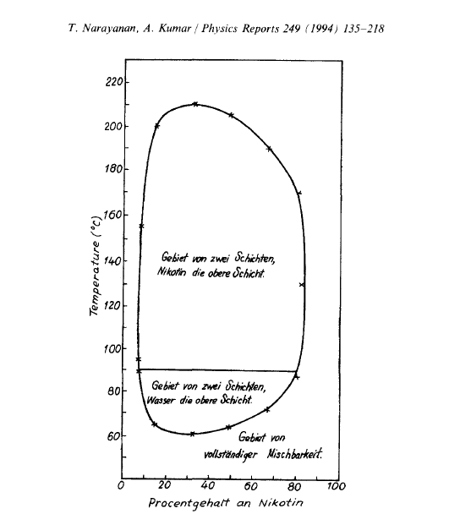
c) Reentrant phase transition
A system undergoes an RPT if a monotonic variation of any thermodynamic quantity results in two (or more) phase transitions such that the final state is macroscopically similar to the initial state.
First observed by Hudson (1904) in a nicotine/water mixture
Z. Phys. Chem. 47 (1904) 113.
Since then:
multicomponent fluid systems, gels, ferroelectrics, liquid crystals, and binary gases
T. Narayanan and A. Kumar, Reentrant phase transitions in multicomponent liquid mixtures, Physics Reports 249 (1994) 135–218.

Slide 21
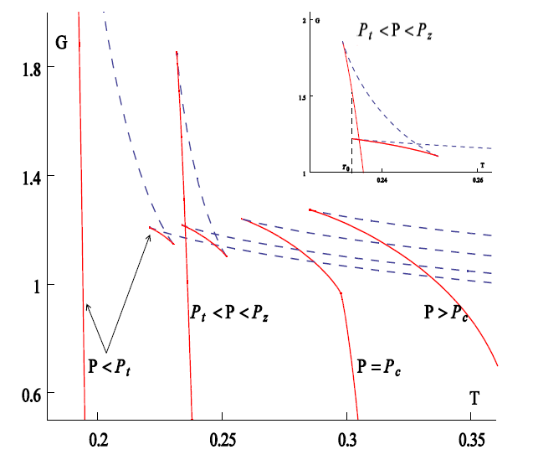
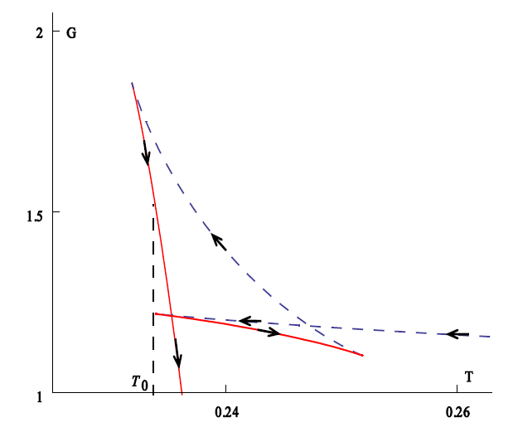
AdS analogue: large/small/large black hole phase transition in
singly spinning Kerr-AdS BH in 6 dimensions
N.Altamirano, DK, R.B. Mann, Reentrant phase transitions in rotating AdS black holes, arXiv:1306.5756 (2013).
Reentrant phase transition
zeroth-order phase transition
accompanied by a peculiar zeroth-order phase transition

Slide 22
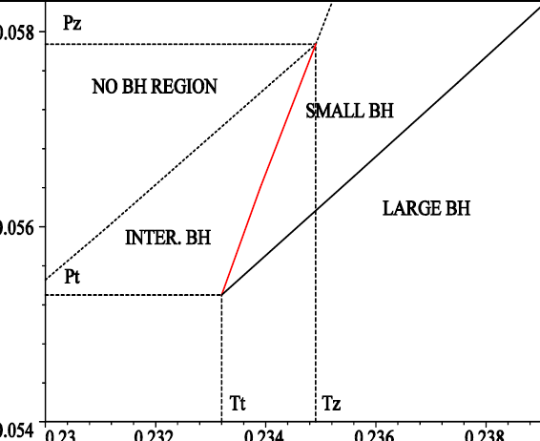
P-T phase diagram
1st order phase transition
0th order phase transition

Slide 23
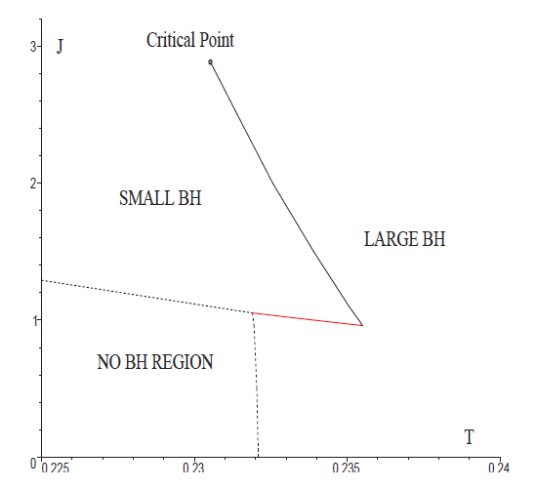
J-T phase diagram
The discovered RPT does not require variable Λ!
Occurs in any d>6: “two components”: BH vs. Black brane?

Slide 24
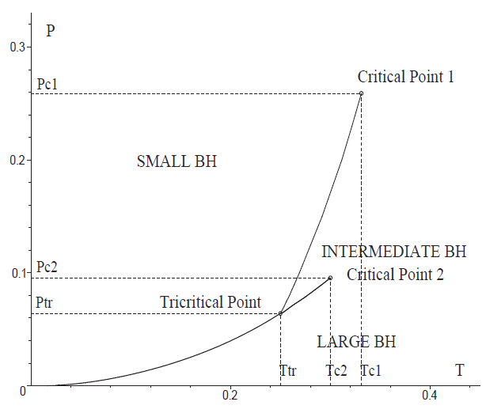
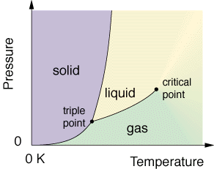
d) Triple point and solid/liquid/gas analogue
large/small/large black hole phase transition and a triple point
in multiply spinning Kerr-AdS BH in 6 dimensions with certain
ratio q of the two angular momenta.
N.Altamirano, DK, R.B. Mann, Z. Sherkatghanad, Kerr-Ads analogue of tricritical point and solid/liquid/gas phase transition, arXiv:1308.2672 (2013).

Slide 25
Conclusions
Thermodynamics is a governing principle, black holes are not an exception!
Recently people have been playing with the idea of identifying the cosmological constant with the dynamical pressure. This gives a way of defining the volume of black holes.
Gain some useful properties: Isoperimetric inequalities, consistency with the Smarr relation, compressibility,....?
One can also search for analogues with “every day thermodynamics of simple substances”: solid/liquid, Van der Waals, reentrant phase transitions, triple points, solid/liquid/gas phase transitions,...
Can also be extended to dS black hole spacetimes (arXiv:1301.5926).
Is there an interpretation in AdS/CFT correspondence?

Slide 27
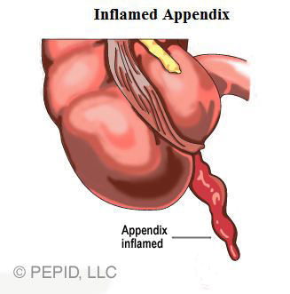
VI) Appendices

Slide 28
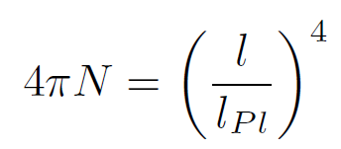
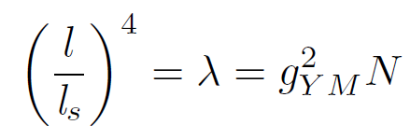
a) Variable Λ and AdS/CFT?
Varying Λ corresponds to varying N (provided we fix the Planck length)
Similarly since CFT, gYM does not run. Going beyond CFT do we get RG flow?
Continuous variation of N is probably OK.
Classical gravity corresponds to
(similar to TD limit…can vary number of moles continuously)
Quantized N…quantum gravity effects?
“Grand-canonical ensemble of stringy vacua” with conjugate quantity playing role of “chemical potential”?

Slide 29
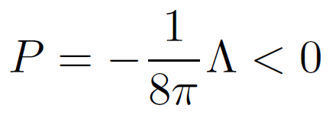
b) Thermodynamics of dS black holes
2 problems:
2 horizons at different temperatures
No timelike KF outside the BH and hence there is no asymptotic mass
B.P. Dolan, D. Kastor, DK, R.B. Mann, J. Traschen, Thermodynamic Volumes and Isoperimetric Inequalities for de Sitter Black Holes, arXiv:13001.5926 (2013).
Identify:
Hamiltonian analysis gives 3 first laws and Smarr relations
TD volume conjectured to obey ISO inequality.

