Slide 1



Lecture VI: Electric Dipole Moments Beyond the Standard Model
M.J. Ramsey-Musolf
U Mass Amherst
http://www.physics.umass.edu/acfi/
ACFI EDM School November 2016

Slide 2
Lecture IV Outline
General Considerations
BSM Motivation
Supersymmetry (Minimal Model)
Higgs Portal CPV: 2 Higgs Doublet Model
Extended Gauge Sector: Left-Right Symmetric Model

Slide 3
I. General Considerations

Slide 4
Recall: SM EDMs

Slide 5
EDMs & SM Physics
d_{n} ~ (10⁻¹⁶ e cm) x θ_{QCD} + d_{n}^{CKM}

Slide 6
EDMs & SM Physics
d_{n} ~ (10⁻¹⁶ e cm) x θ_{QCD} + d_{n}^{CKM}
Strong CP Problem

Slide 7
EDMs & SM Physics
d_{n} ~ (10⁻¹⁶ e cm) x θ_{QCD} + d_{n}^{CKM}
Suppression factors
( ΔS = 1 CPV ) x ( ΔS = 1 CPC )
s₁ s₂ s₃ s_{δ}
Multi loop

Slide 8
EDMs & SM Physics
d_{n} ~ (10⁻¹⁶ e cm) x θ_{QCD} + d_{n}^{CKM}
d_{n}^{CKM} = (1 – 6) x 10⁻³² e cm
C. Seng arXiv: 1411.1476

Slide 9
EDMs & BSM Physics
d ~ (10⁻¹⁶ e cm) x (υ / Λ)² x sinφ x y_{f} F

Slide 10
EDMs & BSM Physics
d ~ (10⁻¹⁶ e cm) x (υ / Λ)² x sinφ x y_{f} F
CPV Phase: large enough for baryogenesis ?

Slide 11
EDMs & BSM Physics
d ~ (10⁻¹⁶ e cm) x (υ / Λ)² x sinφ x y_{f} F
BSM mass scale: TeV ? Much higher ?
υ = 246 GeV Higgs vacuum expectation value
Λ > 246 GeV Mass scale of BSM physics

Slide 12
EDMs & BSM Physics
d ~ (10⁻¹⁶ e cm) x (υ / Λ)² x sinφ x y_{f} F
BSM dynamics: perturbative? Strongly coupled?
y_{f} Fermion f Yukawa coupling
F Function of the dynamics

Slide 13
EDMs & BSM Physics
d ~ (10⁻¹⁶ e cm) x (υ / Λ)² x sinφ x y_{f} F
Need information from at least three “frontiers”

Slide 14
EDMs & BSM Physics
d ~ (10⁻¹⁶ e cm) x (υ / Λ)² x sinφ x y_{f} F
Need information from at least three “frontiers”
Baryon asymmetry Cosmic Frontier
High energy collisions Energy Frontier
EDMs Intensity Frontier

Slide 15
EDM Interpretation & Multiple Scales
Baryon Asymmetry
Collider Searches
Early universe CPV
BSM CPV
Particle spectrum; also scalars for baryon asym
SUSY, GUTs, Extra Dim…
d= 6 Effective Operators: “CPV Sources”
fermion EDM, quark chromo EDM, 3 gluon, 4 fermion
Energy Scale
QCD Matrix Elements
Nuclear & atomic MEs
d_{n} , g_{πNN} , …
Schiff moment, other P- & T-odd moments, e-nucleus CPV
Expt

Slide 16
Wilson Coefficients: Summary
δ_{f} fermion EDM (3)
δ_{q} quark CEDM (2)
C_{G} 3 gluon (1)
C_{quqd} non-leptonic (2)
C_{lequ, ledq} semi-leptonic (3)
C_{ϕud} induced 4f (1)
~
~
12 total + θ
light flavors only (e,u,d)
16

Slide 17
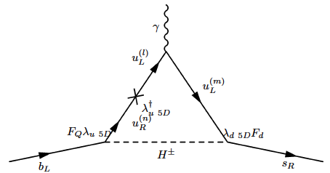
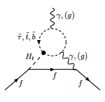
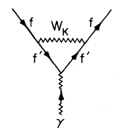
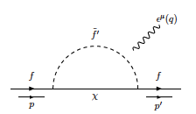
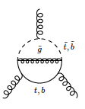
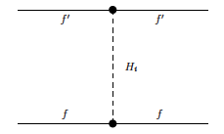
BSM Origins
EDM: γff
CEDM: gff
Weinberg ggg:
Four fermion
udHH
RS
MSSM
LRSM
ϕ
d_{L}
W⁺
u_{R}
u_{L}
d_{R}
ϕ

Slide 18
II. BSM Motivation

Slide 19
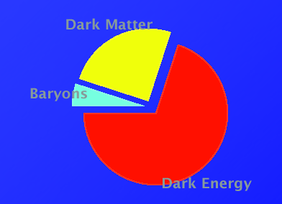
The Origin of Matter
Cosmic Energy Budget
Dark Matter
27 %
Baryons
Baryons
5 %
68 %
Dark Energy
Explaining the origin, identity, and relative fractions of the cosmic energy budget is one of the most compelling motivations for physics beyond the Standard Model

Slide 20
Naturalness Problem

Slide 21
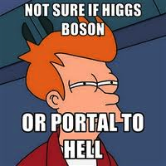
Scalar Fields in Particle Physics

Slide 22
Scalar Fields in Particle Physics
Scalar fields are a simple
Scalar fields are theoretically problematic
Δ m² ~ λ Λ²
Discovery of a (probably) fundamental 125 GeV scalar :
Is it telling us anything about Λ ? Naturalness?

Slide 23
Scalar Fields in Particle Physics
Scalar fields are a simple
Scalar fields are theoretically problematic
Δ m² ~ λ Λ²
Discovery of a (probably) fundamental 125 GeV scalar :
m_{h}² ~ λ v² & G_{F} ~ 1/v² : what keeps G_{F} “large” ?

Slide 24
LHC Implications
Weak scale BSM physics (e.g., SUSY) is there but challenging for the hadronic collider
BSM physics is there but a bit heavy (some fine tuning)
We are thinking about the problem incorrectly (cosmological constant???)

Slide 25
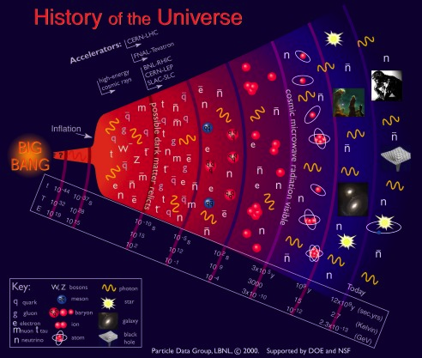
Symmetries & Cosmic History
EW Symmetry Breaking: Higgs
New Forces ?
Standard Model Universe
QCD: q+g! n,p…
QCD: n+p! nuclei
Astro: stars, galaxies,..

Slide 26
Symmetries & Cosmic History
EW Symmetry Breaking: Higgs
New Forces ?
Standard Model Universe
SUSY ?
GUTS ?
Extra Dims ?
~
W_{L}
W_{R}
W_{L}*
Puzzles the Standard Model can’t solve
Origin of matter
Unification & gravity
Weak scale stability
Neutrinos

Slide 27
Symmetries & Cosmic History
EW Symmetry Breaking: Higgs
New Forces ?
Standard Model Universe
SUSY ?
GUTS ?Extra Dims ?
~
W_{L}
W_{R}
W_{L}*
Puzzles the Standard Model can’t solve
Origin of matter
Unification & gravity
Weak scale stability
Neutrinos

Slide 28
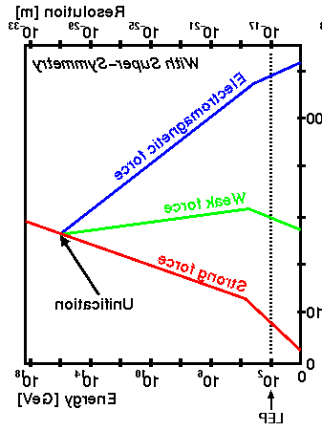
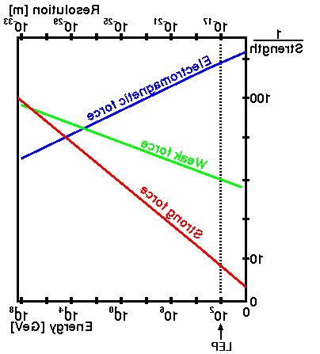
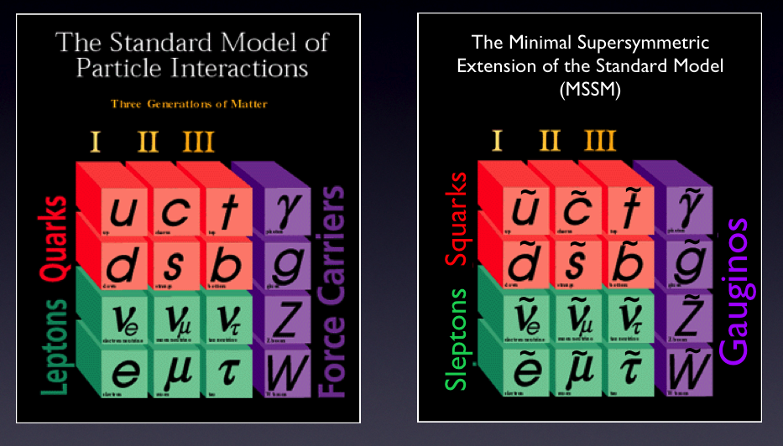
Symmetries & Cosmic History
EW Symmetry Breaking: Higgs ?
New Forces ?
Standard Model Universe
100
100
α(μ) ⁻¹
α(μ) ⁻¹
“Near miss” for grand unification
Unification
10
10
Desert
g = g(μ)
10 ¹⁸
10 ¹⁸
10 ²
10 ¹⁸
10 ²
μ
10 ²
μ

Slide 29
Symmetries & Cosmic History
EW Symmetry Breaking: Higgs ?
New Forces ?
Standard Model Universe
100
α(μ) ⁻¹
10
Weak Int Rates:
Solar burning
Element abundances
Desert
g = g(μ)
SUSY: Canceling quantum corrections protect G_{F}
10 ¹⁸
10 ²
μ

Slide 30
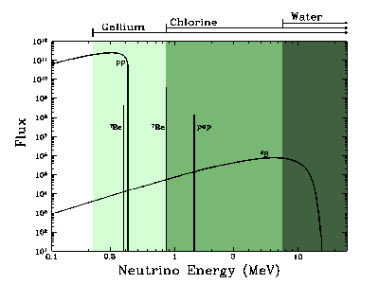
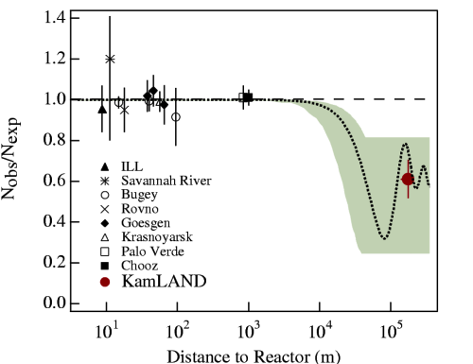
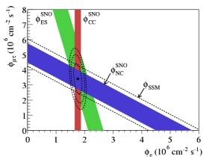
Symmetries & Cosmic History
EW Symmetry Breaking: Higgs ?
New Forces ?
Standard Model Universe
SUSY ?
GUTS ?
Extra Dims ?
~
W_{L}
W_{R}
W_{L}*
Puzzles the Standard Model can’t solve
Origin of matter
Unification & gravity
Weak scale stability
Neutrinos

Slide 31
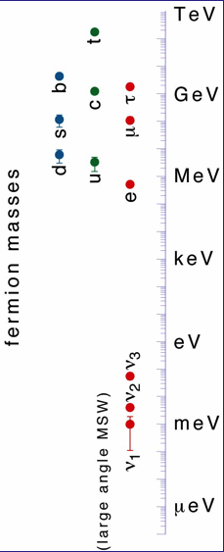
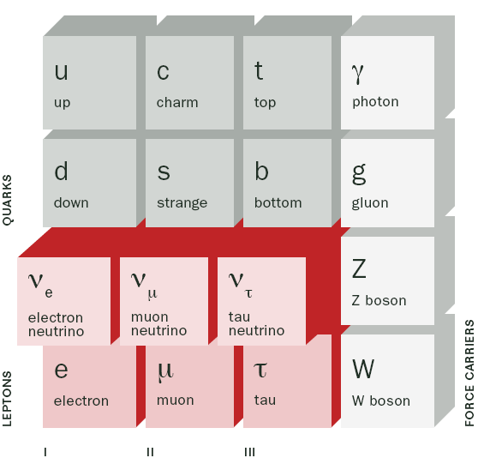
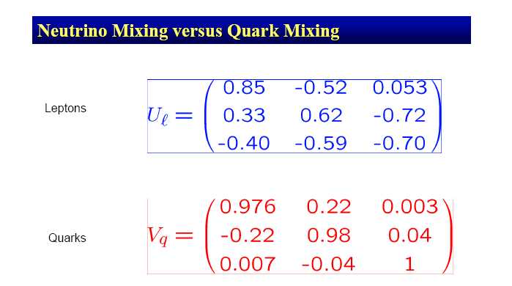
Neutrinos & the Flavor Problem
EW Symmetry Breaking: Higgs ?
New Forces ?
Standard Model Universe
Seesaw ν_{R} ?
~
W_{L}
W_{R}
N_{R}
W_{L}*
New “Periodic Table”
“Seesaw Mechanism”
Unobserved heavy ν s
Why so different ?
Not physical states
Observed light ν s
~ 10¹⁴ GeV
Courtesy R. D. McKeown

Slide 32
III. Supersymmetry

Slide 33
G_{F} is Too Large
G_{F} ~ 10⁻⁵/M_{P}² μ_{WEAK} ~ 250 GeV
λ

Slide 34
SUSY protects G_{F}
=0 if SUSY is exact

Slide 35
SUSY: a candidate symmetry of the early Universe
Unify all forces
Protect G_{F} from shrinking
Produce all the matter that exists
3 of 4
Yes
Maybe so
Account for neutrino properties
Give self-consistent quantum gravity
Maybe
Probably necessary

Slide 36
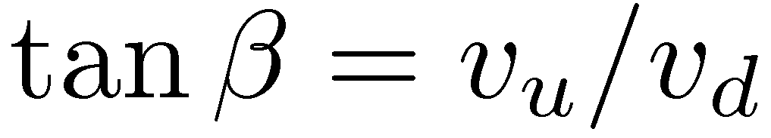
Minimal Supersymmetric Standard Model (MSSM)
No new coupling constants
Two Higgs vevs
Supersymmetry
Supersymmetric Higgs mass, μ
Fermions
Bosons
sfermions
gauginos
Higgsinos
Charginos, neutralinos

Slide 37
Minimal Supersymmetric Standard Model (MSSM)

Slide 38
SUSY and R Parity
If nature conserves
vertices have even number of superpartners
Consequences
Lightest SUSY particle
is stable
viable dark matter candidate
Proton is stable
Superpartners appear only in loops

Slide 39
SUSY must be a broken symmetry
Superpartners have not been seen
Theoretical models of SUSY breaking
SUSY Breaking
Visible World
Hidden World
Flavor-blind mediation
How is SUSY broken?

Slide 40
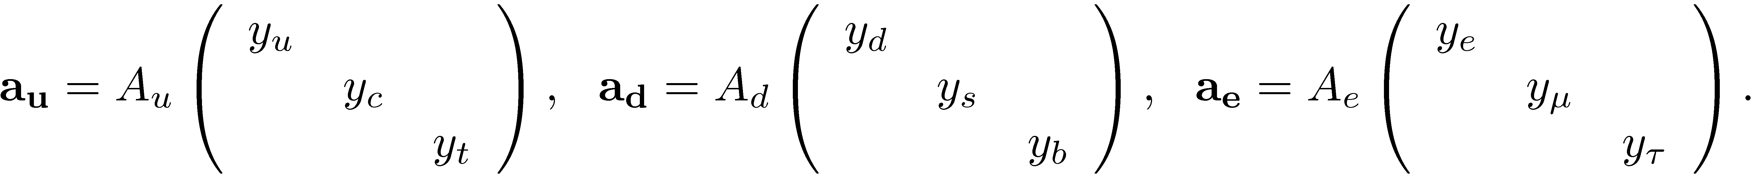
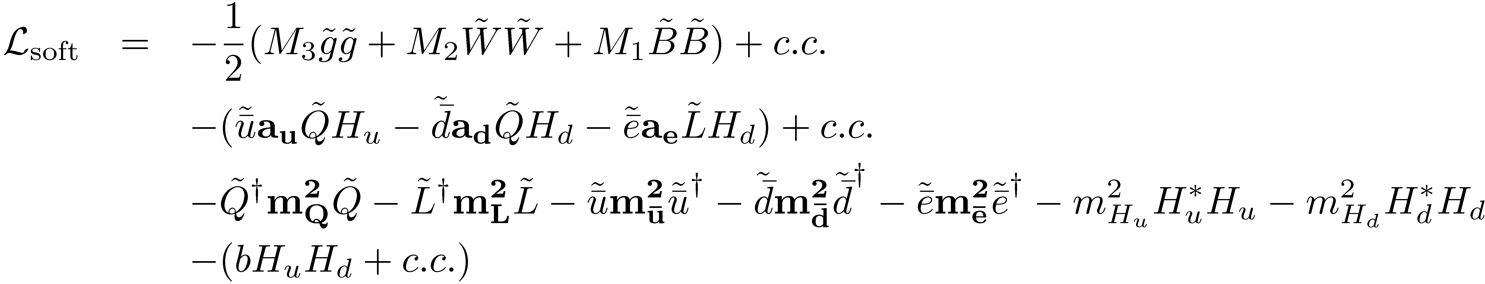
MSSM SUSY Breaking
One solution: a_{f} ~ Y_{f}
Superpartners have not been seen
Theoretical models of SUSY breaking
Gaugino mass
Triscalar interactions
Sfermion mass
~ 100 new parameters
40 new CPV phases
Flavor mixing parameters
O(1) CPV phases & flavor mixing ruled out by expt: “SUSY CP” & “SUSY flavor” problems
How is SUSY broken?

Slide 41
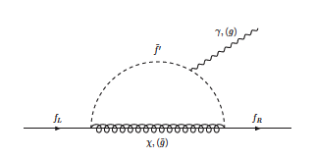
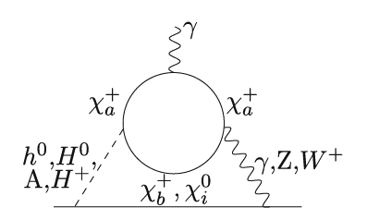
EDMs BSM: MSSM
φ_{j} = arg (μM_{j}b*)
φ_{A} = arg (A_{f} M_{j} )
One Loop: EDM, cEDM
Two Loop “Barr Zee”: EDM, cEDM

Slide 42
EDMs BSM: MSSM
φ_{j} = arg (μM_{j}b*)
φ_{A} = arg (A_{f} M_{j} )
Two Loop: Weinberg 3 Gluon

Slide 43
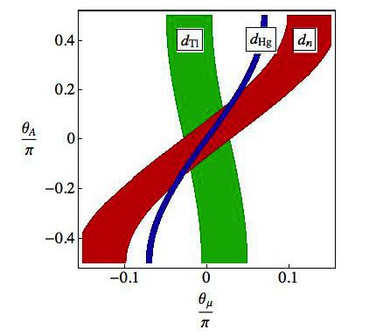
EDMs BSM: MSSM
Universality Assumption
φ_{j} = arg (μM_{j}b*)
φ₁ = φ₂=φ₃
φ_{A} = arg (A_{f} M_{j} )
Common φ_{A}
One Loop: EDM, cEDM
Ritz CIPANP 09 +

Slide 44
EDMs BSM: MSSM
φ_{j} = arg (μM_{j}b*)
φ_{A} = arg (A_{f} M_{j} )
One Loop: EDM, cEDM
Two Loop “Barr Zee”: EDM, cEDM
Heavy squarks: electroweak Barr-Zee dominates

Slide 45
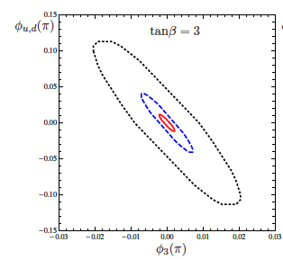
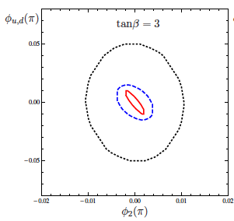
EDMs BSM: MSSM
φ_{j} = arg (μM_{j}b*)
φ_{A} = arg (A_{f} M_{j} )
~
m_{q} ~ 200 GeV
~
m_{q} ~ 500 GeV
~
m_{q} ~ 1000 GeV
One & two Loop: EDM, cEDM

Slide 46
IV. Higgs Portal CPV

Slide 47
What is the CP Nature of the Higgs Boson ?
Interesting possibilities if part of an extended scalar sector

Slide 48
What is the CP Nature of the Higgs Boson ?
Interesting possibilities if part of an extended scalar sector
Two Higgs doublets ?
H ! H₁ , H₂

Slide 49
What is the CP Nature of the Higgs Boson ?
Interesting possibilities if part of an extended scalar sector
Two Higgs doublets ?
H ! H₁ , H₂
An example: MSSM but not most general due to restrictions of supersymmetry

Slide 50
What is the CP Nature of the Higgs Boson ?
Interesting possibilities if part of an extended scalar sector
Two Higgs doublets ?
New parameters:
H ! H₁ , H₂
tan β = <H₁> / <H₂>
sin α_{b}
CPV !

Slide 51
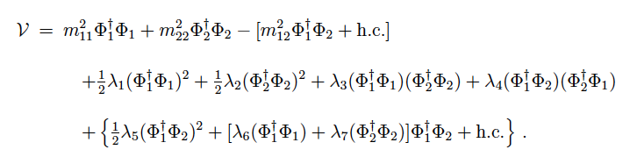
Two Higgs Double Model: Features
Scalar Potential
Complex parameters: m₁₂² & λ_{5,6,7}

Slide 52

Two Higgs Double Model: Features
Yukawa Interactions
Notation: η_{j} Matrices in flavor space (denoted Y_{j} elsewhere)
“Type III 2DHM” Both doublets couple to u_{R} & d_{R}

Slide 53
Two Higgs Double Model: Features
Yukawa Interactions
Avoid “Flavor Changing Neutral Currents” :
Place restrictions on the the Yukawa couplings !
“Type I & Type II 2DHM”

Slide 54

Two Higgs Double Model: Features
Yukawa Interactions
Avoid “Flavor Changing Neutral Currents” :
Place restrictions on the the Yukawa couplings !
“Type I & Type II 2DHM”

Slide 55

Two Higgs Double Model: Features
Scalar Potential : CPV w/ “Z₂ Symmetry”
Complex parameters: m₁₂² & λ₅
“Rephasing invariant”:

Slide 56
Higgs Portal CPV
Inoue, R-M, Zhang: 1403.4257
CPV & 2HDM: Type I & II
λ_{6,7} = 0 for simplicity
EWSB
+ loops w/ quarks & external gluons

Slide 57
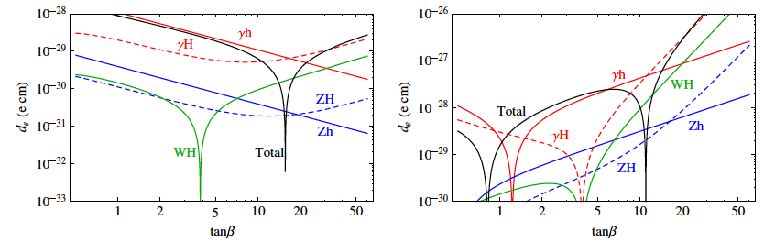
EDM “Anatomy”
Inoue, R-M, Zhang: 1403.4257
Electron
Type II
Type I
Note: absolute values plotted

Slide 58
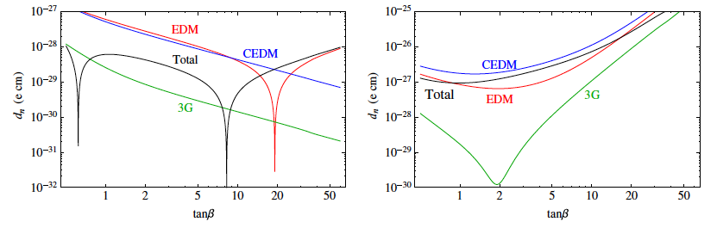
EDM “Anatomy”
Inoue, R-M, Zhang: 1403.4257
Neutron
Type I
Type II
Note: absolute values plotted

Slide 59
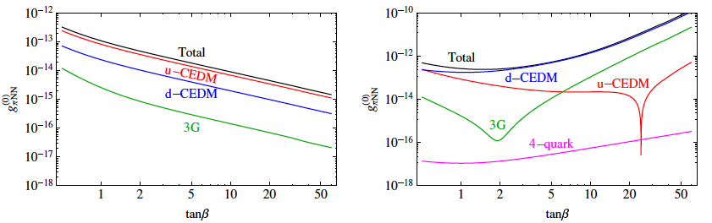
EDM “Anatomy”
Inoue, R-M, Zhang: 1403.4257
TVPV πNN Coupling (I=0)
Type I
Type II
Note: absolute values plotted

Slide 60
Future Reach: Higgs Portal CPV
CPV & 2HDM: Type II illustration
λ_{6,7} = 0 for simplicity
Hg
ThO
n
Ra
Present
Future:
d_{n} x 0.1
d_{A}(Hg) x 0.1
d_{ThO} x 0.1
d_{A}(Ra)
Future:
d_{n} x 0.01
d_{A}(Hg) x 0.1
d_{ThO} x 0.1
d_{A}(Ra)
sin α_{b} : CPV scalar mixing
Inoue, R-M, Zhang: 1403.4257
68

Slide 61
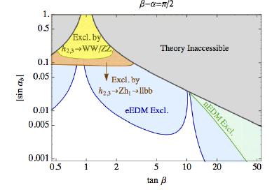
Higgs Portal CPV: EDMs & LHC
CPV & 2HDM: Type II illustration
λ_{6,7} = 0 for simplicity
Hg
ThO
n
LHC Current
Ra
Dawson et al: 1503.01114
M_{h2} = 400 GeV
Present
Future:
d_{n} x 0.1
d_{A}(Hg) x 0.1
d_{ThO} x 0.1
d_{A}(Ra)
Future:
d_{n} x 0.01
d_{A}(Hg) x 0.1
d_{ThO} x 0.1
d_{A}(Ra)
sin α_{b} : CPV scalar mixing
Inoue, R-M, Zhang: 1403.4257
68

Slide 62
Higgs Portal CPV: EDMs & LHC
CPV & 2HDM: Type II illustration
λ_{6,7} = 0 for simplicity
Hg
ThO
n
LHC Future ?
Ra
Dawson et al: 1503.01114
M_{h2} = 400 GeV
Present
Future:
d_{n} x 0.1
d_{A}(Hg) x 0.1
d_{ThO} x 0.1
d_{A}(Ra)
Future:
d_{n} x 0.01
d_{A}(Hg) x 0.1
d_{ThO} x 0.1
d_{A}(Ra)
sin α_{b} : CPV scalar mixing
Inoue, R-M, Zhang: 1403.4257
68

Slide 63
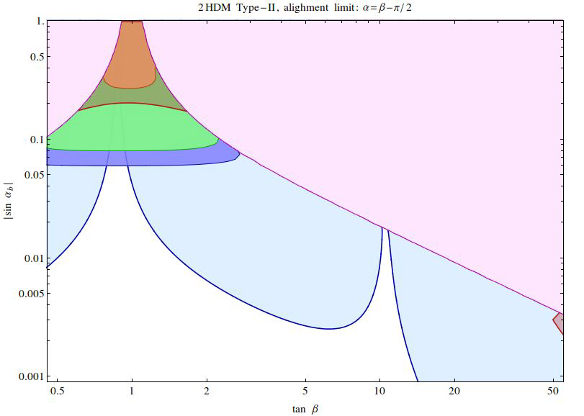
Higgs Portal CPV: EDMs & LHC
CPV & 2HDM: Type II illustration
λ_{6,7} = 0 for simplicity
Current d_{n}
Hg
LHC 100 fb⁻¹
LHC 300 fb⁻¹
ThO
n
Run II
Ra
Chen, Li, RM preliminary
M_{h2} = 550 GeV
Present
Future:
d_{n} x 0.1
d_{A}(Hg) x 0.1
d_{ThO} x 0.1
d_{A}(Ra) [10⁻²⁷ e cm]
Future:
d_{n} x 0.01
d_{A}(Hg) x 0.1
d_{ThO} x 0.1
d_{A}(Ra)
sin α_{b} : CPV scalar mixing
Inoue, R-M, Zhang: 1403.4257

Slide 64
Low-Energy / High-Energy Interplay
Discovery
“Diagnostic”
?
Low energy
High energy

Slide 65
V. Left-Right Symmetric Model

Slide 66
BSM Physics: Where Does it Live ?
BSM ?
SUSY, LNV, extended Higgs sector…
M_{W}
Mass Scale
Sterile ν’s, axions, dark U(1)…
BSM ?
Coupling

Slide 67
BSM Mass Scale
Parity Breaking Scale ~ M_{W}^{R} ?
Energy Scale
Weak Scale ~ M_{W}^{L}

Slide 68
Left-Right Symmetric Model
Parity Breaking Scale ~ M_{W}^{R} ?
Energy Scale
Weak Scale ~ M_{W}^{L}
SU(2)_{L} x SU(2)_{R} x U(1)_{B-L}

Slide 69
Left-Right Symmetric Model
See-saw scale ?
Parity Breaking Scale ~ M_{W}^{R} ?
Energy Scale
Weak Scale ~ M_{W}^{L}
SU(2)_{L} x SU(2)_{R} x U(1)_{B-L}

Slide 70

Left-Right Symmetric Model
Gauge boson mass eigenstates
CKM Matrices for LH & RH sectors

Slide 71



Left-Right Symmetric Model
Dimensionless EDM: δ
LRSM: One loop

Slide 72
Left-Right Symmetric Model
Dimensionless EDM: δ
LRSM: One loop
W_{L} – W_{R} mixing
V_{CKM}^{R}
V_{CKM}^{L}

Slide 73

Left-Right Symmetric Model
Dimensionless EDM: δ
LRSM: One loop
W_{L} – W_{R} mixing
V_{CKM}^{R}
V_{CKM}^{L}

Slide 74

Left-Right Symmetric Model
Dimensionless EDM: δ
LRSM: Neutron

Slide 75


Left-Right Symmetric Model
Four quark operator:
ϕ
d_{L}
W⁺
u_{R}
u_{L}
d_{R}
ϕ

Slide 76

Left-Right Symmetric Model
Four quark operator:
ϕ
d_{L}
W⁺
u_{R}
u_{L}
d_{R}
ϕ
Caveat: large nuclear theory uncertainty !

Slide 77
EDM Interpretation & Multiple Scales
Baryon Asymmetry
Collider Searches
Early universe CPV
BSM CPV
Particle spectrum; also scalars for baryon asym
SUSY, GUTs, Extra Dim…
d= 6 Effective Operators: “CPV Sources”
fermion EDM, quark chromo EDM, 3 gluon, 4 fermion
Energy Scale
QCD Matrix Elements
Nuclear & atomic MEs
d_{n} , g_{πNN} , …
Schiff moment, other P- & T-odd moments, e-nucleus CPV
Expt

Slide 78
Wilson Coefficients: Summary
δ_{f} fermion EDM (3)
δ_{q} quark CEDM (2)
C_{G} 3 gluon (1)
C_{quqd} non-leptonic (2)
C_{lequ, ledq} semi-leptonic (3)
C_{ϕud} induced 4f (1)
~
~
12 total + θ
light flavors only (e,u,d)
78

Slide 79
BSM Origins
EDM: γff
CEDM: gff
Weinberg ggg:
Four fermion
udHH
RS
MSSM
LRSM
ϕ
d_{L}
W⁺
u_{R}
u_{L}
d_{R}
ϕ

Slide 80
Back Up Slides

Slide 81
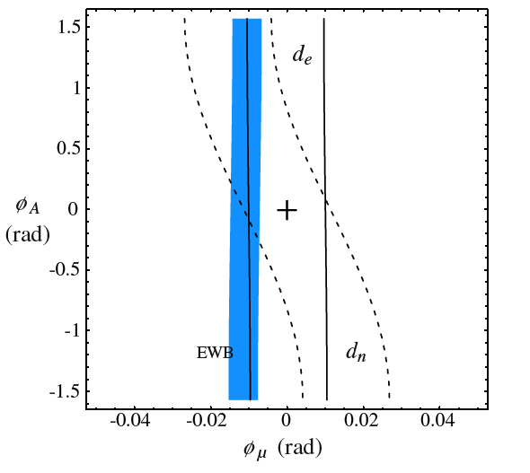
EDM Probes: EWB Implications
sinφ_{CP} ~ 1 ! M > 5000 GeV
M < 500 GeV! sinφ_{CP} < 10⁻²
Universal gaugino phases
Arg(μM_{i}b*) =
Arg(μM_{j}b*)
Cirigliano, R-M, Tulin, Lee ‘06
Ritz CIPANP 09 +
Cirigliano, R-M, Tulin, Lee ‘06

Slide 82
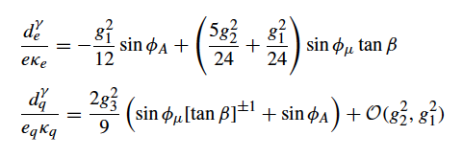
EDMs BSM: MSSM
φ_{j} = arg (μM_{j}b*)
φ_{A} = arg (A_{f} M_{j} )
One Loop: EDM, cEDM

Slide 83
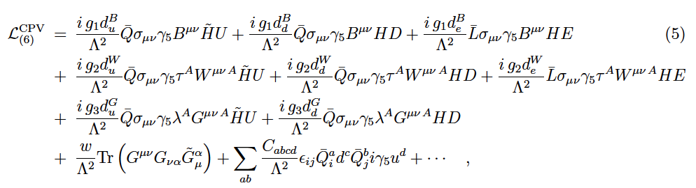

EDMs BSM: MSSM
Universality Assumption
φ_{j} = arg (μM_{j}b*)
φ₁ = φ₂=φ₃
φ_{A} = arg (A_{f} M_{j} )
Common φ_{A}
EW scale
Quark & Lepton EDMs
EWSB

Slide 84
MSSM: SUSY Breaking Models I
Visible Sector:
Hidden Sector: SUSY-breaking
MSSM
Flavor-blind mediation
Gravity-Mediated (mSUGRA)

Slide 85
MSSM: SUSY Breaking Models II
Visible Sector:
Hidden Sector: SUSY-breaking
MSSM
Flavor-blind mediation
Gauge-Mediated (GMSB)
messengers

Slide 86
MSSM: SUSY Breaking Models III
Visible Sector:
Hidden Sector: SUSY-breaking
MSSM
Flavor-blind mediation
Parameter evolution: mass
at the weak scale

Slide 87
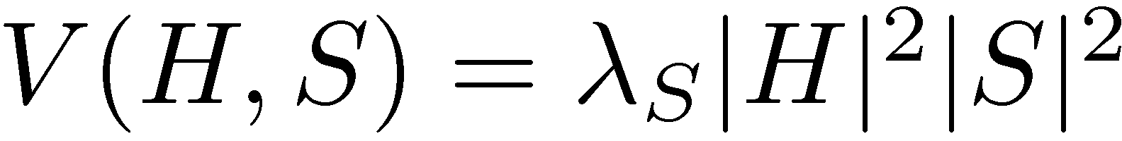
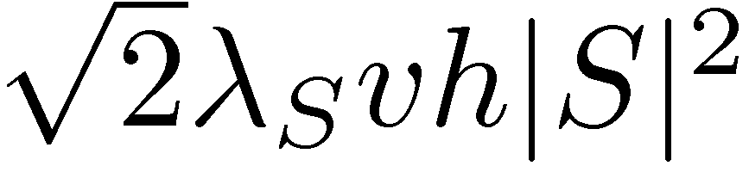
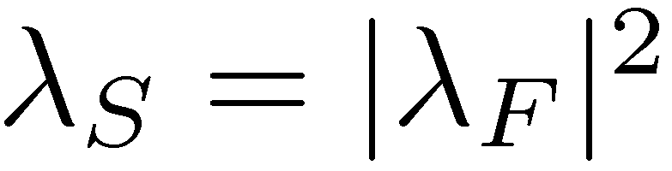
G_{F} & the “hierarchy problem”
SUSY Relation:
Quadratic divergence ~ Λ_{UV}² cancels
After EWSB:

Slide 88
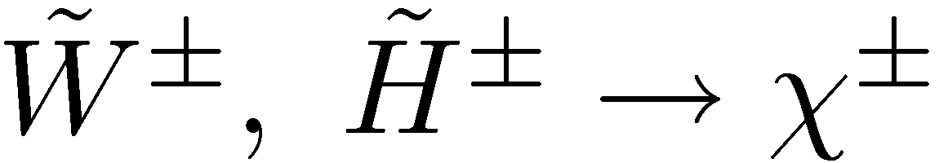
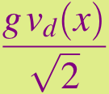
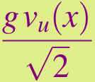
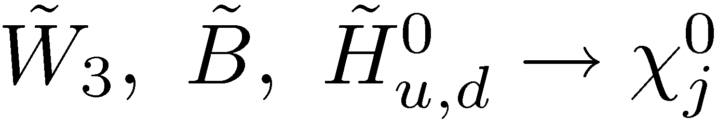
Gaugino-Higgsino Mixing
Chargino Mass Matrix
T ~T_{EW} : scattering of H,W from background field
T << T_{EW}
~
~
CPV
= Ν₁₁B ⁰ + Ν₁₂W ⁰ + Ν₁₃H_{d}⁰ + Ν₁₄H_{u}⁰
M₂
M_{C} =
μ
T << T_{EW} : mixing of H,W to χ⁺, χ⁰
BINO
WINO
HIGGSINO
~
~
~
~
Neutralino Mass Matrix
M₁
0
-m_{Z} cos β sin θ_{W}
m_{Z} cos β cos θ_{W}
M_{N} =
0
M₂
m_{Z} sin β sin θ_{W}
-m_{Z} sin β sin θ_{W}
-m_{Z} cos β sin θ_{W}
m_{Z} cos β cos θ_{W}
0
-μ
m_{Z} sin β sin θ_{W}
-m_{Z} sin β sin θ_{W}
-μ
0

Slide 89
Relic Abundance of SUSY DM
T << T_{EW} : mixing of H,W to χ⁺, χ⁰
Neutralino Mass Matrix
~
~
~
~
M₁
0
-m_{Z} cos β sin θ_{W}
m_{Z} cos β cos θ_{W}
M_{N} =
0
M₂
m_{Z} sin β sin θ_{W}
-m_{Z} sin β sin θ_{W}
-m_{Z} cos β sin θ_{W}
m_{Z} cos β cos θ_{W}
0
-μ
m_{Z} sin β sin θ_{W}
-m_{Z} sin β sin θ_{W}
-μ
0
= Ν₁₁B ⁰ + Ν₁₂W ⁰ + Ν₁₃H_{d}⁰ + Ν₁₄H_{u}⁰
BINO
WINO
HIGGSINO
+ res
+ coannihilation

Slide 90
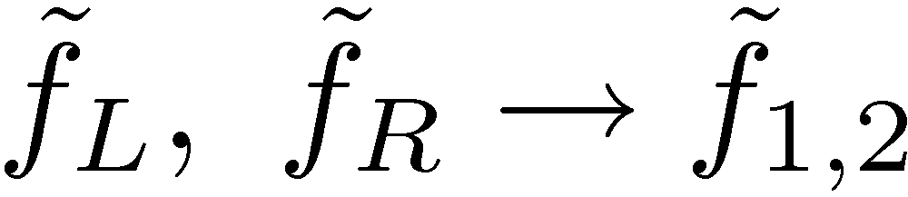
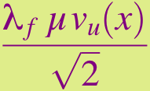
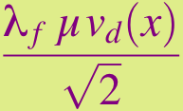
Sfermion Mixing
Sfermion mass matrix
T ~T_{EW} : scattering of f_{L}, f_{R} from background field
~
~
T << T_{EW} : mixing of f_{L}, f_{R} to f₁, f₂
~
~
~
~
Q_{f} < 0
Q_{f} > 0

