Slide 1



Lecture V: Electric Dipole Moments and the Baryon Asymmetry
M.J. Ramsey-Musolf
U Mass Amherst
http://www.physics.umass.edu/acfi/
ACFI EDM School November 2016

Slide 2
Lecture V Outline
General Considerations
Electroweak Baryogenesis
Electroweak Phase Transition
CPV & EDMs

Slide 3
I. General Considerations

Slide 4
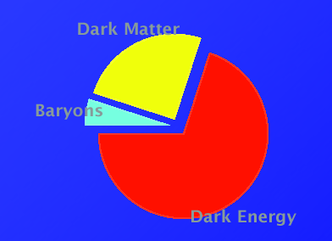
The Origin of Matter
Cosmic Energy Budget
Dark Matter
27 %
Baryons
Baryons
5 %
68 %
Dark Energy
Explaining the origin, identity, and relative fractions of the cosmic energy budget is one of the most compelling motivations for physics beyond the Standard Model

Slide 5
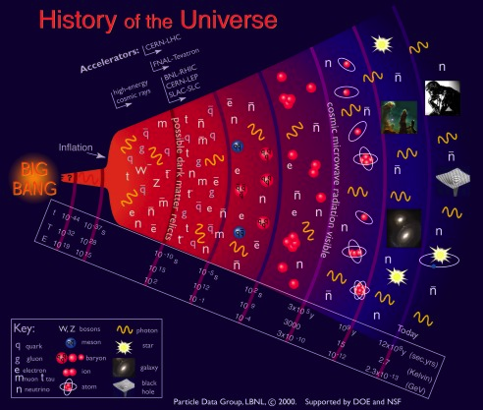
Symmetries & Cosmic History
EW Symmetry Breaking: Higgs
Standard Model Universe
10⁻³⁵ s
10⁻¹¹ s
10⁻⁵ s
~ 1 m
380k yr
QCD: q+g! n,p…
QCD: n+p! nuclei
Astro: stars, galaxies,..

Slide 6
Symmetries & Cosmic History
EW Symmetry Breaking: Higgs
BSM Physics?
Standard Model Universe
10⁻³⁵ s
10⁻¹¹ s
10⁻⁵ s
~ 1 m
380k yr
QCD: q+g! n,p…
QCD: n+p! nuclei
Astro: stars, galaxies,..

Slide 7
Symmetries & Cosmic History
EW Symmetry Breaking: Higgs
Standard Model Universe
How did we go from nothing to something ?
10⁻³⁵ s
10⁻¹¹ s
10⁻⁵ s
~ 1 m
380k yr
QCD: q+g! n,p…
QCD: n+p! nuclei
Astro: stars, galaxies,..

Slide 8
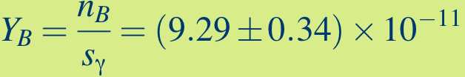
Symmetries & Cosmic History
EW Symmetry Breaking: Higgs
Baryogenesis: When? CPV? SUSY? Neutrinos?
Standard Model Universe
?
10⁻³⁵ s
10⁻¹¹ s
10⁻⁵ s
~ 1 m
380k yr
QCD: q+g! n,p…
QCD: n+p! nuclei
Astro: stars, galaxies,..

Slide 9
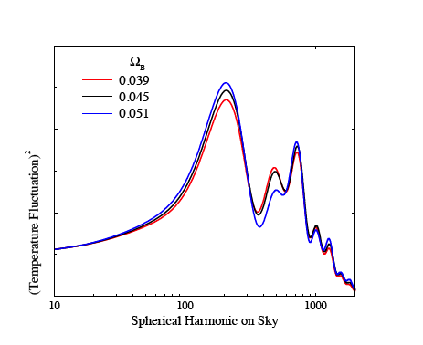
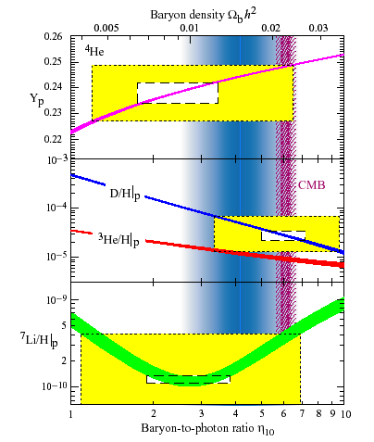
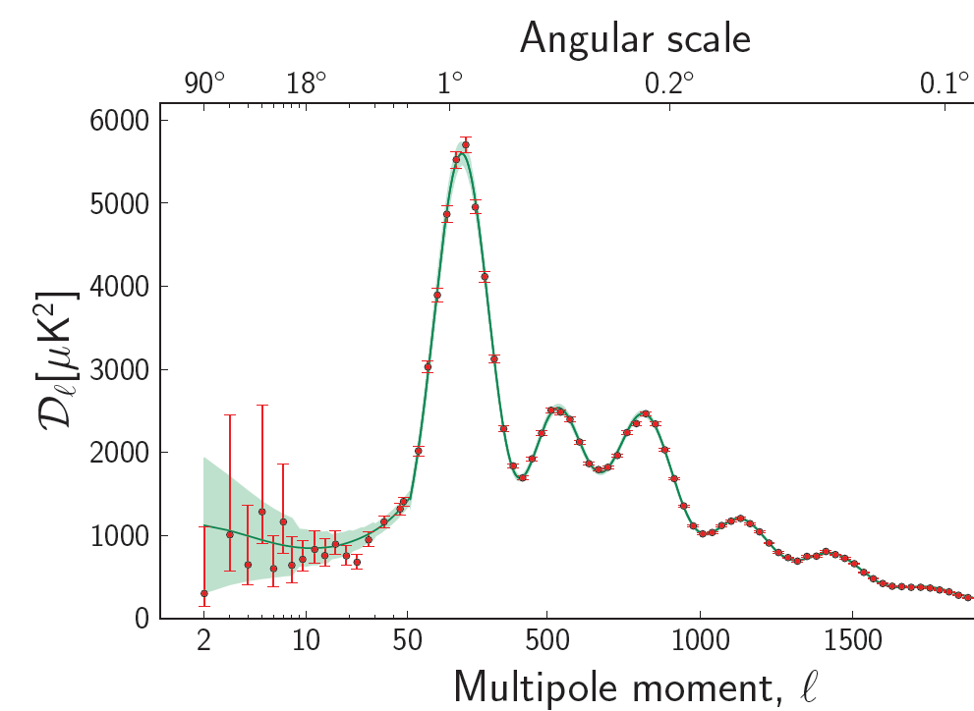
Cosmic Baryon Asymmetry
Cosmic Microwave Bcknd:
Shape of anisotropies depends on Y_{B}
Big Bang Nucleosynthesis:
Light element abundances depend on Y_{B}

Slide 10
Cosmic Baryon Asymmetry
Big Bang Nucleosynthesis:
Light element abundances depend on Y_{B}

Slide 11
Cosmic Baryon Asymmetry
Cosmic Microwave Bcknd:
Shape of anisotropies depends on Y_{B}

Slide 12



Symmetries & Cosmic History
EW Symmetry Breaking: Higgs
Baryogenesis: When? CPV? SUSY? Neutrinos?
Standard Model Universe
?
?
C: Charge Conjugation
P: Parity
10⁻³⁵ s
10⁻¹¹ s
10⁻⁵ s
~ 1 m
380k yr
QCD: q+g! n,p…
QCD: n+p! nuclei
Astro: stars, galaxies,..

Slide 13
Cosmic Baryon Asymmetry
One number ! BSM Physics

Slide 14

Ingredients for Baryogenesis
B violation (sphalerons)
C & CP violation
Out-of-equilibrium or CPT violation

Slide 15
Ingredients for Baryogenesis
Standard Model
BSM
B violation (sphalerons)
C & CP violation
Out-of-equilibrium or CPT violation







Slide 16
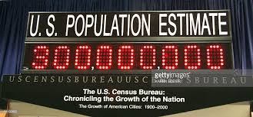
Cosmic Baryon Asymmetry
One number ! IIII IIII IIII … Explanations
BARYOGENESIS THEORIES
Theory

Slide 17
Cosmic Baryon Asymmetry
One number ! IIII IIII IIII … Explanations
Experiment can help:
BARYOGENESIS THEORIES
Discover ingredients
Falsify candidates
Theory

Slide 18
Ingredients for Baryogenesis
Scenarios: leptogenesis, EW baryogenesis, Afflek-Dine, asymmetric DM, cold baryogenesis, post-sphaleron baryogenesis…
Standard Model
BSM
B violation (sphalerons)
C & CP violation
Out-of-equilibrium or CPT violation







Slide 19
Ingredients for Baryogenesis
Scenarios: leptogenesis, EW baryogenesis, Afflek-Dine, asymmetric DM, cold baryogenesis, post-sphaleron baryogenesis…
Ingredients?
Standard Model
BSM
B violation (sphalerons)
C & CP violation
Out-of-equilibrium or CPT violation







Slide 20
Ingredients for Baryogenesis
Scenarios: leptogenesis, EW baryogenesis, Afflek-Dine, asymmetric DM, cold baryogenesis, post-sphaleron baryogenesis…
Testable
Standard Model
BSM
B violation (sphalerons)
C & CP violation
Out-of-equilibrium or CPT violation







Slide 21
Baryogenesis Scenarios
10¹²
Standard thermal lepto
10⁹
Affleck Dine
Energy Scale (GeV)
10 ²
Electroweak, resonant lepto, WIMPY baryo, ARS lepto…
10⁻¹
Post-sphaleron, cold…

Slide 22
Baryogenesis Scenarios
10¹²
Standard thermal lepto
10⁹
Affleck Dine
Energy Scale (GeV)
10 ²
Electroweak, resonant lepto, WIMPY baryo, ARS lepto…
10⁻¹
Post-sphaleron, cold…
Most directly testable

Slide 23
Baryogenesis Scenarios
Discover (some) ingredients & possibly falsify
10¹²
Standard thermal lepto
10⁹
Affleck Dine
Energy Scale (GeV)
10 ²
Electroweak, resonant lepto, WIMPY baryo, ARS lepto…
10⁻¹
Post-sphaleron, cold…
Most directly testable

Slide 24
Baryogenesis Scenarios
Discover (some) ingredients & possibly falsify
10¹²
Standard thermal lepto
10⁹
Affleck Dine
Energy Scale (GeV)
10 ²
Electroweak, resonant lepto, WIMPY baryo, ARS lepto…
10⁻¹
Post-sphaleron, cold…
Most directly testable
EDMs !

Slide 25
Electroweak Baryogenesis
Was Y_{B} generated in conjunction with electroweak symmetry-breaking?

Slide 26
Symmetries & Cosmic History
EW Symmetry Breaking: Higgs
Baryogenesis: When? CPV? SUSY? Neutrinos?
Standard Model Universe
?
EW Baryogenesis: testable w/ EDMs + colliders
Leptogenesis: look for ingred’s w/ νs: DBD, ν osc
10⁻³⁵ s
10⁻¹¹ s
10⁻⁵ s
~ 1 m
380k yr
QCD: q+g! n,p…
QCD: n+p! nuclei
Astro: stars, galaxies,..

Slide 27
II. Electroweak Baryogenesis

Slide 28
Electroweak Baryogenesis Ingredients
Baryon number violation
Strong first order electroweak phase transition
Effective CPV

Slide 29

Electroweak Baryogenesis: Ingredients
Sakharov Criteria
Anomalous B-violating processes
SM Sphalerons:

B violation
C & CP violation
Nonequilibrium dynamics
EDMs
SM CKM CPV:

Sakharov, 1967
Prevent washout by inverse processes
LHC: Scalars
SM EWPT:


Slide 30
Electroweak Baryogenesis Ingredients
Baryon number violation
Strong first order electroweak phase transition
Effective CPV

Slide 31
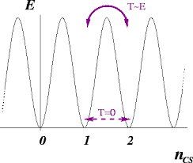
Electroweak Sphalerons
A_{λ}
Sphaleron Configuration

Slide 32
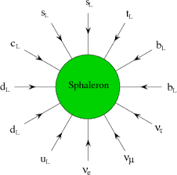
Electroweak Sphalerons
A_{λ}
Sphaleron Configuration
Anomaly
Δ (B+L) / N_{F}

Slide 33
Electroweak Baryogenesis Ingredients
Baryon number violation
Strong first order electroweak phase transition
Effective CPV

Slide 34
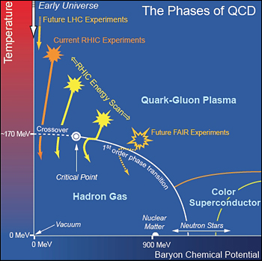
Symmetries & Cosmic History
EW Symmetry Breaking: Higgs
What is the nature of the EW phase transition ?
Standard Model Universe
10⁻³⁵ s
10⁻¹¹ s
10⁻⁵ s
~ 1 m
380k yr
QCD: q+g! n,p…
QCD: n+p! nuclei
Astro: stars, galaxies,..

Slide 35
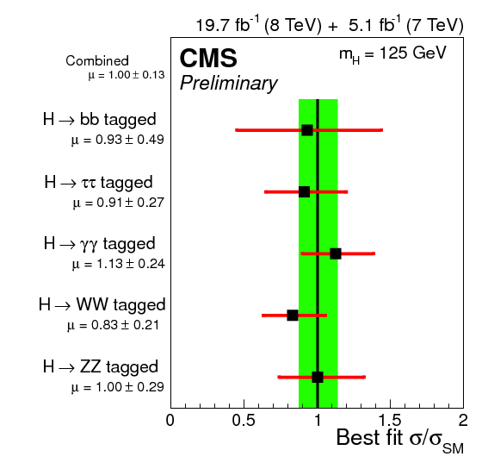
BEH-like Boson Observation

Slide 36
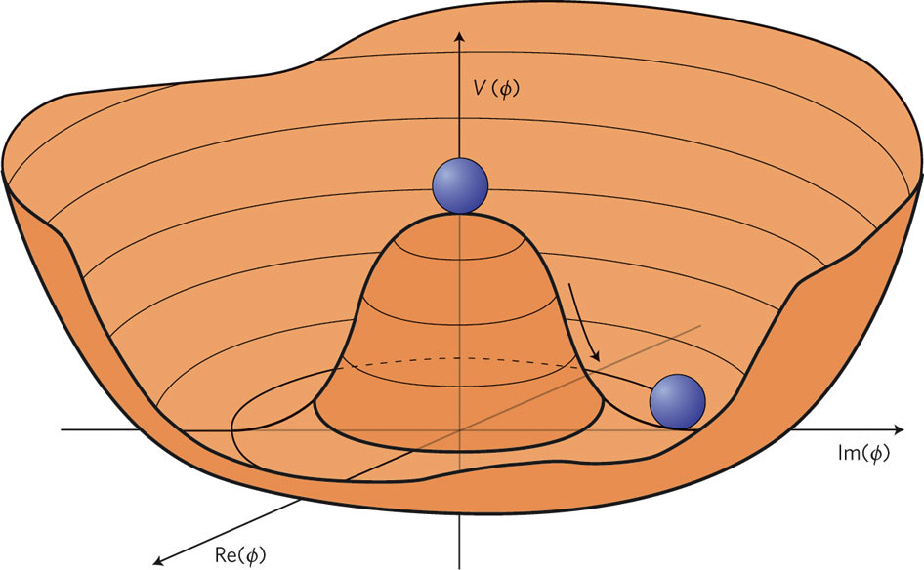
EWSB: The Scalar Potential
From Nature
What was the thermal history of EWSB ?

Slide 37
EWSB: The Scalar Potential
From Nature
What was the thermal history of EWSB ?

Slide 38
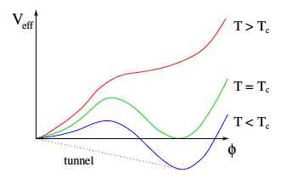
Scalar Potential: Thermal History
Single-Step EWSB
Constrained by experiment, but not the only possibility

Slide 39
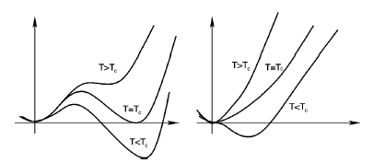
EW Phase Transition: New Scalars & CPV
1st order
2nd order

Slide 40
EW Phase Transition: New Scalars & CPV
1st order
2nd order
Increasing m_{h}

Slide 41
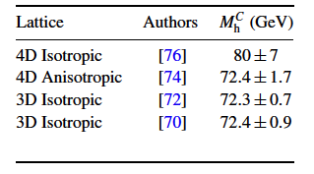
EW Phase Transition: New Scalars
“Strong” 1st order EWPT
1st order
2nd order
Bubble nucleation
Increasing m_{h}
SM: 1st order EWPT endpoint
EWSB

Slide 42
EW Phase Transition: St’d Model
1st order
2nd order
Temperature
125 GeV
Increasing m_{h}
Higgs Mass
EW Phase Diagram
How does this picture change in presence of new TeV scale physics ? What is the phase diagram ?
SM EW: Cross over transition

Slide 43
EW Phase Transition: New Scalars
“Strong” 1st order EWPT
1st order
2nd order
Bubble nucleation
Increasing m_{h}
New scalars
EWSB
Baryogenesis Gravity Waves Scalar DM LHC Searches
Novel EWSB patterns
New states
Δ Higgs prop’s

Slide 44
Electroweak Baryogenesis Ingredients
Baryon number violation
Strong first order electroweak phase transition
Effective CPV

Slide 45
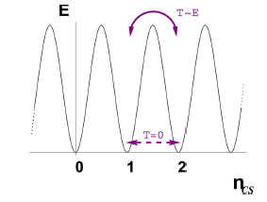
EW Phase Transition: New Scalars & CPV
“Strong” 1st order EWPT
1st order
2nd order
Bubble nucleation
Increasing m_{h}
New scalars
Baryogenesis Gravity Waves Scalar DM LHC Searches
Y_{B} : CPV & EW sphalerons
EWSB

Slide 46
EW Phase Transition: New Scalars & CPV
“Strong” 1st order EWPT
1st order
2nd order
Bubble nucleation
Increasing m_{h}
New scalars
Baryogenesis Gravity Waves Scalar DM LHC Searches
Y_{B} : CPV & EW sphalerons
EWSB
BSM

Slide 47
EW Phase Transition: New Scalars & CPV
“Strong” 1st order EWPT
1st order
2nd order
Bubble nucleation
Increasing m_{h}
New scalars
Baryogenesis Gravity Waves Scalar DM LHC Searches
Y_{B} : diffuses into interiors
EWSB

Slide 48
EW Phase Transition: New Scalars & CPV
“Strong” 1st order EWPT
1st order
2nd order
Preserve Y_{B}^{initial}
Bubble nucleation
Quench EW sph
Increasing m_{h}
New scalars
Baryogenesis Gravity Waves Scalar DM LHC Searches
Y_{B} : diffuses into interiors
EWSB

Slide 49
III. Electroweak Phase Transition
Did the conditions for EWBG exist ?

Slide 50
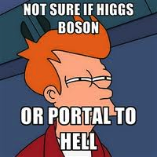
The Higgs Portal

Slide 51

Portals & Early Universe
Standard Model
Hidden Sector
“Singlets”

Slide 52
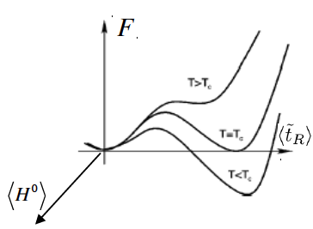

EW Phase Transition: Higgs Portal
1st order
2nd order
< φ >
Increasing m_{h}
“Higgs Portal”
New scalars
New scalars that interact with SM via the Higgs +…
+…

Slide 53
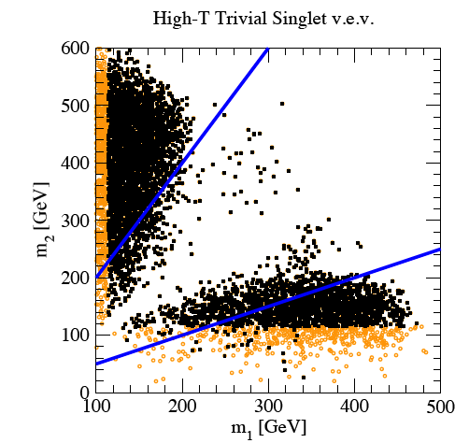
EW Phase Transition: New Scalars
1st order
2nd order
<S >
Increasing m_{h}
Scan: EWPT-viable model parameters
Light: all models
Black: LEP allowed
New scalars
Real Singlet:
φ ! S
Simplest Extension: two states h₁ & h₂
Profumo, R-M, Shaugnessy JHEP 0708 (2007) 010

Slide 54
EW Phase Transition: St’d Model
1st order
2nd order
Singlets
Temperature
125 GeV
Increasing m_{h}
Higgs Mass
EW Phase Diagram
How does this picture change in presence of new TeV scale physics ? What is the phase diagram ?
SM EW: Cross over transition

Slide 55
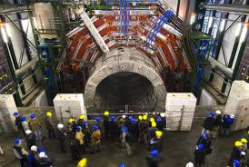
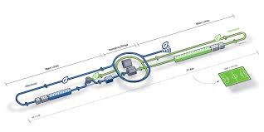
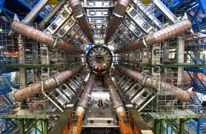
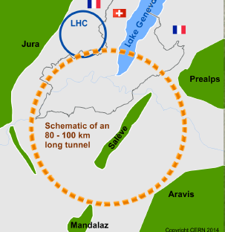
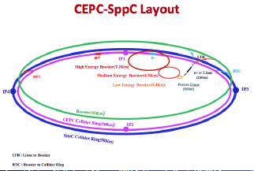
Experimental Probes: Energy Frontier
LHC
International Linear Collider
ATLAS
CMS
Future Circular e⁺e⁻ & pp
Future Circular e⁺e⁻ & pp
Thanks: S. Gascon-Shotkin

Slide 56
EW Phase Transition: New Scalars
1st order
2nd order
<S >
Increasing m_{h}
m₂ > 2 m₁
Mixed States: Precision $ ILC, CPEC, FCC-ee
New scalars
Real Singlet:
φ ! S
Simplest Extension: two states h₁ & h₂
m₁ > 2 m₂
Profumo, R-M, Shaugnessy JHEP 0708 (2007) 010

Slide 57
EW Phase Transition: New Scalars
1st order
2nd order
<S >
Increasing m_{h}
m₂ > 2 m₁
Mixed States: Precision $ ILC, CPEC, FCC-ee
New scalars
Novel signatures:
Simplest Extension: two states h₁ & h₂
τ⁻
τ⁺
m₁ > 2 m₂
No & RM, arXiv:1310.6035 : LHC Discovery w/ 100 fb⁻¹

Slide 58
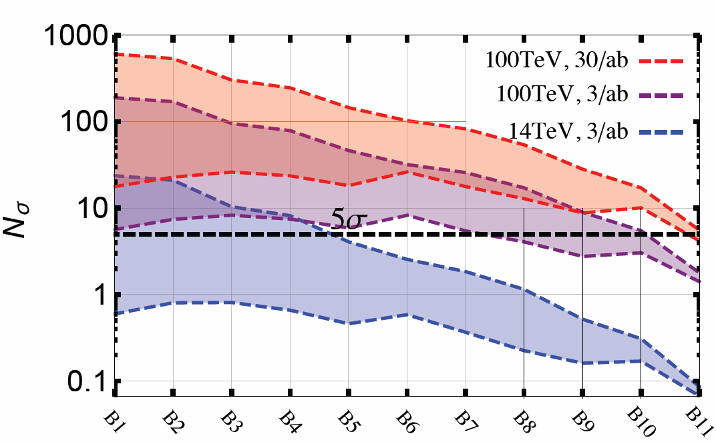
EW Phase Transition: New Scalars
1st order
2nd order
<S >
Increasing m_{h}
Next gen pp
m₂ > 2 m₁
Mixed States: Precision $ ILC, CPEC, FCC-ee
New scalars
Novel signatures:
Simplest Extension: two states h₁ & h₂
LHC
τ⁻
τ⁺
m₂ !
m₁ > 2 m₂
Next gen pp: Kotwal, No, R-M, Winslow 1604.XXXX

Slide 59
EW Phase Transition: New Scalars
1st order
2nd order
<S >
Modified Higgs Self-Coupling
m₂ > 2 m₁
Mixed States: Precision $ ILC, CPEC, FCC-ee
h₁
h₁
h₁
m₁ > 2 m₂

Slide 60
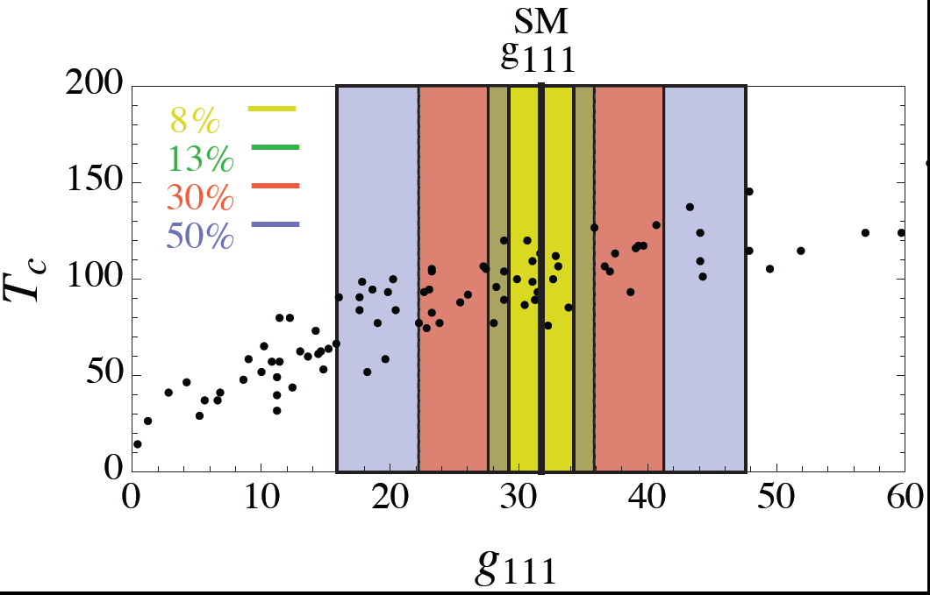
EW Phase Transition: New Scalars
1st order
2nd order
<S >
Modified Higgs Self-Coupling
m₂ > 2 m₁
Mixed States: Precision $ ILC, CPEC, FCC-ee
Increasing m_{h}
New scalars
m₁ > 2 m₂
Profumo, R-M, Wainwright, Winslow: 1407.5342

Slide 61
EW Phase Transition: New Scalars
1st order
2nd order
<S >
Modified Higgs Self-Coupling
m₂ > 2 m₁
ILC
HL-LHC
Mixed States: Precision $ ILC, CPEC, FCC-ee
Increasing m_{h}
New scalars
FCC-ee/ CEPC
FCC-hh/SPPC
m₁ > 2 m₂
Profumo, R-M, Wainwright, Winslow: 1407.5342

Slide 62
IV. CPV & EDMs
Did sufficiently effective CPV interactions occur ?

Slide 63
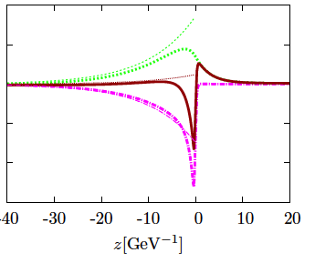
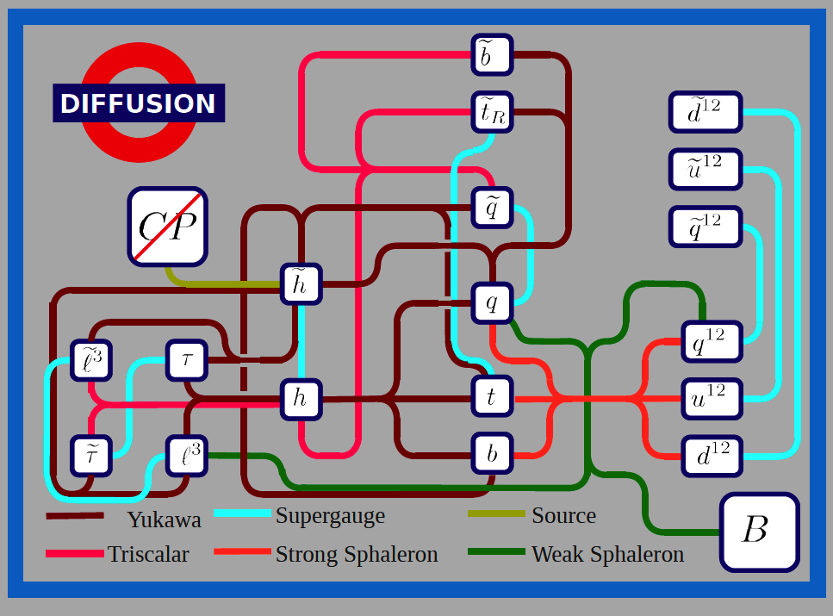


CPV in EW Baryogenesis
LH leptons
Bubble interior
Unbroken phase
Topological transitions
LH quarks
Bubble exterior
LH fermions
BSM CPV
Broken phase
CP Violation & Transport
MSSM: Chung, Garbrecht, R-M, Tulin ‘09
MSSM: ~ 30 Coupled Eqns
Transport: A Competition
R-M et al
CPV
Chem Eq
Diffusion
Thanks: B. Garbrecht

Slide 64
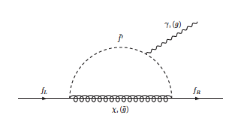
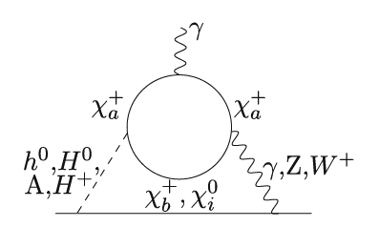
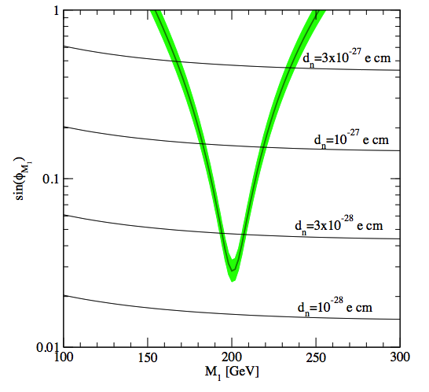
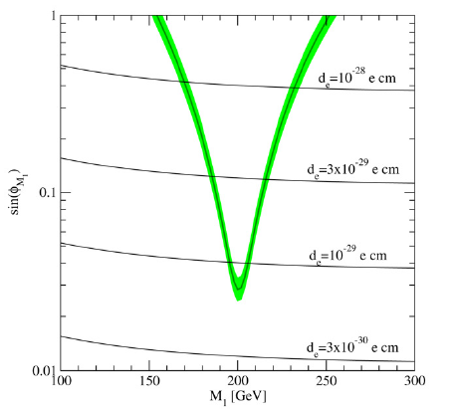
EDMs & EWBG: MSSM & Beyond
~
γ, g
f
~
f
V
f
Heavy sfermions: LHC consistent & suppress 1-loop EDMs
Sub-TeV EW-inos: LHC & EWB -viable but non-universal phases
Compatible with observed BAU
d_{e} = 10⁻²⁸ e cm
ACME: ThO
d_{n} = 10⁻²⁷ e cm
sin(μM₁b*)
sin(μM₁b*)
d_{e} = 10⁻²⁹ e cm
d_{n} = 10⁻²⁸ e cm
Next gen d_{e}
Next gen d_{n}
Li, Profumo, RM ‘09-’10
Compressed spectrum

Slide 65
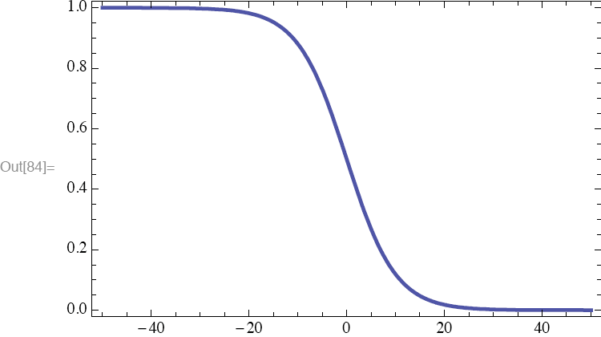
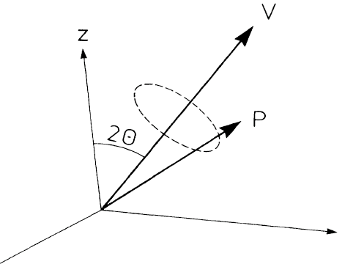


Origin of the resonant behavior
VC, C.Lee, MJRM, S.Tulin, 0912.3523, 1106.0747
Particles involved in EWB mix through v(x)
When m₁ ~ m₂ one has maximal mixing and maximal Losc
Behavior controlled by L_{w} vs L_{osc} = 2π v_{rel}/(ω1 - ω2) vs L_{coll}
Resonant enhancement due to non-adiabatic evolution (L_{osc}/L_{w} >> 1)
Analogy with spin 1/2 in external t-dependent magnetic field.
B
BROKEN
PHASE
UNBROKEN
PHASE
right-moving modes
y
x(T⁻¹)
x

Slide 66
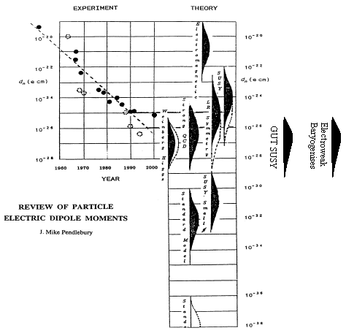
EDMs: What We May Learn
Present n-EDM limit
Proposed n-EDM limit
Matter-Antimatter
Asymmetry in
the Universe:
?
MSSM
“n-EDM has killed more theories than any other single experiment”
Theory: How robust ? Can EDMs kill EW baryogenesis ?

Slide 67


CPV for EWBG
EDM
Theoretical creativity
EDM
EWBG
Back up slides & discussion

Slide 68
Back Up Slides

Slide 69
Did EWSB Happen Only Once ?
Not necessarily
BSM “non-singlets” ! Multi-step EWSB

Slide 70
EW Phase Transition: New Scalars
1st order
2nd order
<Σ⁰ >
Increasing m_{h}
New scalars
Real Triplet
Σ⁺ , Σ⁻ , Σ⁰
Two-step EWPT & dark matter
Patel, R-M, PRD 88 (2013) 035013 ; Fileviez-Perez, Patel, RM, Wang, PRD 79 (2009) 055024

Slide 71
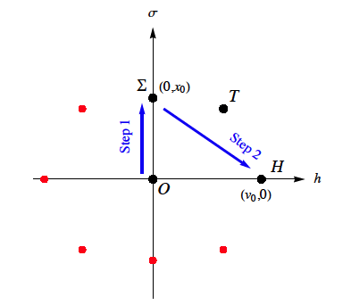
EW Phase Transition: New Scalars
1st order
2nd order
<Σ⁰ >
Increasing m_{h}
Small entropy dilution
Quench sphalerons
New scalars
Real Triplet
Σ⁺ , Σ⁻ , Σ⁰
Two-step EWPT & dark matter
Baryogenesis
Σ dark matter
Patel, R-M, PRD 88 (2013) 035013

Slide 72
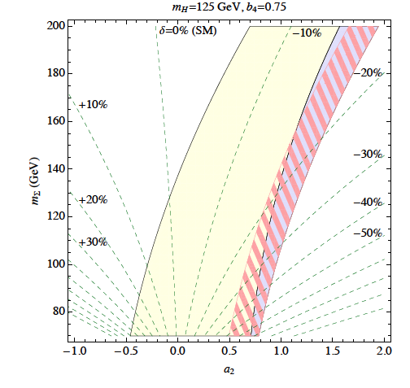
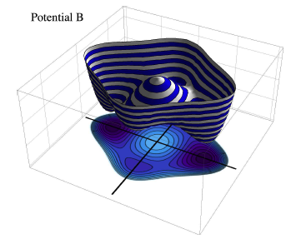
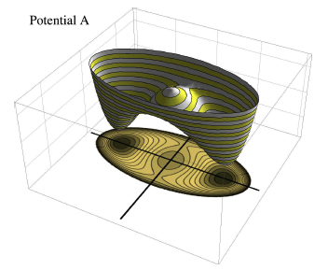
LHC Tests: Modified Higgs Properties
Σ⁺
γ
1st order
2nd order
γ
<Σ⁰ >
Two-step EWB favorable
Σ Mass (GeV)
ΣΣ H Coupling
Patel, R-M, PRD 88 (2013) 035013

Slide 73
LHC Tests: Modified Higgs Properties
Σ⁺
γ
1st order
2nd order
γ
<Σ⁰ >
EWB favorable
HL-LHC,
FCC-ee /CPEC
Σ Mass (GeV)
ILC 250
ΣΣ H Coupling
Patel, R-M, PRD 88 (2013) 035013

Slide 74
Two-Step EW Baryogenesis
Illustrative Model:
New sector: “Real Triplet” Σ
Gauge singlet S
<φ⁰ >
H ! Set of “SM” fields: 2 HDM
Quench sphalerons
Small entropy dilution
Two CPV Phases:
δ_{Σ} : Triplet phase
δ_{S} : Singlet phase
Baryogenesis
Σ dark matter
Inoue, Ovanesyan, R-M: 1508.05404

Slide 75
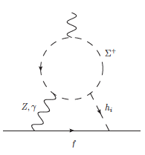
Two-Step EW Baryogenesis & EDMs
EDMs are Two Loop
Two CPV Phases:
δ_{Σ} : Triplet phase
δ_{S} : Singlet phase
Insensitive to δ_{S} : electrically neutral ! “partially secluded”
Inoue, Ovanesyan, R-M: 1508.05404

Slide 76
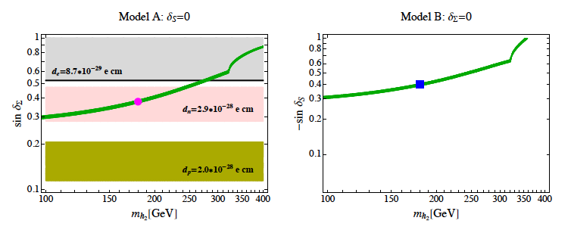
Illustrative Model: Results
Two cases: (A) δ_{S} = 0 (B) δ_{Σ} =0
Triplet CPV
Y_{B}
Singlet CPV
Present d_{e}
Present d_{e}
Future d_{n}
Future d_{p} ?
No EDM constraints
Inoue, Ovanesyan, R-M: 1508.05404

Slide 77

Flavored EW Baryogenesis
τ_{L}
EWBG by
μ_{R}

Slide 78
Flavored EW Baryogenesis
τ_{L}
EWBG by
μ_{R}
Flavor basis (high T)
Mass basis (T=0)
Guo, Li, Liu, R-M, Shu 1609.09849

Slide 79
Flavored EW Baryogenesis
τ_{L}
EWBG by
μ_{R}
Flavor basis (high T)
Mass basis (T=0)
CPV h ! ττ
Guo, Li, Liu, R-M, Shu 1609.09849

Slide 80
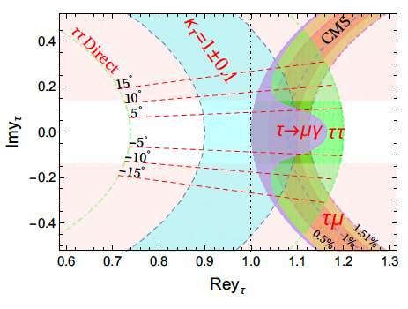
Flavored EW Baryogenesis
τ_{L}
EWBG by
μ_{R}
Flavor basis (high T)
Mass basis (T=0)
CPV h ! ττ
EWBG viable
Guo, Li, Liu, R-M, Shu 1609.09849

Slide 81
EW Phase Transition: New Scalars & CPV
1st order
2nd order
Increasing m_{h}
New scalars

Slide 82
EW Phase Transition: New Scalars & CPV
“Strong” 1st order EWPT
1st order
2nd order
Bubble nucleation
Increasing m_{h}
New scalars
Baryogenesis Gravity Waves Scalar DM LHC Searches
EWSB

Slide 83
Symmetries & Cosmic History
EW Symmetry Breaking: Higgs
BSM Physics?
Standard Model Universe
How did we go from nothing to something ?
10⁻³⁵ s
10⁻¹¹ s
10⁻⁵ s
~ 1 m
380k yr
QCD: q+g! n,p…
QCD: n+p! nuclei
Astro: stars, galaxies,..

Slide 84
Symmetries & Cosmic History
EW Symmetry Breaking: Higgs
Baryogenesis: When? CPV? SUSY? Neutrinos?
Standard Model Universe
How did we go from nothing to something ?
10⁻³⁵ s
10⁻¹¹ s
10⁻⁵ s
~ 1 m
380k yr
QCD: q+g! n,p…
QCD: n+p! nuclei
Astro: stars, galaxies,..

Slide 85
Symmetries & Cosmic History
EW Symmetry Breaking: Higgs
Baryogenesis: When? CPV? SUSY? Neutrinos?
Standard Model Universe
?
10⁻³⁵ s
10⁻¹¹ s
10⁻⁵ s
~ 1 m
380k yr
QCD: q+g! n,p…
QCD: n+p! nuclei
Astro: stars, galaxies,..

Slide 86
Symmetries & Cosmic History
EW Symmetry Breaking: Higgs
Baryogenesis: When? CPV? SUSY? Neutrinos?
Standard Model Universe
?
EW Baryogenesis: testable w/ EDMs + colliders
Leptogenesis: look for ingred’s w/ νs: DBD, ν osc
10⁻³⁵ s
10⁻¹¹ s
10⁻⁵ s
~ 1 m
380k yr
QCD: q+g! n,p…
QCD: n+p! nuclei
Astro: stars, galaxies,..

