Slide 1




Search for the Schiff Moment of Radium-225
+
T
+
P
_
+
_
_
EDM
Spin
EDM
Spin
EDM
Spin
Zheng-Tian Lu
Physics Division, Argonne National Laboratory
Department of Physics, University of Chicago

Slide 2
EDM Searches in Three Sectors
Nucleons (n, p)
Quark EDM
Physics beyond the Standard Model:
SUSY, etc.
Nuclei (Hg, Ra, Rn)
Quark Chromo-EDM
Electron in paramagnetic
molecules (YbF, ThO)
Electron EDM
Sector | Exp Limit (e-cm) | Method | Standard Model
Electron | 9 x 10⁻²⁹ | ThO in a beam | 10⁻³⁸
Neutron | 3 x 10⁻²⁶ | UCN in a bottle | 10⁻³¹
¹⁹⁹Hg | 3 x 10⁻²⁹ | Hg atoms in a cell | 10⁻³³
M. Ramsey-Musolf (2009)

Slide 3
The Seattle EDM Measurement
¹⁹⁹Hg stable, high Z, groundstate ¹S₀, I = ½, high vapor pressure
E
Optical Pumping
E
m_{F} = -1/2
m_{F} = +1/2
7p ³P₁
F = 1/2
Courtesy of Michael Romalis
σ+
7s² ¹S₀
F = 1/2
m_{F} = -1/2
m_{F} = +1/2

Slide 4
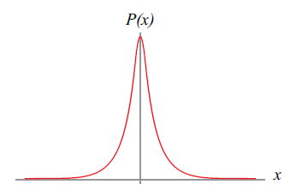
The Seattle EDM Measurement
¹⁹⁹Hg stable, high Z, groundstate ¹S₀, I = ½, high vapor pressure
E
E
Courtesy of Michael Romalis
Limits and Sensitivities
Current: < 3 x 10⁻²⁹ e-cm
-- Griffith et al., PRL (2009)
Next 5 years: 3 x 10⁻³⁰ e-cm
Beyond 2020: 6 x 10⁻³¹ e-cm
f
15 Hz

Slide 5
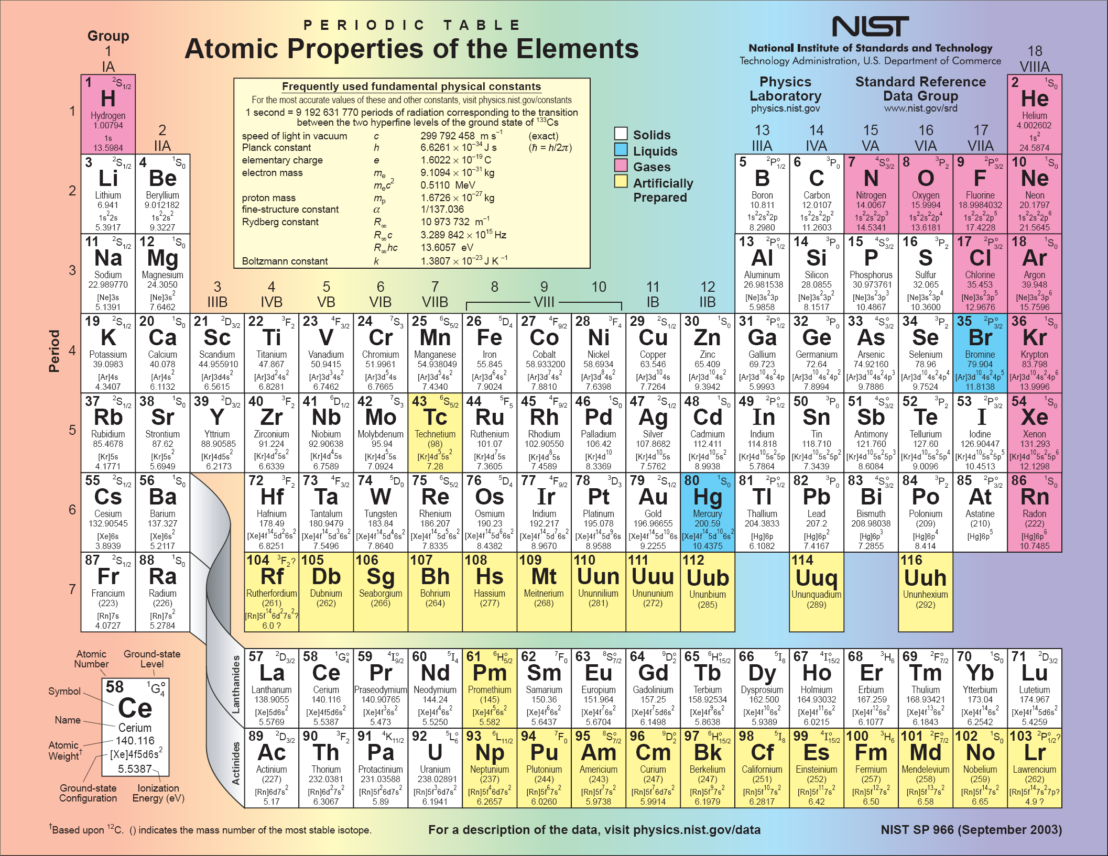
¹S₀

Slide 6
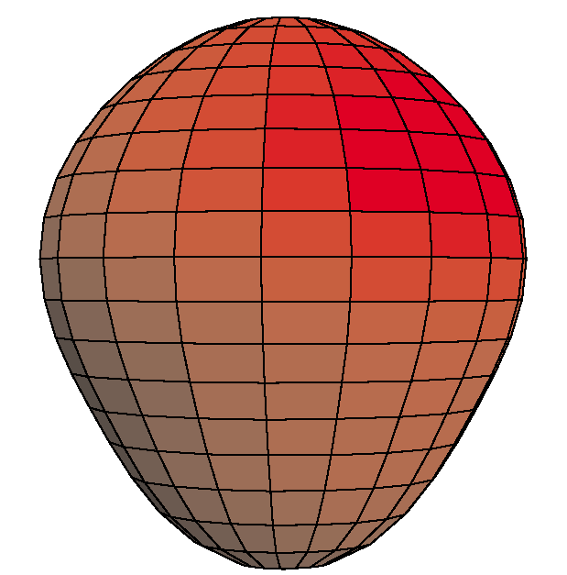
EDM of ²²⁵Ra enhanced and more reliably calculated
Closely spaced parity doublet – Haxton & Henley, PRL (1983)
Large Schiff moment due to octupole deformation – Auerbach, Flambaum & Spevak, PRL (1996)
Relativistic atomic structure (²²⁵Ra / ¹⁹⁹Hg ~ 3) – Dzuba, Flambaum, Ginges, Kozlov, PRA (2002)
Parity doublet
|α⟩
|β⟩
Enhancement Factor: EDM (²²⁵Ra) / EDM (¹⁹⁹Hg)
 | Isoscalar | Isovector
Skyrme SIII | 300 | 4000
Skyrme SkM* | 300 | 2000
Skyrme SLy4 | 700 | 8000
Ψ⁻ = (|α⟩ − |β⟩)/√2
Ψ⁺ = (|α⟩ + |β⟩)/√2
55 keV
Schiff moment of ²²⁵Ra, Dobaczewski, Engel, PRL (2005)
Schiff moment of ¹⁹⁹Hg, Dobaczewski, Engel et al., PRC (2010)
“[Nuclear structure] calculations in Ra are almost certainly more reliable than those in Hg.”
– Engel, Ramsey-Musolf, van Kolck, Prog. Part. Nucl. Phys. (2013)
Constraining parameters in a global EDM analysis.
– Chupp, Ramsey-Musolf, arXiv1407.1064 (2014)

Slide 7
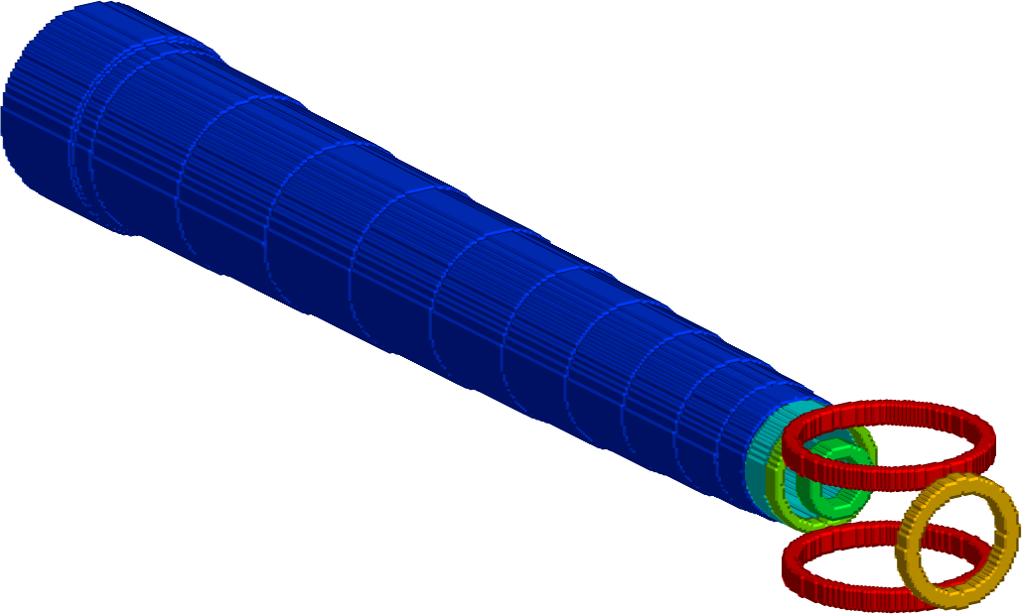

EDM measurement on ²²⁵Ra in a trap
²²⁵Ra:
I = ½
t_{1/2} = 15 d
Collaboration of Argonne, Kentucky, Michigan State
Efficient use of the rare ²²⁵Ra atoms
High electric field (> 100 kV/cm)
Long coherence time (~ 100 s)
Negligible “v x E” systematic effect
Oven:
²²⁵Ra
Transverse
cooling
Zeeman
Slower
Magneto-optical
Trap (MOT)
Statistical uncertainty
100 d
100 kV/cm
10%
100 s
10⁶
Optical dipole
trap (ODT)
Long-term goal: δd = 3 x 10⁻²⁸ e cm
EDM
measurement

Slide 8
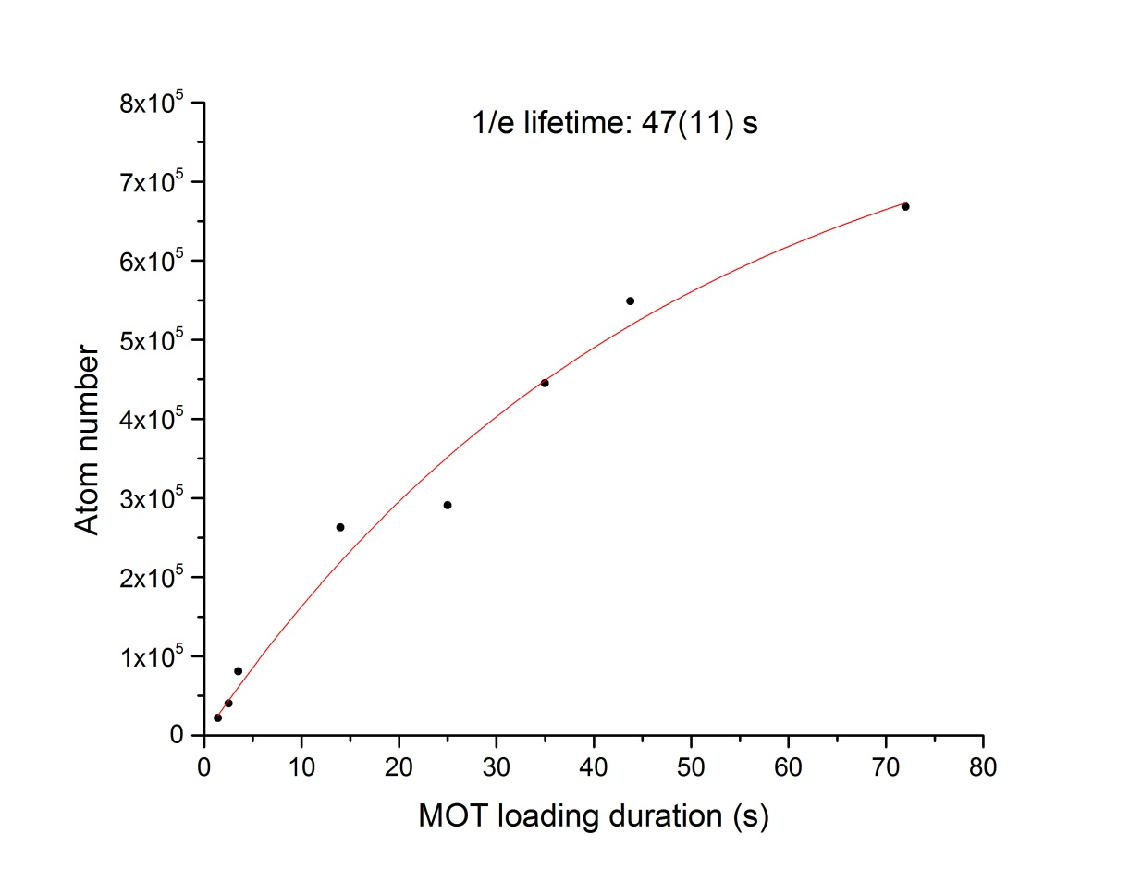
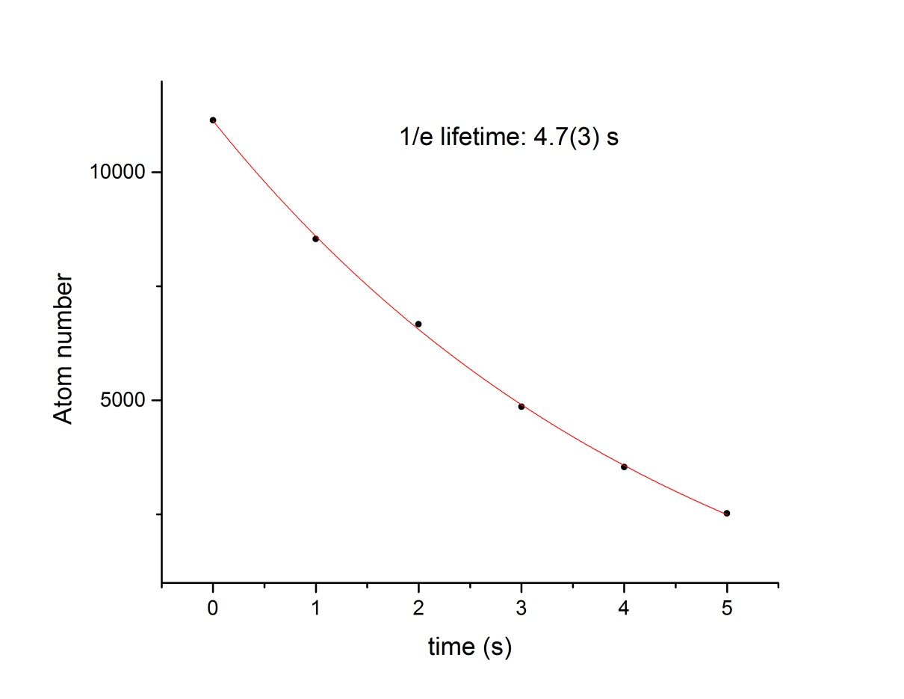
Trap Lifetimes
Magneto-Optical Trap (MOT)
in the first trap chamber
Optical Dipole Trap (ODT)
in the EDM chamber

Slide 9
Optical Dipole Trap
Fiber laser: λ = 1550 nm, Power = 40 Watts
Focused to 100 μm → trap depth 400 μK
EDM in an optical dipole trap – Fortson & Romalis (1999)
v x E , Berry’s phase effects suppressed
Cold scattering suppressed between cold Fermionic atoms
Rayleigh scat. rate ~ 10⁻¹ s⁻¹ ; Raman scat. rate ~ 10⁻¹² s⁻¹
Vector light shift ~ μHz
Parity mixing induced shift negligible
Conclusion: possible to reach 10⁻³⁰ e cm for ¹⁹⁹Hg

Slide 10
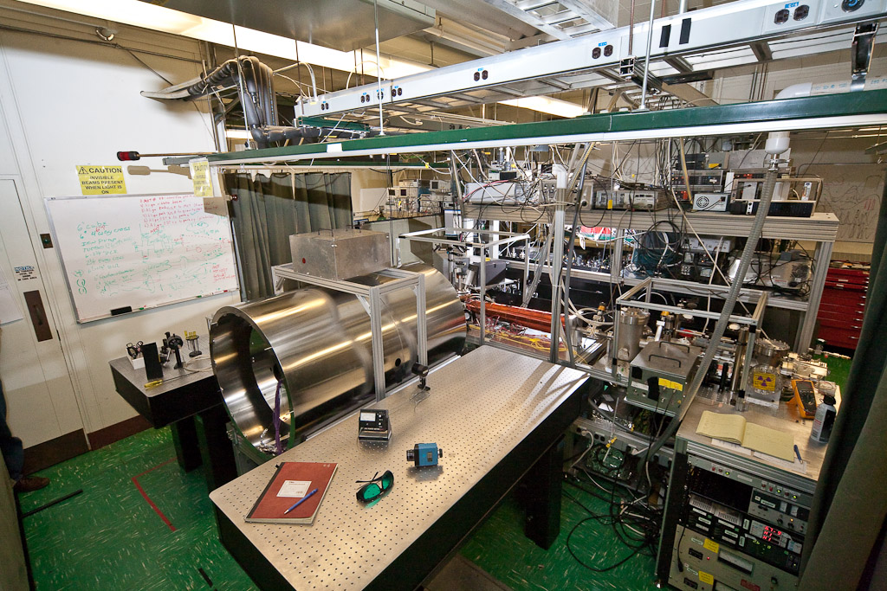
Apparatus

Slide 11
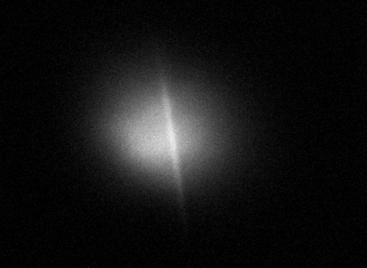
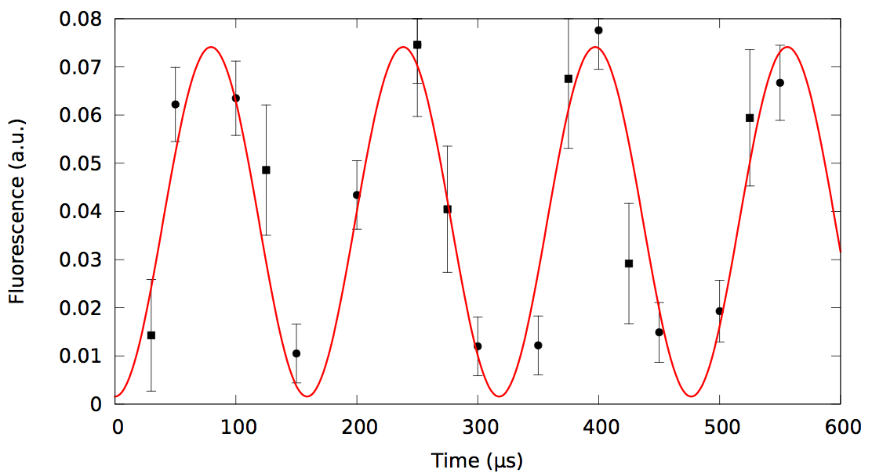

Preparation of Cold Radium Atoms for EDM
2006 – Atomic transitions identified and studied;
2007 – Magneto-optical trap (MOT) of radium realized;
2010 – Optical dipole trap (ODT) of radium realized;
2011 – Atoms transferred to the measurement trap;
2012 – Spin precession of Ra-225 in ODT observed;
2014 – Attempt to measure EDM of Ra-225.
N.D. Scielzo et al., PRA Rapid 73, 010501 (2006)
J.R. Guest et al., PRL 98, 093001 (2007)
R.H. Parker et al., PRC 86, 065503 (2012)
MOT & ODT
MOT & ODT
Precession frequency:
Sideview
Head-on
view
ODT 0.04 mm

Slide 12
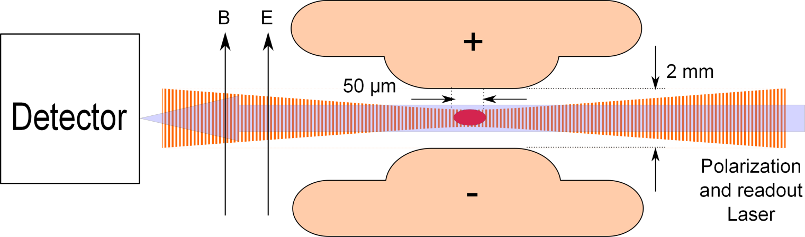
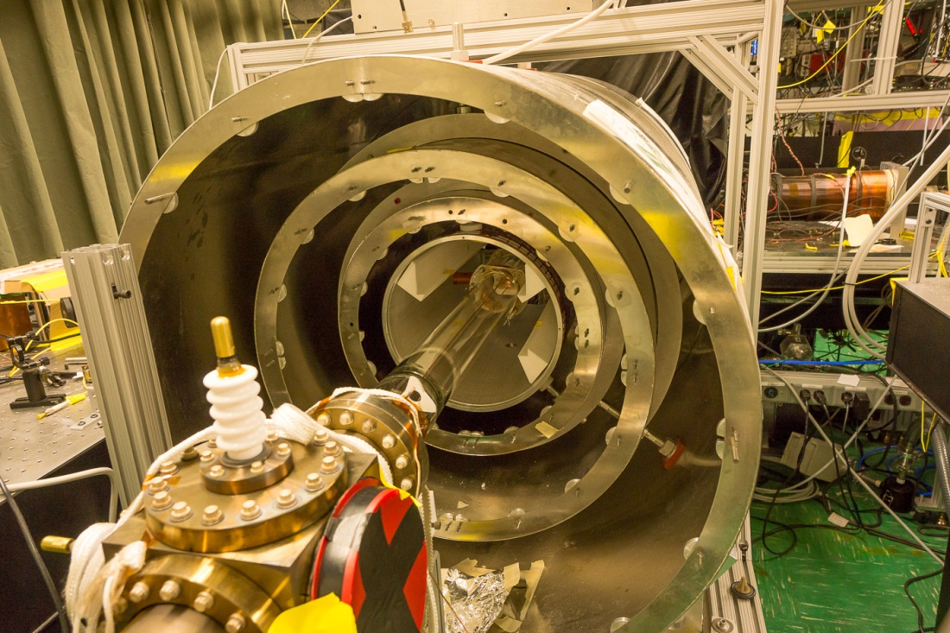
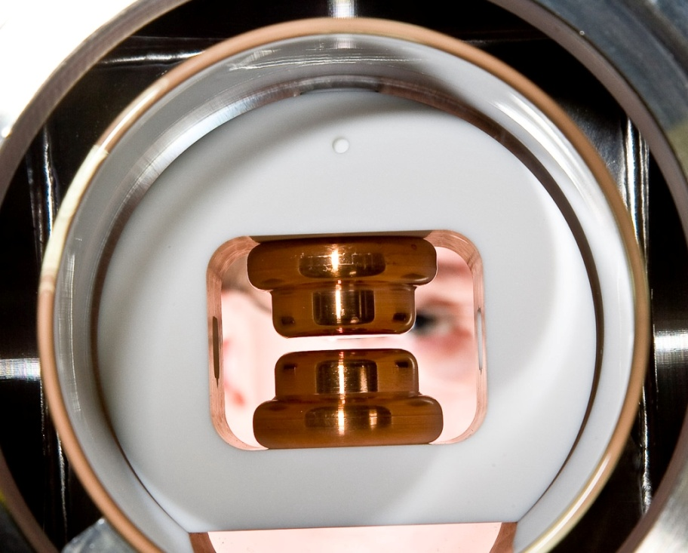
B & E Fields Installed
EDM (d) measurement:
B = 10 mG
E = 100 kV/cm

Slide 13
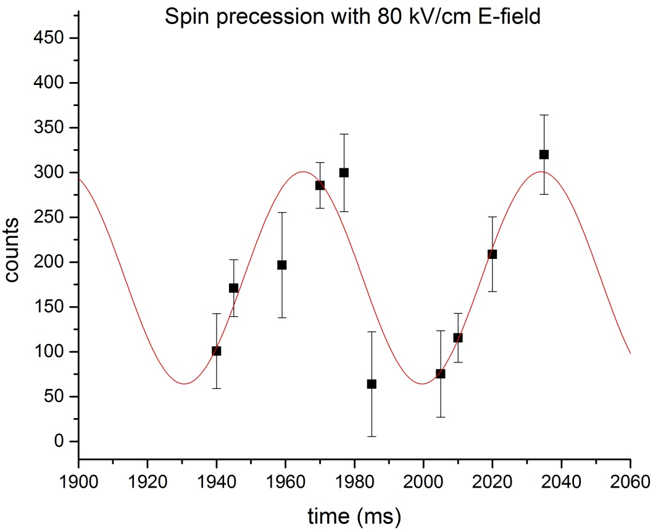
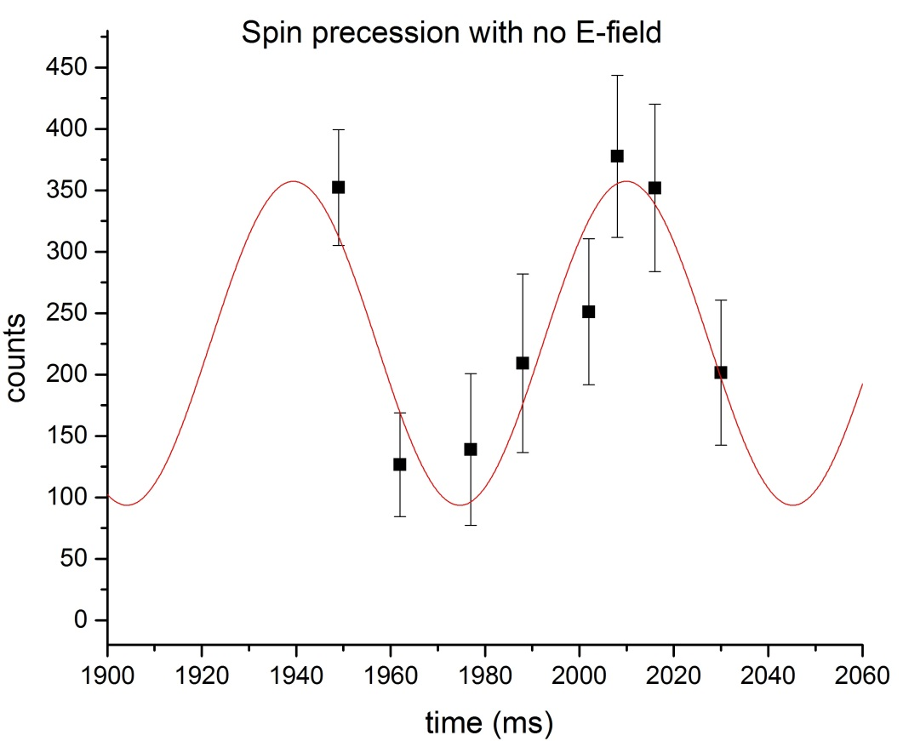
Spin Precession – Oct, 2014
Expected period = 56(6) ms
Period = 69(11) ms
Period = 70(10) ms

Slide 14

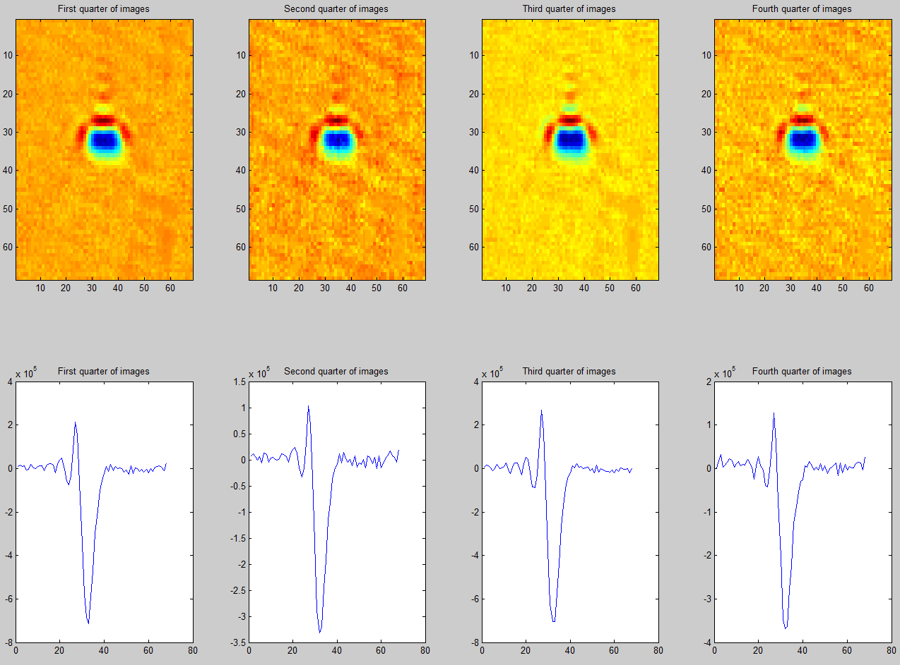
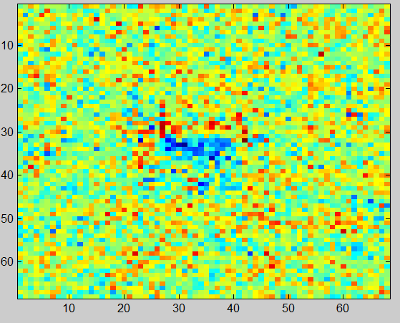
Absorption Detection of Spin State
F = 3/2
Photons scattering events
2-3 photons per atom
¹P₁
F = 1/2
Signal-to-noise Ratio
For 100 atoms, SNR ~ 0.2
483 nm
¹S₀
F = 1/2
m_{F} = -1/2
+1/2
Ra-226
Atom number detection
Ra-225
Spin detection

Slide 15
STIRAP
(stimulated Raman adiabatic passage)
F = 3/2
¹P₁
F = 1/2
1429 nm
483 nm
³D₁
¹S₀
F = 1/2
m_{F} = -1/2
+1/2
Stimulated, Adiabatic process
No fluorescence

Slide 16
Absorption Detection on a Cycling Transition
m_{F} = +3/2
F = 3/2
Photons scattering events
2-3 photons per atom
100-1000 photons per atom
¹P₁
F = 1/2
Signal-to-noise Ratio
For 100 atoms, SNR ~ 0.2
For 100 atoms, SNR ~ 10
483 nm
³D₁
¹S₀
F = 1/2
m_{F} = -1/2
+1/2

Slide 17
Improve trapping efficiency with a blue upgrade
7p ¹P₁
6 ns
7p ¹P₁
6 ns
Pump #1
Pump #1
6d ¹D₂
430 μs
420 ns
7p ³P₁
420 ns
7p ³P₁
6d ³D₂
6d ³D₁
6d ³D₁
Trap, 714 nm
Slow & Trap, 714 nm
7s² ¹S₀
7s² ¹S₀

Slide 18
7p ¹P₁
6 ns
7p ¹P₁
6 ns
Improve trapping efficiency with a blue upgrade
Pump #3
Pump #1
Pump #1
6d ¹D₂
430 μs
Pump #2
Scheme
1st slowing laser: 483 nm (strong)
2nd slowing laser: 714 nm
3 repumpers: 1428 nm, 1488 nm, 2.75 mm
¹⁷¹Yb as co-magnetometer
* ²²⁵Ra and ¹⁷¹Yb trapped, < 50 mm apart
Benefits
100 times more atoms in the trap
Improved control on systematic uncertainties
420 ns
7p ³P₁
420 ns
7p ³P₁
Slow, 483 nm
6d ³D₂
6d ³D₁
6d ³D₁
Trap, 714 nm
Slow & Trap, 714 nm
KVI barium trap
S. De et al. PRA (2009)
7s² ¹S₀
7s² ¹S₀

Slide 19
²²⁵Ra Yields
²³³U
159 kyr
α
²²⁵Ac
10 d
²²⁹Th
7.3 kyr
α
β
α
Fr, Rn,…
~4 hr
²²⁵Ra
15 d
Presently available
National Isotope Development Center, ORNL
  Decay daughters of ²²⁹Th ²²⁵Ra: 10⁸ /s
Projected
FRIB (B. Sherrill, MSU)
  Beam dump recovery with a ²³⁸U beam 6 x 10⁹ /s
  Dedicated running with a ²³²Th beam 5 x 10¹⁰ /s
ISOL@FRIB (I.C. Gomes and J. Nolen, Argonne)
  Deuterons on thorium target, 1 mA x 400 MeV = 400 kW 10¹³ /s
MSU K1200 (R. Ronningen and J. Nolen, Argonne)
  Deuterons on thorium target, 10 uA x 400 MeV = 4 kW 10¹¹ /s
19

Slide 20
Outlook
2014-2015
  Implement STIRAP – more efficient way to detect spin;
  Longer trap lifetime;
2015-2018, blue upgrade – more efficient trap;
Five-year goal (before FRIB): 10⁻²⁶ e cm;
2020 and beyond (at FRIB): 3 x 10⁻²⁸ e cm;
Far future: search for EDM in diatomic molecules
  Effective E field is enhanced by a factor of 10³;
  Reach the Standard Model value of 10⁻³⁰ e cm.

Slide 21
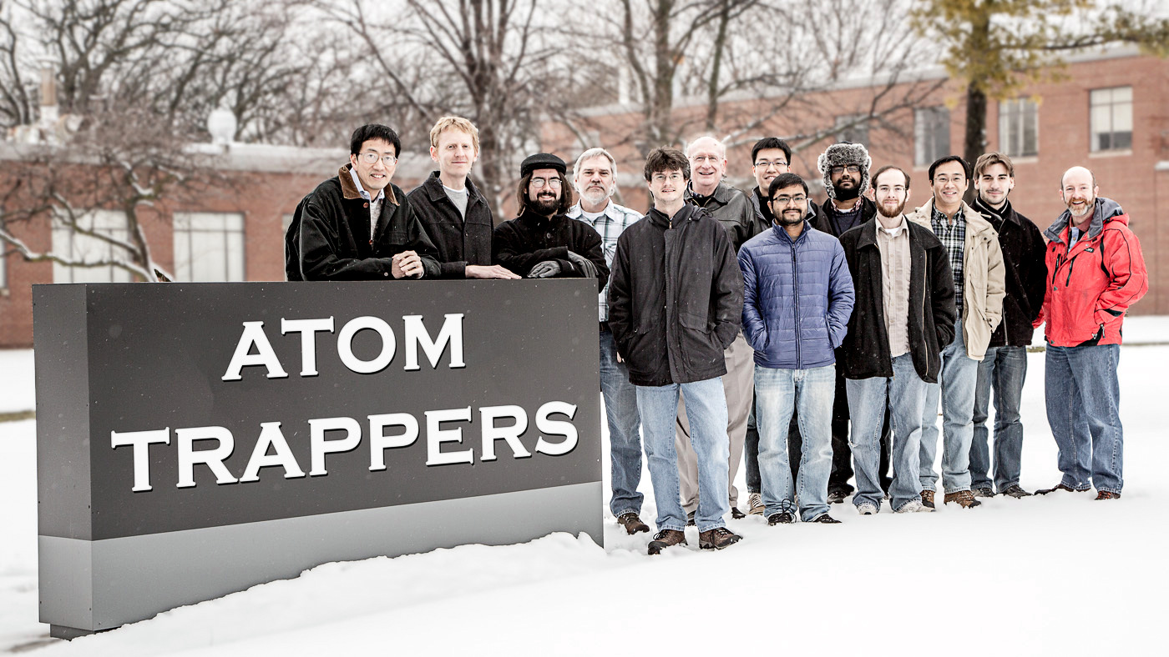
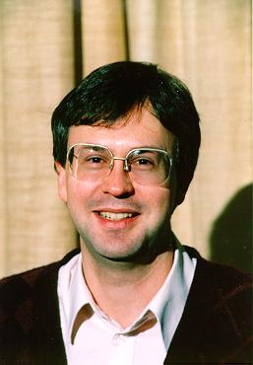
“Cold” Atom Trappers
Argonne: Kevin Bailey, Michael Bishof, John Greene, Roy Holt, Nathan Lemke, Zheng-Tian Lu, Peter Mueller, Tom O’Connor, Richard Parker;
Kentucky: Mukut Kalita, Wolfgang Korsch;
Michigan State: Jaideep Singh;
Northwestern: Matt Dietrich.

