Slide 1
Onward to the ‘final state’ in measuring
the mass of the neutrino
ACFI, December 14, 2015
Hamish Robertson, CENPA, University of Washington

Slide 2
Kinematic measurement of Neutrino Mass
The final-state distribution (FSD) in tritium beta decay
How well does KATRIN have to know it?
Does ¹⁶³Ho offer an escape from the need to know the FSD?
Project 8: Is an atomic experiment feasible?

Slide 3
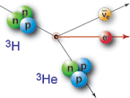

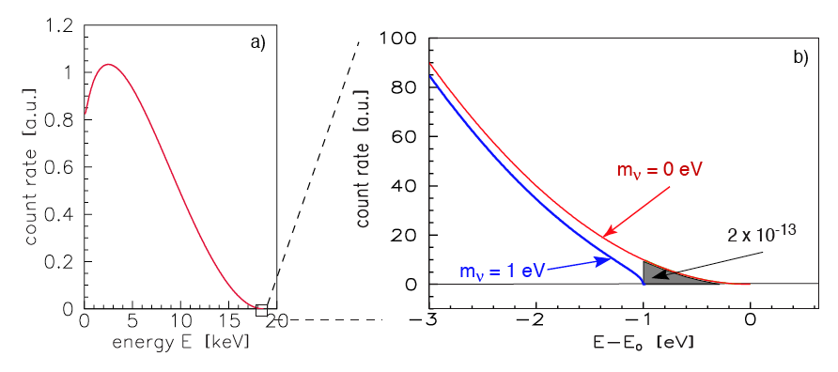
Neutrino mass from Beta Spectra
With flavor mixing:
mixing
neutrino masses
from oscillations
mass scale

Slide 4
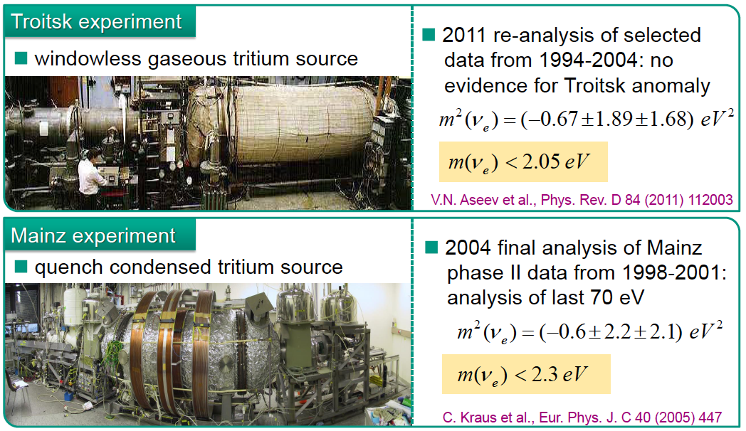
Present Laboratory Limit from 2 tritium experiments:
Together:…
m_{v} < 1.8 eV (95% CL)

Slide 5

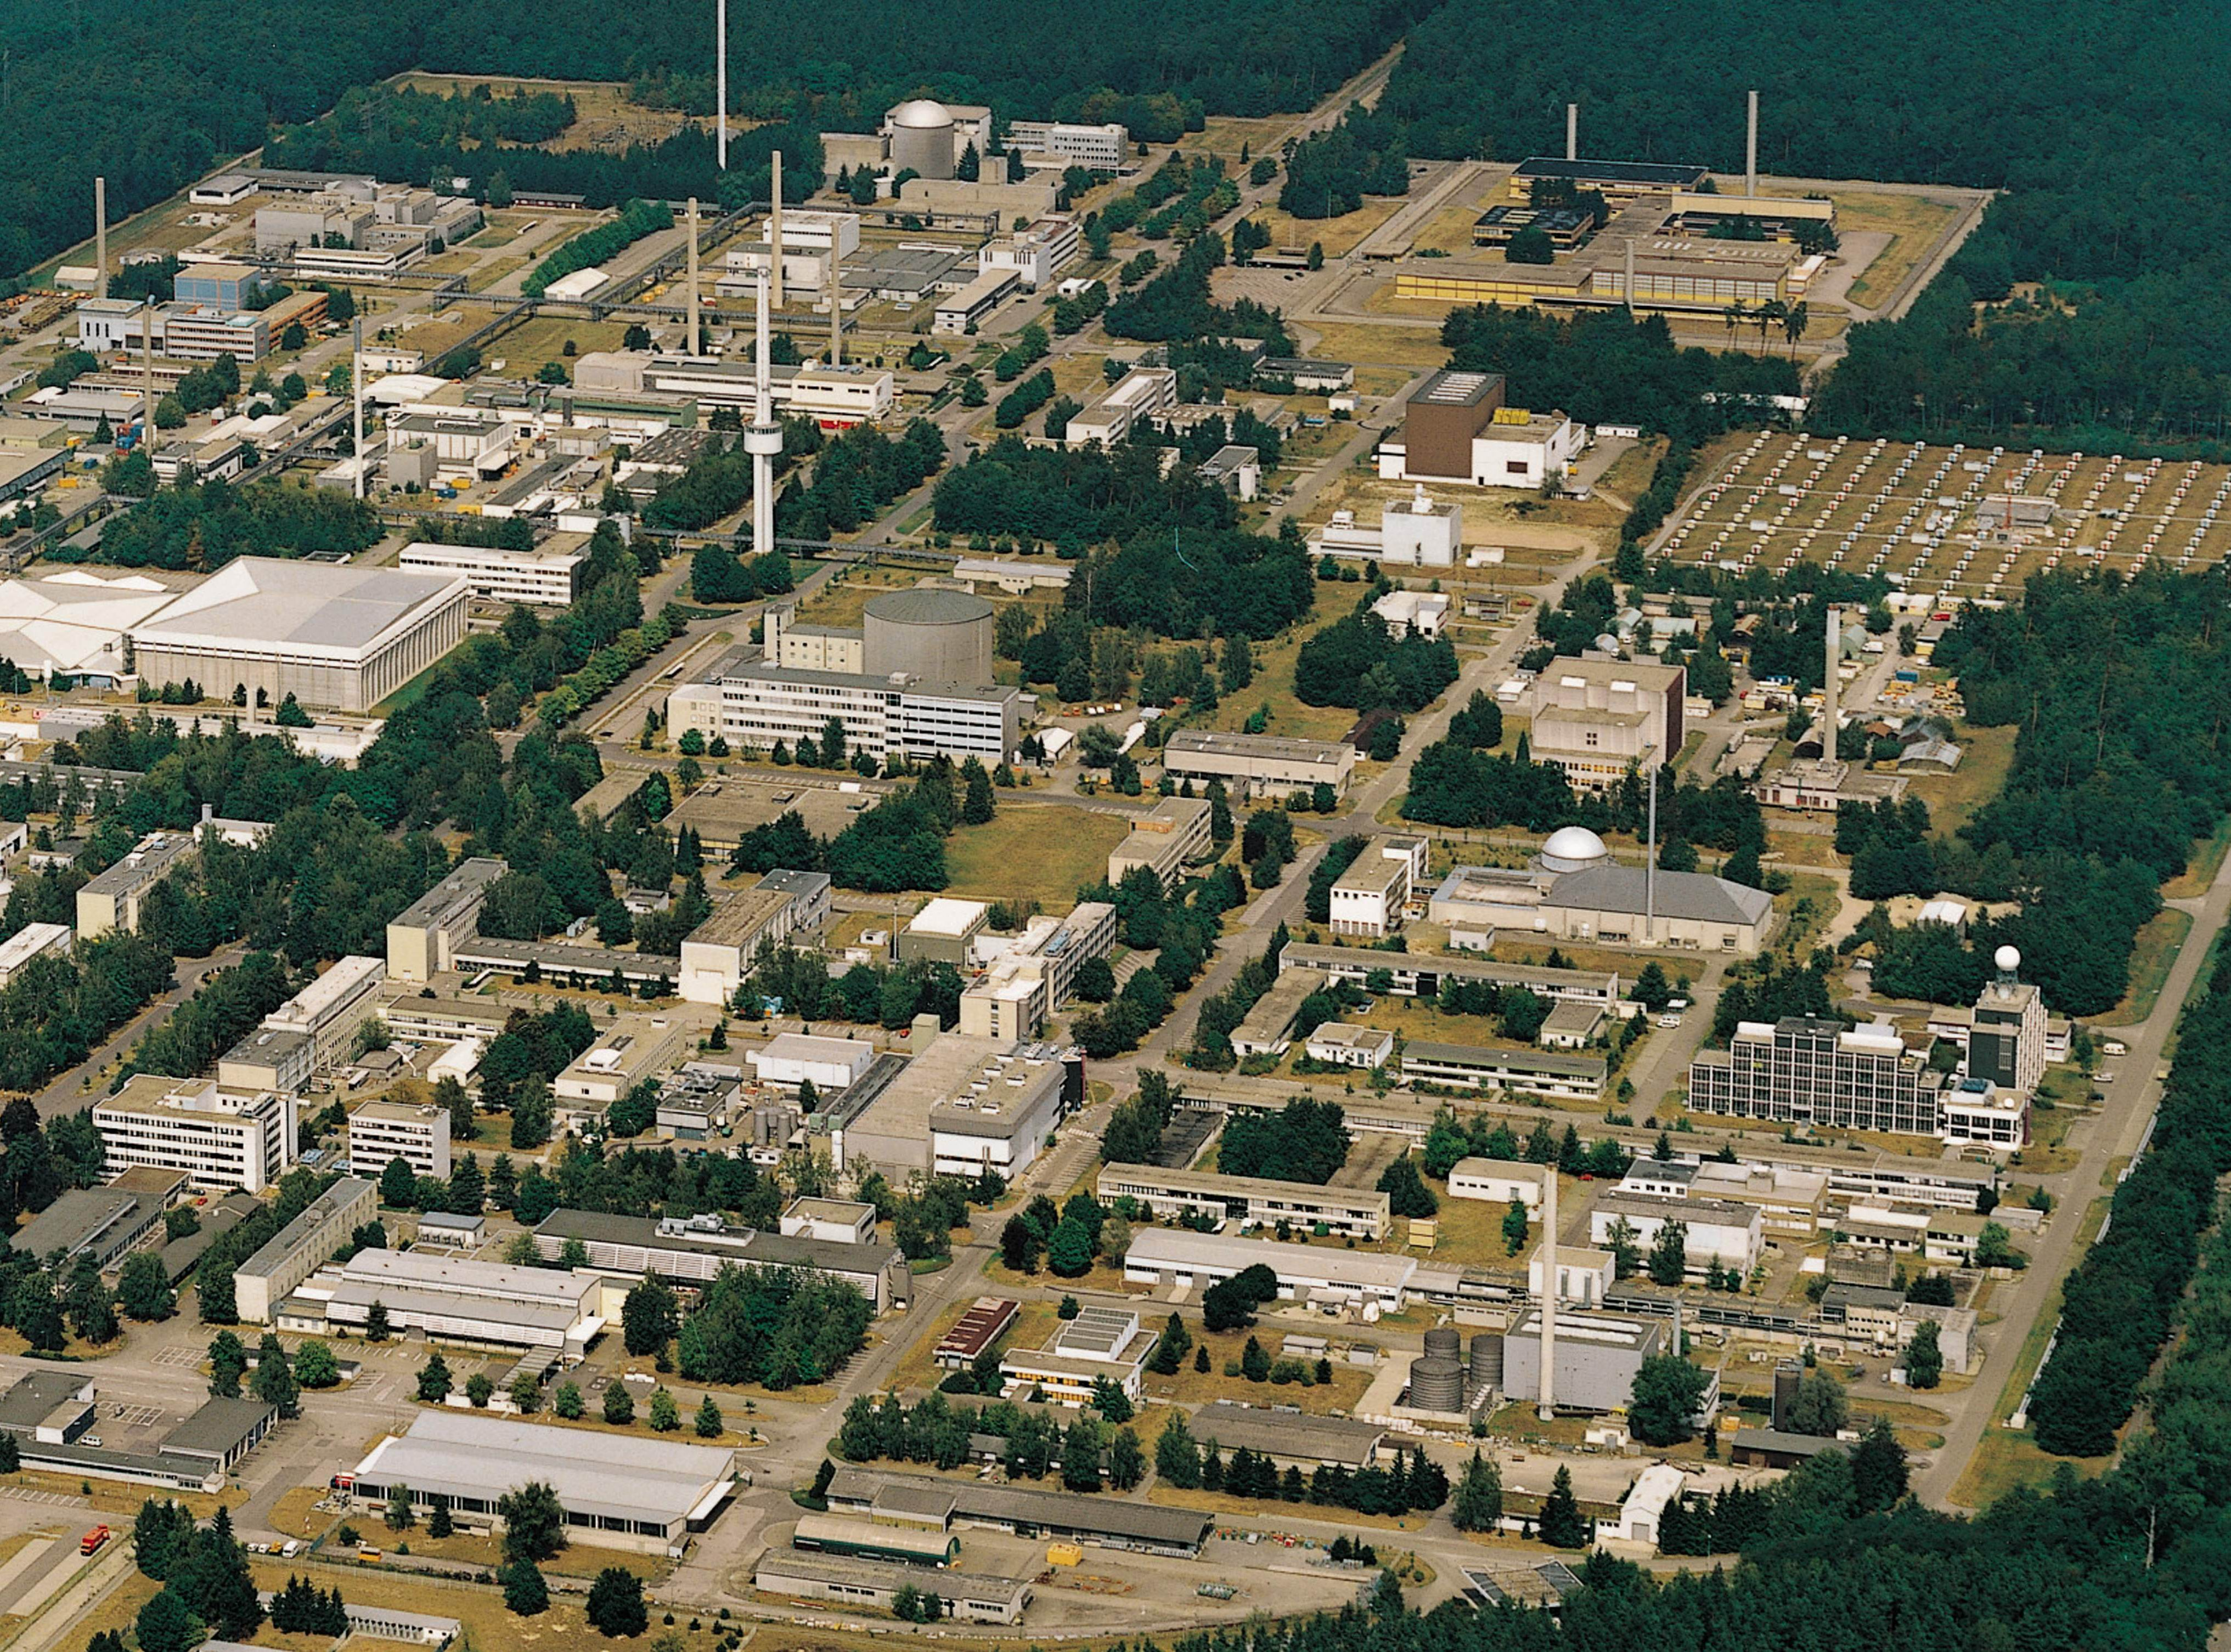
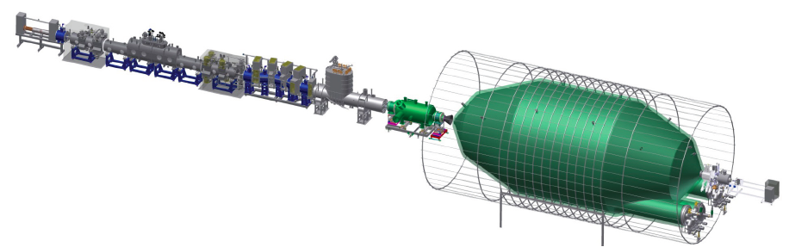
KATRIN
At Karlsruhe Institute of Technology
unique facility for closed T₂ cycle:
Tritium Laboratory Karlsruhe
A direct, model-independent, kinematic method, based on β decay of tritium.
TLK
~ 75 m long with 40 s.c. solenoids

Slide 6
KATRIN’s uncertainty budget
σ(m_{v}²)
0
0.01 eV²
Statistical
Final-state spectrum
T⁻ ions in T₂ gas
Unfolding energy loss
Column density
Background slope
HV variation
Potential variation in source
B-field variation in source
Elastic scattering in T₂ gas
σ(m_{v}²)_{total}= 0.025 eV²
m_{v}< 0.2 eV (90 % CL)

Slide 7
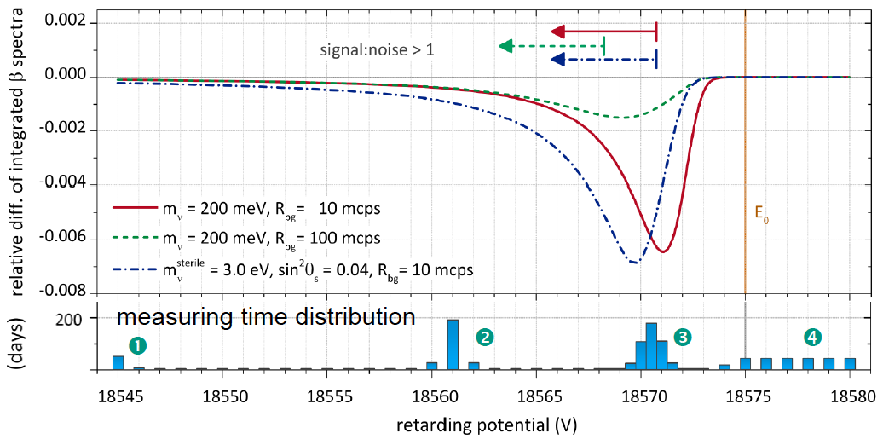
Neutrino mass signal

Slide 8
KATRIN’s uncertainty budget
σ(m_{v}²)
0
0.01 eV²
Statistical
Final-state spectrum
T⁻ ions in T₂ gas
Unfolding energy loss
Column density
Background slope
HV variation
Potential variation in source
B-field variation in source
Elastic scattering in T₂ gas
σ(m_{v}²)_{total}= 0.025 eV²
m_{v}< 0.2 eV (90 % CL)

Slide 9
Molecular final-state spectrum
Saenz et al. PRL 84 (2000)
T₂ → ³HeT⁺
β spectrum
Q_{A} = 18.6 keV

Slide 10
Molecular final-state spectrum
Saenz et al. PRL 84 (2000)
Fackler et al. PRL 55 (1985)
695 eV²
611 eV²
LANL 1991, LLNL 1995

Slide 11
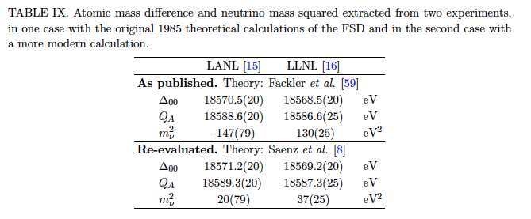

An old problem solved
Bodine, Parno, HR; PRC 91 035505 (2015)

Slide 12
Molecular final-state spectrum
Saenz et al. PRL 84 (2000)
0.2 eV²
Fackler et al. PRL 55 (1985)
694 eV²
KATRIN
LANL 1991, LLNL 1995

Slide 13
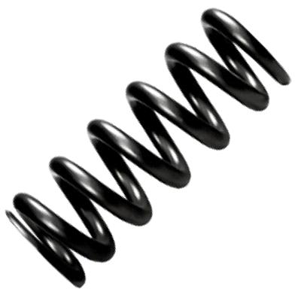
Molecular final-state spectrum – G.S.
rotation
e⁻
vibration
translation
T₂ molecule

Slide 14
Molecular final-state spectrum – G.S.
Saenz:
σ = 0.436 eV
ZPM:
σ = 0.420 eV
Bodine, Parno, HR; PRC 91 035505 (2015)

Slide 15
final-state spectrum Comments
For molecular T₂ only the ground-state manifold is relevant now and electronic excitations are no longer a concern.
The full FS variance (electronic included) is experimentally confirmed to ~2% (LANL, LLNL).
KATRIN’s 1% systematic (mainly g.s.) seems realistic.
The g.s. manifold has an rms width of 0.436 eV (FWHM 1.02 eV), which limits the neutrino mass reach of any molecular experiment.

Slide 16
Mass Range Accessible
starting
2016
KATRIN
Present
Lab Limit
1.8 eV

Slide 17
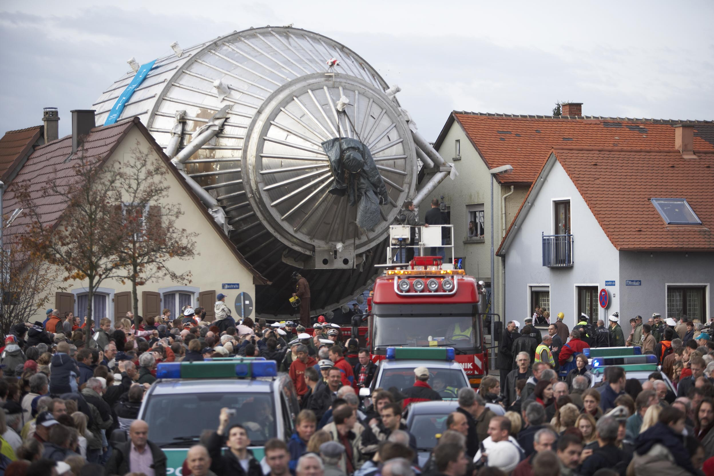
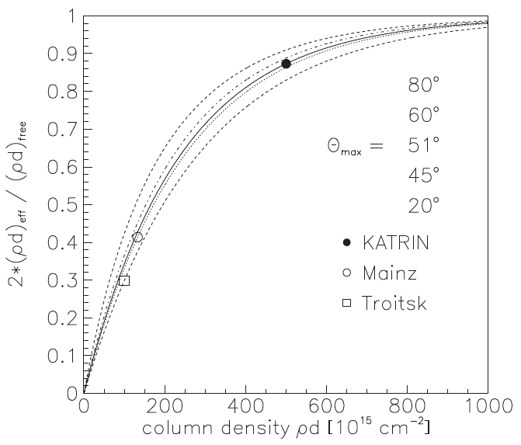
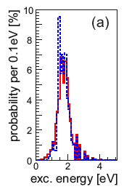

The Last Order of Magnitude
If the mass is below 0.2 eV, how can we measure it?
KATRIN may be the largest such experiment possible.
Size of experiment now:
Diameter 10 m.
Source T₂ column density near max
Rovibrational states of THe⁺, HHe⁺ molecule
Next diameter: 300 m!

Slide 18
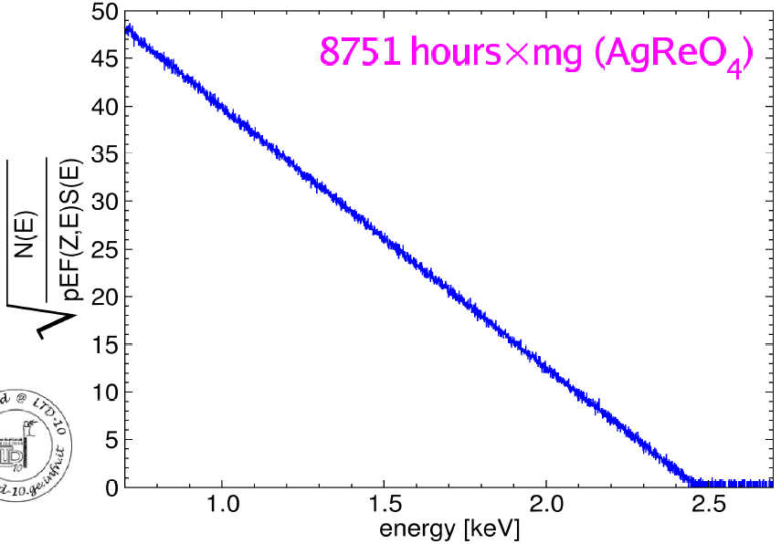
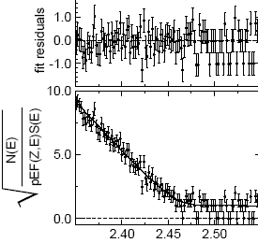
Microcalorimeters for ¹⁸⁷Re ß-decay
MIBETA: Kurie plot of 6.2 ×10⁶ ¹⁸⁷Re ß-decay events (E > 700 eV)
MANU2 (Genoa)
metallic Rhenium
m(ν) < 26 eV
Nucl. Phys. B (Proc.Suppl.) 91 (2001) 293
MIBETA (Milano)
AgReO₄
m(ν) < 15 eV
10 crystals:
8751 hours x mg (AgReO₄)
Nucl. Instr. Meth. 125 (2004) 125
MARE (Milano, Como,
Genoa, Trento, US, D)
Phase I : m(ν) < 2.5 eV
E₀ = (2465.3 ± 0.5_{stat} ± 1.6_{syst}) eV
m_{ν}² = (-112 ± 207 ± 90) eV²
hep-ex/0509038

Slide 19
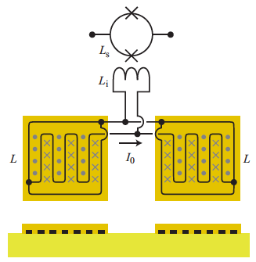
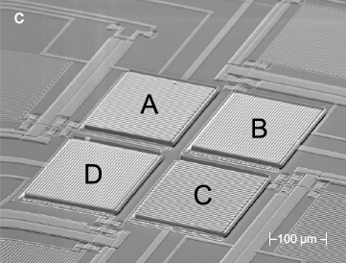
Electron Capture Holmium Expt (ECHo)
Gastaldo et al. NIM A711, 150 (2013)
¹⁶³Ho implanted in Metallic Magnetic Calorimeters
Au:Er paramagnetic sensors

Slide 20
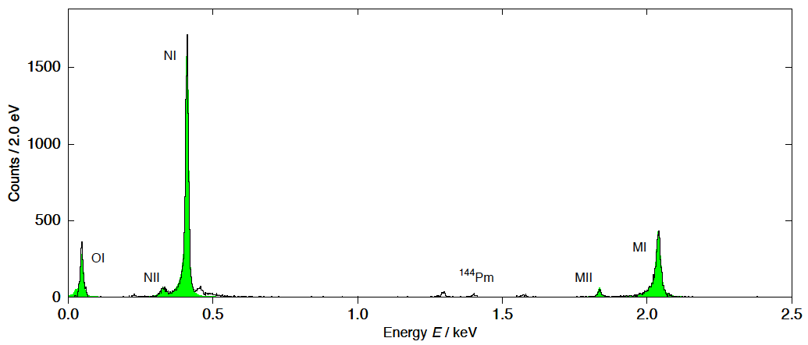
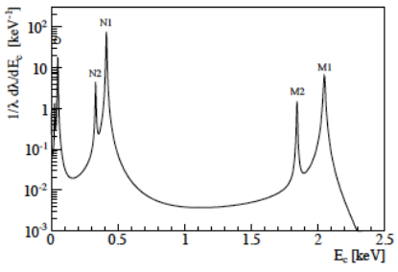
Ranitzsch et al. 1409.0071
Energy resolution 8.3 eV
De Rujula & Lusignoli PL 118B 429 (1982)

Slide 21
Spectrum with both single and double vacancies in the ¹⁶³Dy daughter.
HR 2014: 1411.2906
PRC 91, 035504 (2015)
Complicated structure near endpoint makes neutrino mass measurement very difficult

Slide 22
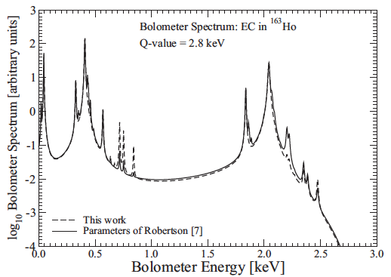
Spectrum with both single and double vacancies in the ¹⁶³Dy daughter – Faessler’s calculation.
Faessler & Simkovic
PRC 91 045505 (2015)
New SHIPTRAP Q-value [PRL 115, 062501 (2015)]:

Slide 23
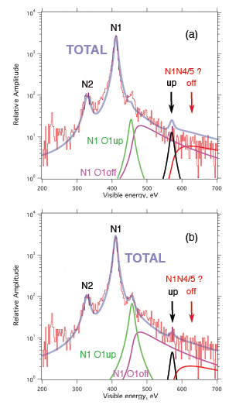
Next, de Rujula calculates shake-off as well as shake-up:
1510.05462v2
As calculated:
Intensities adjusted:
The theoretical description is better and the Q-value puts the endpoint in a region where only 3-hole excitations exist. But now the intensity is worse than tritium!

Slide 24
We need…
a new idea.

Slide 25
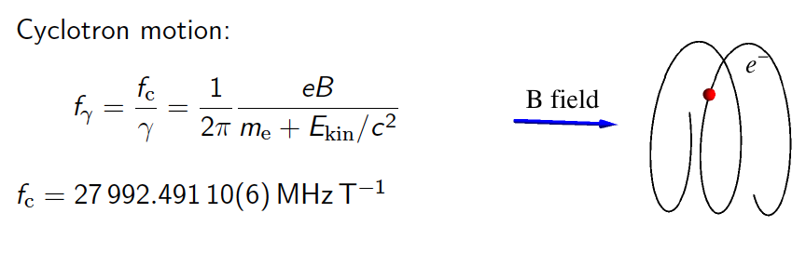
Cyclotron radiation from tritium beta decay
(B. Monreal and J. Formaggio, PRD 80:051301, 2009)
“Never measure anything but frequency.”
A. Schawlow
Surprisingly, this has never been observed for a single electron.

Slide 26
Energy rEsolution
~30
For 1 eV energy resolution, you need about 2 ppm frequency.
For 2 ppm frequency, you need 500,000 cycles, or 15 μs.
Electron travels 2 km.
You need a trap!

Slide 27
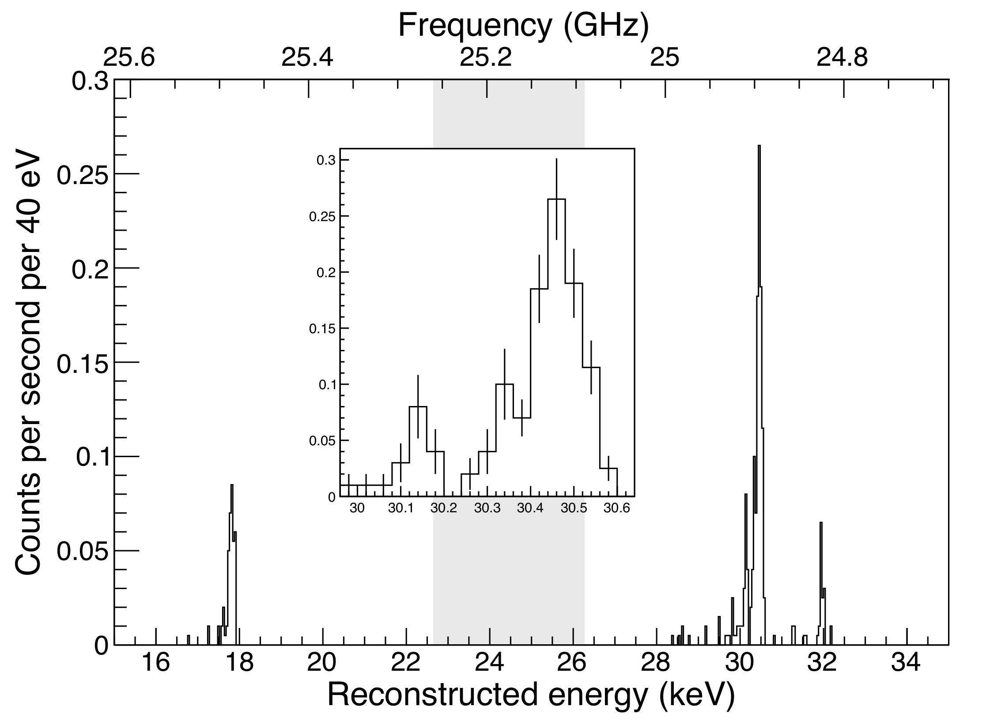
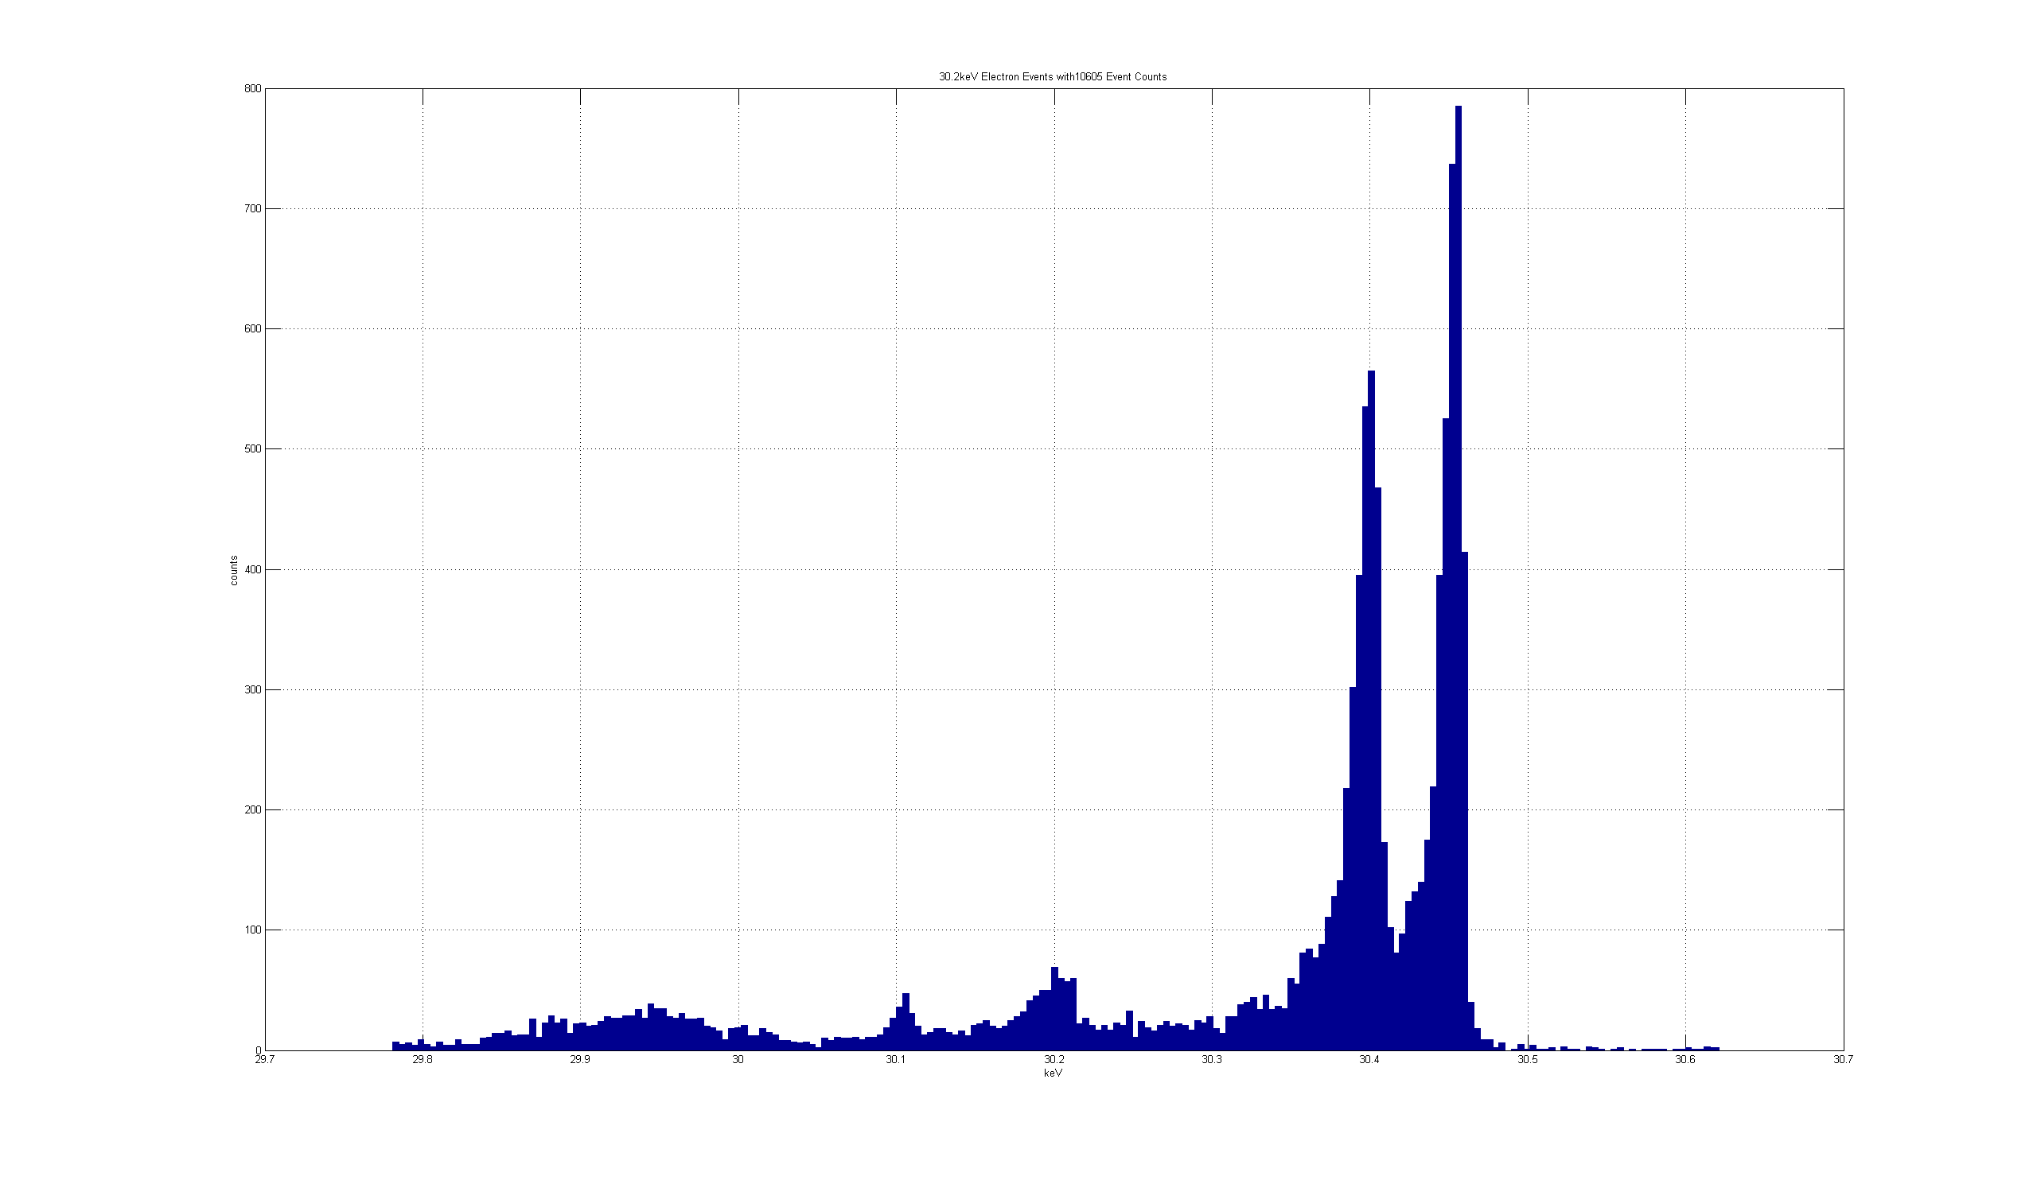
Shallow trap data
^{83m}Kr
These lines are ~50 eV apart
Preliminary
Analysis in Progress
29.8
30.0
30.2
30.4
30.6
Reconstructed energy (keV)

Slide 28
Why is this so important?
Source is transparent to microwaves: can make it as big as necessary.
Whole spectrum is recorded at once, not point-by-point.
Excellent resolution should be obtainable.
An atomic source of T (rather than molecular T₂) may be possible. Eliminates the final-state theory input.

Slide 29
Next: a tritium experiment
Fill a volume with tritium gas at low pressure
Instrument with antennas and receivers
Apply uniform magnetic field
Measure the spectrum

Slide 30
Project 8 sensitivity
and OPTIMISTIC

Slide 31
Project 8 sensitivity
Existing mass limit
Normal vs inverted hierarchy
Current system volume

Slide 32
Is an atomic source feasible?
Must reject molecules to 10⁻⁵ (endpoint is 8 eV higher)
Produce T in RF discharge: 90:10 T₂:T
Cool to ~10 K in PTFE tube (Silvera method).
State select.
Inject into trap, trap low-field-seeking polarization.
Trap and cool to ~1 K by scattering from ⁴He.
Trap in same magnetic field configuration that is trapping the electrons: ‘bathtub’ axial trap + added barrel conductors. High fields are essential: complicated SC magnet. 5T ~ 3.1 K.
Neither T₂ nor ⁴He are trapped magnetically.
Surprisingly, all of this looks sort of feasible, although not easy.
The statistical accuracy alone doesn’t convey the added confidence an atomic source would give.

Slide 33
Magnetic configuration of trap
Solenoidal uniform field for electron cyclotron motion
Pinch coils to reflect electrons
Ioffe conductors (multipole magnetic field) to reflect radially moving atoms.
The ALPHA antihydrogen trap parameters:
Magnetic well depth 0.54 K (50 μeV)
Trap density initially ~10⁷ cm⁻³
Trap lifetime ~ 1000 s

Slide 34
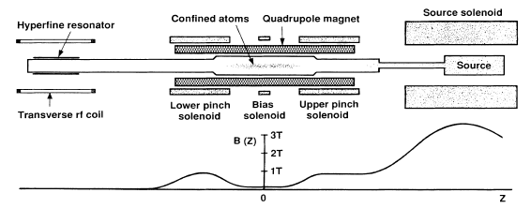
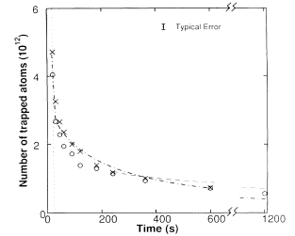
An early H trap (AT&T, MIT)
6 x 10¹² cm⁻³
40 mK
400 s
Effect of dipolar spin flips
Hess et al. PRL 59, 672 [1987]

Slide 35
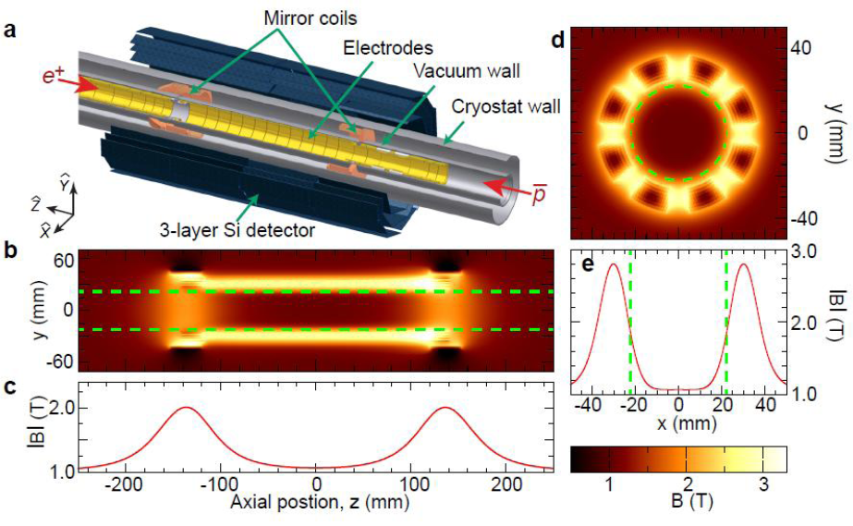
ALPHA’s antihydrogen trap
ALPHA Collaboration: Nature Phys.7:558-564,2011; arXiv 1104.4982

Slide 36
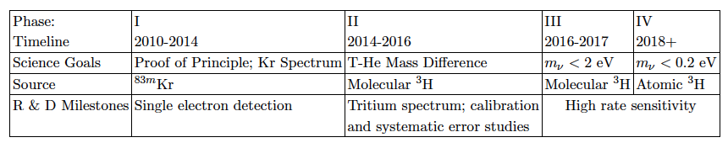
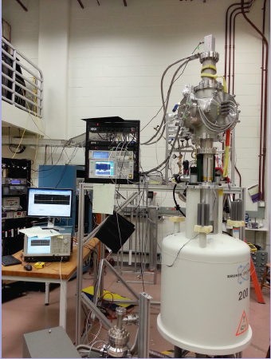
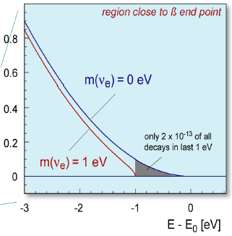
Project 8: a phased approach

Slide 37
Mass Range Accessible
starting
2016
KATRIN
Present
Lab Limit
1.8 eV

Slide 38
Neutrino Mass Limits from Beta decay
KATRIN

Slide 39
summary
Direct mass measurements are largely model independent:
  Majorana or Dirac
  No nuclear matrix elements
  No complex phases
  No cosmological degrees of freedom
One experiment in construction (KATRIN); 2016 start.
Five experiments in R&D (Project 8, ECHo, HoLMES, NuMECS, PTOLEMY)
Success of Project 8 proof-of-concept.
  New spectroscopy based on frequency
  First step toward frequency-based determination of neutrino mass
  Prospects for an atomic experiment

Slide 40
Fin

Slide 41
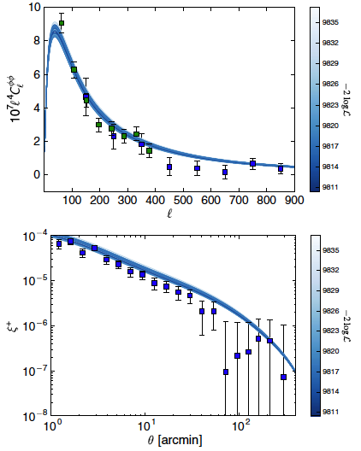
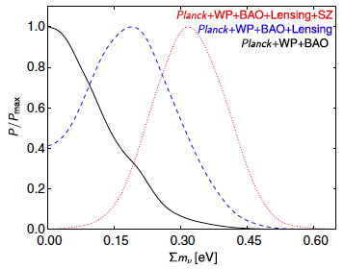
Battye and Moss, PRL 112, 051303 (2014)
Lensing power spectrum
Planck
SPT
Some tensions in ΛCDM resolved with neutrino mass:
Shear correlation spectrum
CFHTLenS

Slide 42
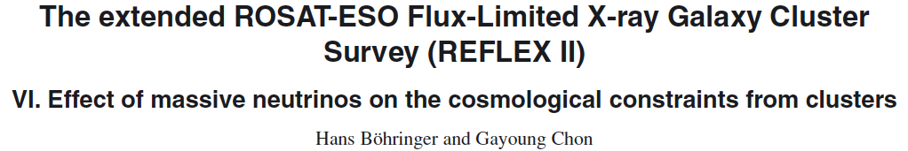
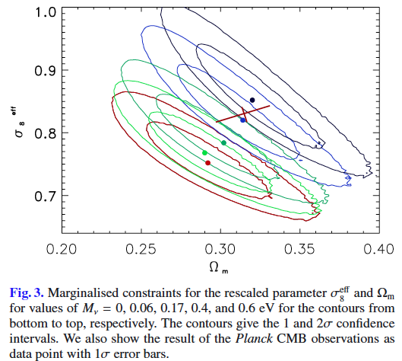

http://www.aanda.org/articles/aa/abs/2015/02/aa25435-14/aa25435-14.html
Galaxy cluster data agree better with CMB when Σm_{ν}=

Slide 43
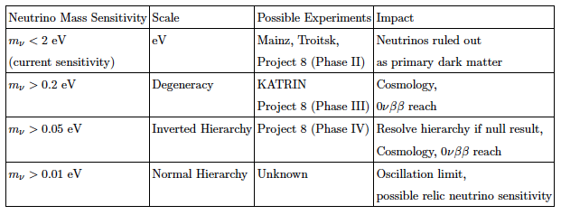
Neutrino mass Physics Impact

Slide 44
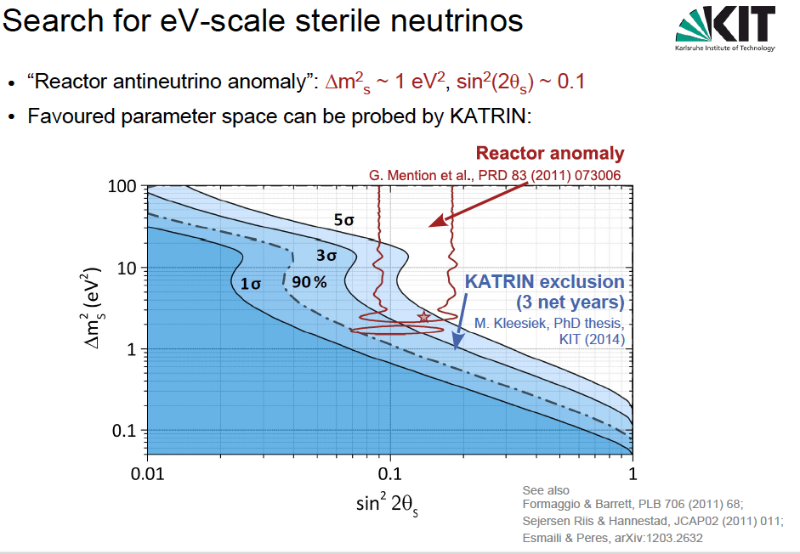

Slide 45
Mass and mixing parameters
Oscillation
Kinematic
Δm₂₁² | 7.54^{+0.21}_{-0.21} x 10⁻⁵ eV²
|Δm₃₂²| | 2.42^{+0.12}_{-0.11} x 10⁻³ eV²
Σm_{i} | > 0.055 eV (90% CL) | < 5.4 eV (95% CL)*
θ₁₂ | 34.1^{+0.9}_{-0.9} deg
θ₂₃ | 39.2^{+1.8}_{-1.8} deg
θ₁₃ | 9.1^{+0.6}_{-0.7} deg
sin²θ₁₃ | 0.025^{+.003}_{-.003}
Marginalized 1-D 1-σ uncertainties.
*C. Kraus et al., Eur. Phys. J. C40, 447 (2005); V. Aseev et al. PRD 84 (2011) 112003.
Other refs, see Fogli et al. 1205.5254

Slide 46
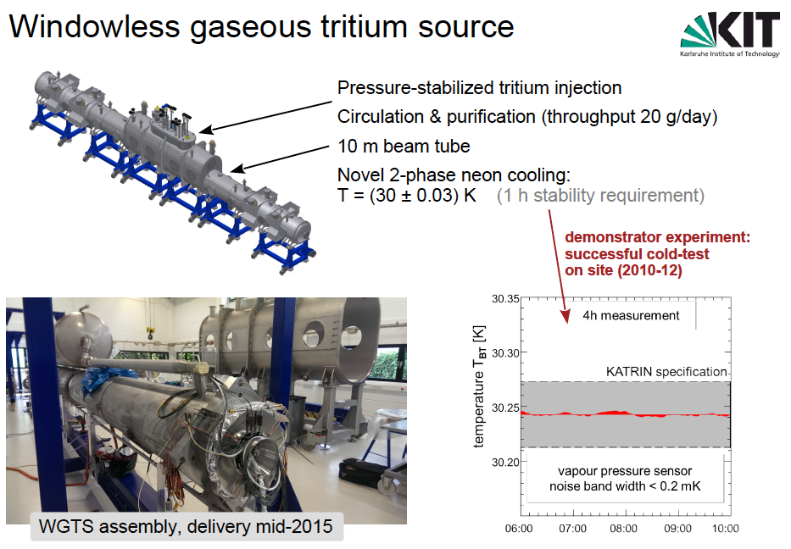
K. Valerius

Slide 47
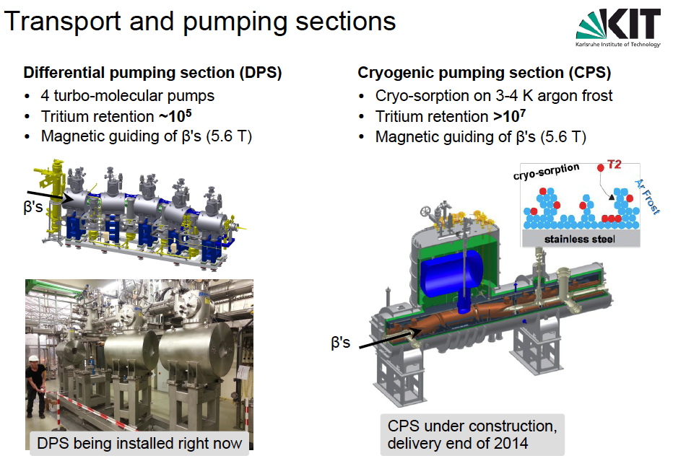
K. Valerius

Slide 48
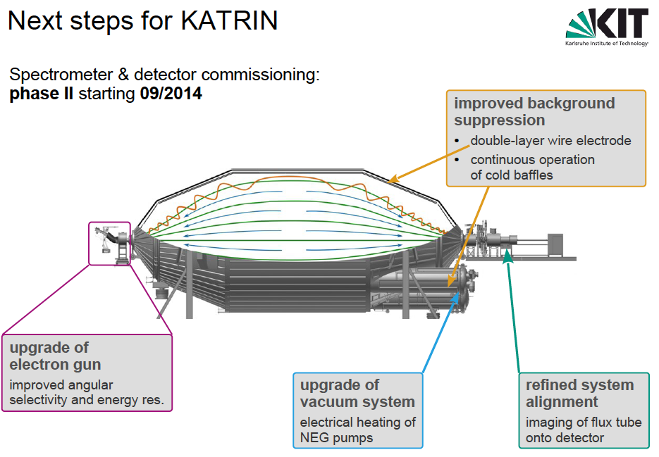
K. Valerius

Slide 49
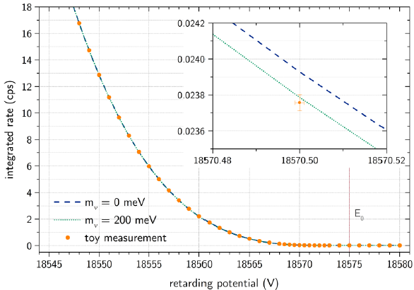
Katrin’s statistical power

Slide 50
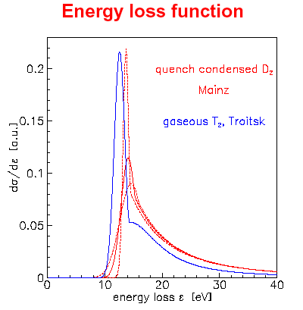
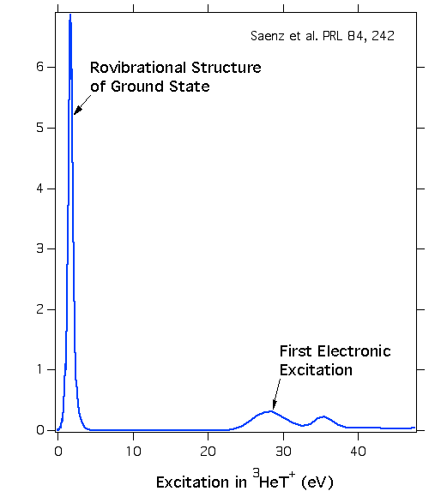
A window to work in
Molecular excitations
Energy loss

Slide 51
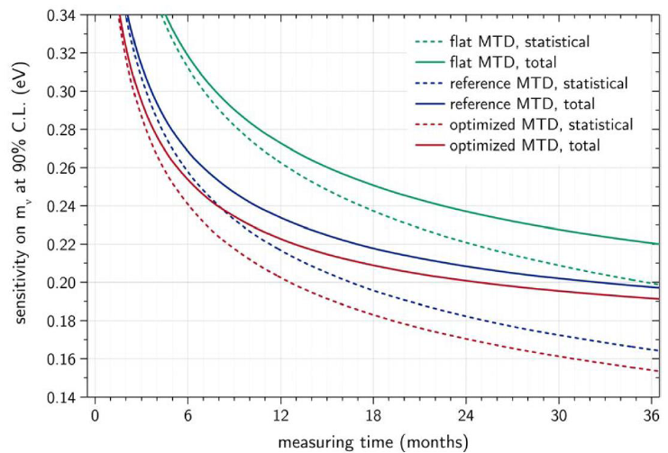
Sensitivity with Time

Slide 52
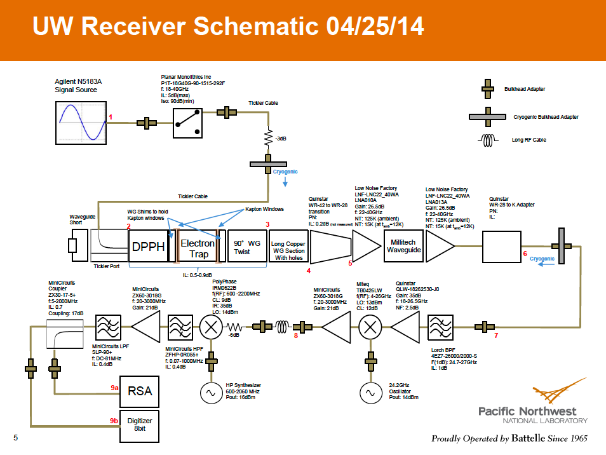

Slide 53
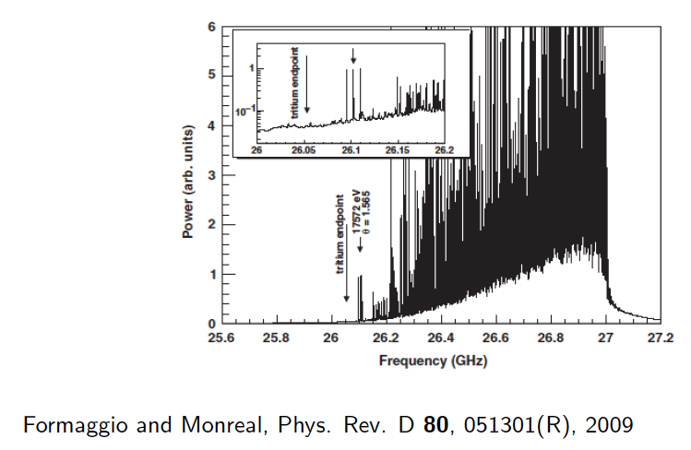

Slide 54
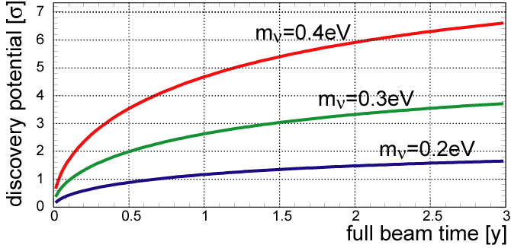
Neutrino mass: some milestones
Construction
Running
KATRIN:
Project 8:
Proof concept
Prototype
Phase I
2013
2014
2015
2016
2017
2018
2019

Slide 55
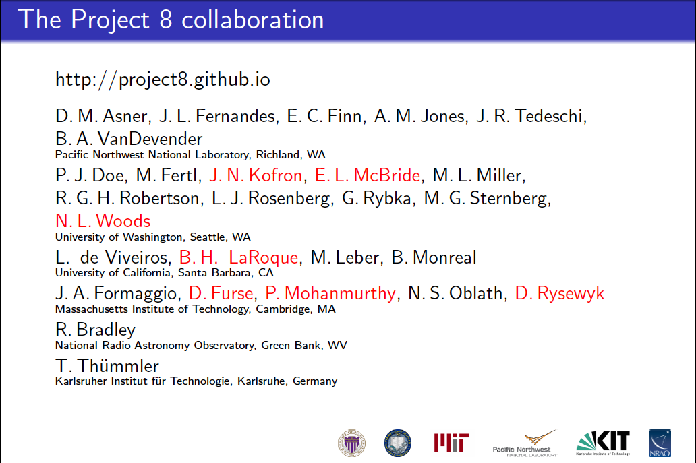

Slide 56
