Slide 1
Status of the Beam Method
M. Scott Dewey
National Institute of Standards and Technology
Workshop on Next Generation Neutron Lifetime Measurements in the U.S.

Slide 2
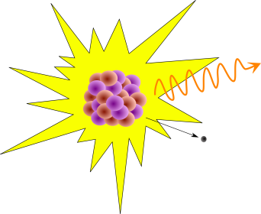
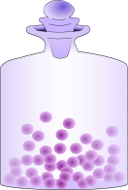

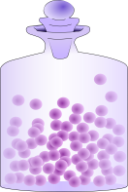
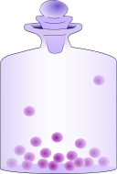

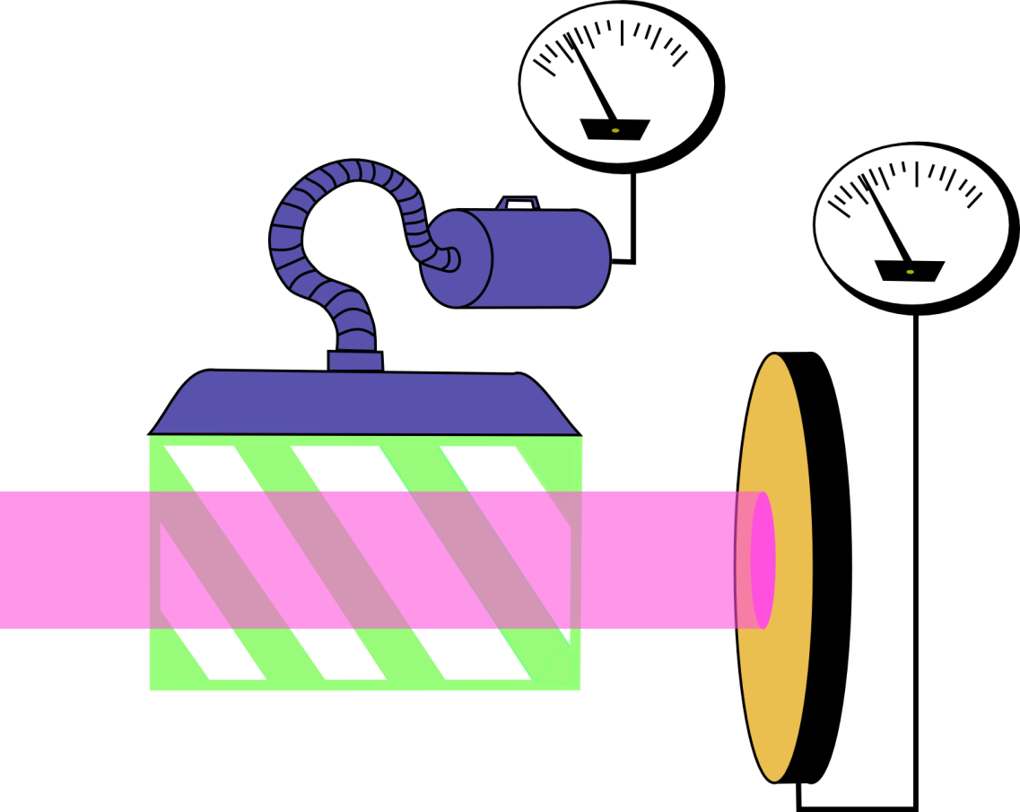
How to Measure τ_{n} … $N(t)=N_{0}e^{−t/{τ_{n}}}$
Direct Observation of Exponential Decay:
Observe the decay rate of N₀ neutrons and the slope of
Similar in principle to Freshman Physics Majors measuring radionuclide half lives
-- only a lot harder.
is
“Bottle” Experiments:
Form two identical ensembles of neutrons and then count how many are left after different times.
Beam Experiments:
Decay rates within a fiducial volume are measured for a beam of well known fluence.
Decay Detector
Neutron Beam
Fiducial Volume
Neutron Detector

Slide 3
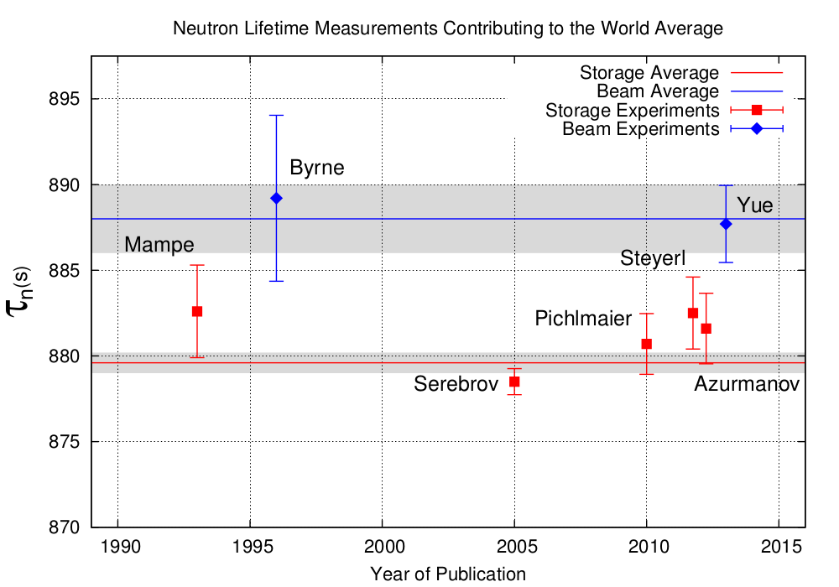
The State of the Neutron Lifetime
Beam Average
Storage Average

Slide 4
Two Beam Methods in Use Today
Bunches of neutrons (a chopped beam)
  Define a measuring time during which a bunch is entirely inside the detector
  Measure the number of neutrons in the bunch
  Measure the number of decays produced during that time
Continuous neutron beam
  Define a length of the beam to monitor
  Define a measuring time
  Measure the average density of neutrons in the beam during that time
  Measure the number of decays produced in that length during that time

Slide 5
Precise measurement of neutron lifetime with pulsed neutron beam at J-PARC
Kenji MISHIMA (KEK)
T. Yamada^{1#}, N. Higashi¹, K. Hirota², T. Ino³, Y. Iwashita⁴,
R. Katayama¹, M. Kitaguch⁵, R. Kitahara⁶, K. Mishima³, H. Oide⁷,
H. Otono⁸, R. Sakakibara², Y. Seki⁹, T. Shima¹⁰, H. M. Shimizu²,
T. Sugino², N. Sumi¹¹, H. Sumino¹², K. Taketani³, G. Tanaka¹¹,
S. Yamashita¹³, H. Yokoyama¹, and T. Yoshioka⁸
Univ. of Tokyo¹, Nagoya Univ.², KEK³, ICR, Kyoto Univ.⁴, KMI, Nagoya Univ.⁵, Kyoto Univ.⁶, CERN⁷, RCAPP, Kyushu Univ.⁸, RIKEN⁹, RCNP, Osaka Univ.¹⁰, Kyushu Univ.¹¹, GCRC, Univ. of Tokyo¹², ICEPP, Univ. of Tokyo¹³
Notes:
I’m talking about a lifetime measurement with pulsed neutron beam at J-PARC.

Slide 6




Principle of our experiment
Cold neutrons are injected into a TPC.
The neutron β-decay and the ³He(n,p)³H reaction are measured simultaneously.
Principle
（Kossakowski,1989）
Count events during time of bunch in the TPC
Neutron bunch
shorter than TPC
Neutron bunch
p
³He(n,p)t
e
ν
τ_{n}
v
ε_{e}
: lifetime of neutron
: velocity of neutron
: detection efficiency of electron
β-decay
ε_{n}
ρ
σ
: detection efficiency of ³He reaction
: density of ³He
: cross section of ³He reaction
³He(n,p)³H
σ₀=cross section@v₀, v₀=2200[m/s]
This method is free from the uncertainties due to external flux monitor, wall loss, depolarization, etc.
Our goal is measurement with 1 sec uncertainty.
Notes:
Principle of our experiment is following.
We use a Time Projection Chamber with doped 3He.
The electron from the neutron decay(上式) and the proton from the 3He(n,p)3H reaction(下式) can described by this fomula.
The ratio of counting rate of electrons and protons gives the neutron lifetime.
By using shorter neutron bunches and measuring only when the bunches are totally in the TPC,
we can obtain high efficiency(tau式).
Both of them are measured simultaneously in a same detector.
So systematic uncertainty of fiducial volume will be canceled.
-----
Comparing with UCN experiment, There are no systematic uncertainties due to wall interaction or depolarization.

Slide 7
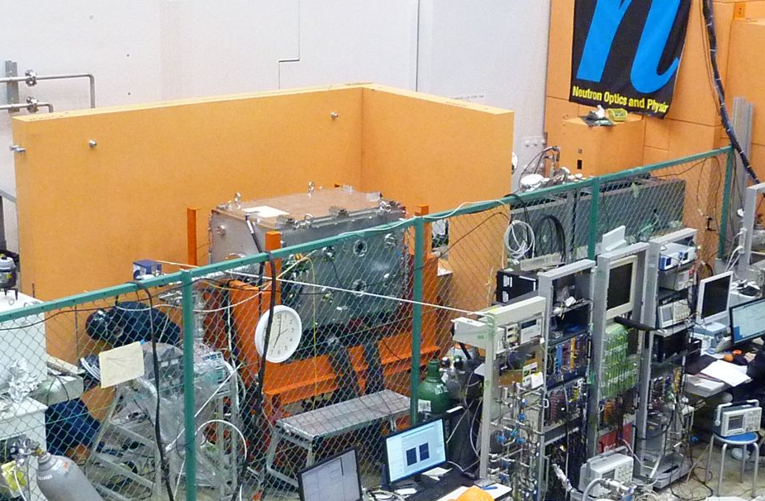
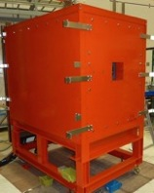
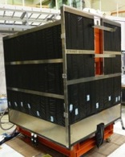
Setup
TPC in the
vacuum chamber
Set up of our experiment in “NOP” beam line.
Inside of
Lead shielding
20 cm Iron shield
Spin Flip Chopper
In a Lead Sheald
Inside of
Cosmic ray Veto
TPC in
a Vacuum chamber
Gas line
DAQ
Notes:
This is our experimental setup.
This is a Spin Flip Chopper to make shorter bunches.
I will explain it later.
This is a vacuum chamber for the TPC.
This picture is under the construction.
Our TPC is covered by la ead shield to reduce environmental radiation.
Plastic scintillators for cosmic-ray veto covers the lead shield.

Slide 8
chronological table
2008 | 2009 | 2010 | 2011 | 2012 | 2013 | 2014 | 2015 | 2016
MLF Power
Earthquake
Accident of hadron hall
2017
嶋TPC
G10-TPC
PEEK-TPC
LARGE PEEK-TPC
1st JPARC
symposium
Design
the G10-TPC
Design the PEEK TPC, (Low noise Amp)
TPC Basic properties test
Upgrade of analysis framework
for physics run
Design and development of Large SFC
Beam intensity is estimated to be 18 times.
Development of software
(Analysis framework, Geant4)
Design and development of DAQ system
Design and development of Large TPC
Development of
DAQ system
Material test
(PEEK)
Data taking2012
(commissioning)
Analysis for commissioning data
Commissioning for the new system
BG survey
First detection of 3He(n,p) reaction
SFC shielding upgrade
Measurement of Beam profile
Data Taking 2014
Data taking
for 1sec level
The first beam accept at the “NOP” Beam line
First detection of
Neutron β-decay
Today
20 kW
100 kW
200 kW
200 kW
300 kW
300 kW
600 kW?
Increasing size the Spin Flip Chopper is planed at 2014/2015.
Intensity will be 18 times by a designed value.
We will start physics run to 1sec at 2016/2017
Notes:
This is a historical table of this experiment.
We started this experiment at 2008, which is reported at the 1st JPARC symposium.
We accept the first beam to our beamline at the end of 2008, and we
We are planning increasing the size of spin flip chopper at 2014 to 2015.
Intensity will be 18 times by a designed value.
After the upgrade, We will start physics run to 1sec at 2016/2017
It takes 30 days for 1MW. Even 300kW it takes 90 days.

Slide 9
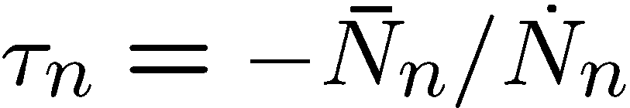
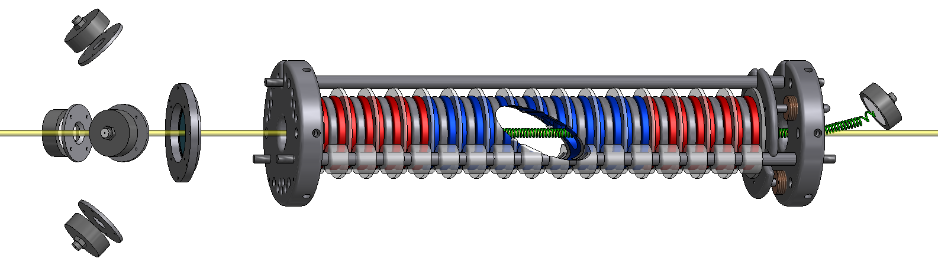


The NIST beam lifetime experiment
α,t detector
Precision aperture
B = 4.6 T
p detector
Neutron beam
n
⁶LiF deposit
Proton trap
+800 V
Beam fluence measurement
( )
Decay product counting volume
( )
Neutron monitor
Proton trap electrostatically traps decay protons and directs them to detector via B field
Neutron monitor measures incident neutron rate by counting n + ⁶Li reaction products (α + t)

Slide 10
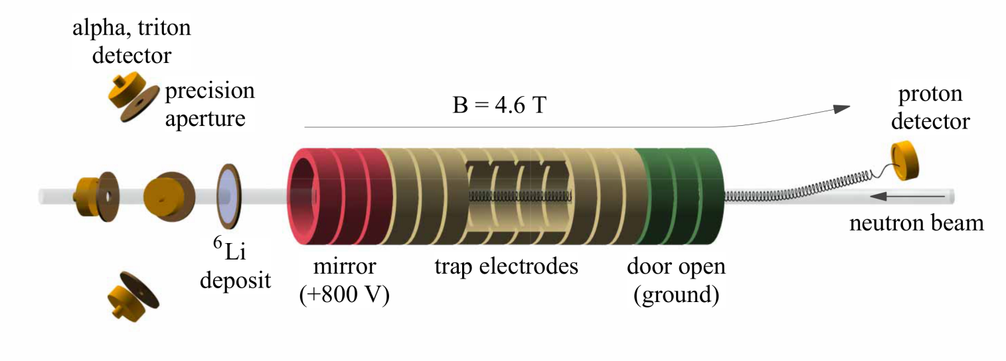
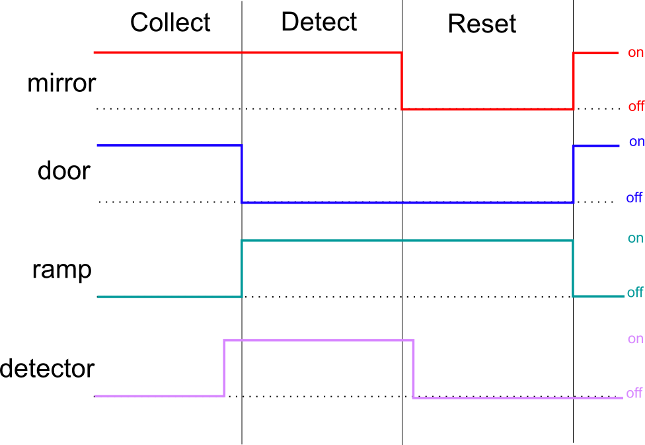
Sussex-ILL-NIST Beam Experiments
graphic by F Wietfeldt
Timing

Slide 11
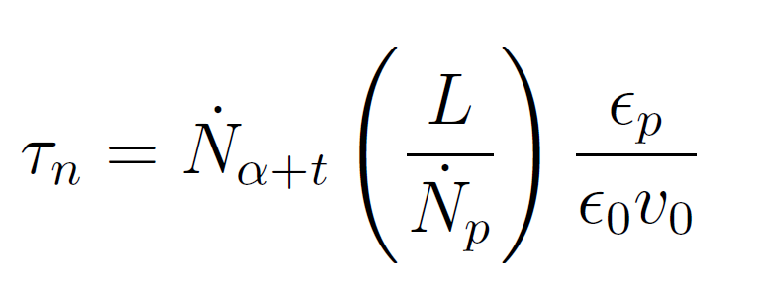
Determining τ_{n}
Alpha-Gamma
Proton rate measured as function of trap length
Proton detection efficiency
n + ⁶Li reaction product counting
Neutron flux monitor efficiency for

Slide 12
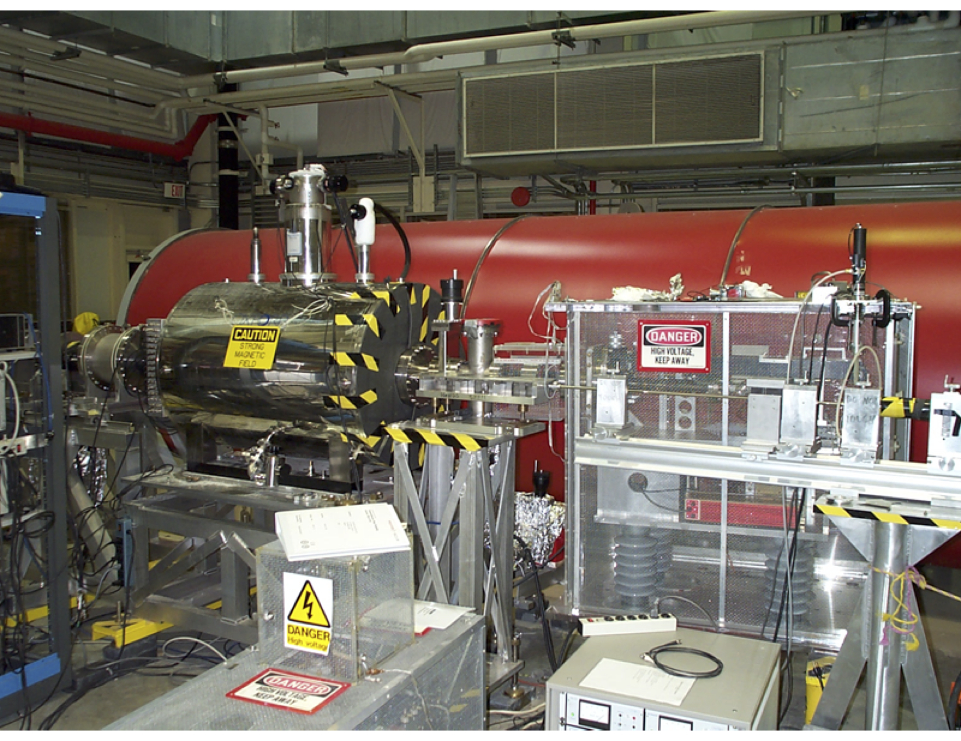

Slide 13
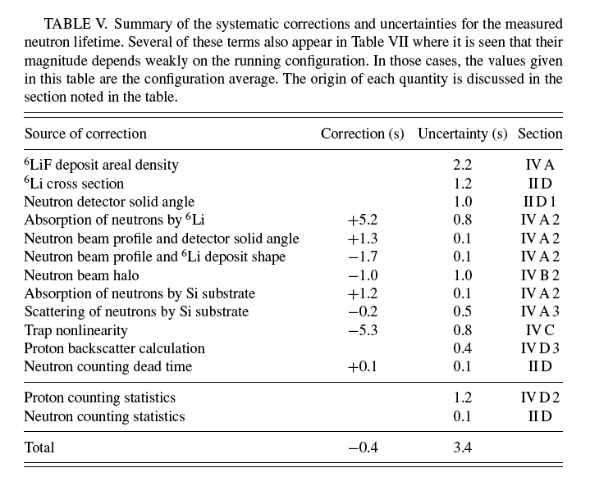
NIST 2005 Error Budget
Most significant improvement
Other major
improvements
Nico et al Phys. Rev. C 71 055502 (2005)

Slide 14
Projected Error Budget (BL2)
Most significant improvement
Other major
improvements

Slide 15
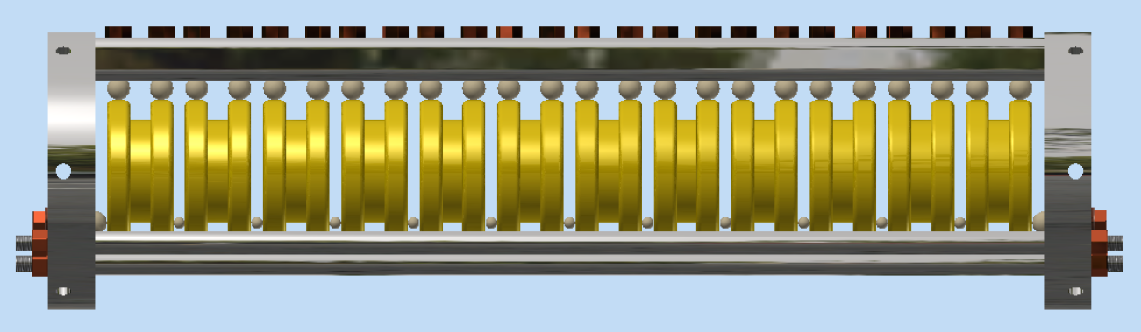
New Mark 3 Trap

Slide 16
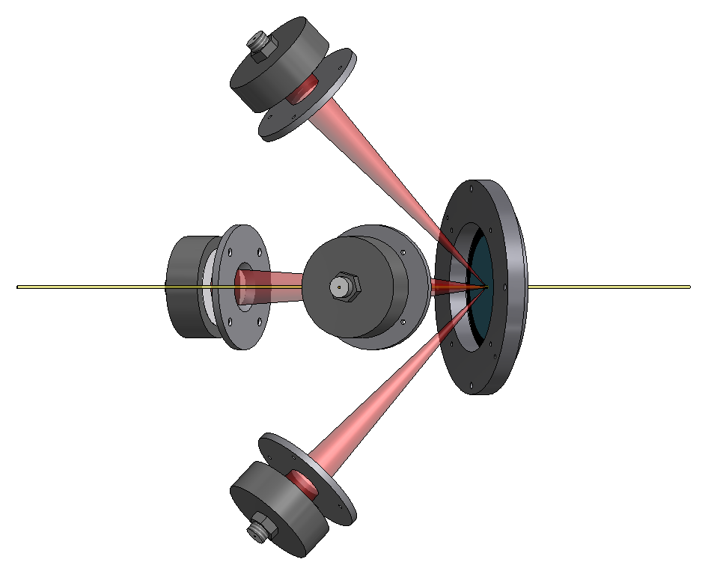


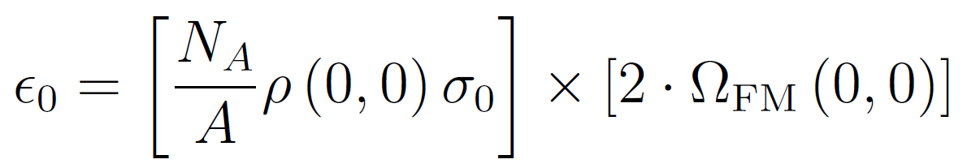
Neutron Counting : 1/V Neutron Monitor
⁶Li deposit
Detected α + t ( )
Neutron beam ( )
Absorbed neutrons
Neutron Beam is not monochromatic, and the spectrum is not used for calculating τ_{n}.
Neutron absorption probability
α, t detection probability
&
Lifetime calculation is not dependent on neutron energy spectrum

Slide 17
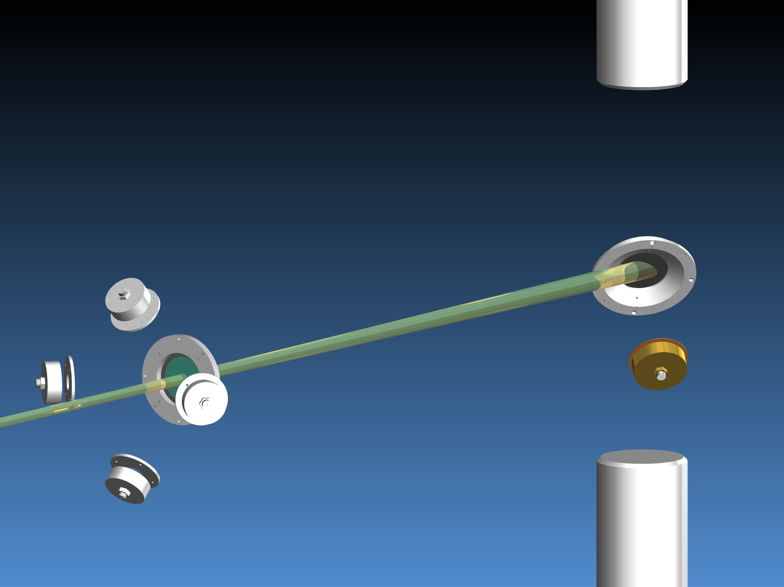
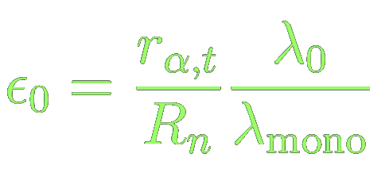
Using AG to calibrate the neutron monitor
HPGe detector
Totally absorbing
¹⁰B target foil
Neutron monitor
Monochromatic neutron beam
PIPS detector
with aperture
Alpha-Gamma
device
HPGe detector

Slide 18
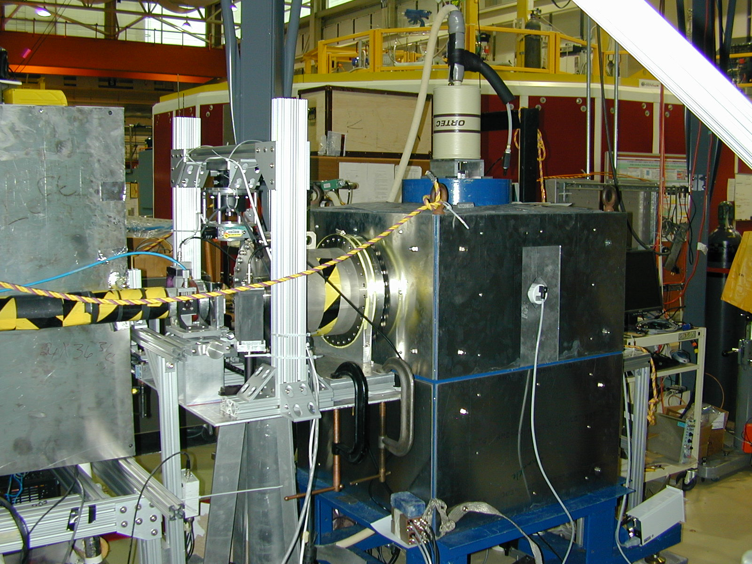
λ measurement
device
Alpha-Gamma
device
Neutron
monitor

Slide 19
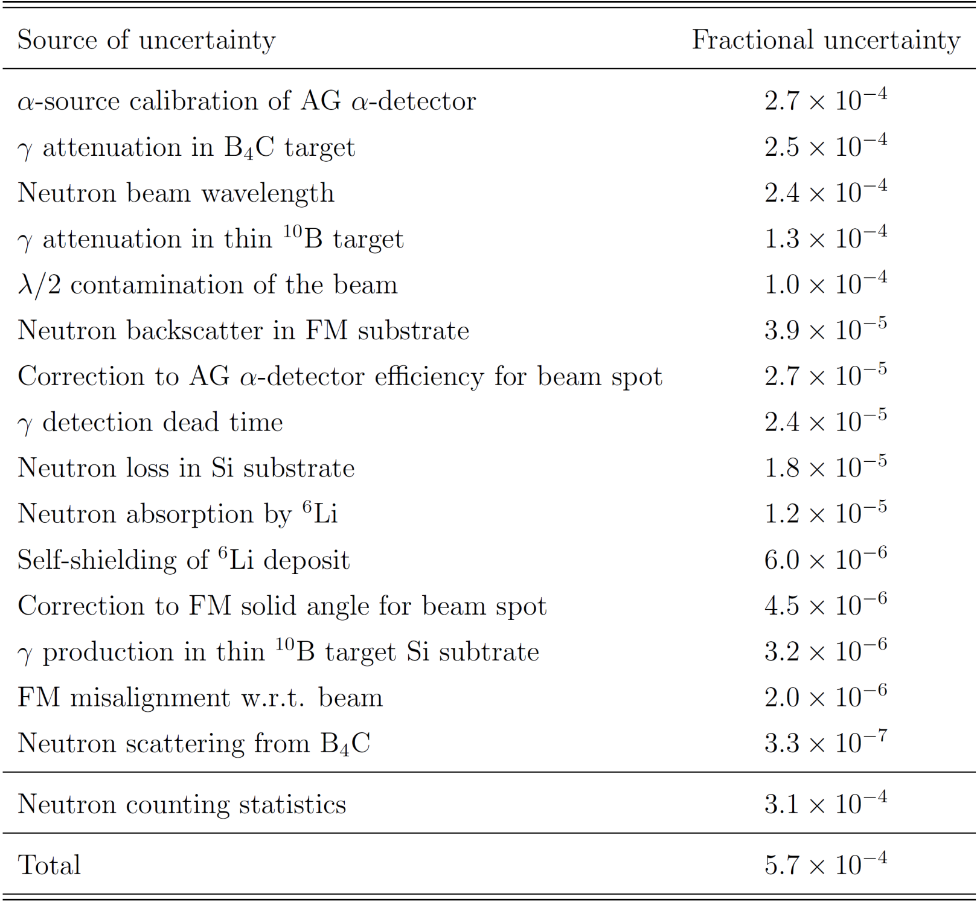
Neutron monitor efficiency uncertainty budget

Slide 21
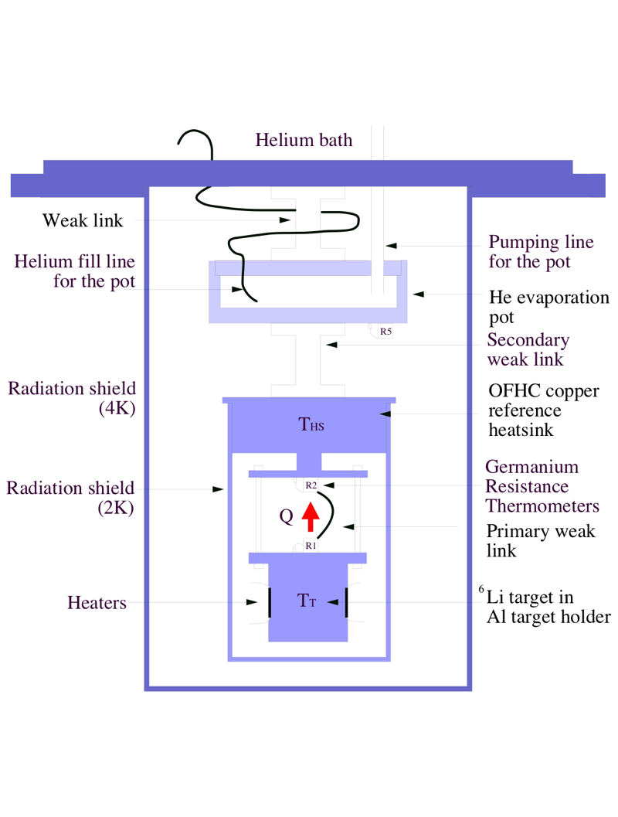
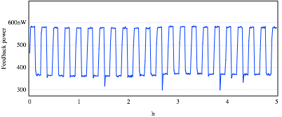
Neutron Radiometer
• Measurement in 2002 using LiMg target but concern about solid state effects.
• Measurement in 2004 with LHe-3 target but limited around 2%.
• Investigation into an improved measurement using LHe-3 (T. Chupp, M. Snow)
Z. Chowdhuri
R.G.H. Robertson and P.E. Koehler, NIM A 37, 251 (1986)
Z. Chowdhuri et al., Rev. Sci. Instrum. 74, 4280 (2003)

Slide 22
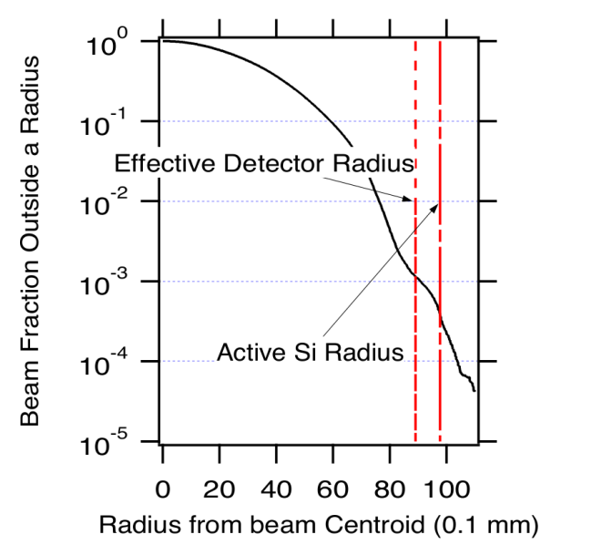
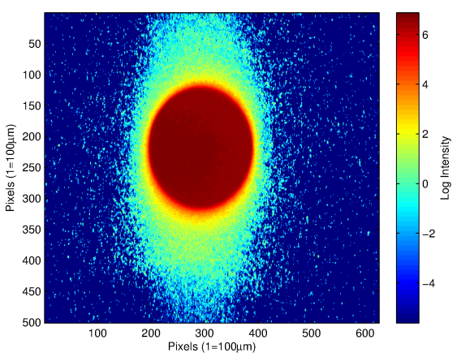
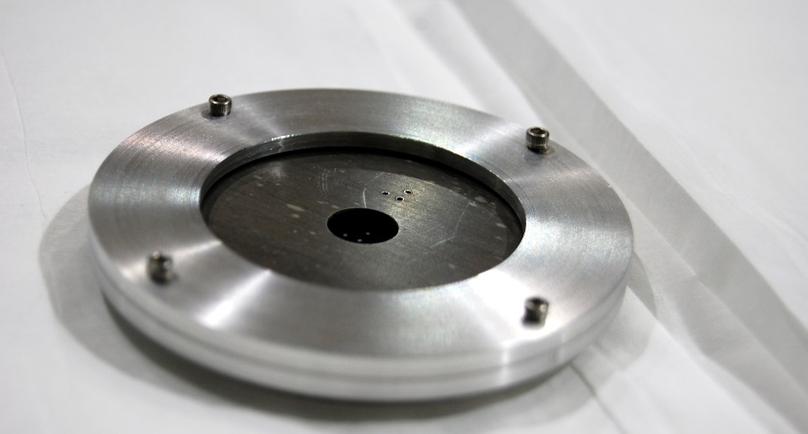
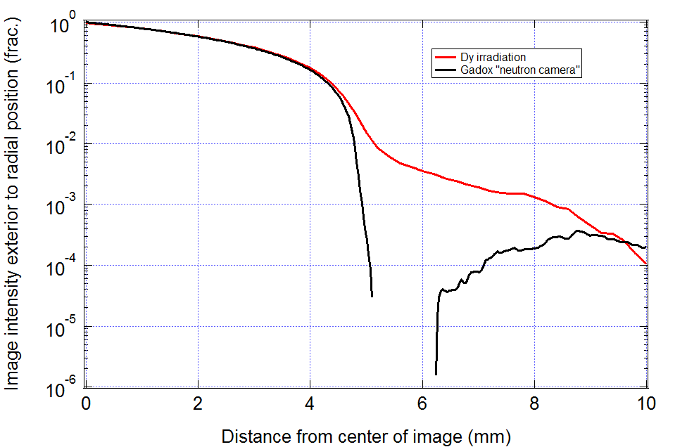
Beam Halo
“Blooming”
We are re-examining the imaging process. We suspect the halo might have been over estimated. If not, we will be using larger detectors. Either way the uncertainty in halo loss for this run will be around 0.1s instead of 1s.
Images were taken using Cd masks to obtain sharp edges
Nico et al Phys Rev C 71 055502 (2005)
Dysprosium imaging techniques were used to measure the neutron beam profile. 10⁻³ beam fraction were found outside the active detector radius.
Precision machined Cadmium mask for Dy foil in collimator mount.

Slide 23
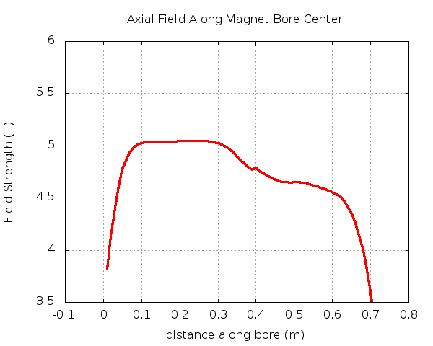
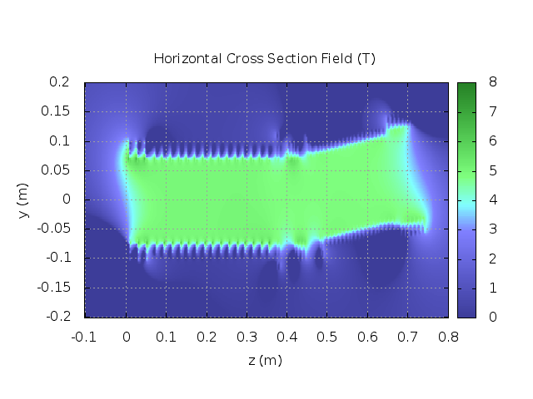
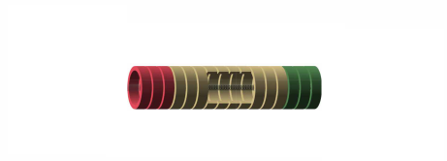

Trap Non-Linearity
Trap Position
L_{end} varies with the trap length due to difference in the electrostatic potential at different radial positions and with the changing magnetic fields near the trap ends.
Previously uncertainty dominated by the variation in the magnetic field for the longest trap length :
Running with smaller trap lengths will eliminate the largest contribution to this systematic uncertainty, giving :

Slide 24
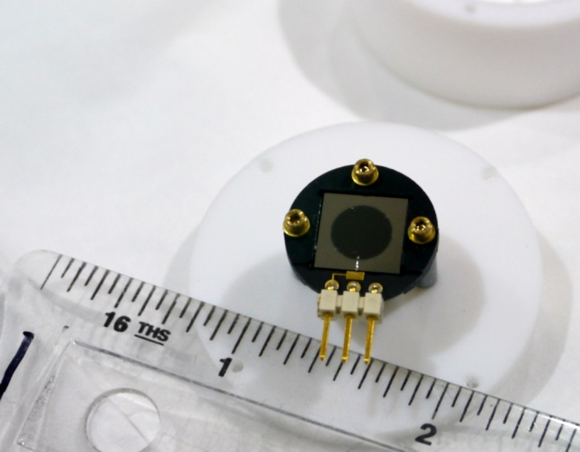
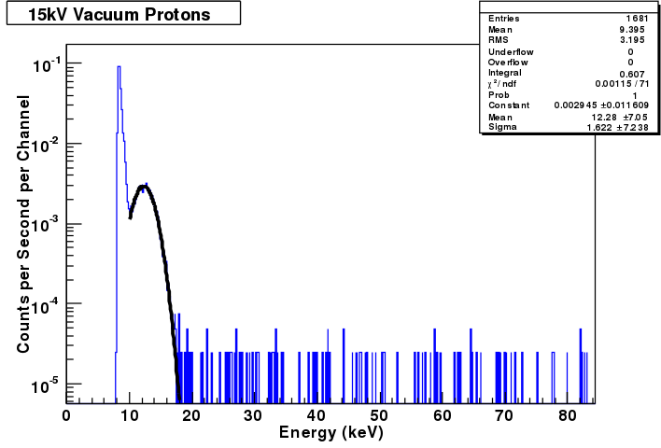
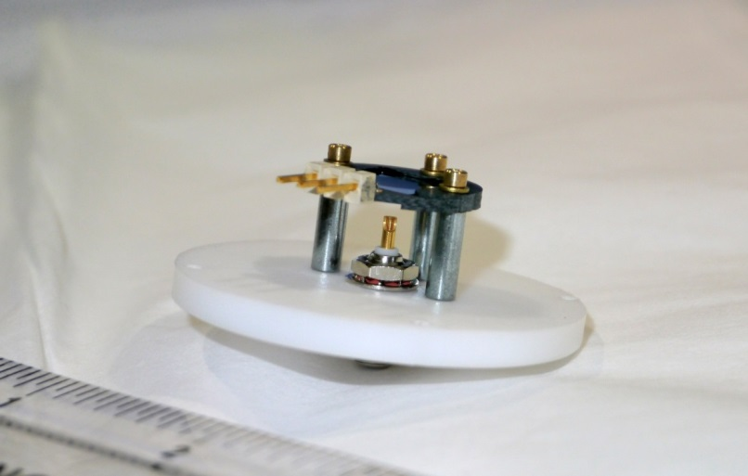
New “Delta-doped” detectors

Slide 25
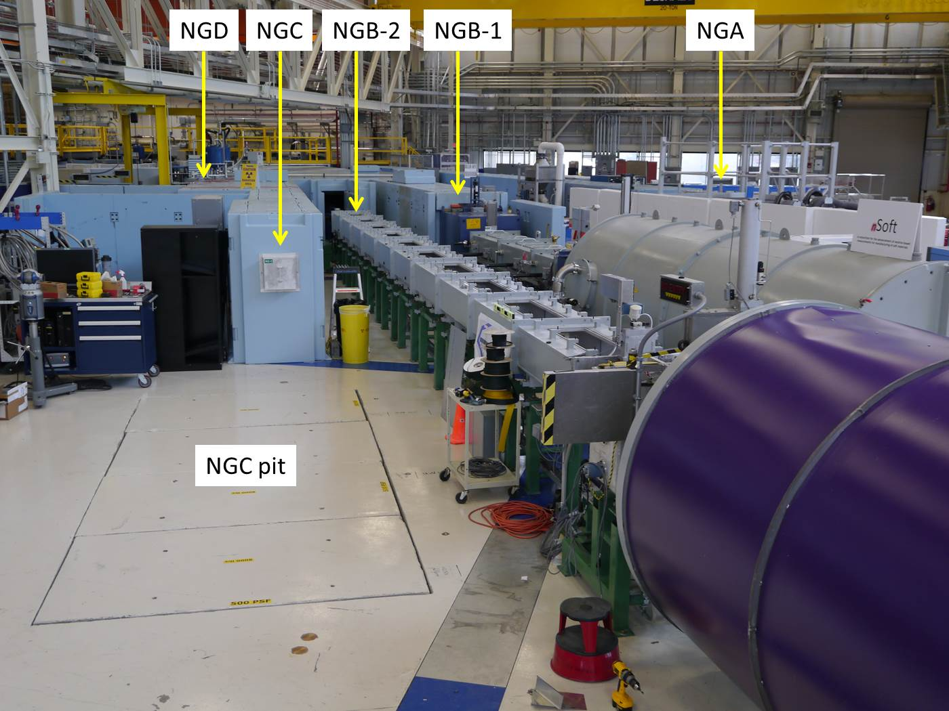

Slide 26
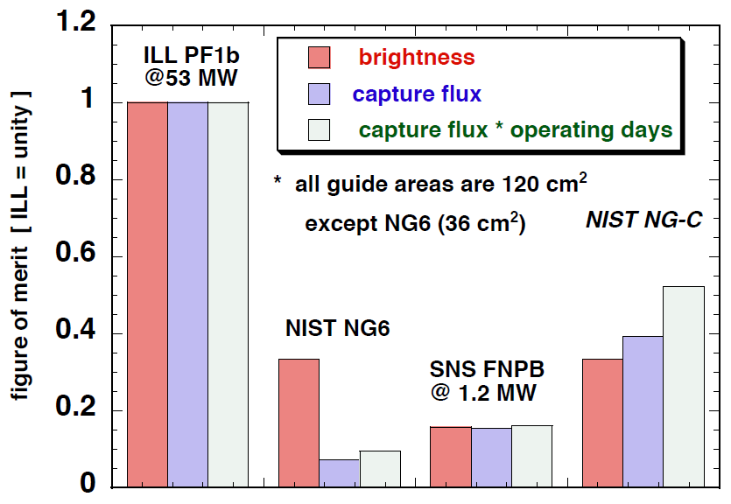

Slide 27
NIST Beam Lifetime Collaboration
Timeline
June 2013 – Moved into the guide hall
October 2014 – aCORN moves onto NGC, we are fully operational and exploring systematic effects sans neutrons
October 2015 – The beam lifetime experiment begins installation on NGC, with a 1 year long run anticipated
Preliminary results should be available during data production
National Institute of Standards
and Technology
M S Dewey J Nico
A Yue D Gilliam
P Mumm
University of Tennessee
G Greene J Mulholland
N Fomin K Grammer
Indiana University
M Snow E Anderson
R Cooper J Fry
Tulane University
F Wietfeldt
G Darius
University of Michigan
T Chupp
M Bales
Jonathan.Mulholland@nist.gov

Slide 28
Conclusions
Two beam lifetime measurements should be forthcoming; both are aiming for 1 s uncertainties
  Penning trap lifetime final result: 2017?
  TPC beam bunch lifetime final result: 2018?
Concerning the Penning trap lifetime experiment
  We will have nearly a year to test and debug the experiment before accepting neutrons; this is unprecedented
  Many of the things we will learn carrying out BL2 will guide BL3 going forward

