Slide 1


EDM experiments review
Yannis K. Semertzidis, Director of CAPP/IBS at KAIST
2 May 2015
The CP Nature of the Higgs Boson Meeting
ACFI, UMASS
The EDM exps. are getting ready for the final run
Neutron EDM experiments
¹⁹⁹Hg, ²²⁵Ra, ThO, …
Storage ring EDMs: proton, deuteron, ³He

Slide 2

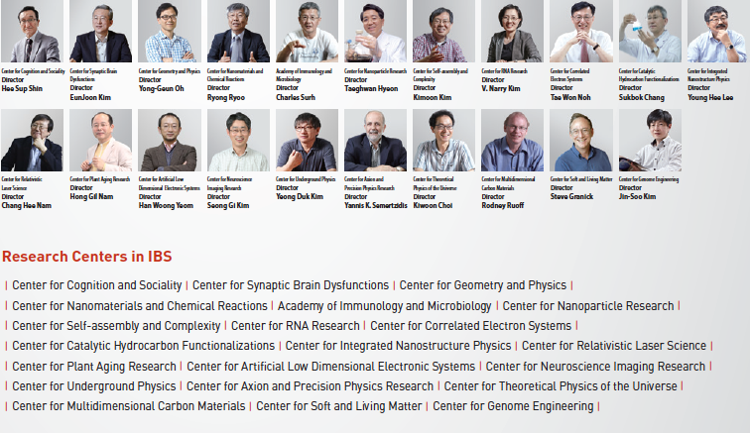
http://www.ibs.re.kr/eng.do

Slide 3
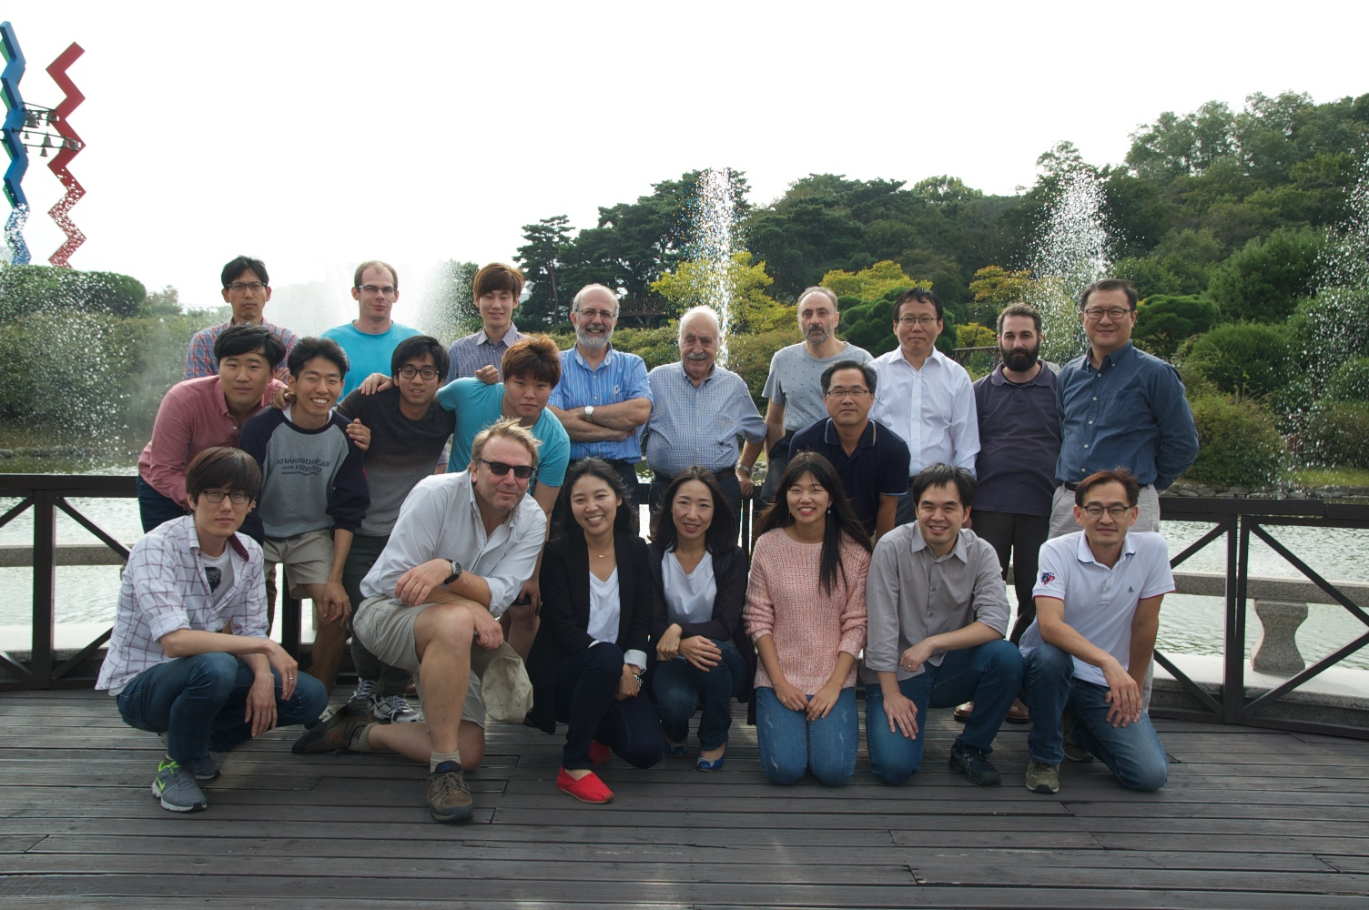
Center for Axion and Precision Physics (CAPP)
http://capp.ibs.re.kr/html/capp_en/

Slide 4
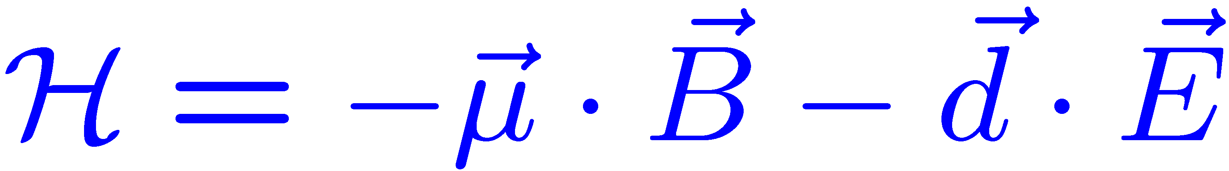
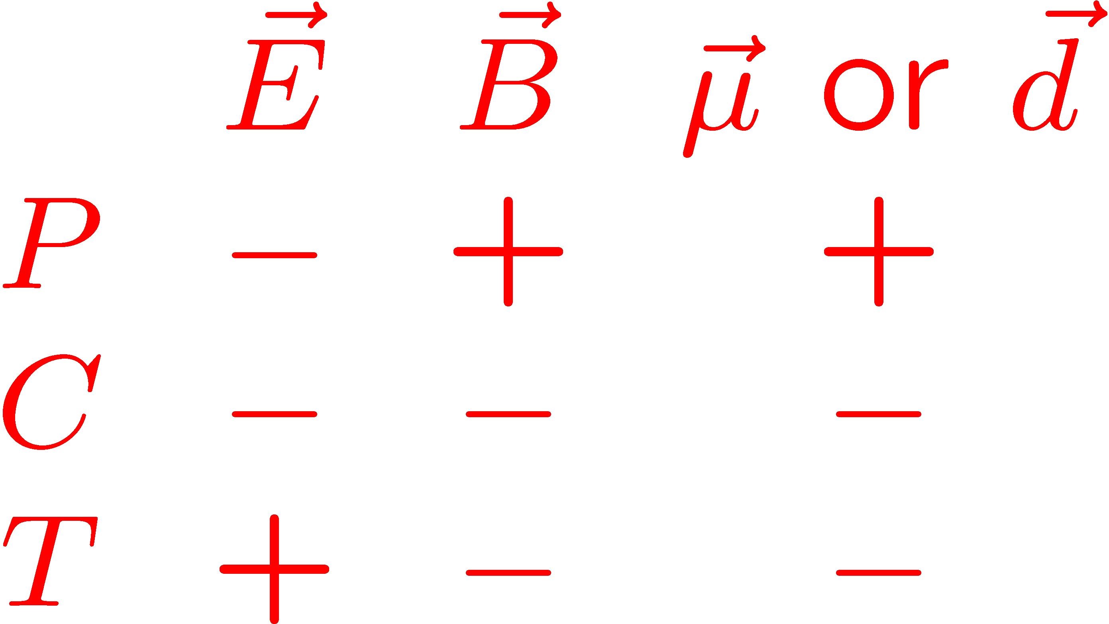
Electric Dipole Moments: P and T-violating when // to spin
T-violation: assuming CPT cons. → CP-violation

Slide 5
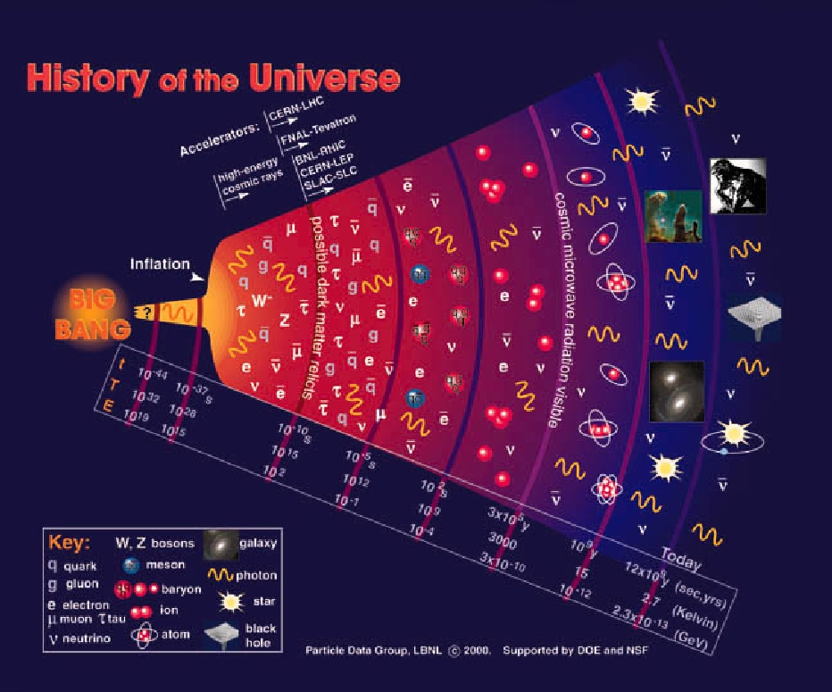
Why is there so much matter after the Big Bang:
We see:
From the SM:

Slide 6
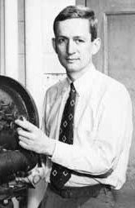
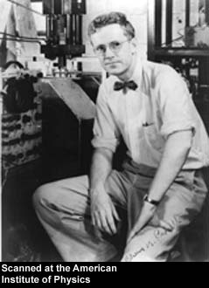
Purcell and Ramsey:
“The question of the possible existence of an electric dipole moment of a nucleus or of an elementary particle…becomes a purely experimental matter”
Phys. Rev. 78 (1950)

Slide 7
Measuring an EDM of Neutral Particles
H = -(d E+ μ B) ● I/I
B
E
B
E
m_{I} = 1/2
d
µ
d
µ
ω₁
ω₂
m_{I} = -1/2
d = 10⁻²⁹ e cm
E = 100 kV/cm
⇒
ω = 5 nrad/s

Slide 8
Short History of EDM
1950’s neutron EDM experiment started to search for parity violation (Ramsey and Purcell).
After P-violation → EDMs require both P,T-Violation
1960’s EDM searches in atomic systems
1970’s Indirect Storage Ring EDM method from the CERN muon g-2 exp.
1980’s Theory studies on systems (molecules) w/ large enhancement factors

Slide 9
Short History of EDM (cont’d)
1990’s First exp. attempts w/ molecules. Dedicated Storage Ring EDM method developed
2000’s Proposal for sensitive dEDM exp. developed.
2010’s Proposal for sensitive pEDM exp. developed
First results on Ra reported.
First results on eEDM from ThO molecules with large enhancements. Major breakthrough.

Slide 10
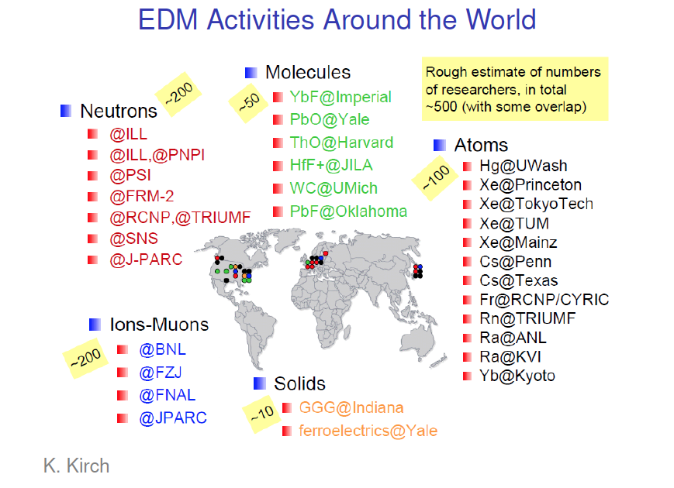

Slide 11
Physics strength comparison (Marciano)
System | Current limit [e⋅cm] | Future goal [e⋅cm] | Neutron equivalent
Neutron | <1.6×10⁻²⁶ | ~10⁻²⁸ | 10⁻²⁸
¹⁹⁹Hg atom | <3×10⁻²⁹ | <10⁻²⁹ | 10⁻²⁵-10⁻²⁶
¹²⁹Xe atom | <6×10⁻²⁷ | ~10⁻²⁹-10⁻³¹ | 10⁻²⁵-10⁻²⁷
Deuteron nucleus |  | ~10⁻²⁹ | 3×10⁻²⁹- 5×10⁻³¹
Proton nucleus | <7×10⁻²⁵ | <10⁻²⁹ | 10⁻²⁹
Notes:
11

Slide 12
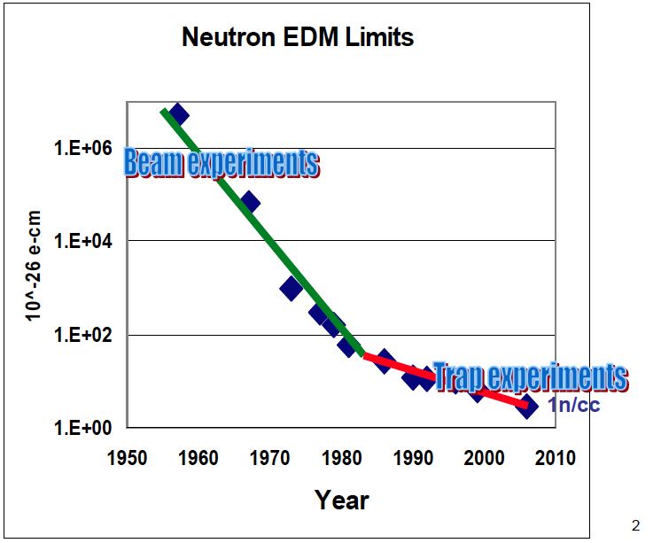
Neutron EDM Experiments
B. Morse

Slide 13
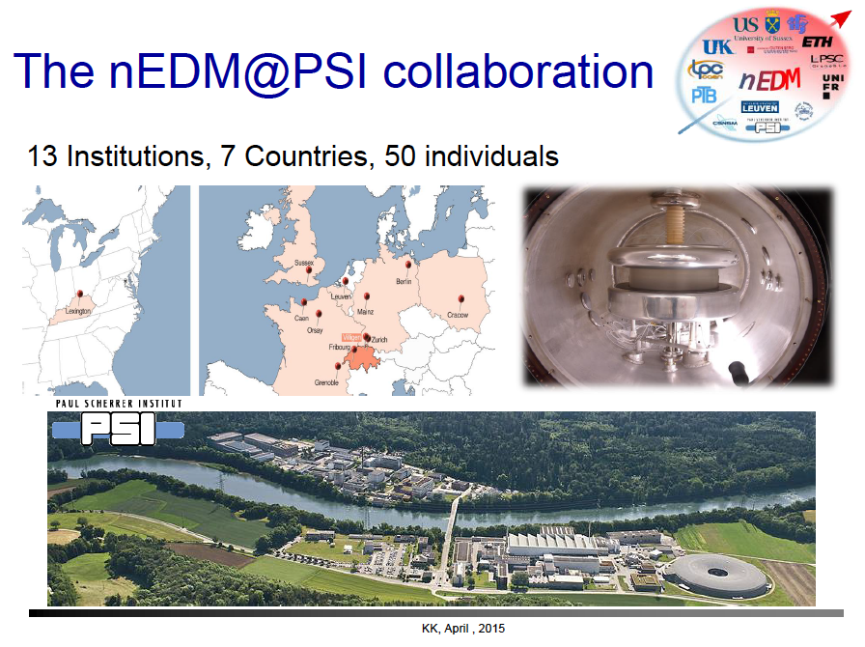
K. Kirch

Slide 14
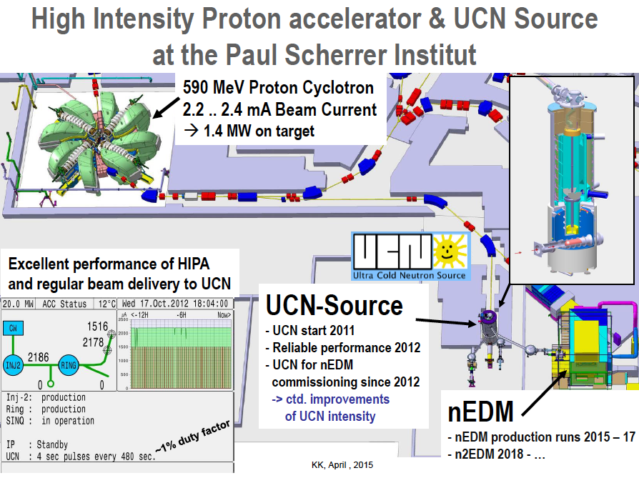

Slide 15
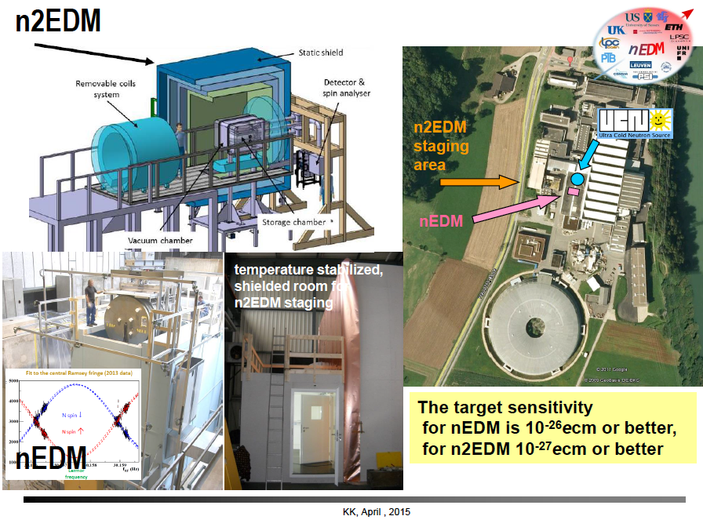

Slide 16
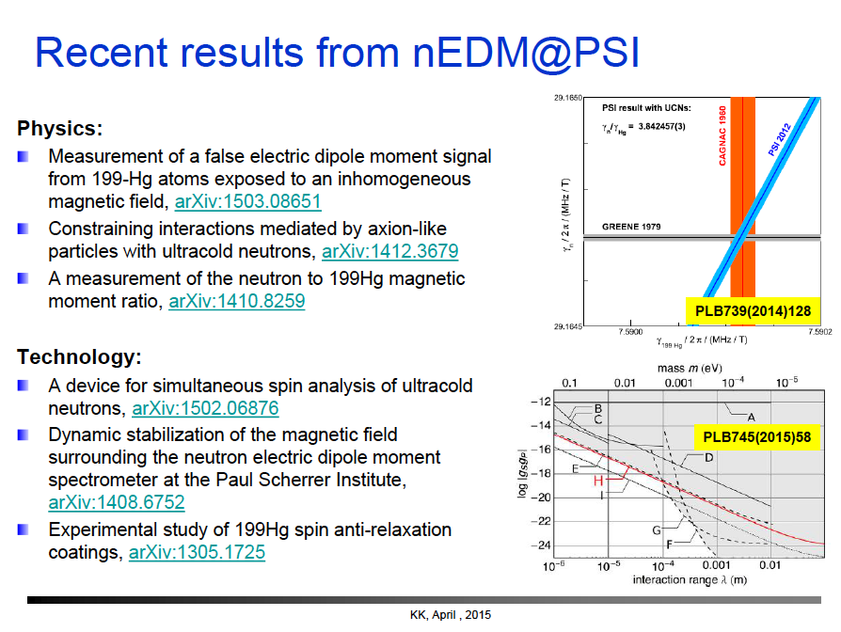

Slide 17
Key Features of nEDM@SNS
Brad Filippone
Sensitivity: ~2x10⁻²⁸ e-cm, 100 times better than existing limit
In-situ Production of UCN in superfluid helium (no UCN transport)
Polarized ³He co-magnetometer
  Also functions as neutron spin precession monitor via spin-dependent n-³He capture cross section using wavelength-shifted scintillation light in the LHe
  Ability to vary influence of external B-fields via “dressed spins”
    Extra RF field allows synching of n & ³He relative precession frequency
Superconducting Magnetic Shield
Two cells with opposite E-field
Control of central-volume temperature
  Can vary ³He diffusion (mfp)- big change in geometric phase effect on ³He
Arguably the most ambitious of all neutron EDM experiments

Slide 18
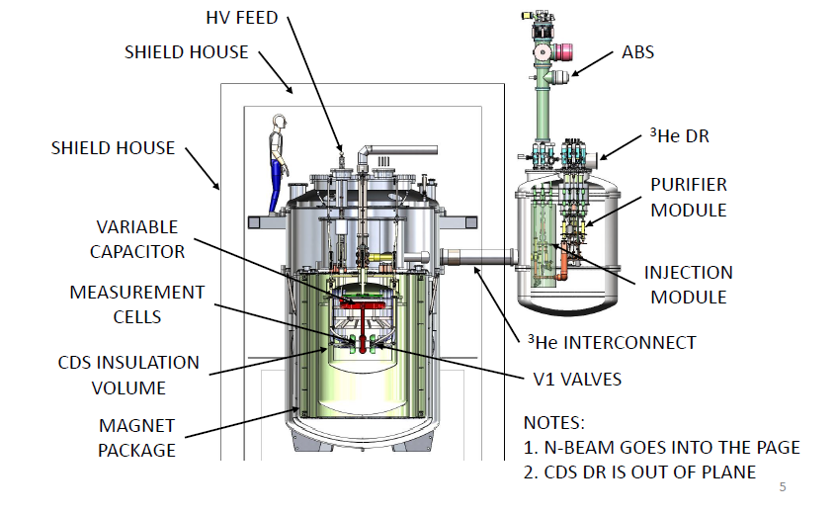
SNS-nEDM Experiment
3He ATOMIC BEAM SOURCE
MAGNETIC SHIELD HOUSE
3He DILUTION REFRIGERATOR
CENTRAL DETECTOR SYSTEM
Neutron beam is into page

Slide 19
nEDM @ SNS COLLABORATION
R. Alarcon, R. Dipert
Arizona State University
G. Seidel
Brown University
E. Hazen, A. Kolarkar, J. Miller, L. Roberts
Boston University
D. Budker
UC Berkeley
M. Blatnik, R. Carr, B. Filippone, C. Osthelder, S. Slutsky,
X. Sun, C. Swank
California Institute of Technology
M. Ahmed, M. Busch, P. –H. Chu, H. Gao
Duke University
I. Silvera
Harvard University
M. Karcz, C.-Y. Liu, J. Long, H.O. Meyer, M. Snow
Indiana University
L. Bartoszek, D. Beck, C. Daurer, J.-C. Peng, T. Rao,
S. Williamson, L. Yang
University of Illinois Urbana-Champaign
C. Crawford, T. Gorringe, W. Korsch,
E. Martin, N. Nouri, B. Plaster
University of Kentucky
S. Clayton, S. Currie, T. Ito, Y, Kim, M. Makela,
J. Ramsey, W.Sondheim
Los Alamos National Lab
K. Dow, D. Hasell, E. Ihloff, J. Kelsey, J. Maxwell, R. Milner, R. Redwine, E. Tsentalovich, C. Vidal
Massachusetts Institute of Technology
D. Dutta, E. Leggett
Mississippi State University
R. Golub, C. Gould, D. Haase, A. Hawari, P. Huffman,
E. Korobkina, K. Leung, A. Reid, A. Young
North Carolina State University
R. Allen, V. Cianciolo, Y. Efremenko, P. Mueller,
S. Penttila, W. Yao
Oak Ridge National Lab
M. Hayden
Simon Fraser University
G. Greene, N. Fomin
University of Tennessee
S. Stanislaus
Valparaiso University
S. Baeβler
University of Virginia
S. Lamoreaux
Yale University

Slide 20
R&D Accomplishments: Last 3 yrs
E-field of > 80 keV/cm in 0.5K superfluid LHe
  Statistical goal requires 75 keV/cm
Cryogenic B-field fractional gradients at
< 2 x 10⁻²⁸ e-cm systematics level
³He transport issues resolved
Light collection studies indicate > 16 p.e.
Design of n/³He systematics test facility
Ultra-Cold Neutron wall loss times > 1800 s
Low-noise SQUID system demonstrated

Slide 21
History/Status of nEDM@SNS
2011: NSAC Neutron Subcommittee
2013: Critical R&D successfully demonstrated
2014-2017: Critical Component Demonstration (CCD) phase begun
  Build working, full-scale, prototypes of technically-challenging subsystems (use these in the full experiment)
  4yr NSF proposal for 6.5M$ CCD funded
  DOE commitment of ≈ 1.8M$/yr for CCD
2018-2020: Large scale Integration and Conventional Component Procurement
2021: Begin Commissioning and Data-taking

Slide 22
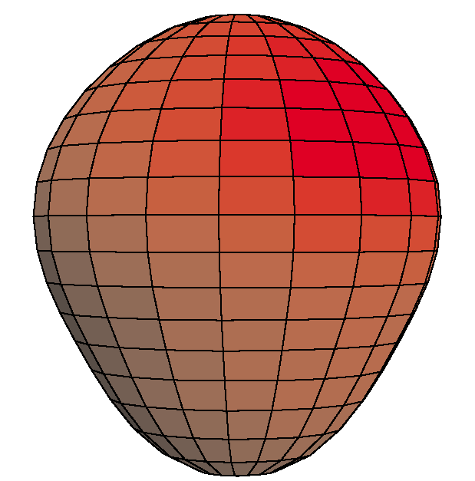
EDM of ²²⁵Ra enhanced and more reliably calculated
Z.T. Lu
Closely spaced parity doublet – Haxton & Henley, PRL (1983)
Large Schiff moment due to octupole deformation – Auerbach, Flambaum & Spevak, PRL (1996)
Relativistic atomic structure (²²⁵Ra / ¹⁹⁹Hg ~ 3) – Dzuba, Flambaum, Ginges, Kozlov, PRA (2002)
Parity doublet
|α⟩
|β⟩
Enhancement Factor: EDM (²²⁵Ra) / EDM (¹⁹⁹Hg)
 | Isoscalar | Isovector
Skyrme SIII | 300 | 4000
Skyrme SkM* | 300 | 2000
Skyrme SLy4 | 700 | 8000
Ψ⁻ = (|α⟩ − |β⟩)/√2
Ψ⁺ = (|α⟩ + |β⟩)/√2
55 keV
Schiff moment of ²²⁵Ra, Dobaczewski, Engel, PRL (2005)
Schiff moment of ¹⁹⁹Hg, Dobaczewski, Engel et al., PRC (2010)
“[Nuclear structure] calculations in Ra are almost certainly more reliable than those in Hg.”
– Engel, Ramsey-Musolf, van Kolck, Prog. Part. Nucl. Phys. (2013)
Constraining parameters in a global EDM analysis.
– Chupp, Ramsey-Musolf, arXiv1407.1064 (2014)

Slide 23
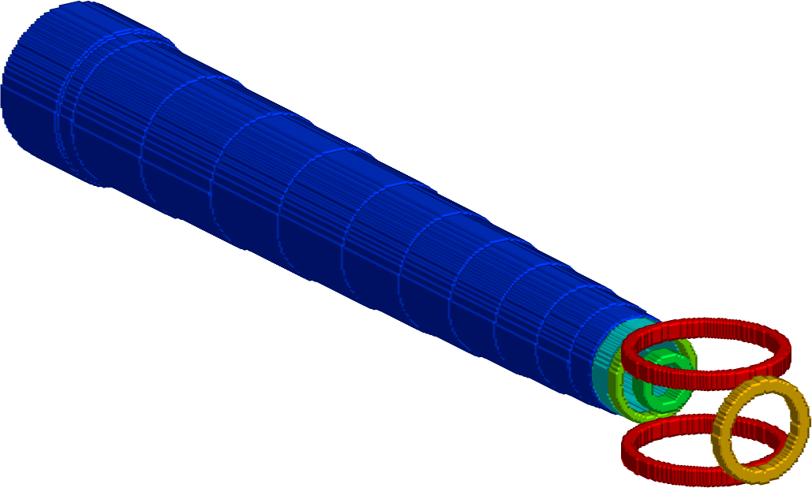

EDM measurement on ²²⁵Ra in a trap
²²⁵Ra:
I = ½
t_{1/2} = 15 d
Collaboration of Argonne, Kentucky, Michigan State
Efficient use of the rare ²²⁵Ra atoms
High electric field (> 100 kV/cm)
Long coherence time (~ 100 s)
Negligible “v x E” systematic effect
Oven:
²²⁵Ra
Transverse
cooling
Zeeman
Slower
Magneto-optical
Trap (MOT)
Statistical uncertainty
100 d
100 kV/cm
10%
100 s
10⁶
Optical dipole
trap (ODT)
Long-term goal: δd = 3 x 10⁻²⁸ e cm
EDM
measurement

Slide 24

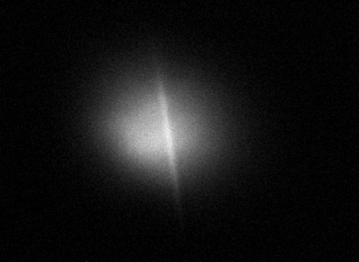
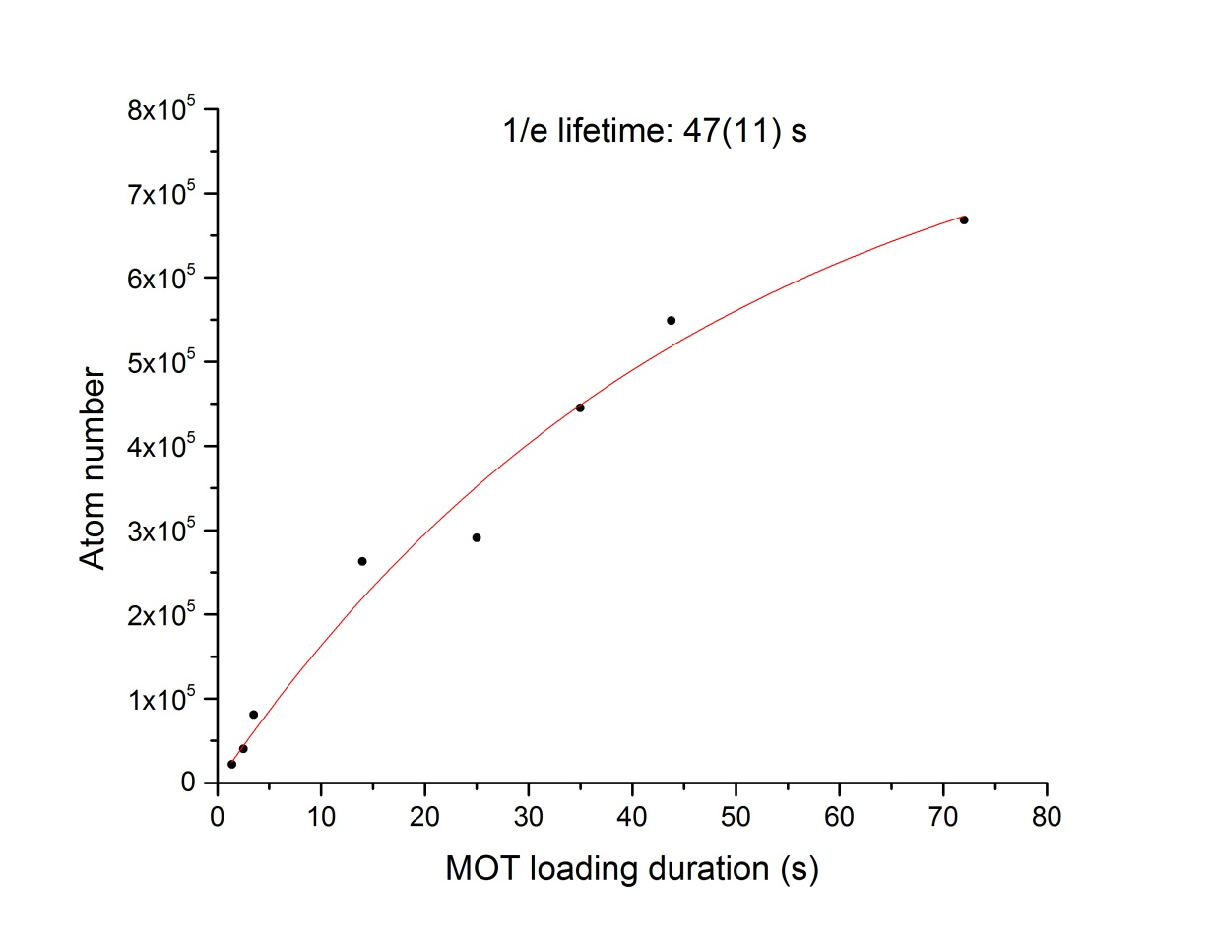
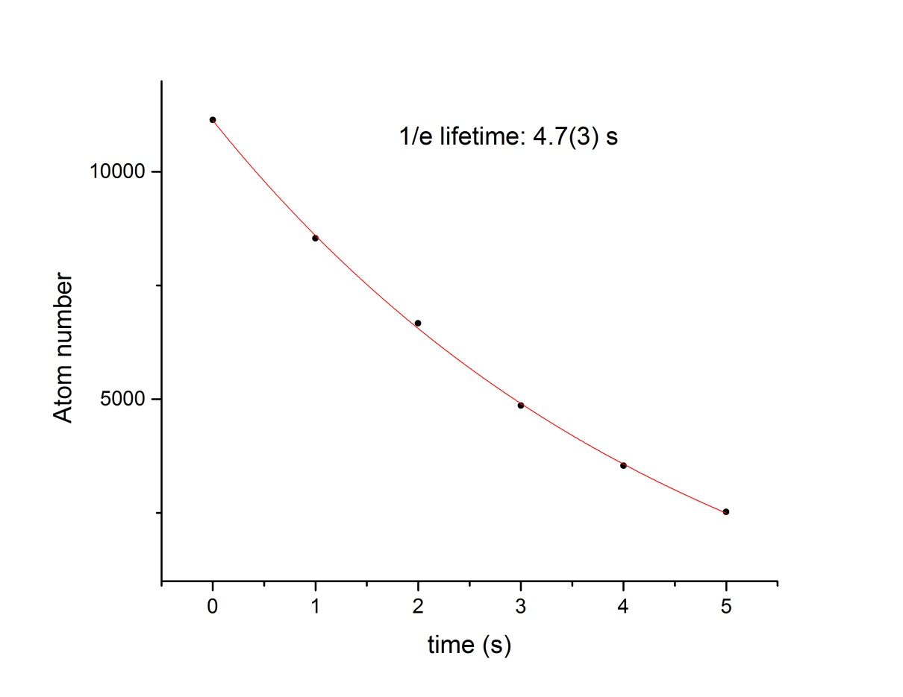
Trap Lifetimes
MOT & ODT
Head-on
view
Sideview
ODT 0.04 mm
Magneto-Optical Trap (MOT)
in the first trap chamber
Optical Dipole Trap (ODT)
in the EDM chamber

Slide 25
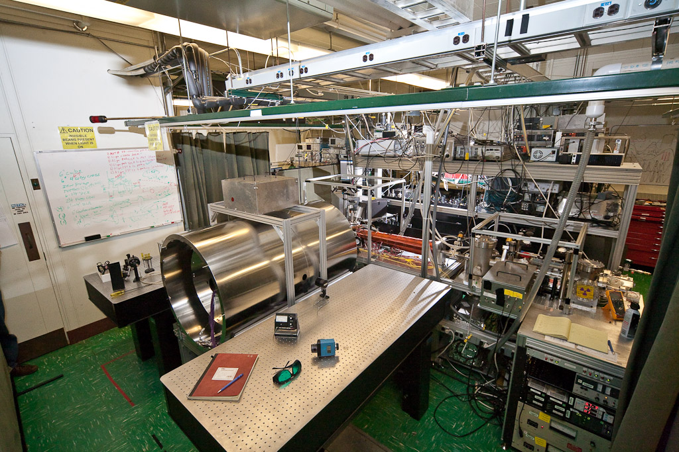
Apparatus

Slide 26
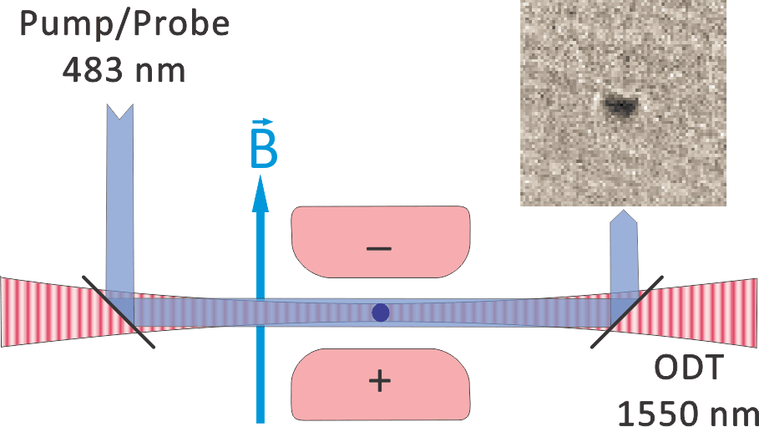
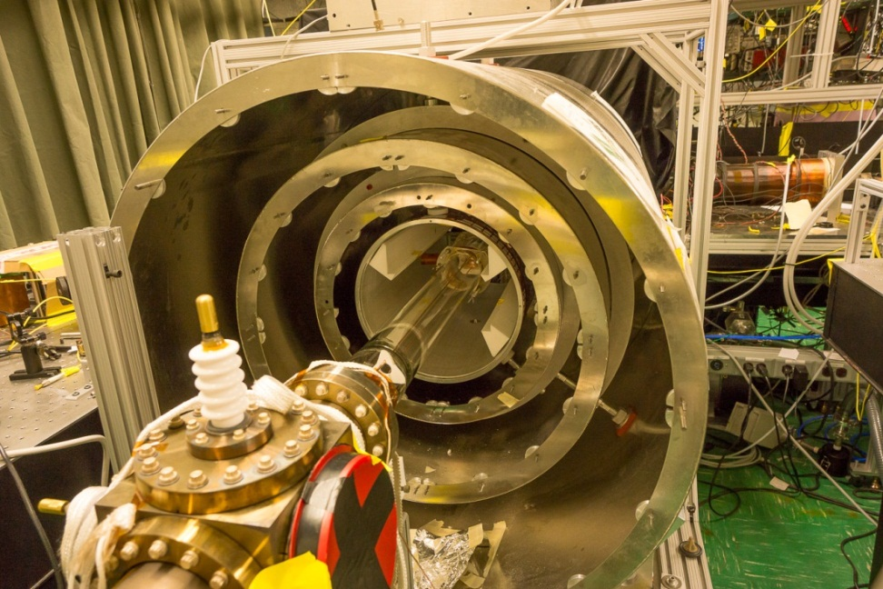
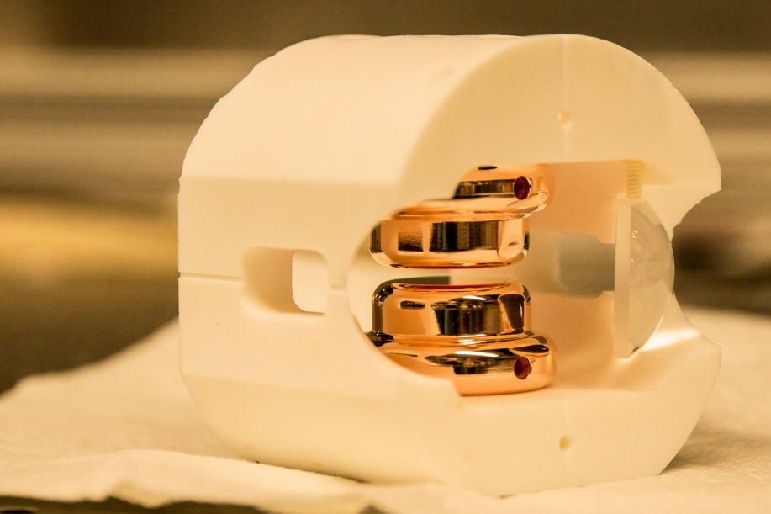
B ~ 10 mGauss
B-field spatial variation < 0.1%/cm
B-field temporal variation < 0.01% (50sec)
E_{max} = 75 kV/cm
E-field spatial variation < 1%/mm

Slide 27
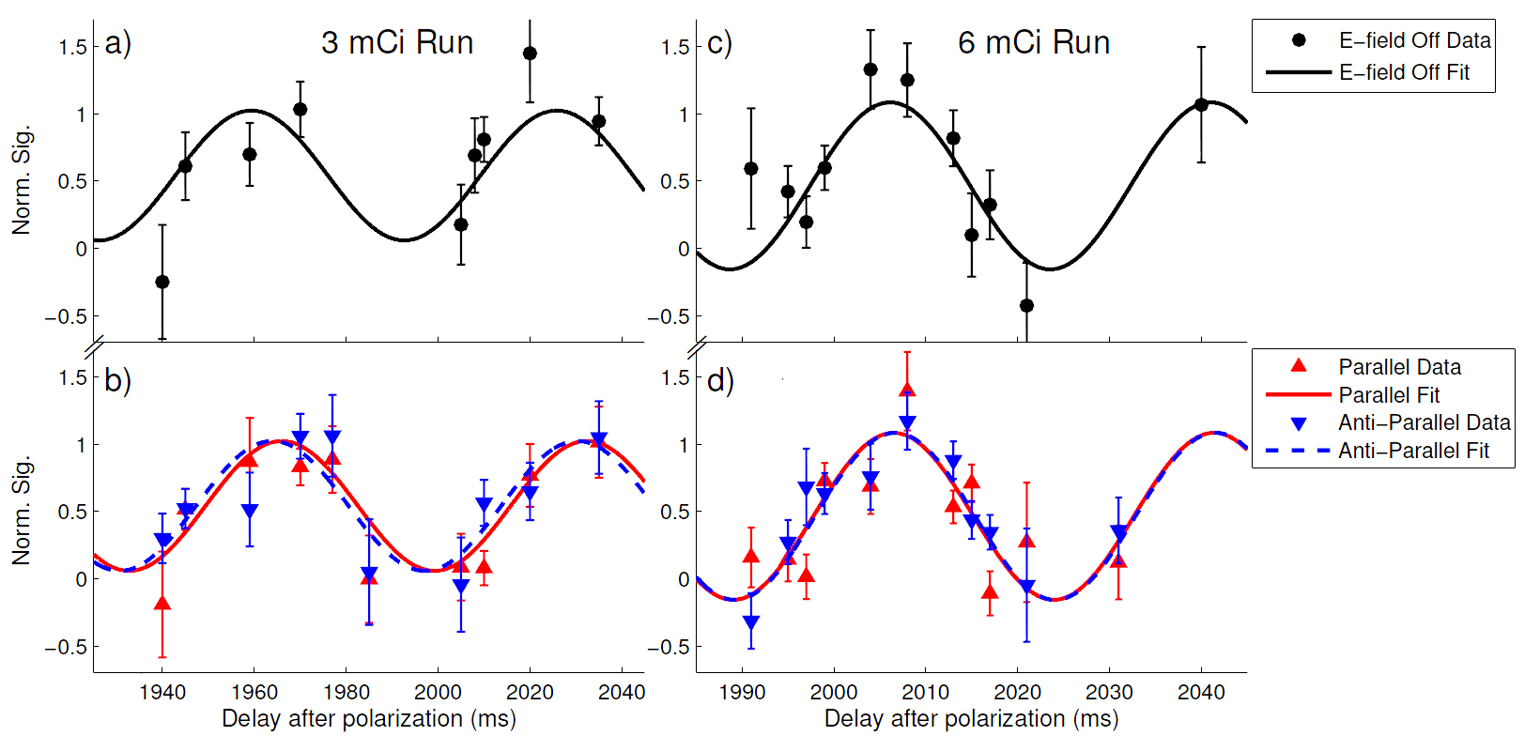
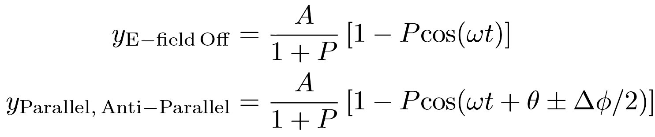
Radium EDM Data
Oct. 2014
Dec. 2014
d_{Ra-225} = (-0.5 ± 2.5_{stat} ± 0.2_{syst}) × 10⁻²² e-cm
|d_{Ra-225}| < 5.0 × 10⁻²² e-cm (95% confidence)
R. H. Parker et al., submitted (2015)

Slide 28
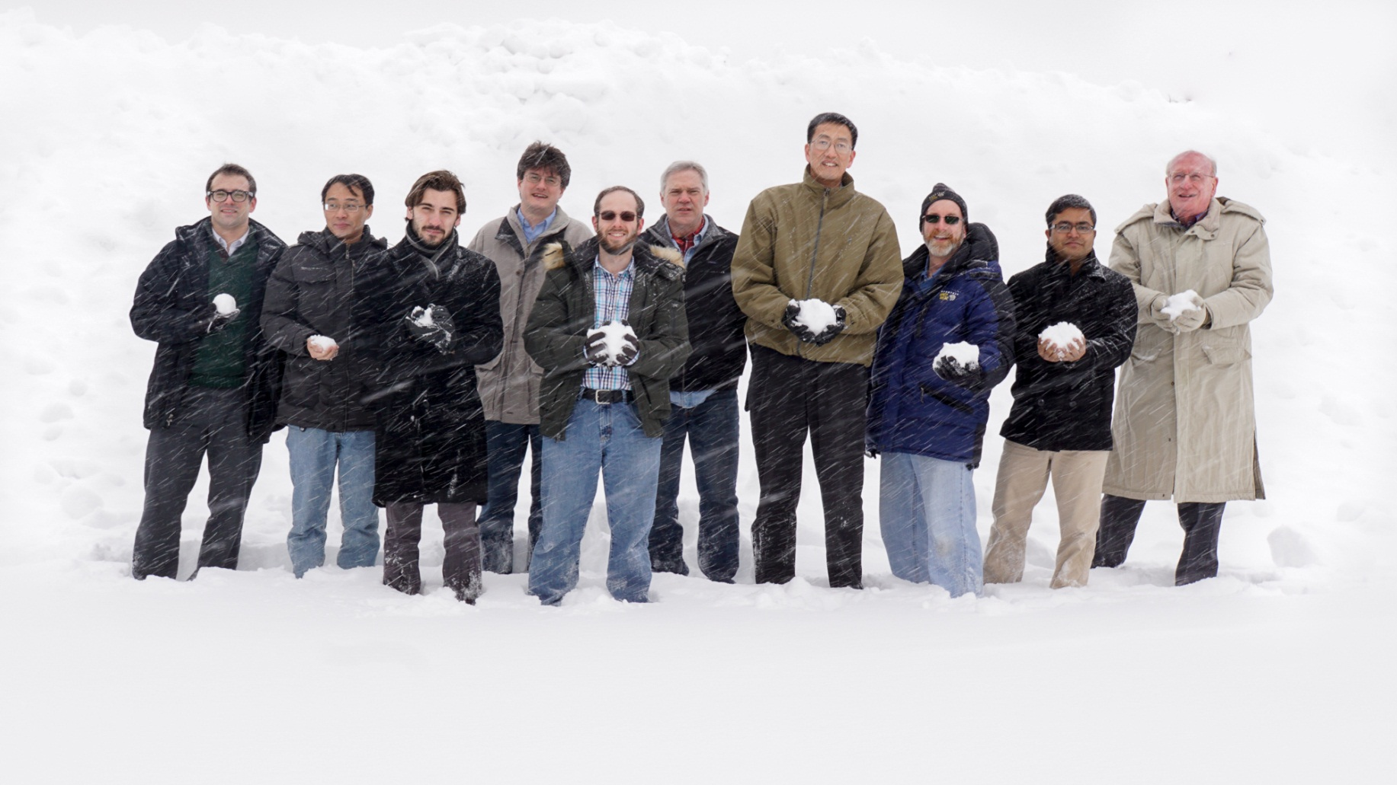
Michael
Bishof
Peter
Mueller
Tom
O’Connor
Z.-T.
Lu
Kevin
Bailey
Mukut
Kalita
Roy
Holt
Richard
Parker
Cold Atom Trappers
Argonne: Kevin Bailey, Michael Bishof, John Greene, Roy Holt, Nathan Lemke, Zheng-Tian Lu, Peter Mueller, Tom O’Connor, Richard Parker
Kentucky: Mukut Kalita, Wolfgang Korsch
Michigan State: Jaideep Singh
Northwestern: Matt Dietrich

Slide 29



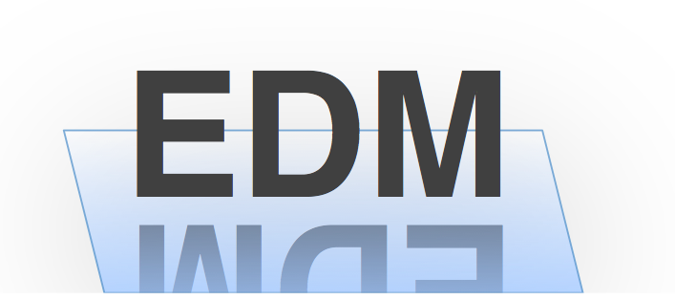
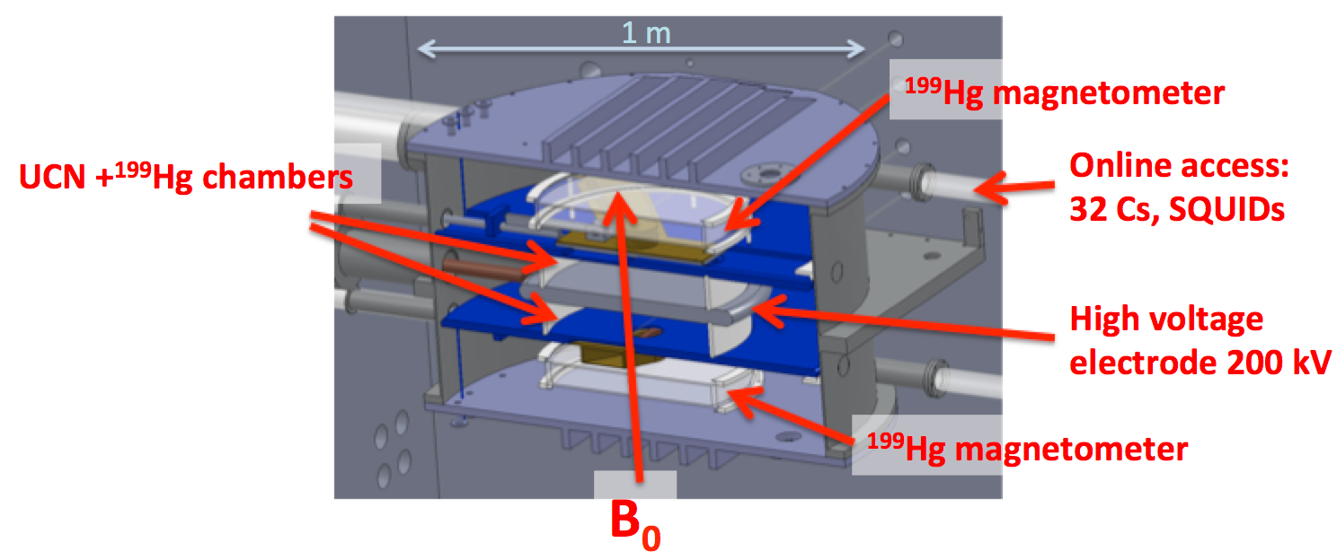
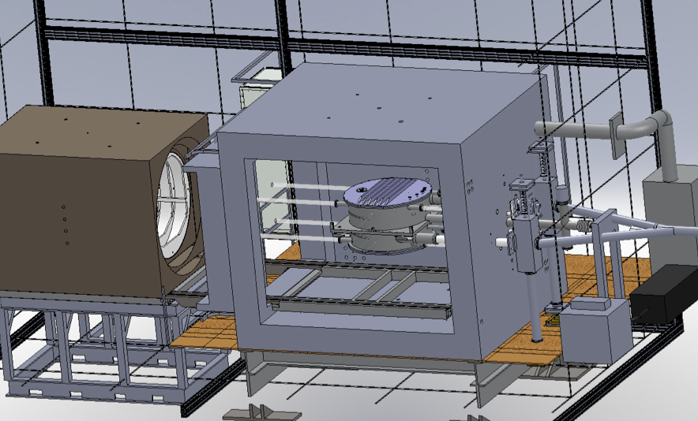
The TUM EDM experiment
P. Fierlinger
Initially a ‘conventional’ Ramsey experiment
UCN trapped at room temperature, ultimately cryogenic trap
Double chamber with co-magnetometer option
¹⁹⁹Hg, Cs, ¹²⁹Xe, ³He, SQUID magnetometers
Portable and modular setup, including magnetically shielded room
Ultimate goal: 10⁻²⁸ ecm sensitivity, staged approach (syst. and stat.)
nedm.ph.tum.de
Double chamber in SF6 container
Modular shield setup
I. Altarev et al., Il Nuovo Cimento 35 C 122 (2012)

Slide 30
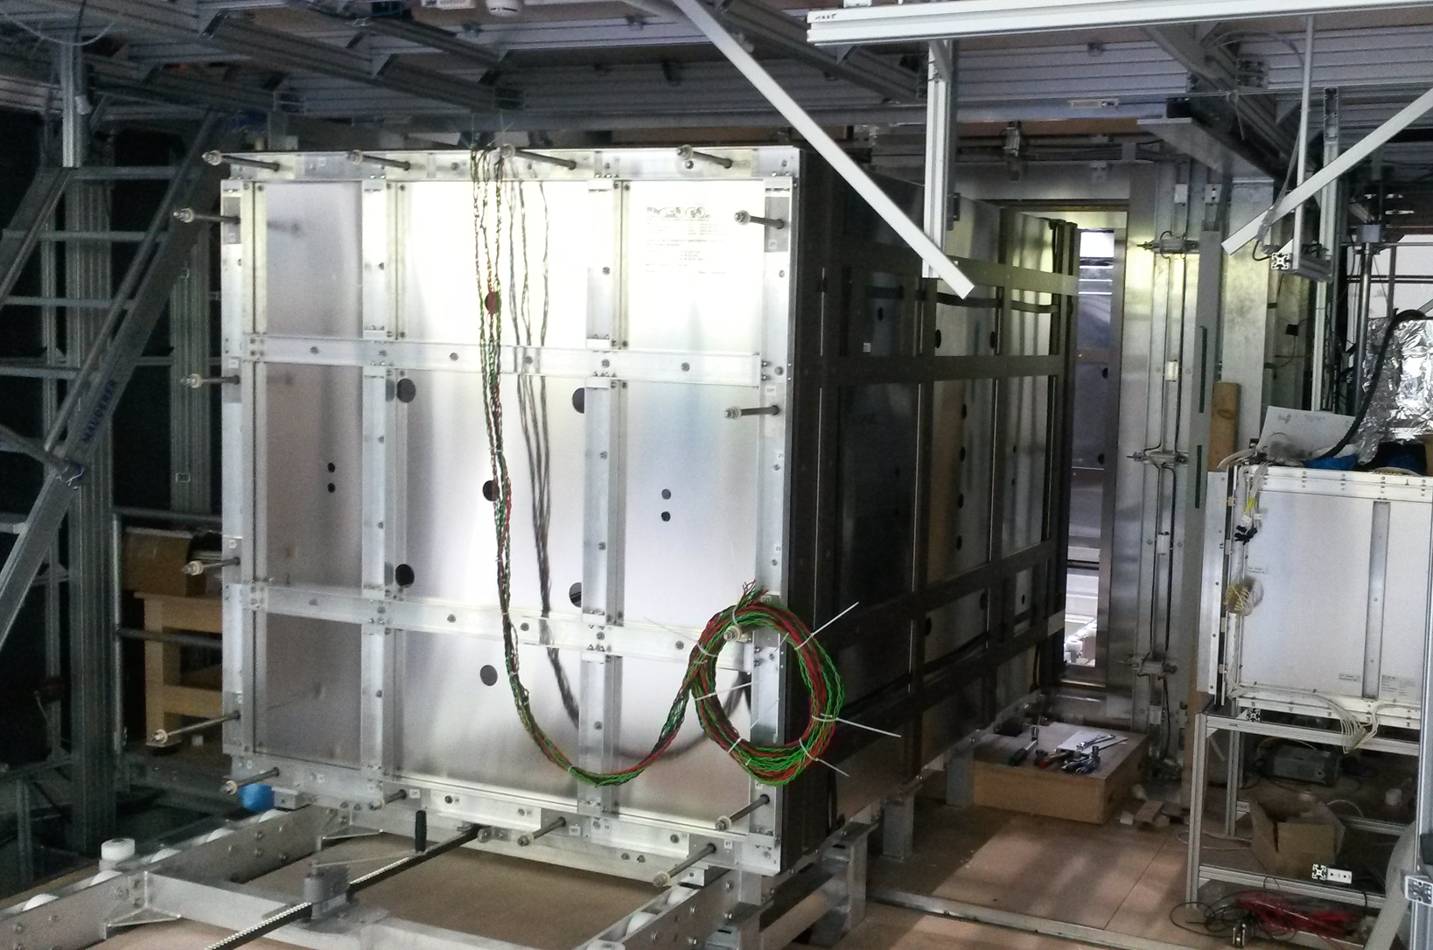
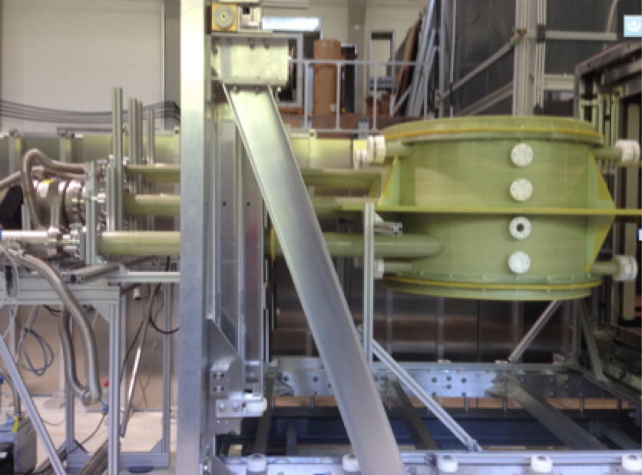
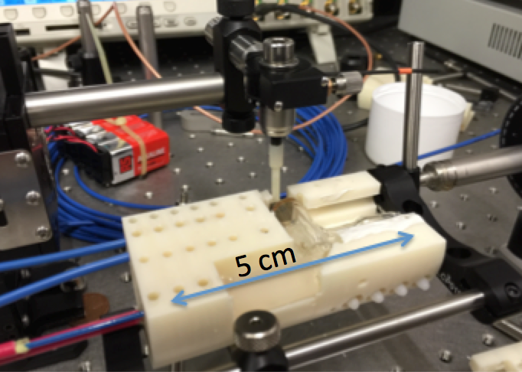
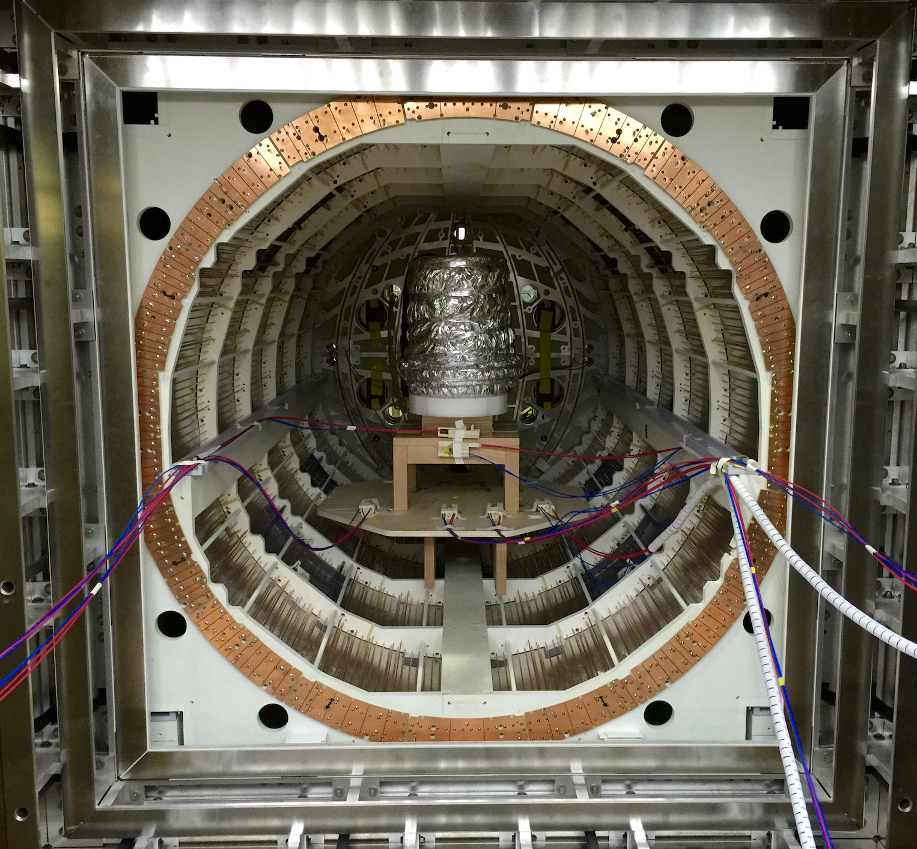
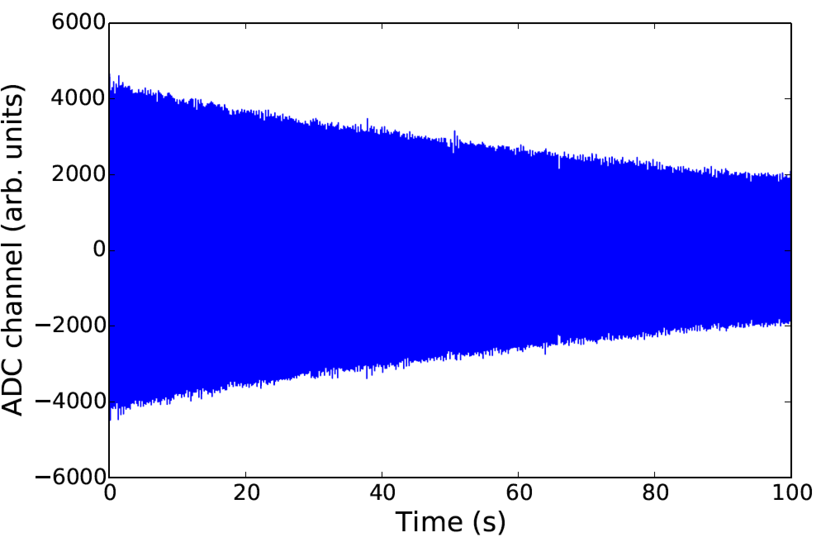
Most hardware built & tested
E.g.: passive magnetic shielding factor > 6 million @ 1 mHz
(without ext. compensation coils!)
I.Altarev et al., arXiv:1501.07408
I. Altarev et al., , arXiv:1501.07861
The smallest gradients over an extended volume ever realized: < 50 pT / m stable gradient over EDM cell volume
Residual field drift < 5 fT in typical Ramsey cycle time
Hg and Cs magnetometery on < 20 fT level:
Basically all magnetic field related systematics under control
Cs sensor head assembly
Raw 199-Hg FPD signal
1.5m

Slide 31
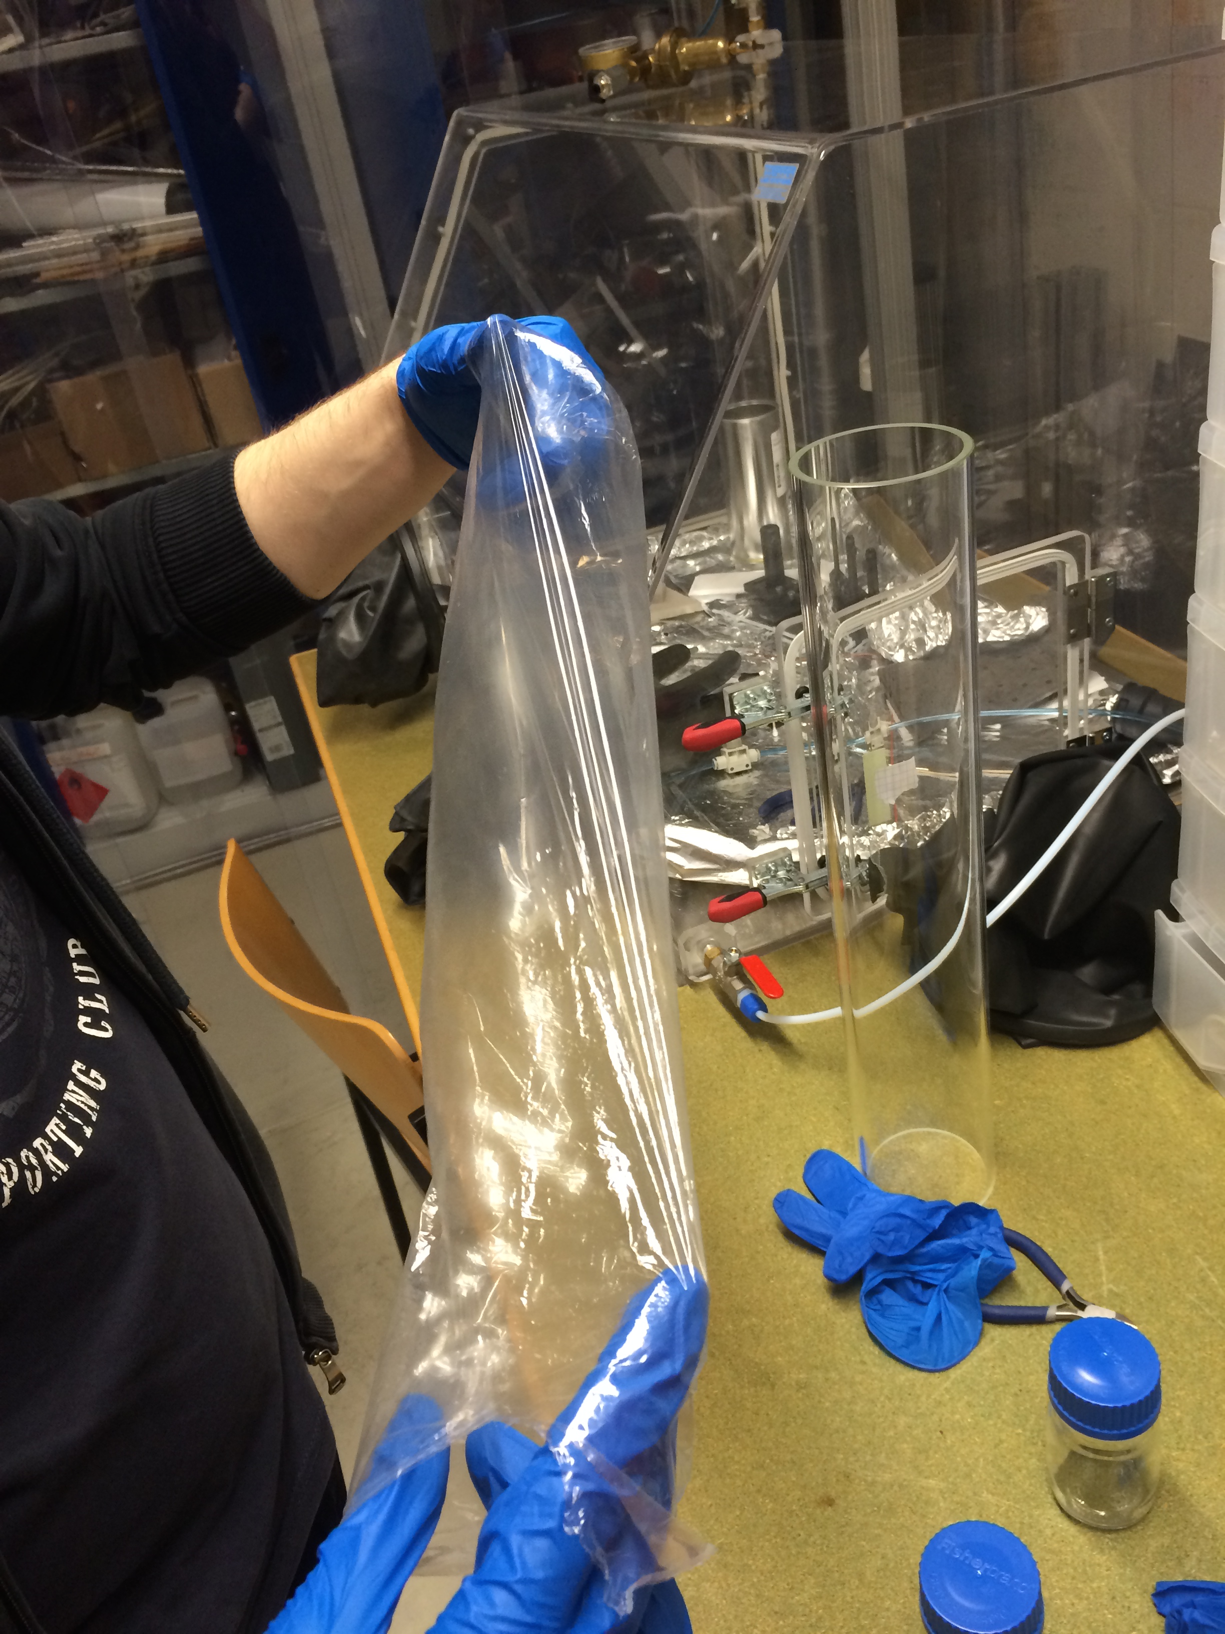
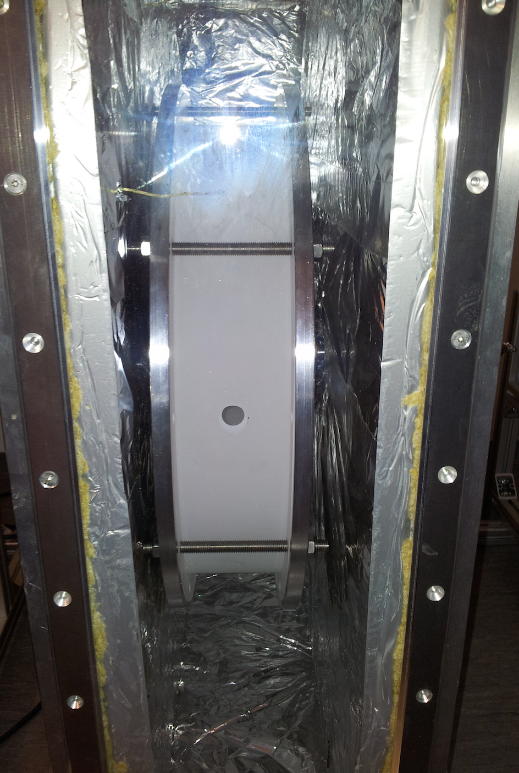
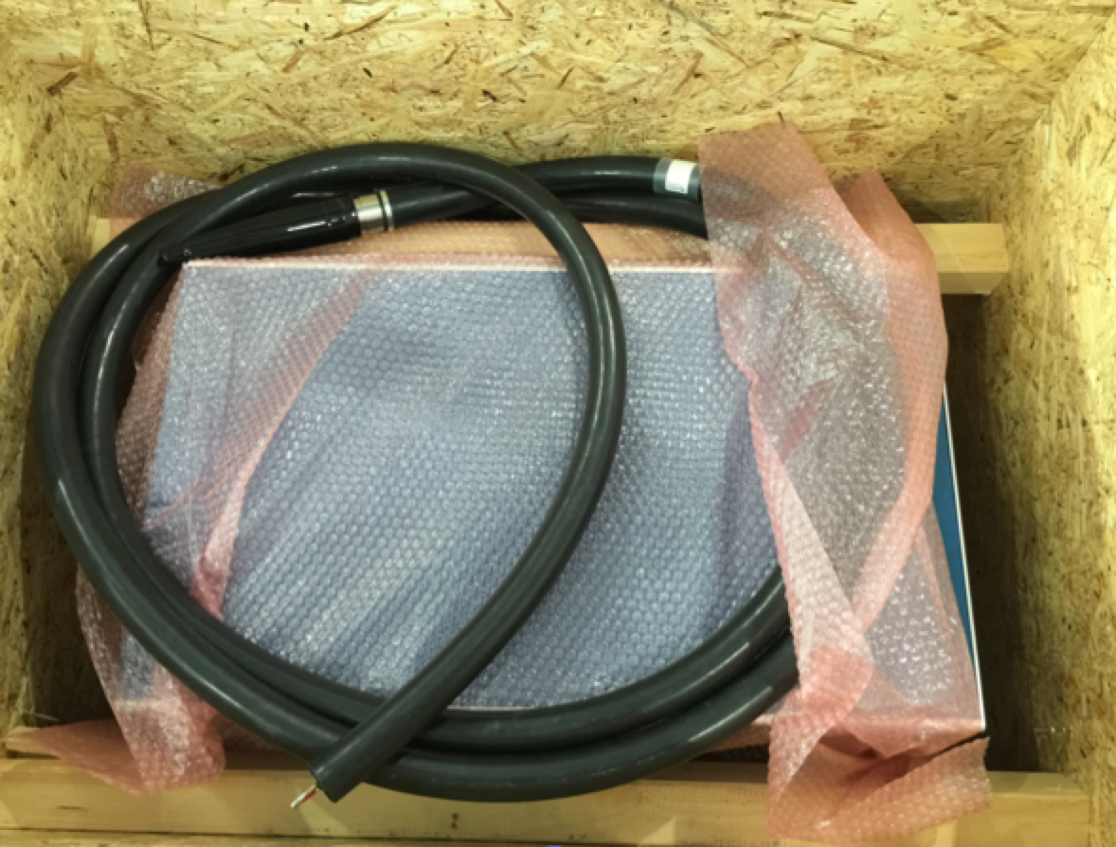
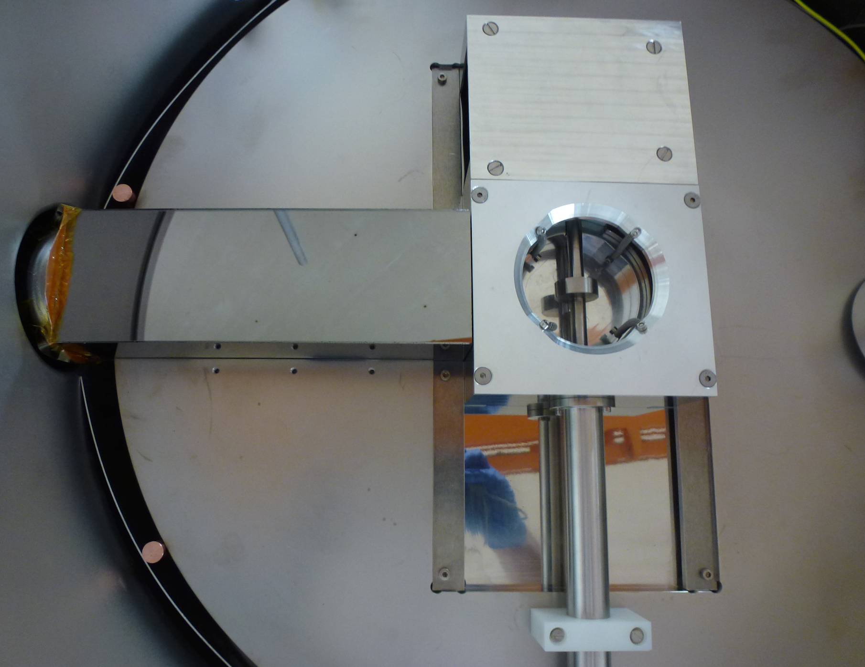
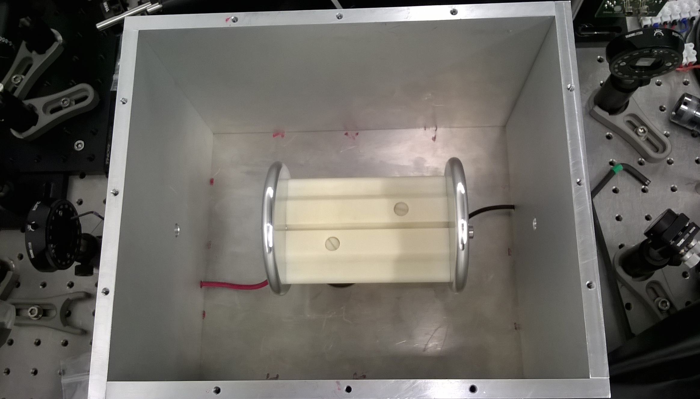
Next steps
  dPe coatings with low UCN loss and depolarization and 214 neV potential developed
  Final UCN chambers to be coated
  HV with active feedback from optical E-field measurement demonstrated, real system under construction
  Tests of chambers and UCN optical components with polarized UCN at ILL are ongoing
  UCN transfer from source to Ramsey chambers in 2015 at ILL
  Ramsey + EDM measurements with UCN starting 2016, stepwise improvements in sensitivity
I. Altarev et al., arXiv:1502.06252
Deuterated polyethylene coatings
dPe coating oven
Bipolar 200 kV supply delivered
UCN shutter at ground electrode
Pockels effect E-field feedback

Slide 32
Proton storage ring EDM experiment is combination of beam + a trap
B. Morse

Slide 33
Storage ring EDM method
Or… how do you turn a weakness into an opportunity?

Slide 34
Stored beam: The radial E-field force is balanced by the centrifugal force.
E
E
E
E
Yannis Semertzidis, CAPP/IBS, KAIST
Notes:
Yannis Semertzidis, BNL
34

Slide 35
The Principle of g-2
Spin vector
Moving: Non-relativistic case
Momentum vector
• B

Slide 36
Effect of Radial Electric Field
E-field are used to focus the beam vertically
Spin vector
Low energy particle
…just right
High energy particle

Slide 37
Effect of Radial Electric Field
Spin vector
…just right
, γ≈29.3
for muons “magic” momentum
(~3.1GeV/c)

Slide 38
Breakthrough concept: Freezing the horizontal spin precession due to E-field
Muon g-2 focusing is electric: The spin precession due to E-field is zero at “magic” momentum (3.1GeV/c for muons, 0.7 GeV/c for protons,…)
The “magic” momentum concept was used in the muon g-2 experiments at CERN, BNL, and …next at FNAL.

Slide 39
Spin Precession in g-2 Ring
(Top View)
Momentum
vector
μ
Spin vector

Slide 40
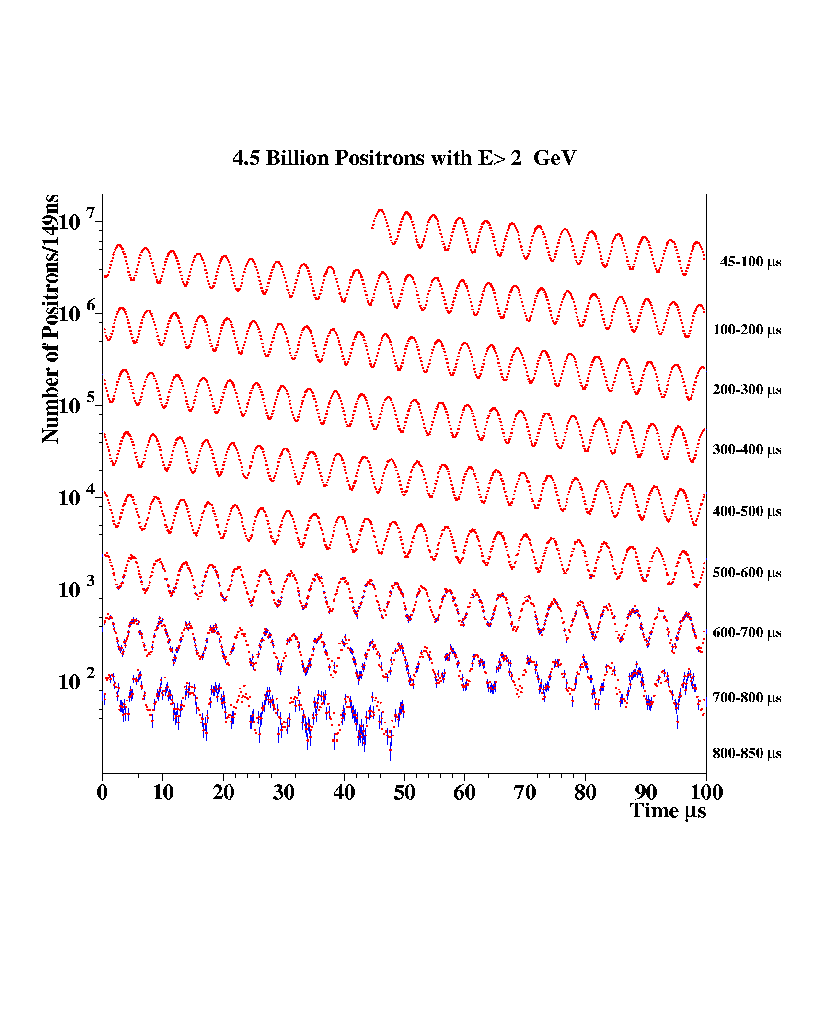
Muon g-2: 4 Billion e⁺ with E>2GeV
Sub-ppm accuracy,
statistics limited

Slide 41
The proton EDM uses an ALL-ELECTRIC ring: spin is aligned with the momentum vector
at the magic momentum
Momentum
vector
E
Spin vector
E
E
E
Yannis Semertzidis, CAPP/IBS, KAIST
Notes:
Yannis Semertzidis, BNL
41

Slide 42
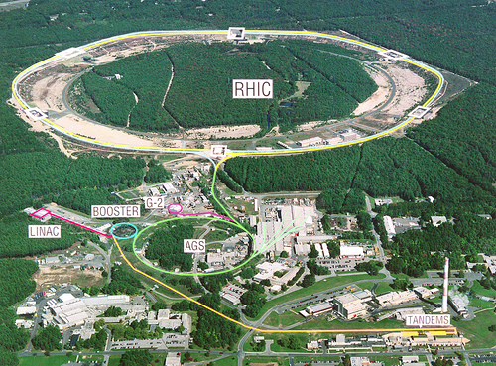
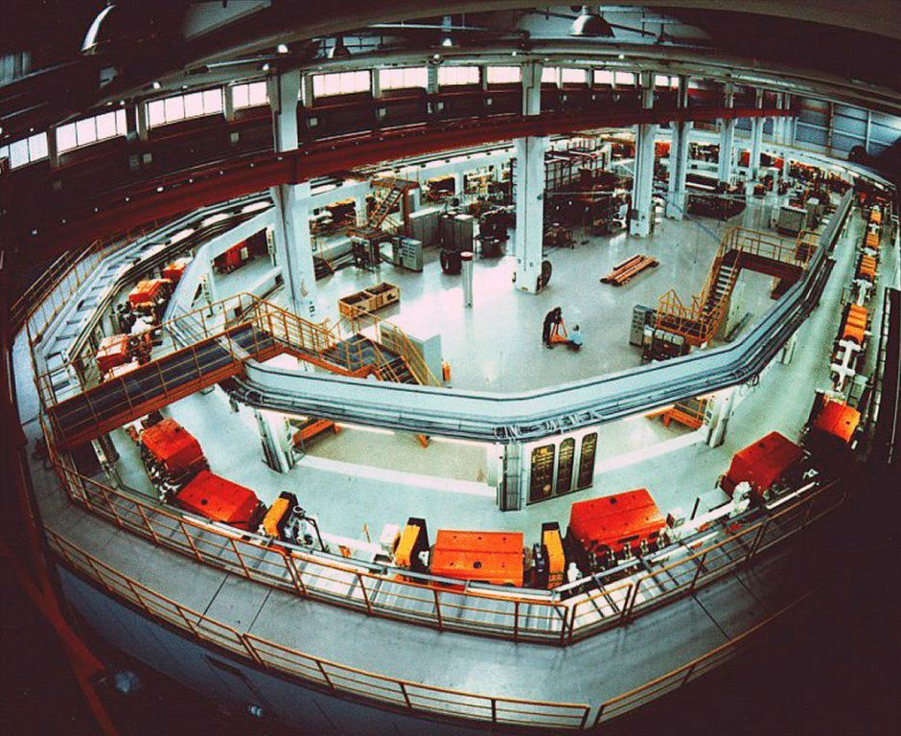
Two different labs could host the storage ring EDM experiments
COSY/IKP, Jülich/Germany: deuteron or a combination ring
AGS/BNL, USA: proton “magic”, larger ring

Slide 43
Why a large radius ring (sr pEDM)?
Electric field needed is moderate (<5MV/m). New techniques with coated Aluminum is a cost savings opportunity.
Long horizontal Spin Coherence Time (SCT) w/out sextupoles. The EDM effect is acting for time ~SCT.
Large ring, requires an existing tunnel

Slide 44
JLab E-field breakthrough
Large grain Nb, no detectable dark current up to 18 MV/m and 3cm plate gap.
TiN coated Al plates reach high E-field strength
JLab to test large surface plates

Slide 45
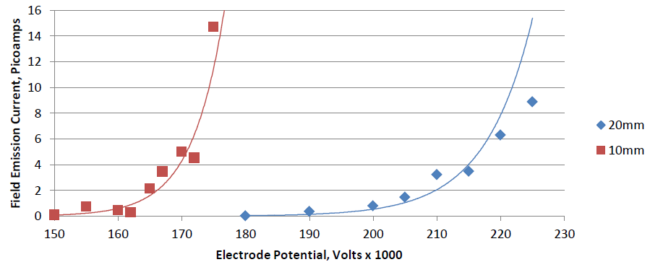
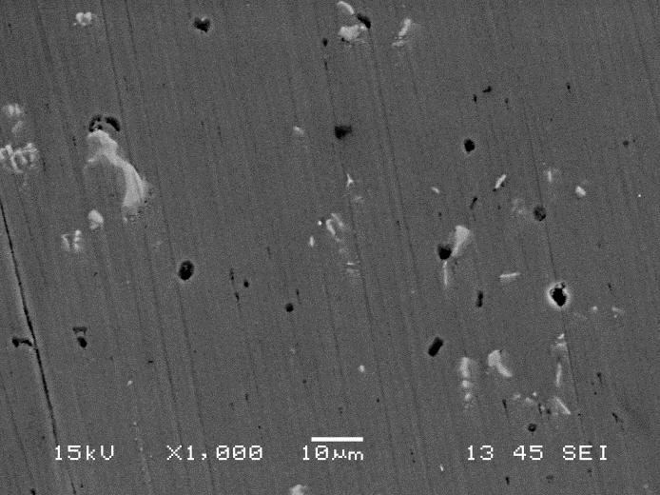
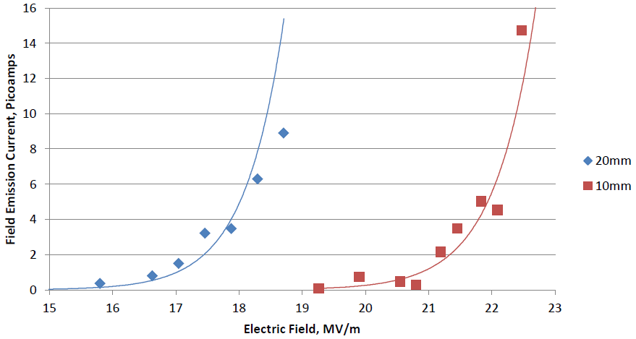
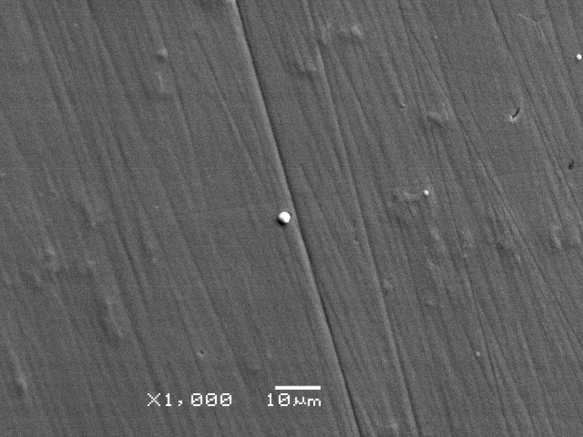
JLab results with TiN-coated Aluminum
No measureable field emission at 225 kV for gaps > 40 mm, happy at high gradient
Bare Al
Matt Poelker, JLab
TiN-coated Al
At BNL we need <5MV/m
for 30mm plate separation
the hard coating covers defects
15 MV/m
20 MV/m
Work of Md. A. Mamun and E. Forman

Slide 46
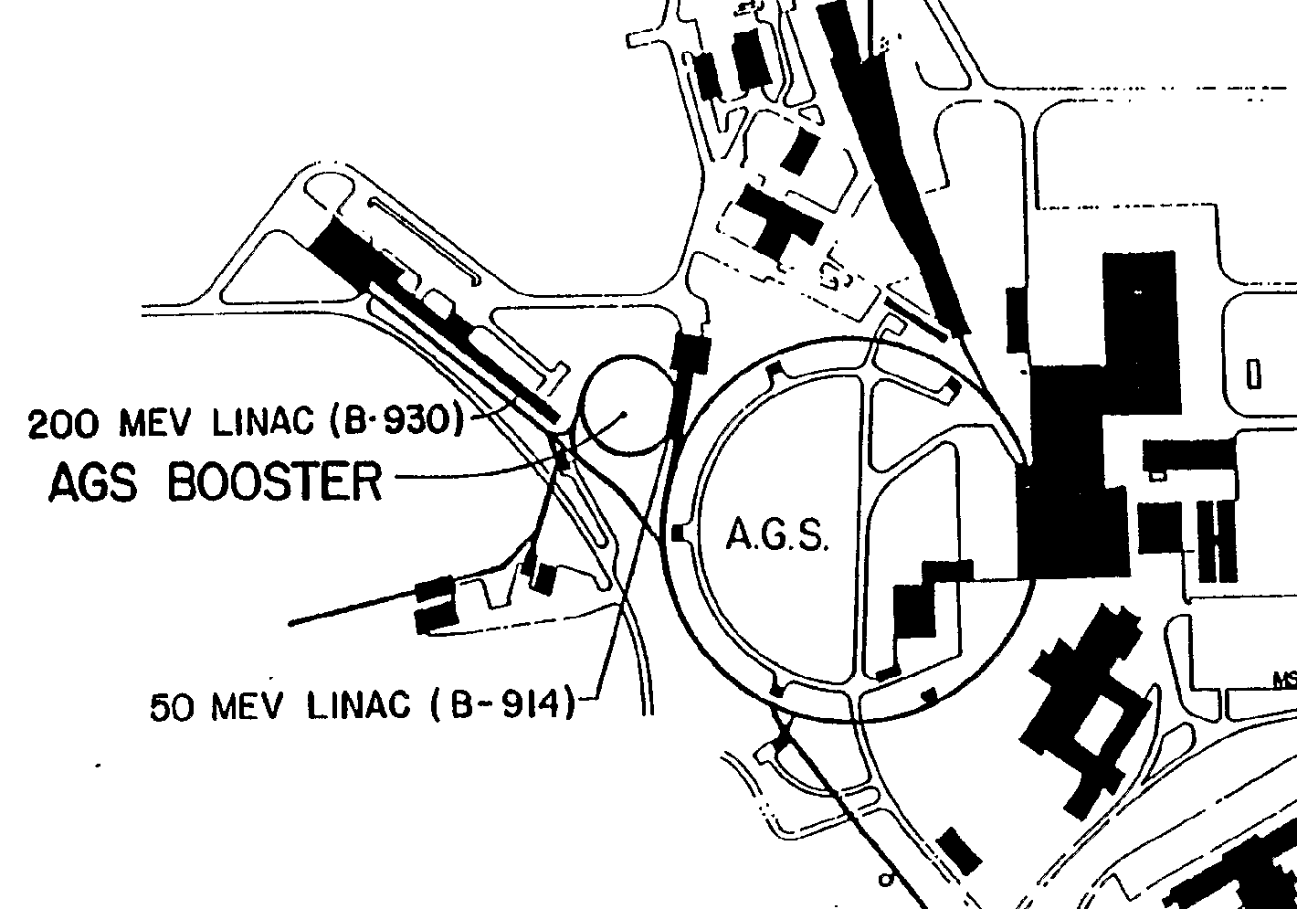
The proton EDM in the AGS tunnel at BNL
Circumference: 800m
Max E-field: 4.5MV/m

Slide 47
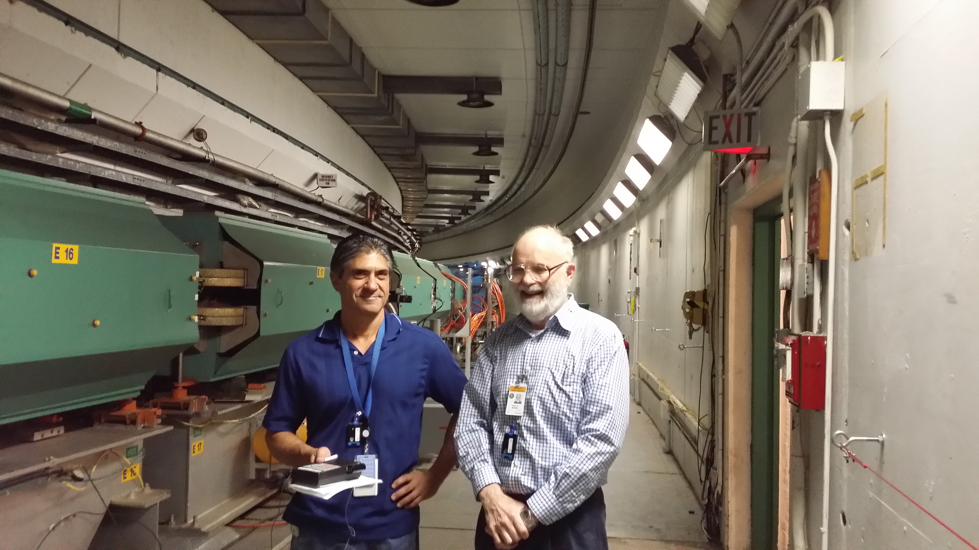
John Benante, Bill Morse in AGS tunnel, plenty of room for an EDM ring.

Slide 48
The proton EDM ring (alternate gradient)
Straight sections are instrumented
with quads, BPMs, polarimeters,
injection points, etc, as needed.
Requirements:
Weak vertical focusing (B-field
sensitivity)
Below transition (reduce IBS)

Slide 49
Proton Statistical Error (230MeV):
τ_{p} : 10³s Polarization Lifetime (Spin Coherence Time)
A : 0.6 Left/right asymmetry observed by the polarimeter
P : 0.8 Beam polarization
N_{c} : 10¹¹p/cycle Total number of stored particles per cycle
T_{Tot}: 10⁷s Total running time per year
f : 1% Useful event rate fraction (efficiency for EDM)
E_{R} : 5 MV/m Radial electric field strength
σ_{d} = 1.4×10⁻²⁹ e-cm / year
Notes:
Yannis Semertzidis, BNL
49

Slide 50
Clock-wise (CW) & Counter-Clock-wise Storage
Total current: zero. Any radial magnetic field in the ring sensed by the stored particles will cause their vertical splitting.
Simultaneous proton-proton storage
Notes:
50

Slide 51
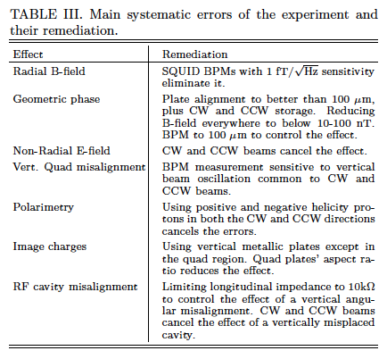
Systematic errors
Recent Breakthrough
by David Kawall…

Slide 52
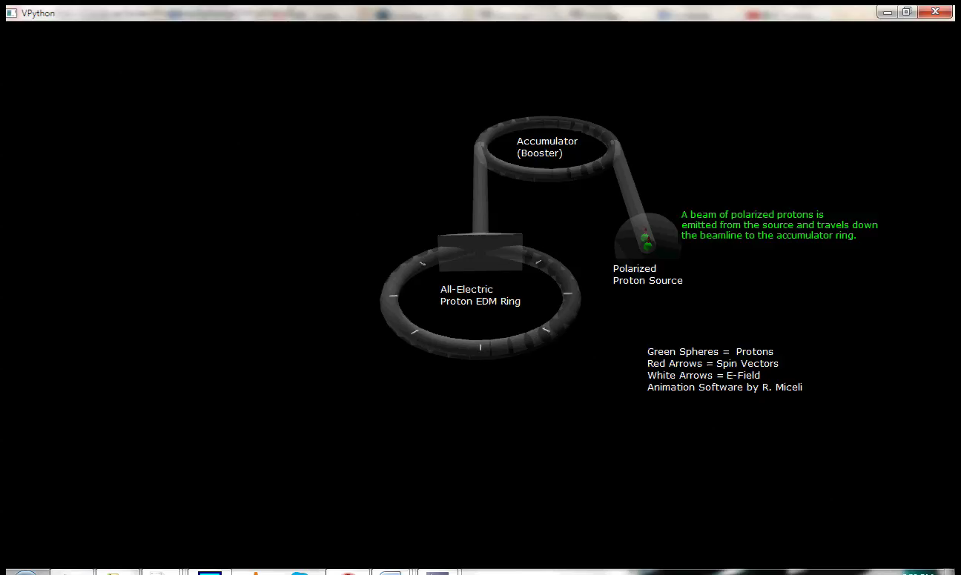
Proton EDM animation

Slide 53
What has been accomplished?
Polarimeter systematic errors (with beams at KVI, and stored beams at COSY).
Precision beam/spin dynamics tracking.
Stable lattice, IBS lifetime: ~10⁴s (Lebedev, FNAL)
Spin coherence time 10³ s; role of sextupoles understood (using stored beams at COSY).
Feasibility of required electric field strength <5 MV/m, 3cm plate separation (JLab, FNAL)
Analytic estimation of electric fringe fields and precision beam/spin dynamics tracking. Stable!
(Paper already published or in progress.)

Slide 54
Technically driven pEDM timeline
2014
15
16
17
18
19
20
21
22
23
Two years systems development (R&D); CDR; ring design, TDR, installation
CDR by end of 2016
Proposal to BNL: fall 2016

Slide 55

Submitted, February 2015

Slide 56

Marciano, CM9/KAIST/Korea, Nov 2014

Slide 57
Let’s indulge on sensitivity
Spin coherence time (10⁴ seconds), stochastic cooling-thermal mixing, …
Higher beam intensity, smaller IBS
Reliable E-field 15 MV/m with negligible dark current
>5% efficient polarimeter, run longer
Potential gain >10² in statistical sensitivity: ~10⁻³¹ e-cm!

Slide 58



Sensitivity to Rule on Several New Models
Gray: Neutron
Red: Electron
If found it could explain
Baryogenesis (p, d, n, ³He)
n current
e current
GUT SUSY
Electroweak
Baryogenises
n target
p, d target
e target
1st upgrade
Statistics limited
Electron EDM new physics reach: 1-3 TeV
Much higher physics reach
than LHC; complementary
e-cm
J.M.Pendlebury and E.A. Hinds, NIMA 440 (2000) 471

Slide 59
Summary
The EDM experiments are gearing up, getting ready:
¹⁹⁹Hg EDM <10⁻²⁹ e-cm sensitivity, imminent
nEDM at PSI 10⁻²⁶ e-cm sensitivity, 2015 - 2017
nEDM at PSI 10⁻²⁷ e-cm sensitivity, 2018 - …
nEDM at SNS ~2×10⁻²⁸ e-cm starting data taking 2021

Slide 60
Summary (cont’d)
ThO, current limit on eEDM: 10⁻²⁸ e-cm, next ×10 improvement.
TUM nEDM effort, making progress in B-field shielding, met B-field specs. It moves to ILL in 2015, goal: 10⁻²⁸ e-cm, staged approach, starting in 2016.
²²⁵Ra EDM, ~5×10⁻²² e-cm now, ~3×10⁻²⁸ e-cm w/ FRIB
Storage ring EDM: pEDM first goal 10⁻²⁹ e-cm, start taking data early 2020’s. Strength: statistics

Slide 61
Extra slides

Slide 62
Large Scale Electrodes, New: pEDM electrodes
Parameter | Tevatron pbar-p Separators | BNL K-pi Separators | pEDM
Length | 2.6m | 4.5m | 3m
Gap | 5cm | 10cm | 3cm
Height | 0.2m | 0.4m | 0.2m
Number | 24 | 2 | 200
Max. HV | ±180KV | ±200KV | ±75KV

Slide 63
Major characteristics of a successful Electric Dipole Moment Experiment
Statistical power:
  High intensity beams
  Long beam lifetime
  Long Spin Coherence Time
An indirect way to cancel B-field effect
A way to cancel geometric phase effects
Control detector systematic errors
Manageable E-field strength, negligible dark current
The storage ring Proton
EDM method has it all!

Slide 64
Emittance out of Booster
These intensity scan was done in 2009 with Booster input 3*10¹¹. Not much horizontal scan was done since then. The vertical scale is normalized 95% emittance.
The corresponding normalized rms emittance at 10¹¹ is 0.7π horizontal, 1.0π vertical for horizontal scraping.
vertical scraping
64
Intensity: 15~2e11 protons
@10¹¹
Horizontal scraping
V:6.1π
H:4.4π

Slide 65


Distortion of the closed orbit due to N^{th}-harmonic of radial B-field
Clockwise beam
Y(ϑ)
The N=0 component
is a first order effect!
Counter-clockwise
beam
Time [s]

Slide 66

SQUID BPM to sense the vertical beam splitting at 1-10kHz

Slide 67

Total noise of (65) commercially available SQUID gradiometers at KRISS
From YongHo Lee’s group
KRISS/South Korea

Slide 68
Spin Coherence Time: need ~10³ s
Not all particles have same deviation from magic momentum, or same horizontal and vertical divergence (all second order effects)
They cause a spread in the g-2 frequencies:
Present design parameters allow for 10³ s.
Much longer SCT with thermal mixing (S.C.)

Slide 69

Peter Fierlinger, Garching/Munich
Under development by
Selcuk Haciomeroglu
at CAPP. Need <0.1nT/m

Slide 70

Residual Magnetic Field ( in Gauss) with Hall Probe
Location E20 upstream
180° 90°
0.14 0.18
0.20 0.19
0.23 0.17
0.52 0.44
Location F12 upstream
180° 90°
0.07 0.07
0.06 0.07
0.26 0.21
0.88 0.80
Location L5 upstream
180° 90°
0.03 0.06
0.05 0.06
0.26 0.26
0.25 0.28
The relative low fields justifies to use AGS tunnel.
(Measured by John Benante)
1
2
3
4

Slide 71

The proton EDM ring evaluation Val Lebedev (Fermilab)
Beam intensity 10¹¹ protons limited by IBS
, kV

Slide 72
E-field plate module: Similar to the (26) FNAL Tevatron ES-separators
Beam position
0.4 m
3 m

Slide 73

E-field plate module: Similar to the (26) FNAL Tevatron ES-separators
Beam position
0.4 m
3 m

Slide 74
Small radius ring option (JEDI)
Electric field needed is large.
Long horizontal Spin Coherence Time (SCT) requires sextupoles.
Smaller cost, larger sensitivity
More R&D needed on E-field, dark currents.

Slide 75
JEDI pre-cursor exp. at COSY
Doing a preliminary experiment in an all-magnetic ring!
Include an RF-Wien filter at the spin tune
It doesn’t influence the particle trajectory but it manipulates the spin for an EDM measurement

Slide 76


Slide 77

Joerg Pretz

Slide 78

See talk by Volker Hejny, SYDM 2.4, Tue 16:10, C/gHS
Joerg Pretz

Slide 79
Opportunities for new collaborators
Electric field strength issues for large surface plates, dark currents
Beam-based alignment, E-field plate alignment (pot. syst. error source)
Beam impedance issues (pot. syst. error source)

Slide 80

pEDM polarimeter principle (placed in a straight section in the ring): probing the proton spin components as a function of storage time
“defining aperture”
polarimeter target
Micro-Megas detector, GEMs, MRPC or Si.
Extraction: lowering the vertical focusing strength
Brantjes et al., NIMA 2012.
carries EDM signal
increases slowly with time
carries in-plane (g-2) precession signal

Slide 81

COSY ring at Juelich
Rings select scattering angle
Polarized deuterons
p = 0.97 GeV/c
Carbon block target (17 mm thick)
B E A M
Bars select azimuthal angle
EDDA detectors as polarimeter
Three sextupole magnet families:
MXS (large β_{X})
MXL (large β_{Y})
MXG
(large D)
LEFT
UP
DOWN
RIGHT
Azimuthal angles yield two asymmetries:
sensitivity to horizontal
component is here
2
E. Stephenson

Slide 82

The EDM signal: early to late change
Comparing the (left-right)/(left+right) counts vs. time we monitor the vertical component of spin
M.C. data
(L-R)/(L+R) vs. Time [s]
Opposite helicity bunches
result to opposite sign slopes

Slide 83

Large polarimeter analyzing power at P_{magic}!

Slide 84


EDMs: Storage ring projects
pEDM in all electric ring at BNL
Jülich, focus on a smaller radius machine
CW and CCW stored beams
(from A. Lehrach)

Slide 85
Possible nuclear EDM sources
neutron, proton, deuteron EDM
deuteron: ~ x10 sensitivity of
neutron and proton
proton EDM ~ -neutron EDM,
deuteron EDM ~1/3 neutron EDM
Quark EDM
Chromo-EDM
Theta-QCD

Slide 86
International srEDM Network
Common R&D
srEDM Coll. pEDM
Proposal to DOE HEP, NP
SQUID-based BPMs
B-field shielding/compensation
Precision simulation
Systematic error studies
E-field tests (low: ~5MV/m)
…
JEDI (COSY/Jülich)
Pre-cursor EDM exp.
Polarimeter tests
Spin Coherence Time tests
Precision simulation
Cooling
E-field tests (high fields)
…

Slide 87
Field Emission from Niobium
Work of M. BastaniNejad
Phys. Rev. ST Accel. Beams, 15, 083502 (2012)
Buffer chemical polish: less time consuming than diamond paste polishing
DPP stainless steel
Fine grain niobium
Large grain niobium
Single crystal niobium
Field strength > 18 MV/m
Conventional High Voltage processing: solid data points
After Krypton Processing: open data points

